Slide 1

How organizations can support
CAREER SUCCESS,
TALENT
DEVELOPMENT and ECONOMIC
GROWTH
Name of Presenter
Email Address
Date

Slide 2
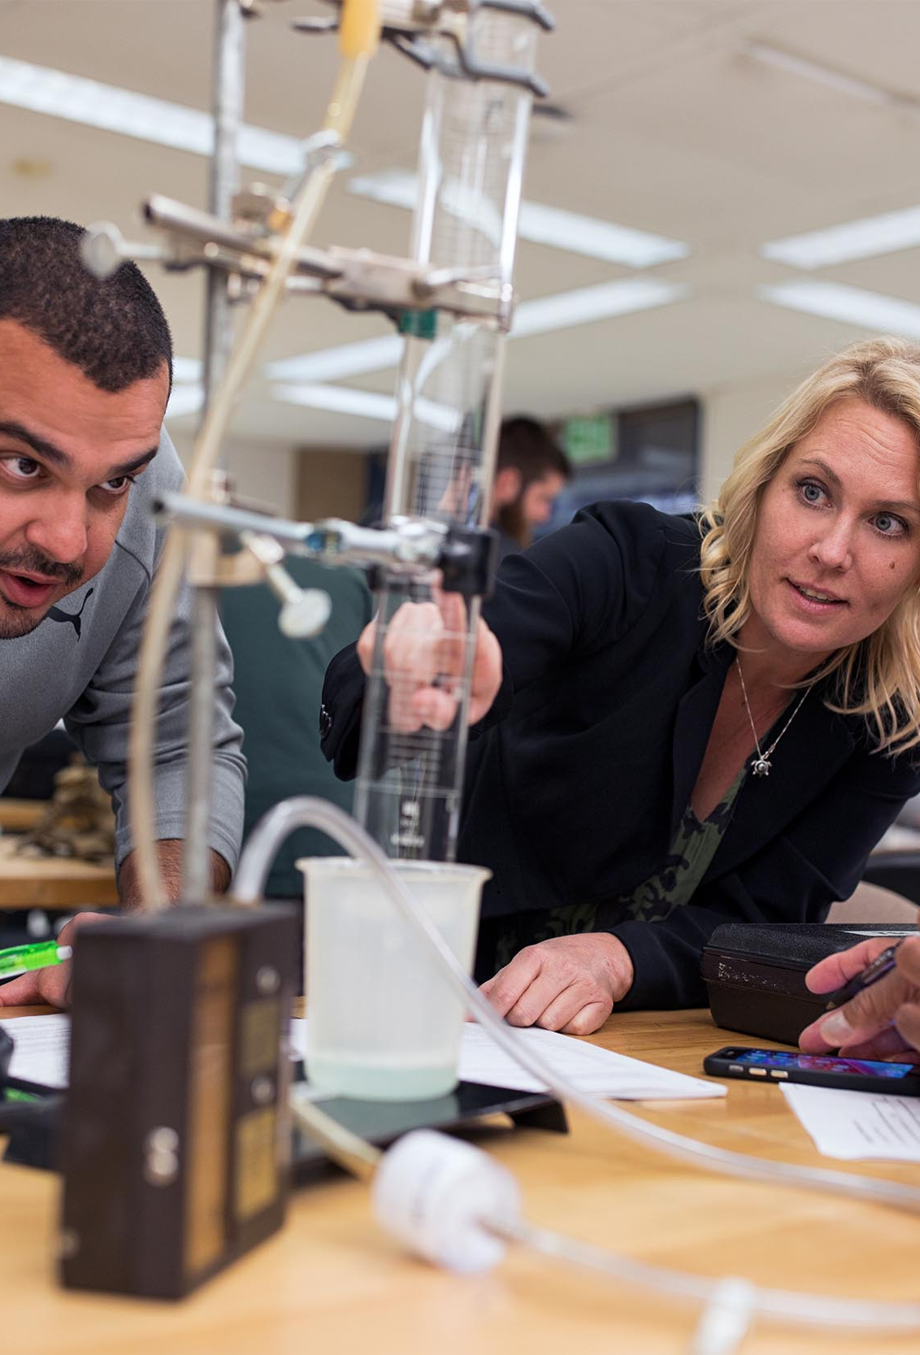
WHO WE ARE
The San Diego & Imperial Counties' Community Colleges' (SDIC Community Colleges) Regional Consortium for Workforce Development aligns 10 community colleges with the workforce needs of priority and emergent sectors and encourages industry-education partnerships. United to fill the growing regional middle-skill labor gaps, our community colleges’ Career Education programs help students learn new skills, complete short-term career training, and/or earn a certificate or an associate degree.
SDIC COMMUNITY COLLEGES CAREER EDUCATION | 2
Our students gain real-world experience with hands-on training from faculty and industry partners like you.

Slide 3
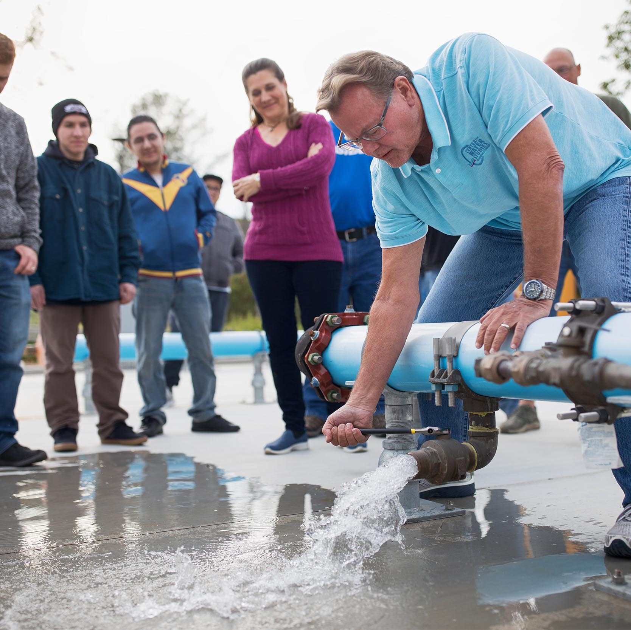
VISION
Transforming the way educators, industry, and community partners equitably advance economic mobility.
SDIC COMMUNITY COLLEGES CAREER EDUCATION | 3
MISSION
The San Diego & Imperial Counties Community Colleges Regional Consortium (SDICCC RC) provides leadership and guidance on regional career education initiatives that serve its members and stakeholders. Driven by an equity framework, we collaborate with educators, industry, community partners, and students to develop a skilled workforce and align to the future needs of the regional ecosystem.

Slide 4
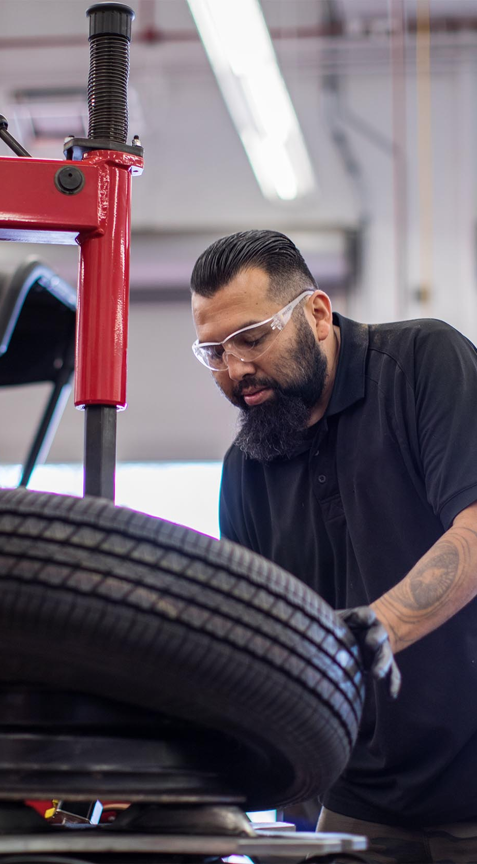










10 COMMUNITY COLLEGES
SDIC COMMUNITY COLLEGES CAREER EDUCATION | 4

Slide 5
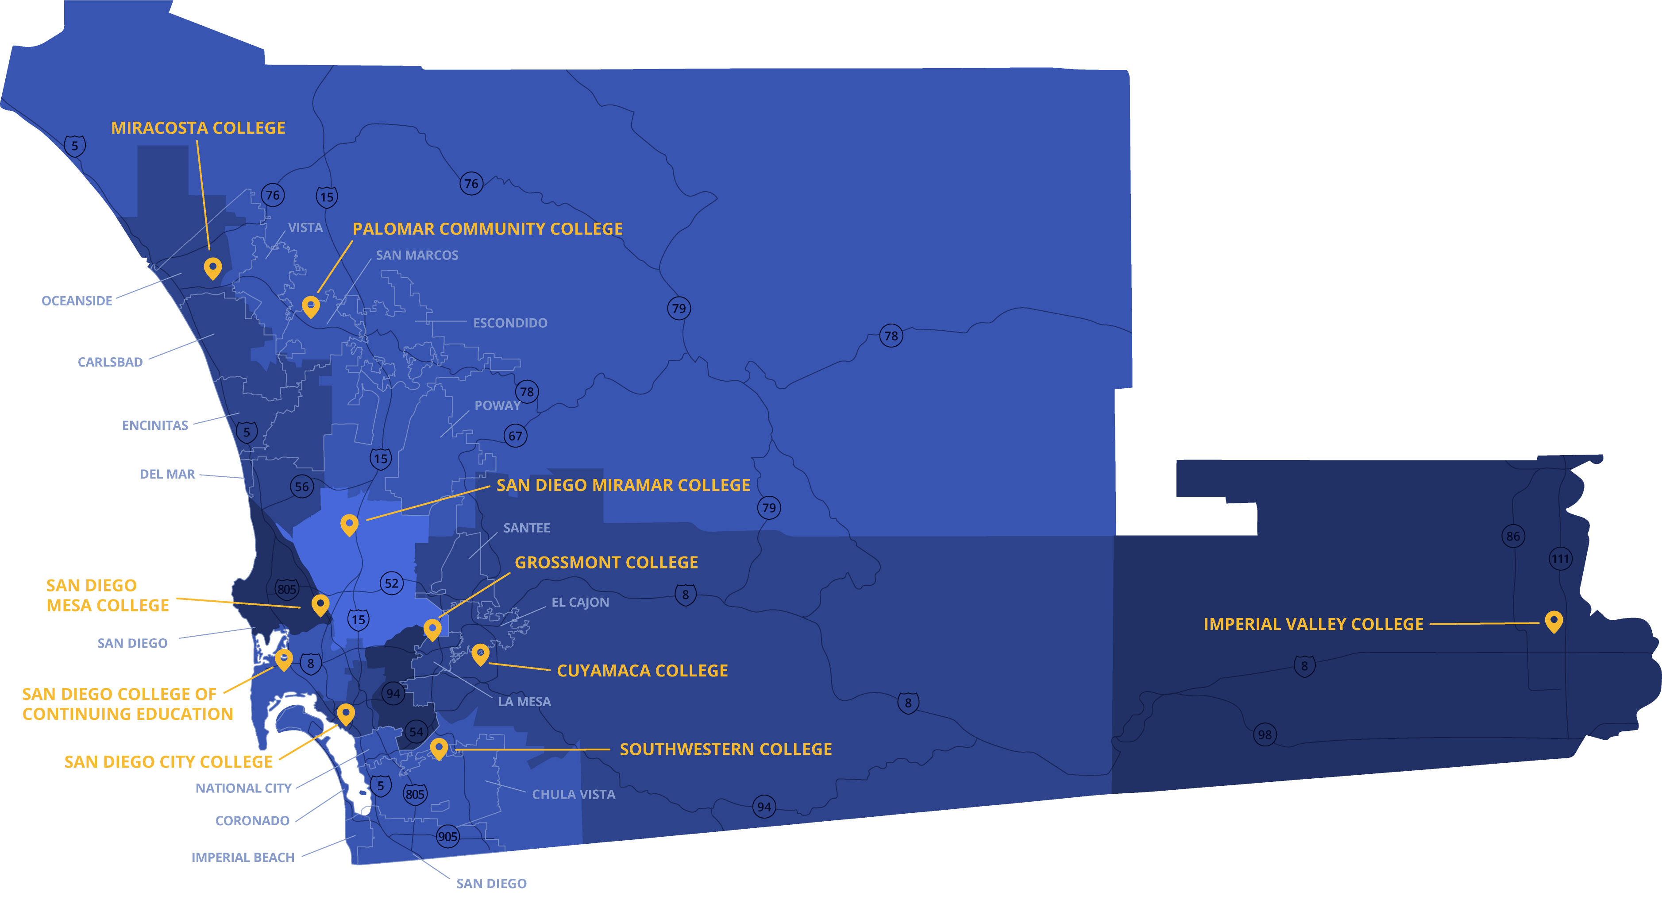
CONVENIENT LOCATIONS

Slide 6
A GROWING NEED
FOR MORE SKILLED LABOR
IN SAN DIEGO COUNTY
of new jobs created between now and 2030 will require PSE (post- secondary education)*​
of jobs have enough qualified people applying for them​
Economic growth will require more skilled labor ​
There is a shortage of qualified talent to fill job growth
There is unequal access to high-paying jobs
“The Great Reshuffling” made it difficult for businesses to retain skilled employees as workers shifted careers and changed jobs ​
Retiring workers will create an experience deficit and increase the need for skilled employees
SDIC COMMUNITY COLLEGES CAREER EDUCATION | 6
*Source: http://progress.inclusivesd.org/; The San Diego-Imperial Center of Excellence for Labor Market Research (COE) - Sector Analysis, Imperial County; 18-CTE-0530_RegionalTemplate_PPT_FNL2_CoBrand

Slide 7
A GROWING NEED FOR MORE SKILLED LABOR IN IMPERIAL COUNTY
regional employment growth projection over the next 5 years
residents possessing a
Bachelor’s Degree
(9.1 % below national average)
Economic growth will require more skilled labor
There is a labor shortage to fill available jobs
There is a shortage of qualified talent to fill job growth
Education pipeline still falls below the national average
Retiring workers will create an experience deficit
SDIC COMMUNITY COLLEGES CAREER EDUCATION | 7
residents with an
Associate’s Degree
(2.2 % below national average)
jobs without enough
workers to fill them
jobs requiring post secondary education with enough qualified people applying for them​
*Sources: Economy Overview Imperial County; The San Diego-Imperial Center of Excellence for Labor Market Research (COE) - Sector Analysis, Imperial County ; 18-CTE-0530_RegionalTemplate_PPT_FNL2_CoBrand

Slide 8
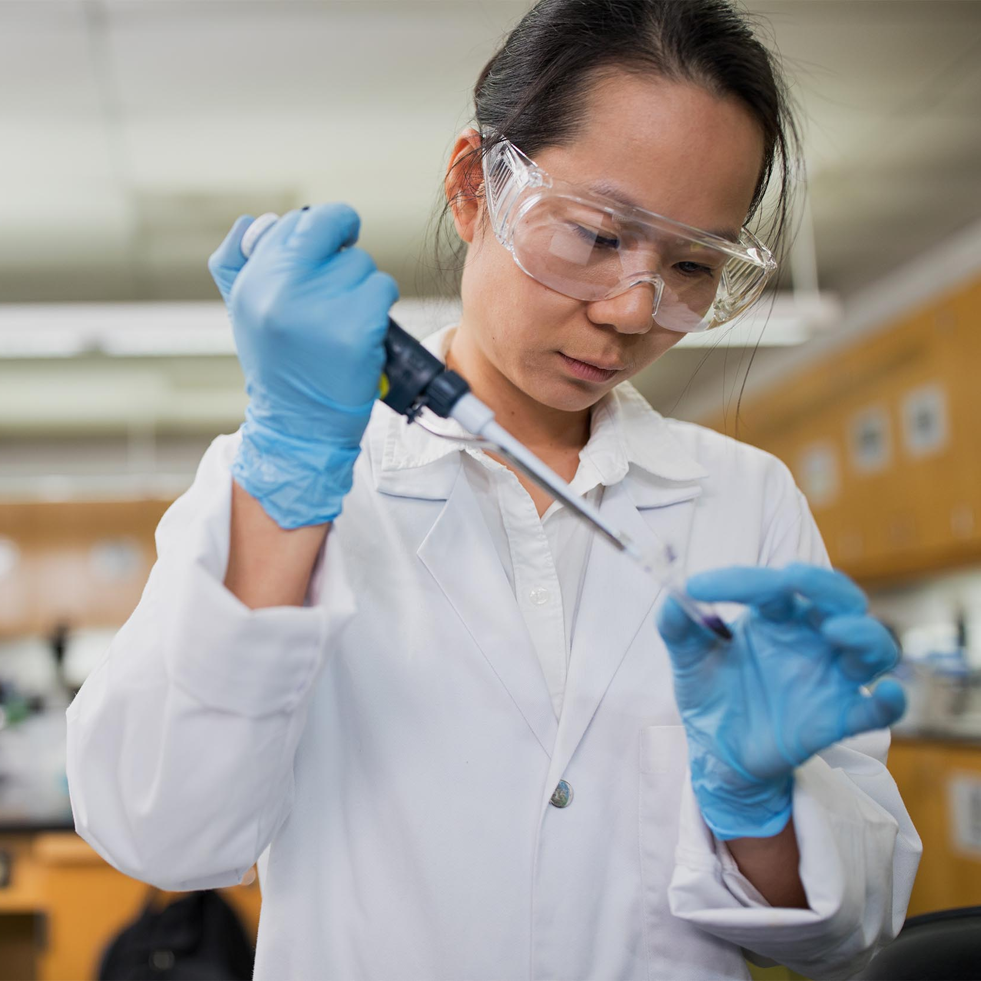
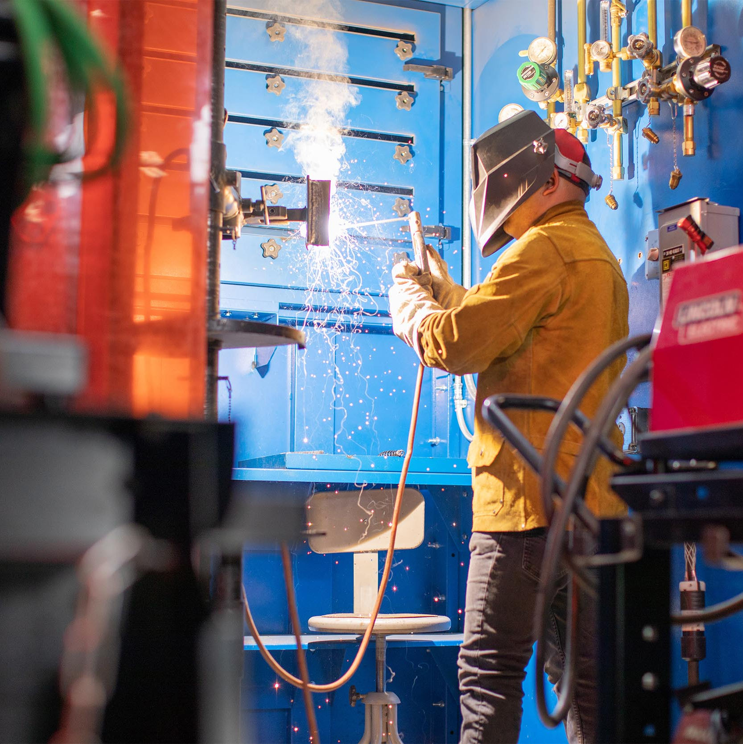
COMMUNITY COLLEGES ARE
A VALUABLE RESOURCE FOR LOCAL INDUSTRIES.
SDIC COMMUNITY COLLEGES CAREER EDUCATION | 8

Slide 9
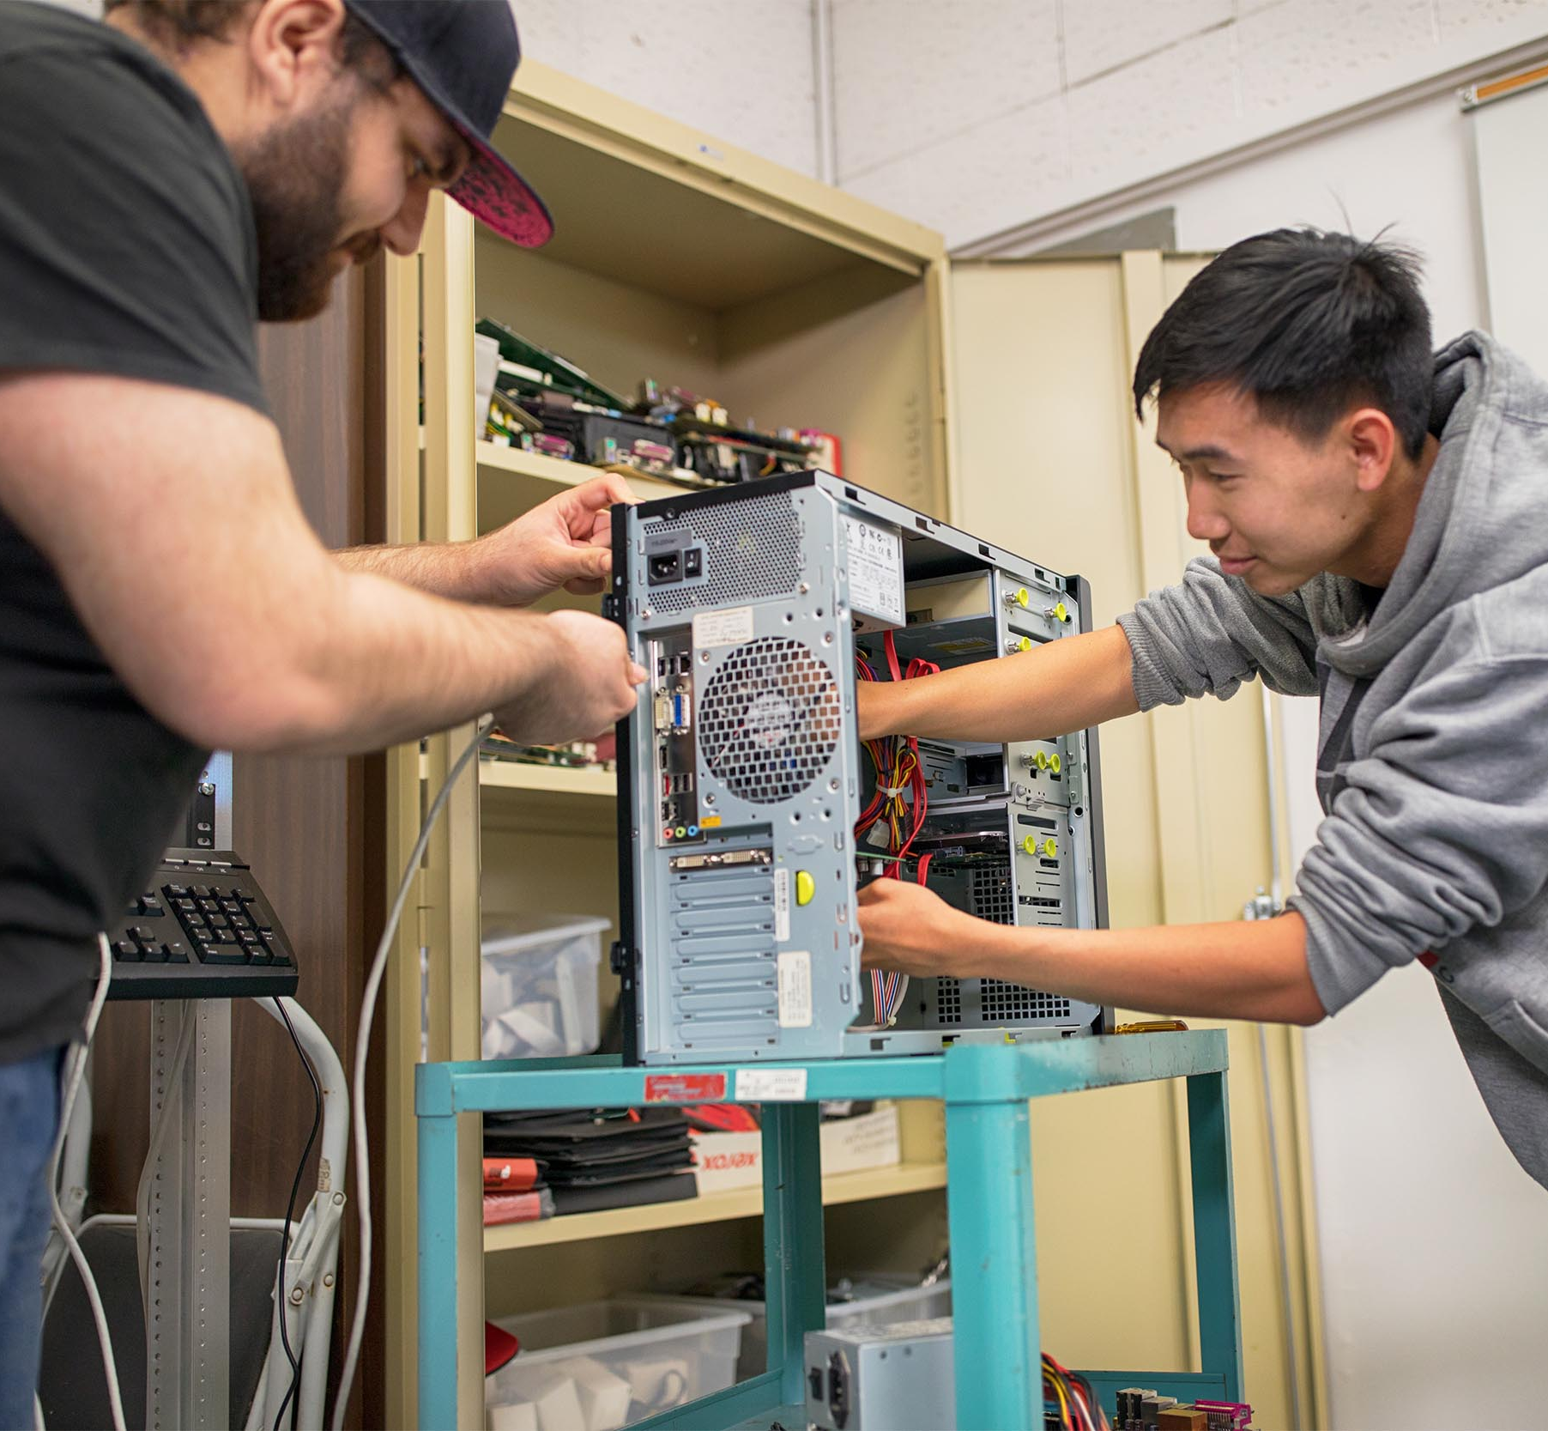
NEW STATEWIDE POLL:
CA Community Colleges are Rising in Popularity
Most Californians believe the University of California and California State University are unaffordable, and they highly value community colleges and vocational training as alternative paths to career success, according to a statewide poll released Monday, May 9, 2022.​
Source: San Diego Union-Tribune, May 9, 2022​
SDIC COMMUNITY COLLEGES CAREER EDUCATION | 9
Source: San Diego Union Tribune

Slide 10

WHY COMMUNITY COLLEGES MATTER
SDIC COMMUNITY COLLEGES CAREER EDUCATION | 10
Deliver highly skilled workforce training
Provide access to affordable education
Enable upward social and economic mobility
Create diverse, local labor pool of candidates
COMMUNITY COLLEGES ARE THE LARGEST WORKFORCE
TRAINING INSTITUTIONS IN CALIFORNIA. ​
Source: 19-CTE-930_EmployerBrochure_FNL_bleed ​

Slide 11
SDIC COMMUNITY COLLEGES HAVE A SUBSTANTIAL ECONOMIC IMPACT ON OUR COMMUNITIES
They support
1
out of every
62
jobs in San Diego
They generate
$2.8
BILLION
in
ADDITIONAL INCOME
for San Diego
They provide a
7.6%
annual return on investment to taxpayers for
EVERY PUBLIC DOLLAR
invested
They provide
$14.20
in benefits to society for
EVERY DOLLAR INVESTED
(health, crime, income assistance, and more)
SDIC COMMUNITY COLLEGES CAREER EDUCATION | 11
Source: The Economic Value of Career and Technical Education at SDICCCA Main Report

Slide 12

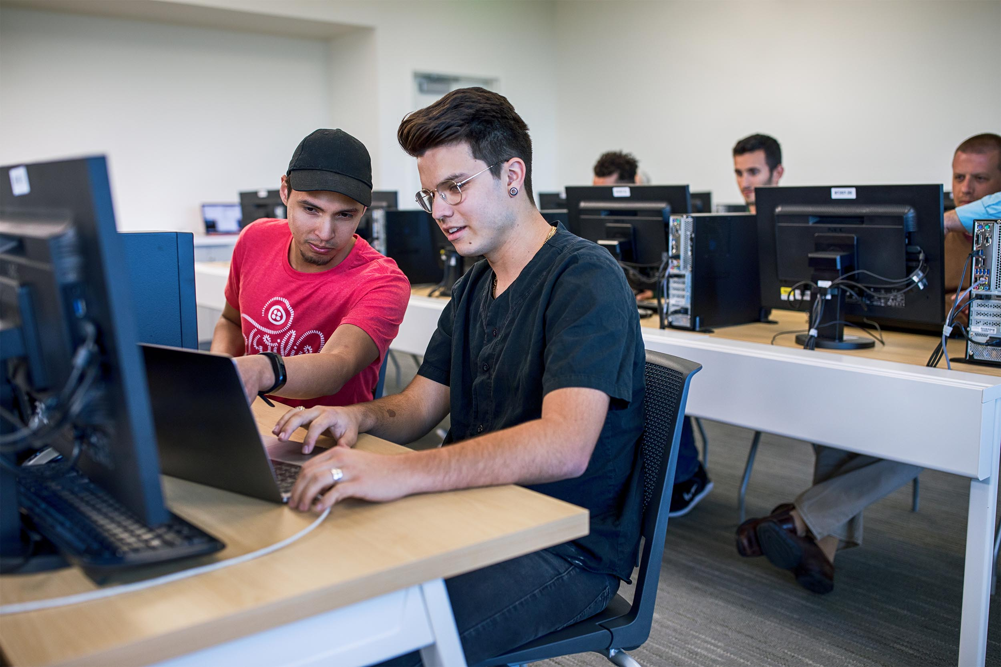




LET SDIC COMMUNITY COLLEGES HELP YOU:
Diversify workforce talent
Increase company performance
Improve workforce efficiency
SDIC COMMUNITY COLLEGES CAREER EDUCATION | 12
Reduce on-the-job training time
Our work begins and ends with employers.
Increase employee retention and upskilling

Slide 13

Help students gain the experience and skills your company is seeking
Influence and develop skilled workers by participating in college programs advisory boards
SDIC COMMUNITY COLLEGES CAREER EDUCATION | 13
Access and recruit students directly to fill your employment needs
PARTNER WITH US TO HELP EDUCATE AND DEVELOP THE SKILLED WORKFORCE YOUR COMPANY NEEDS TO SUCCEED

Slide 14











ADVANCED
MANUFACTURING​
ADVANCED
TRANSPORTATION
& LOGISTICS​
AGRICULTURE, WATER
& ENVIRONMENTAL
TECHNOLOGIES​
BUSINESS & ENTREPRENEURSHIP
We are equipping the region's talent pool with skills to meet your industry’s demands with 200+ degrees and certification specialties.
SDIC COMMUNITY COLLEGES CAREER EDUCATION | 14
EDUCATION
& HUMAN
DEVELOPMENT
ENERGY,
CONSTRUCTION
& UTILITIES
HEALTH
INFORMATION
COMMUNICATION
TECHNOLOGIES
& DIGITAL MEDIA
LIFE
SCIENCES
& BIOTECH
PUBLIC SAFETY
& GOVERNMENT
RETAIL,
HOSPITALITY
& TOURISM

Slide 15
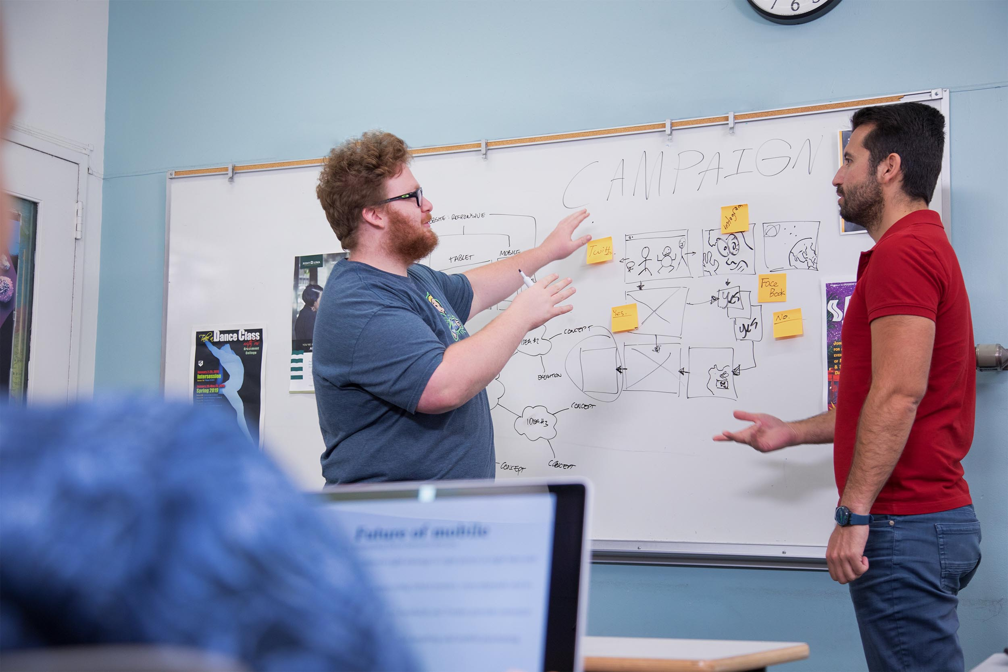


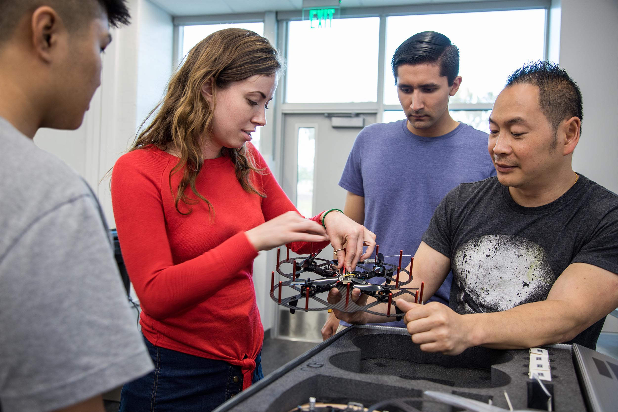

OUR COLLEGES ARE DESIGNATED AS PREFERRED PROVIDERS
OF WORKFORCE TALENT IN:
Business
Cybersecurity
Engineering
Healthcare
SDIC COMMUNITY COLLEGES CAREER EDUCATION | 15
“Preferred Providers” must conduct rigorous academic training and demonstrate an ability to meet the needs of diverse and underrepresented student populations.
Life Sciences
Manufacturing
Software
Source: SanDiegoBusiness.org
Notes:
Designated by San Diego’s Regional Economic Corporation (EDC) and ranked by 17 top employers in the region, “Preferred Providers” must conduct rigorous academic training and demonstrate an ability to meet the needs of diverse and underrepresented student populations.

Slide 16
PREFERRED PROVIDER
SDIC COMMUNITY COLLEGES CAREER EDUCATION | 16
Business
Engineering
Healthcare
Software ​
Source: SanDiegoBusiness.org

Slide 17
PREFERRED PROVIDER
SDIC COMMUNITY COLLEGES CAREER EDUCATION | 17
Business
Cybersecurity
Healthcare
Life Sciences
Manufacturing
Software ​
Source: SanDiegoBusiness.org

Slide 18
PREFERRED PROVIDER
Manufacturing
SDIC COMMUNITY COLLEGES CAREER EDUCATION | 18
Source: SanDiegoBusiness.org

Slide 19
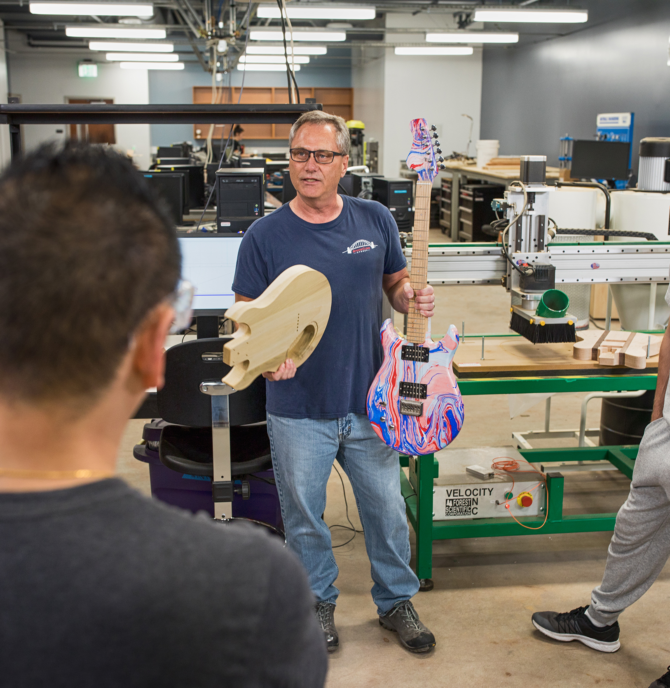

PREFERRED PROVIDER
Manufacturing
SDIC COMMUNITY COLLEGES CAREER EDUCATION | 19
Source: SanDiegoBusiness.org

Slide 20
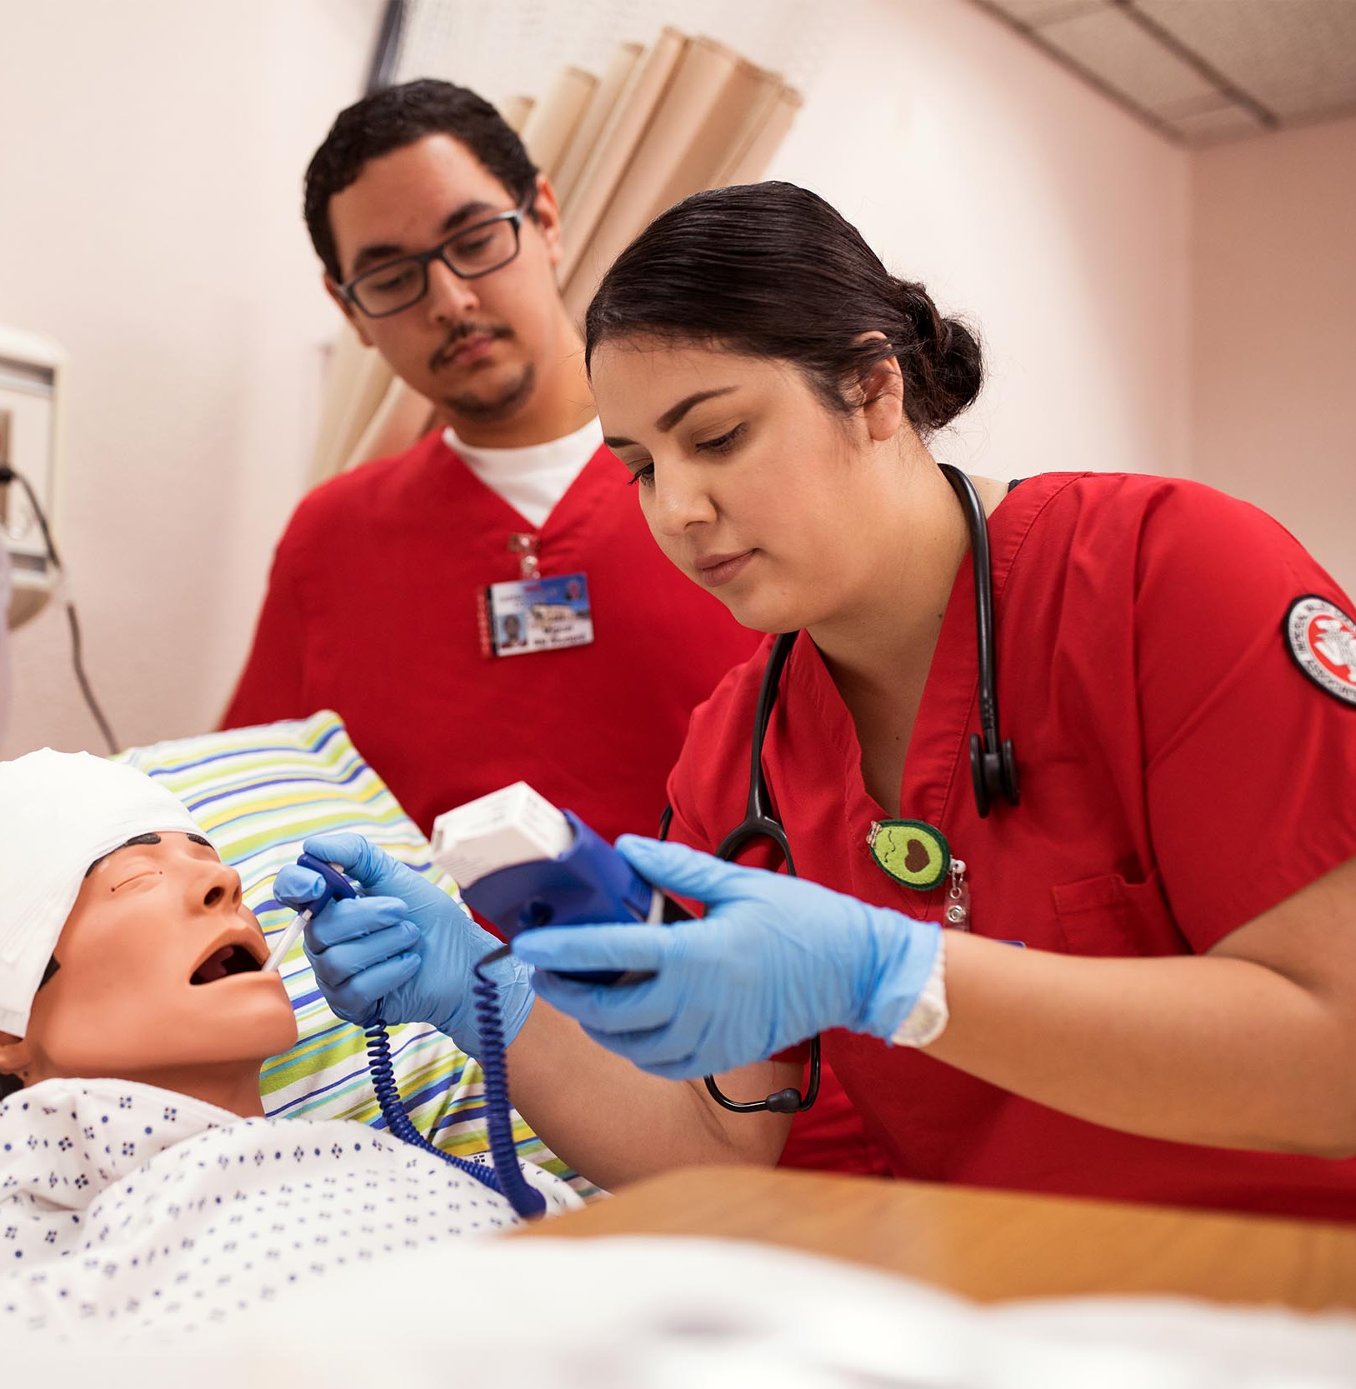

PREFERRED PROVIDER
Healthcare
SDIC COMMUNITY COLLEGES CAREER EDUCATION | 20
Source: SanDiegoBusiness.org

Slide 21


PREFERRED PROVIDER
Cybersecurity
SDIC COMMUNITY COLLEGES CAREER EDUCATION | 21
Source: SanDiegoBusiness.org

Slide 22
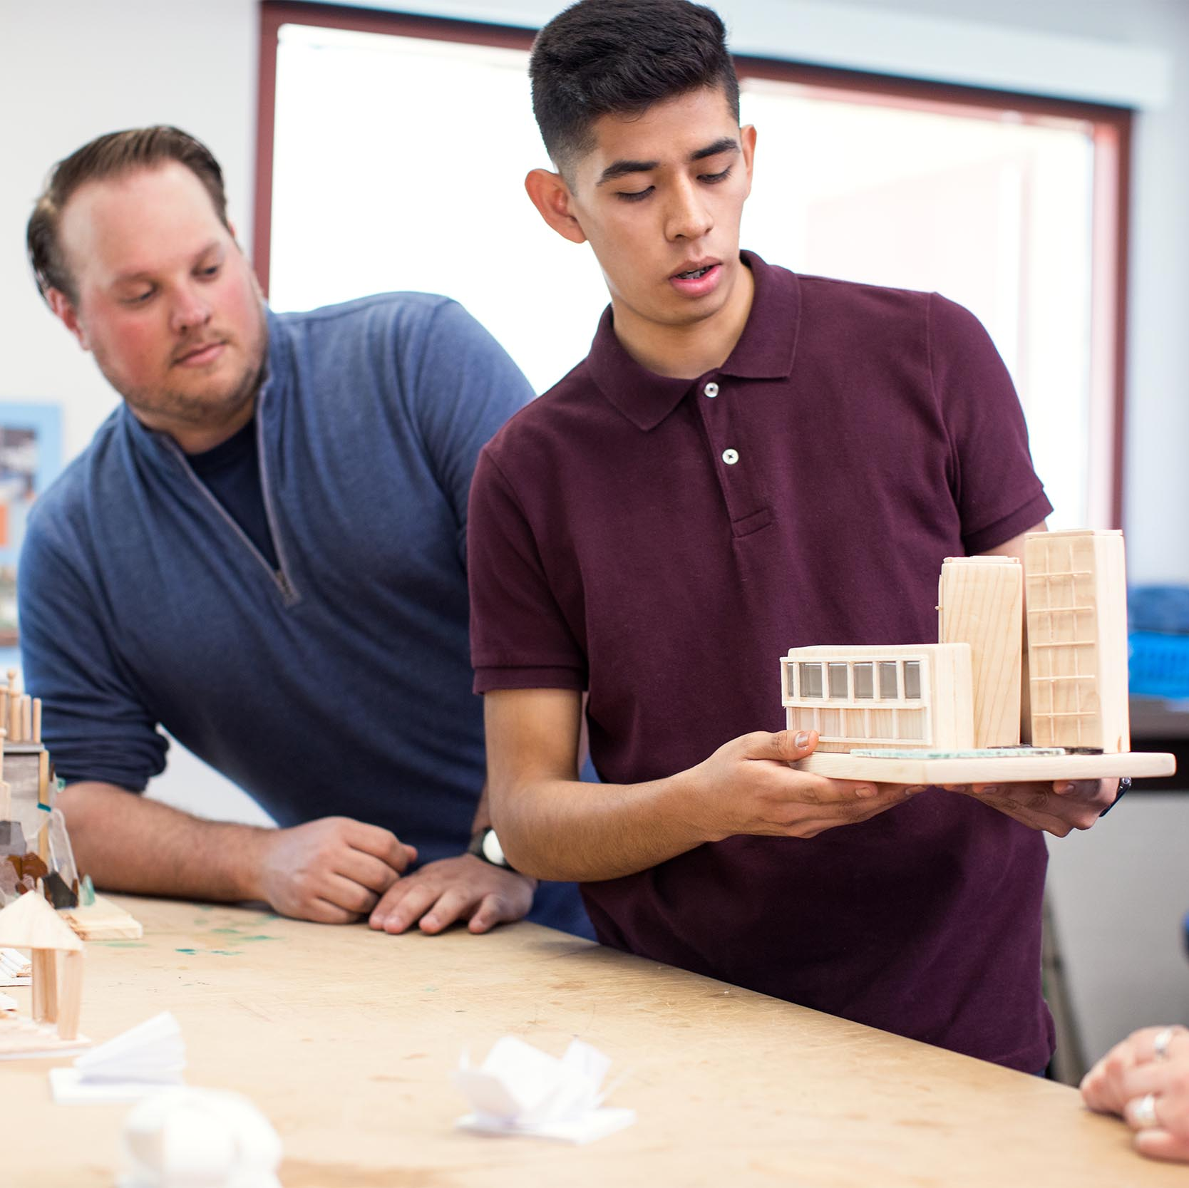
SDIC COMMUNITY COLLEGES CAREER EDUCATION | 22
Our career education programs represent a diverse student body with a wide range of backgrounds and experiences.

Slide 23


SDIC COMMUNITY COLLEGES CAREER EDUCATION | 23
51,044 (52%)
female students
46,645 (48%)
male students
2018-2019 CAREER EDUCATION PROGRAM STUDENTS*
*self-identified at registration
*non-binary data is not available at this time

Slide 24

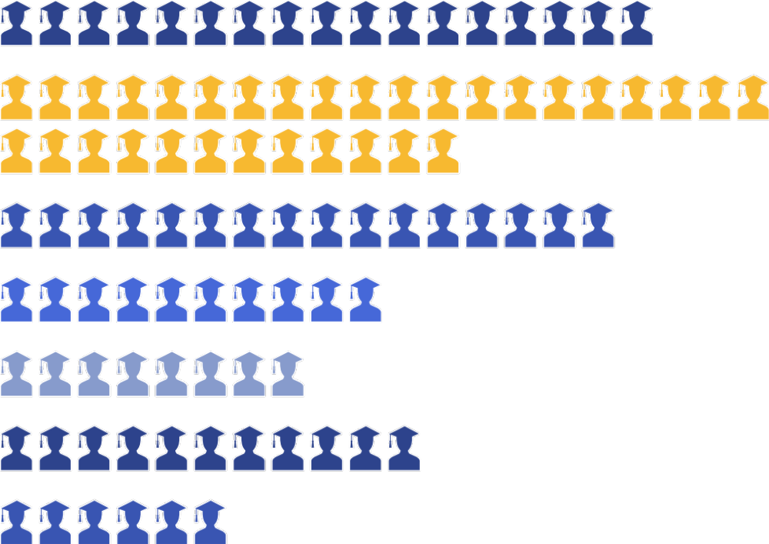
19 or less
17%
20 to 24
32%
25 to 29
16%
30 to 34
10%
SDIC COMMUNITY COLLEGES CAREER EDUCATION | 24
35 to 39
8%
40 to 54
11%
55 and older
6%
2018-2019 CAREER EDUCATION PROGRAM STUDENTS BY AGE

Slide 25

AFRICAN AMERICAN / BLACK (5.4%)
HISPANIC (44.9%)
WHITE (32.4%)
AMERICAN INDIAN / ALASKAN NATIVE / MULTIPLE VALUES REPORTED (5.9%)
SDIC COMMUNITY COLLEGES CAREER EDUCATION | 25
ASIAN / PACIFIC ISLANDER (11.4%)
2018-2019 CAREER EDUCATION PROGRAM STUDENTS BY RACE

Slide 26
2018 – 2019 CAREER EDUCATION PROGRAM STUDENTS
BY MILITARY AFFILIATION
SDIC COMMUNITY COLLEGES CAREER EDUCATION | 26
1,892
MILITARY
(Active Duty, Active Reserve, National Guard)
4,806
VETERANS

Slide 27
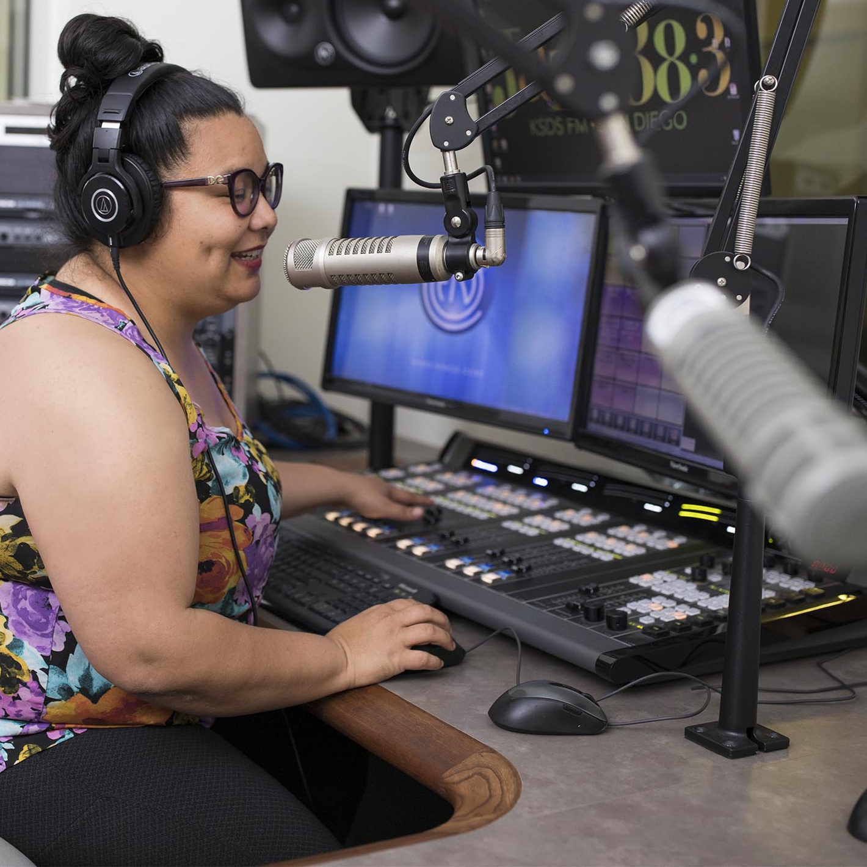
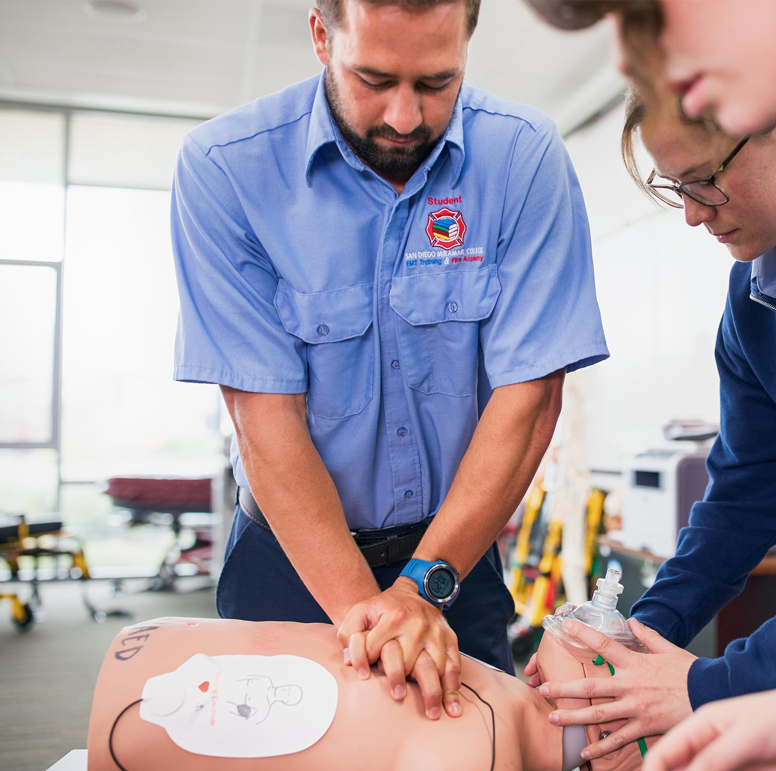
SPECIAL POPULATIONS
Individuals with disabilities
Individuals from economically disadvantaged families, including low-income youth and adults
Individuals preparing for nontraditional fields
Single parents, including single pregnant women
Out-of-workforce individuals
Unhoused individuals
Youth who are in, or have aged out of, the foster care system
Youth with a parent who is a member of the armed forces and is on active duty
Individuals with other barriers to educational achievement, including English language learners
SDIC COMMUNITY COLLEGES CAREER EDUCATION | 27

Slide 28
WORKING TOGETHER, WE CAN HELP SHAPE YOUR WORKFORCE
THE WORKFORCE YOU WANT
FOR THE SKILLS
YOU NEED
YOU
WITH STUDENTS
Share industry needs by advising our curriculum, validating our labor market information,
or serving on advisory committees. ​
Help students gain professional experience in your industry and practice essential skills through work-based learning activities like Capstone projects, job shadowing, career speakers, workplace tours, internships, and apprenticeships opportunities.
SDIC COMMUNITY COLLEGES CAREER EDUCATION | 28
Share your job openings with us, and we will help promote within our community college network.
BUILD
TRAIN
CONNECT

Slide 29

“The Consortium has been pivotal in EDC's efforts to strengthen the region's talent pipeline. Offering accessible and wide-ranging curriculum to students across the entire County, the community colleges are the model of inclusion and equal opportunity to meaningful careers. Adaptive also to industry needs, the Consortium's engagement and willingness to adjust curriculum to meet the demands/needs of local employers make them one of the region’s most valuable resources.”
- Taylor Dunne
Manager of Talent Initiatives
San Diego Regional EDC
SDIC COMMUNITY COLLEGES CAREER EDUCATION | 29

Slide 30
“Partnering with community colleges in the San Diego region has given us a new pipeline for talent that’s critical to our shipyard’s success.”
- Dennis DuBard
Public and Government Relations Manager General Dynamics NASSCO
“Nearly half of our technicians at Mossy Toyota alone are graduates or students of Career Education programs at area colleges.”
- Dale Snow
Director of After Sales Mossy Auto Group
SDIC COMMUNITY COLLEGES CAREER EDUCATION | 30
“Candidates are coming from many different paths these days, and the students we’re hiring from the community colleges are very strong and well prepared. The community colleges are doing an excellent job of building relationships with employers that inform the curriculum and provide students with training in the practical skills employers need.”
- Abe Chohan | Vice President of Operations | Inova Diagnostics
Source: SDIC Community Colleges marketing campaigns, 2020 Career Education Community Impact Report & Press Release "San Diego and Imperial Counties Community Colleges Partner with Local Companies to Prepare and Launch Students into Good-Paying Middle-Skill Jobs"

Slide 31
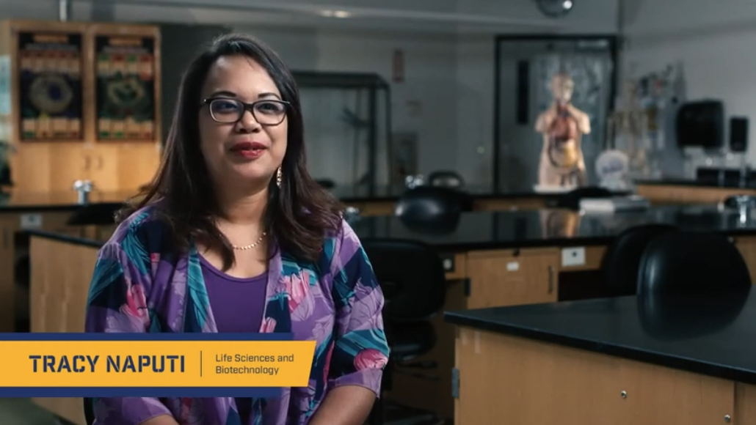
SDIC COMMUNITY COLLEGES CAREER EDUCATION | 31

Slide 32
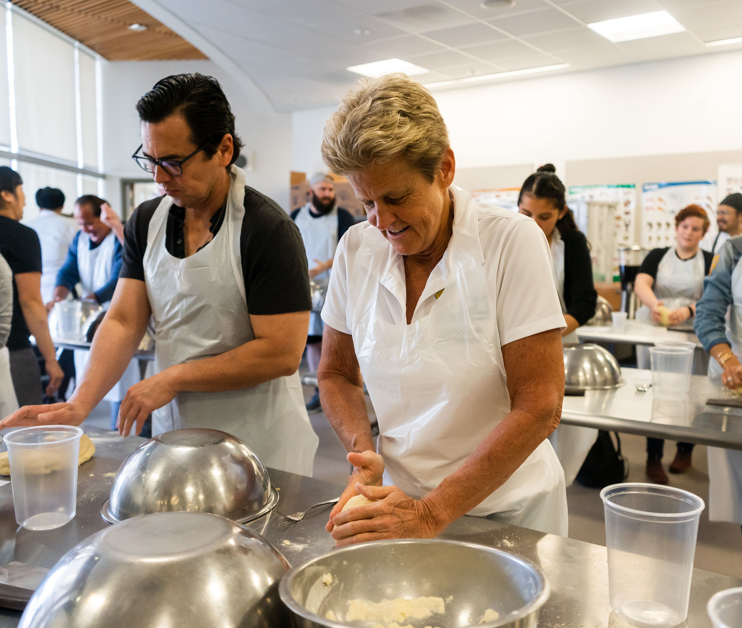
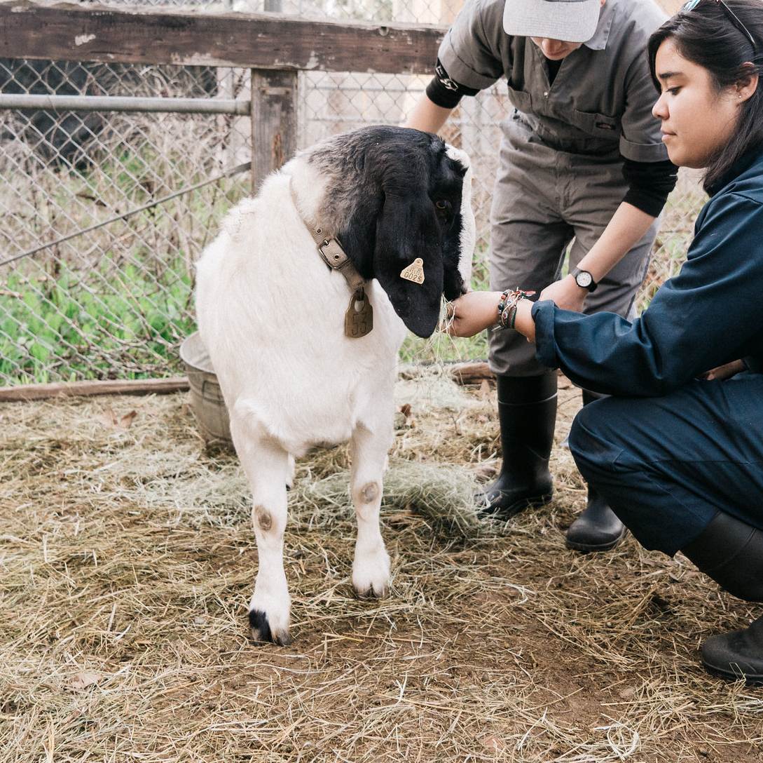
SDIC COMMUNITY COLLEGES CAREER EDUCATION | 32
Questions?

Slide 33

THANK YOU!
SDIC COMMUNITY COLLEGES CAREER EDUCATION | 33
LET’S TALK!
Presenter Name
Email Address

