Slide 1


Slide 2


Slide 3


Slide 4
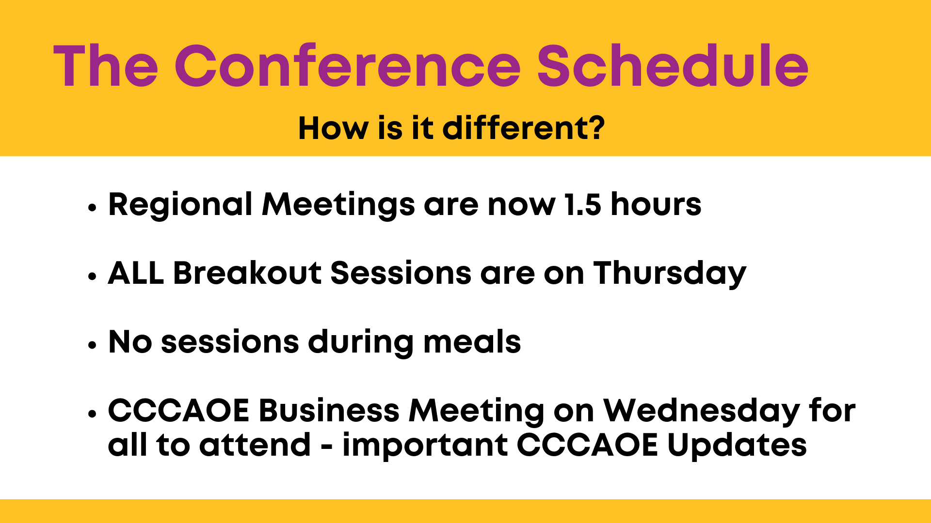

Slide 5
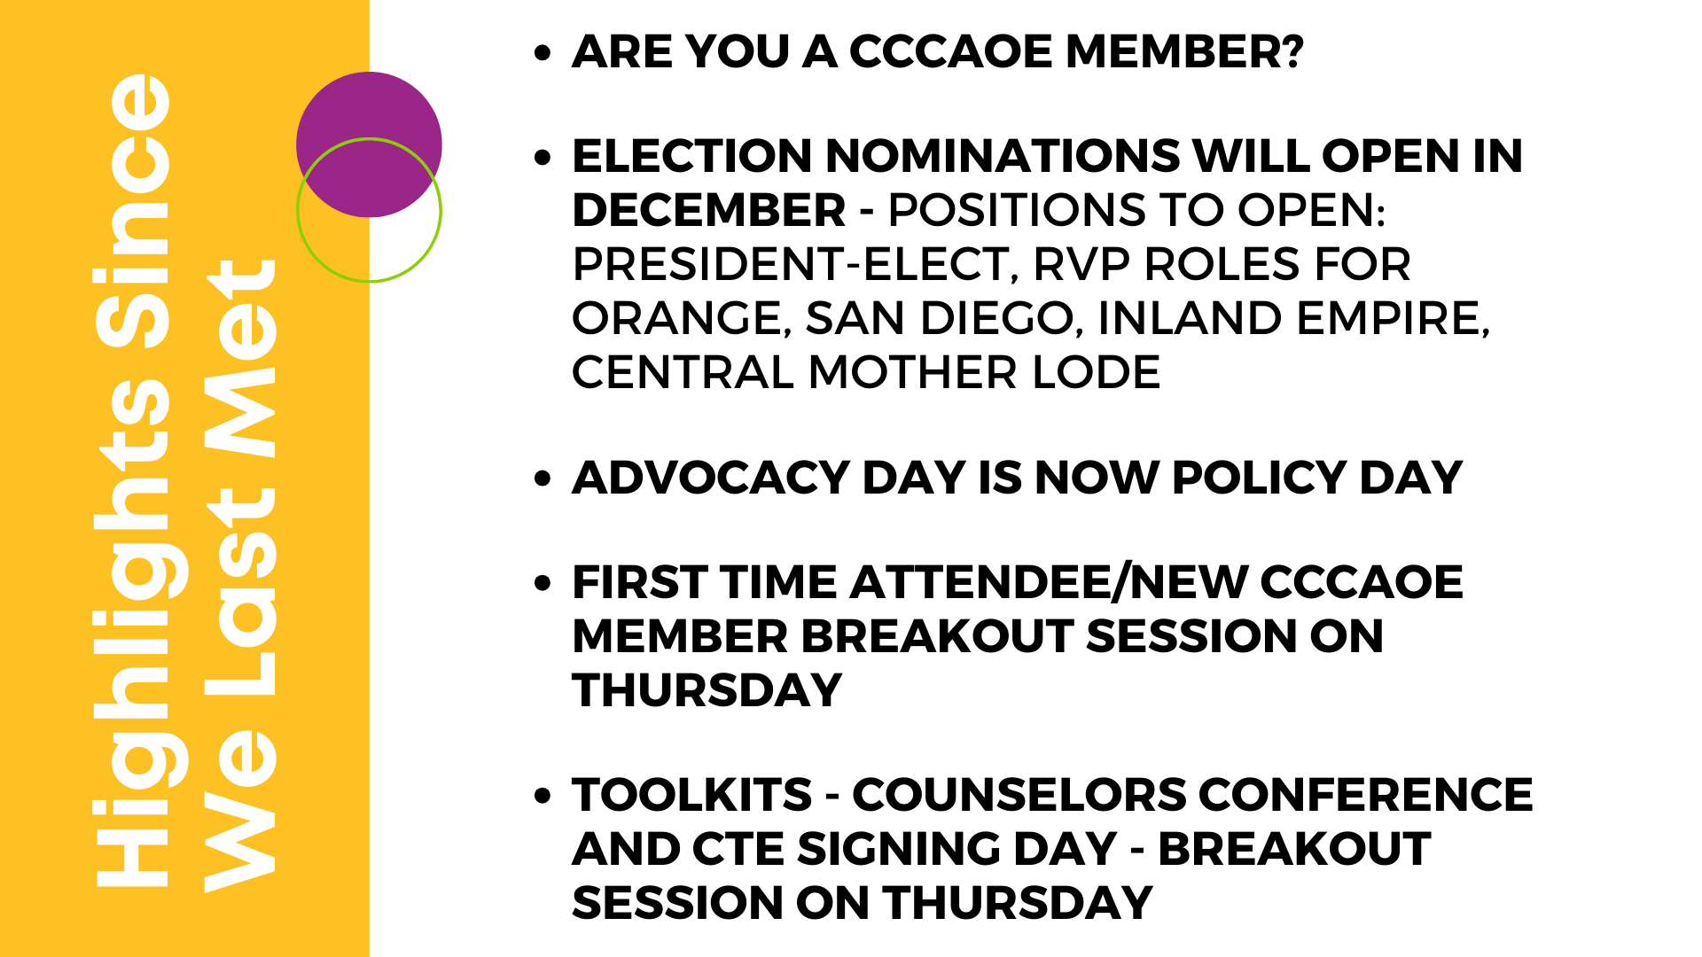

Slide 6


Slide 7

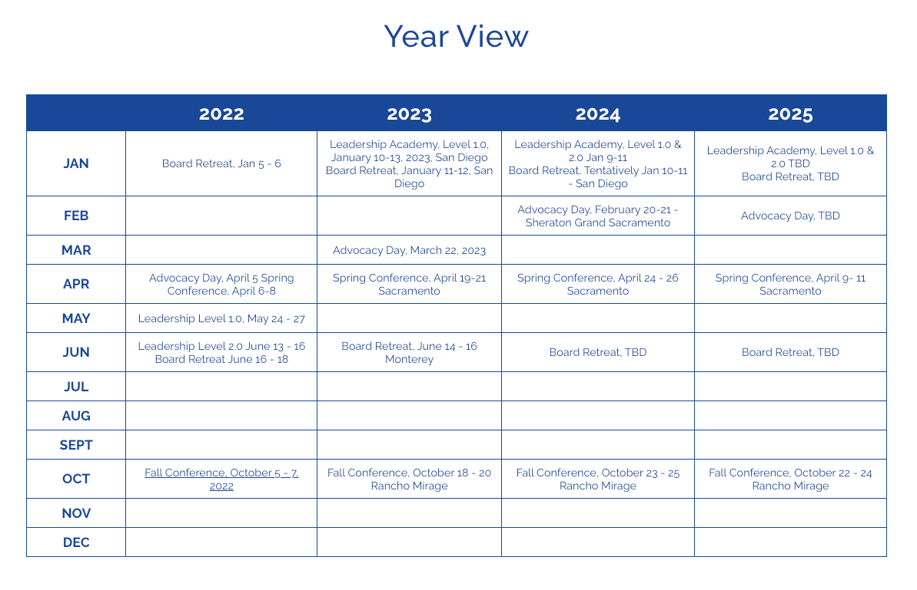
CCCAOE Webpage
QUICK LOOK EVENT CALENDAR

Slide 8

Sign up with your CCCAOE RVP to “Tell Us Your Story” on Thursday 10/19 between 1 and 3 pm.

Slide 9


Slide 10


