Slide 1

Welcome!!
When Planning for College Isn’t Enough
What Counselors Should Know
About CTE
Notes:
Esteban
Who’s in the room? Who had a direct path to the position you are currently in? Stand if you knew you wanted to be in the position you are currently in after graduating from college? Stay standing if you knew when you were graduating from high school you would doing the job you are doing today? Stay standing if you knew as a child...

Slide 2


Introductions
Esteban Monge
Work-Based Learning Specialist
Grossmont Union High School District
Health Pathway Coordinator
Classroom Teacher (10 yrs)
Sports Medicine, Biology, IB Biology
Jamie Davenport
CTE Curriculum Specialist
Grossmont Union High School District
CPA Coordinator (5 yrs)
Classroom Teacher (10 yrs)
ELA, Social Studies, Public Services (Law)
Notes:
Talk about our own jagged career paths.

Slide 3
Historical Context of CTE
Federal funding for Vocational Education goes all the way back to 1917;
1960s - Regional Occupational Centers and Programs (ROCP) began in California;
1976 - CA passes laws establishing specific structures and outcomes for ROCPs.
1984 - Vocational legislation was renamed after Carl D. Perkins with the Carl D. Perkins Vocational Education Act;
2006 - Carl D. Perkins Career and Technical Education Act (Perkins IV) introduced “Programs of Study” and required many programs to increase their focus on academic rigor and achievement.
  CTE Model Curriculum Standards adopted in CA in 2005;
  CTE Standards revised to align with CCSS / NGSS / HSSS in 2013.
Notes:
Jamie; What are some words/associations that come to mind when you hear CTE?
CTE is not just for those students or students who are not “college bound.”

Slide 4
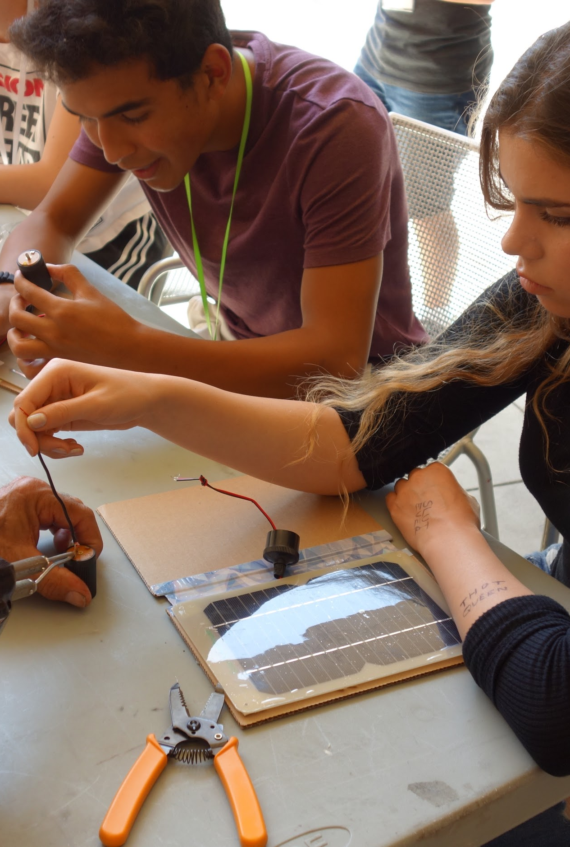
Historical Context of CTE cont.
Currently in California:
  71 ROCPs across the state;
  ROCPS enroll an average of 1,757 high school students each year.
    22% of students are enrolled in UC “a-g” approved courses;
    78% of ROCP courses offered are part of a sequenced pathway;
    42% of all ROCP courses are articulated with a local community college;
    22% of all classes lead to an industry certification.
Strong Workforce Program provides annual, ongoing funding to address the middle skills job gap in CA by providing MORE and BETTER CTE.
Notes:
Jamie;
SWP - 2016-17;
San Diego and Imperial County Regional Consortium (coordinating the event);

Slide 5
What is CTE in 2019?
1

Slide 6
Programs of Study
California Department of Education definition:
“A program of study... involves a multiyear sequence of courses that integrates core academic knowledge with technical and occupational knowledge to provide students with a pathway to postsecondary education and careers.”
Perkins Program of Study Requirements:
Sequenced courses that integrate academic and CTE content;
Incorporate and align secondary / postsecondary educational elements;
Opportunities for postsecondary credit;
Lead to an industry recognized credential or certificate at post-secondary level; or an AA or BA/BS
Notes:
Jamie - CTE is a comprehensive program, not just an elective!
Many CTE courses are UC A-G approved; or approved for other graduation credit (ex. VAPA)

Slide 7
Introductory Courses
Concentrator Courses
Capstone Course
Not required; Do not figure into CCI data; Good way to let students try-out a pathway.
Required; Enrollment numbers reported to state;
Required; Students must complete with a C or higher; Most important number reported to the state.
Notes:
Jaime: Intro (9-10th grade), Concentrators (10-11th grade), Capstone (11-12th Grade). Non-Senior capstone students do not get captured on Perkins data but they do get captured for CCI Dashboard; Not just an elective!

Slide 8
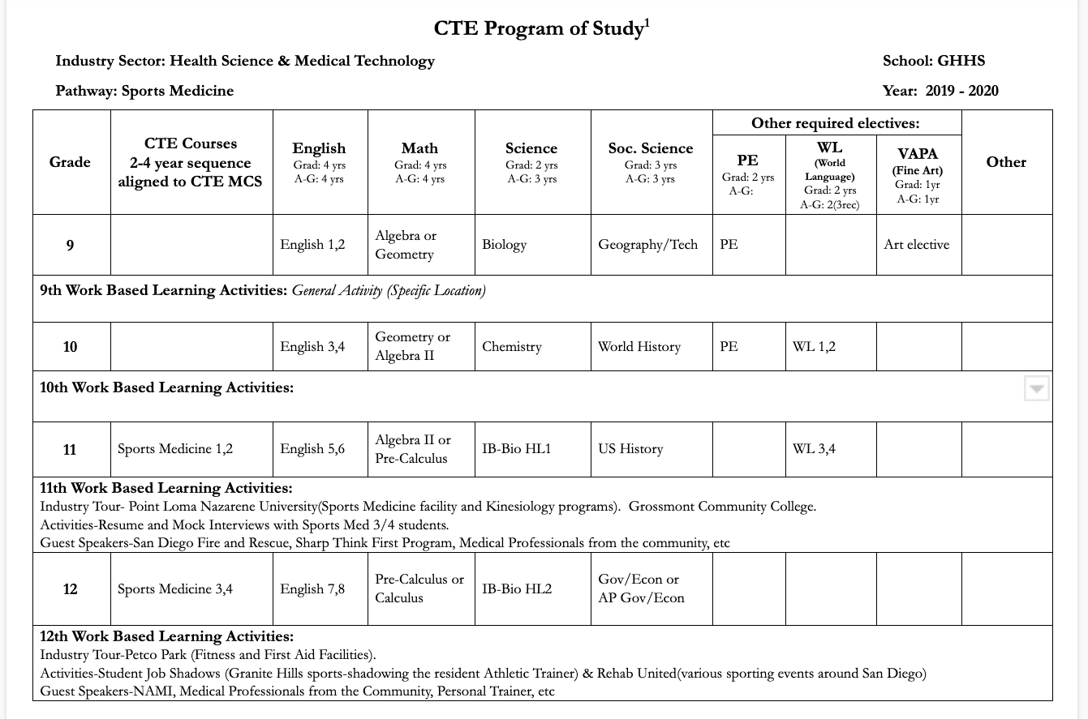
Notes:
Esteban - Record and incorporate WBL plans for each course. Looking to revise our POS format for next year.

Slide 9
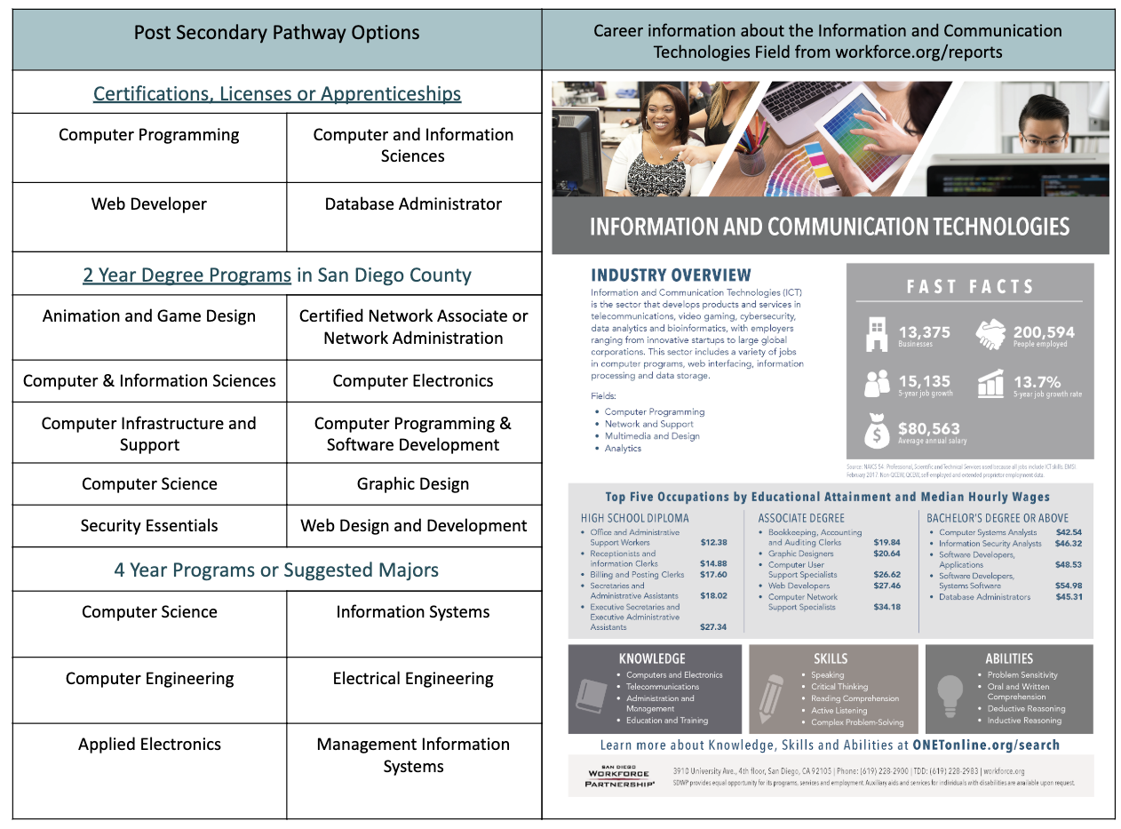
Notes:
Esteban

Slide 10
Why is CTE important in 2019?
2
Notes:
Filling middle skill job gap; providing students with real-life experience and training.

Slide 11
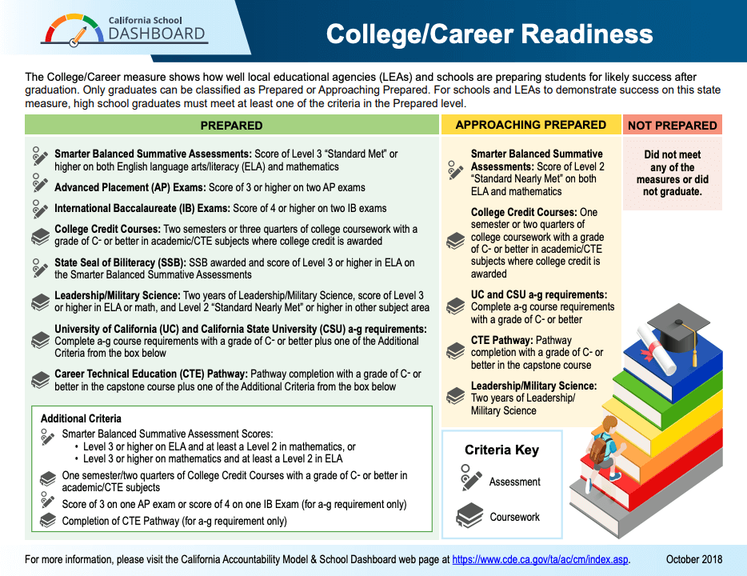
Notes:
Jamie; Not just an elective!

Slide 12
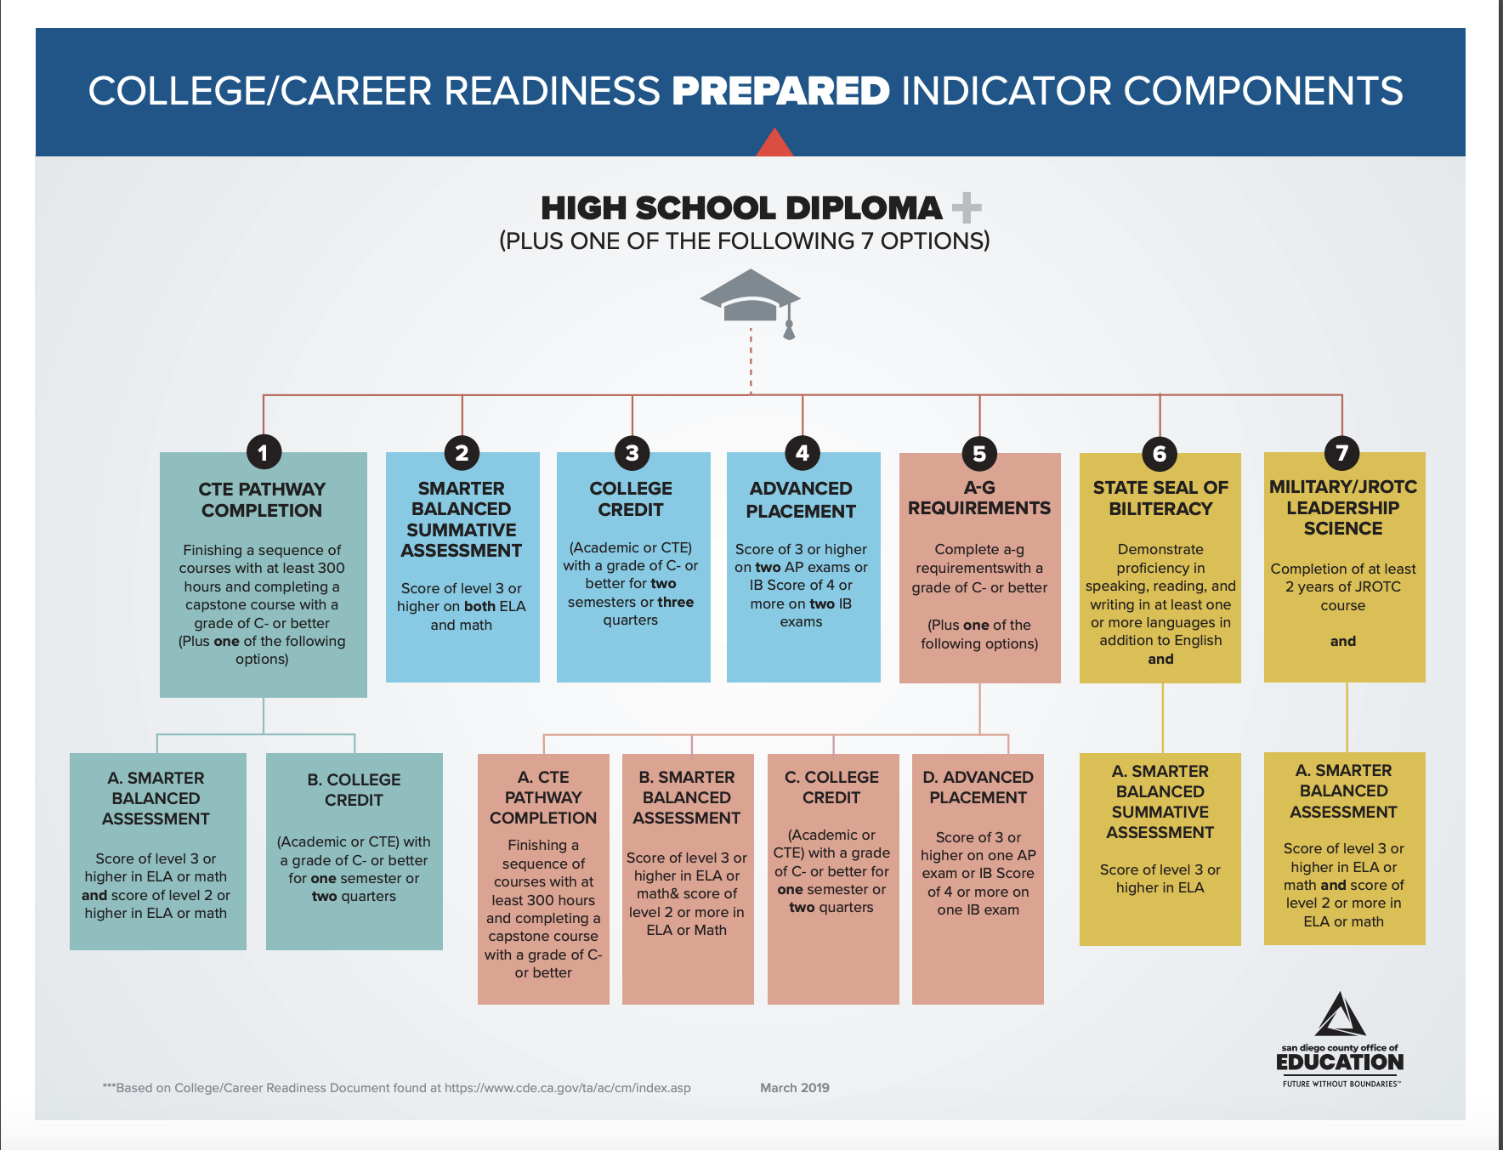
Notes:
D & F rate for CTE courses is lower than most A-G courses. 90% of capstone students are passing. 92% overall for all CTE courses for the GUHSD.

Slide 13
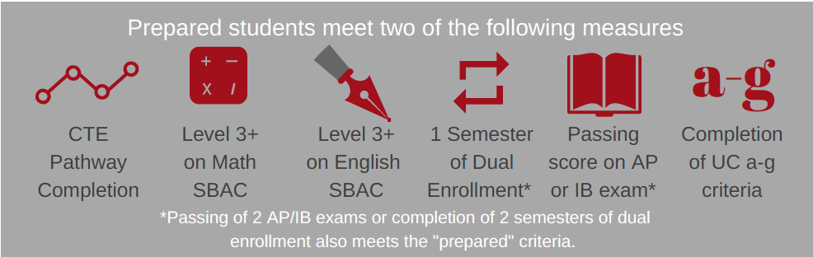
Notes:
Jamie - conflicts w/ other courses;

Slide 14
17-18 Perkins E2 Follow-Up
Site | Responses % | Employment Related | Education Related
Grossmont | 66% | 14 | 50
El Cajon Valley | 49% | 5 | 2
Mount Miguel | 54% | 3 | 6
El Capitan | 72% | 4 | 2
Granite Hills | 49% | 6 | 22
Monte Vista | 59% | 3 | 8
Santana | 80% | 7 | 15
Valhalla | 61% | 6 | 14
West Hills | 40% | 1 | 2
IDEA | 60% | 1 | 1
District | 61%(338 total) | 50 | 122 (50% combined)
‹#›
Notes:
Esteban-Add a picture.

Slide 15
Labor Market Info
CTE is the perfect vehicle to begin filling the gap in middle skill job sector.
Notes:
Esteban

Slide 16
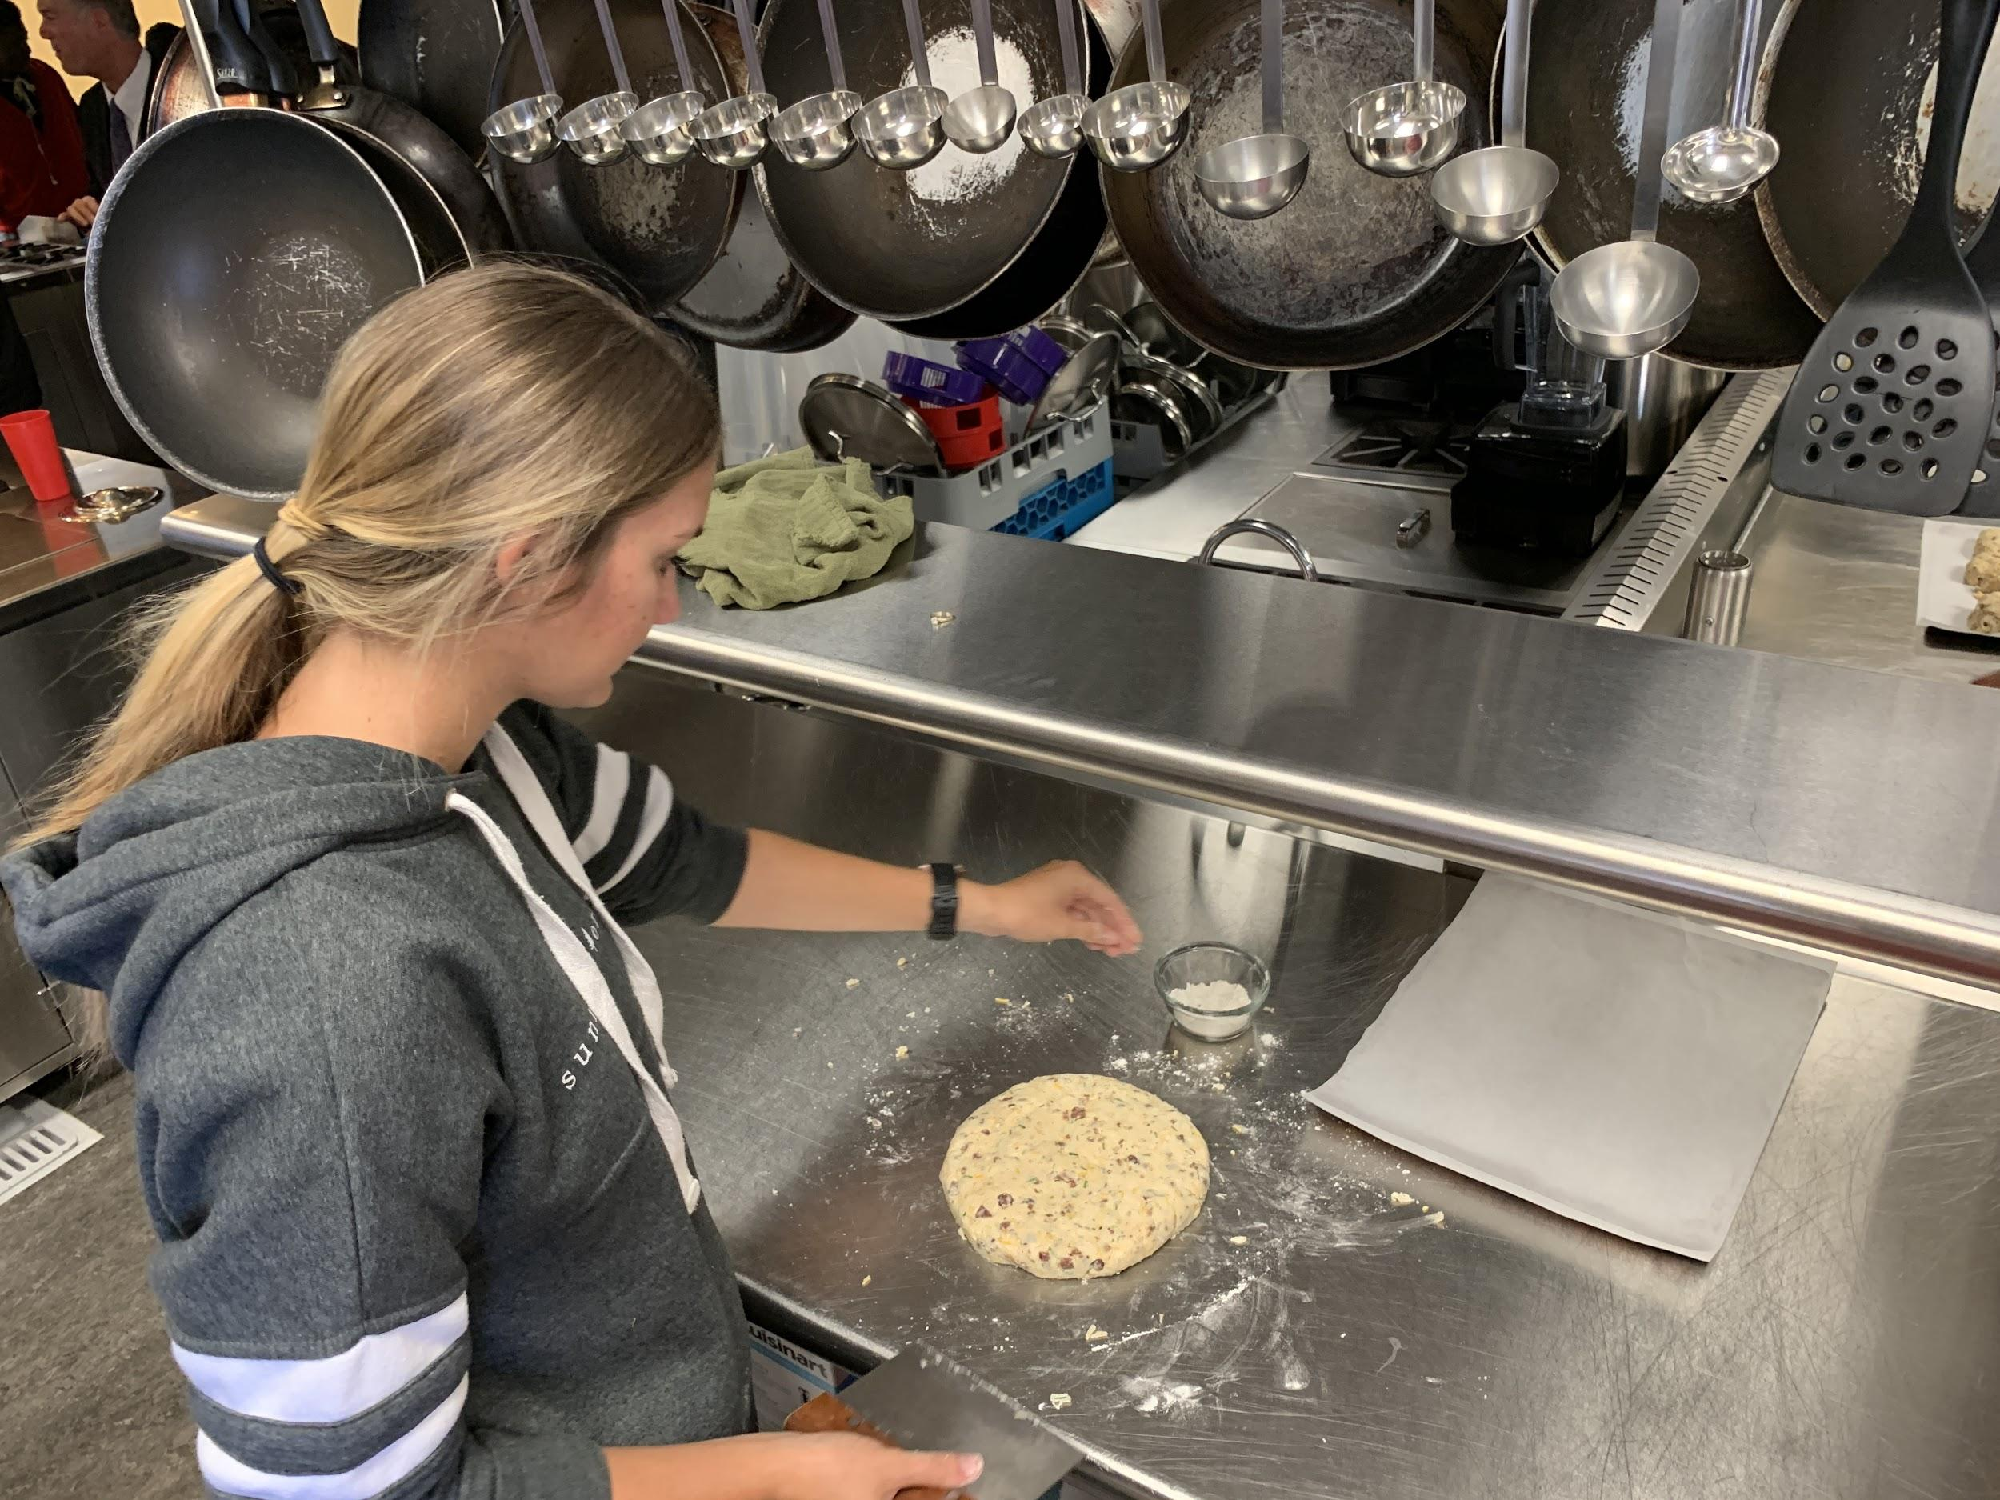
Turn and Talk
Turn to your neighbor and share one take-away from this morning’s presentation on the Labor Market.
Notes:
Esteban

Slide 17
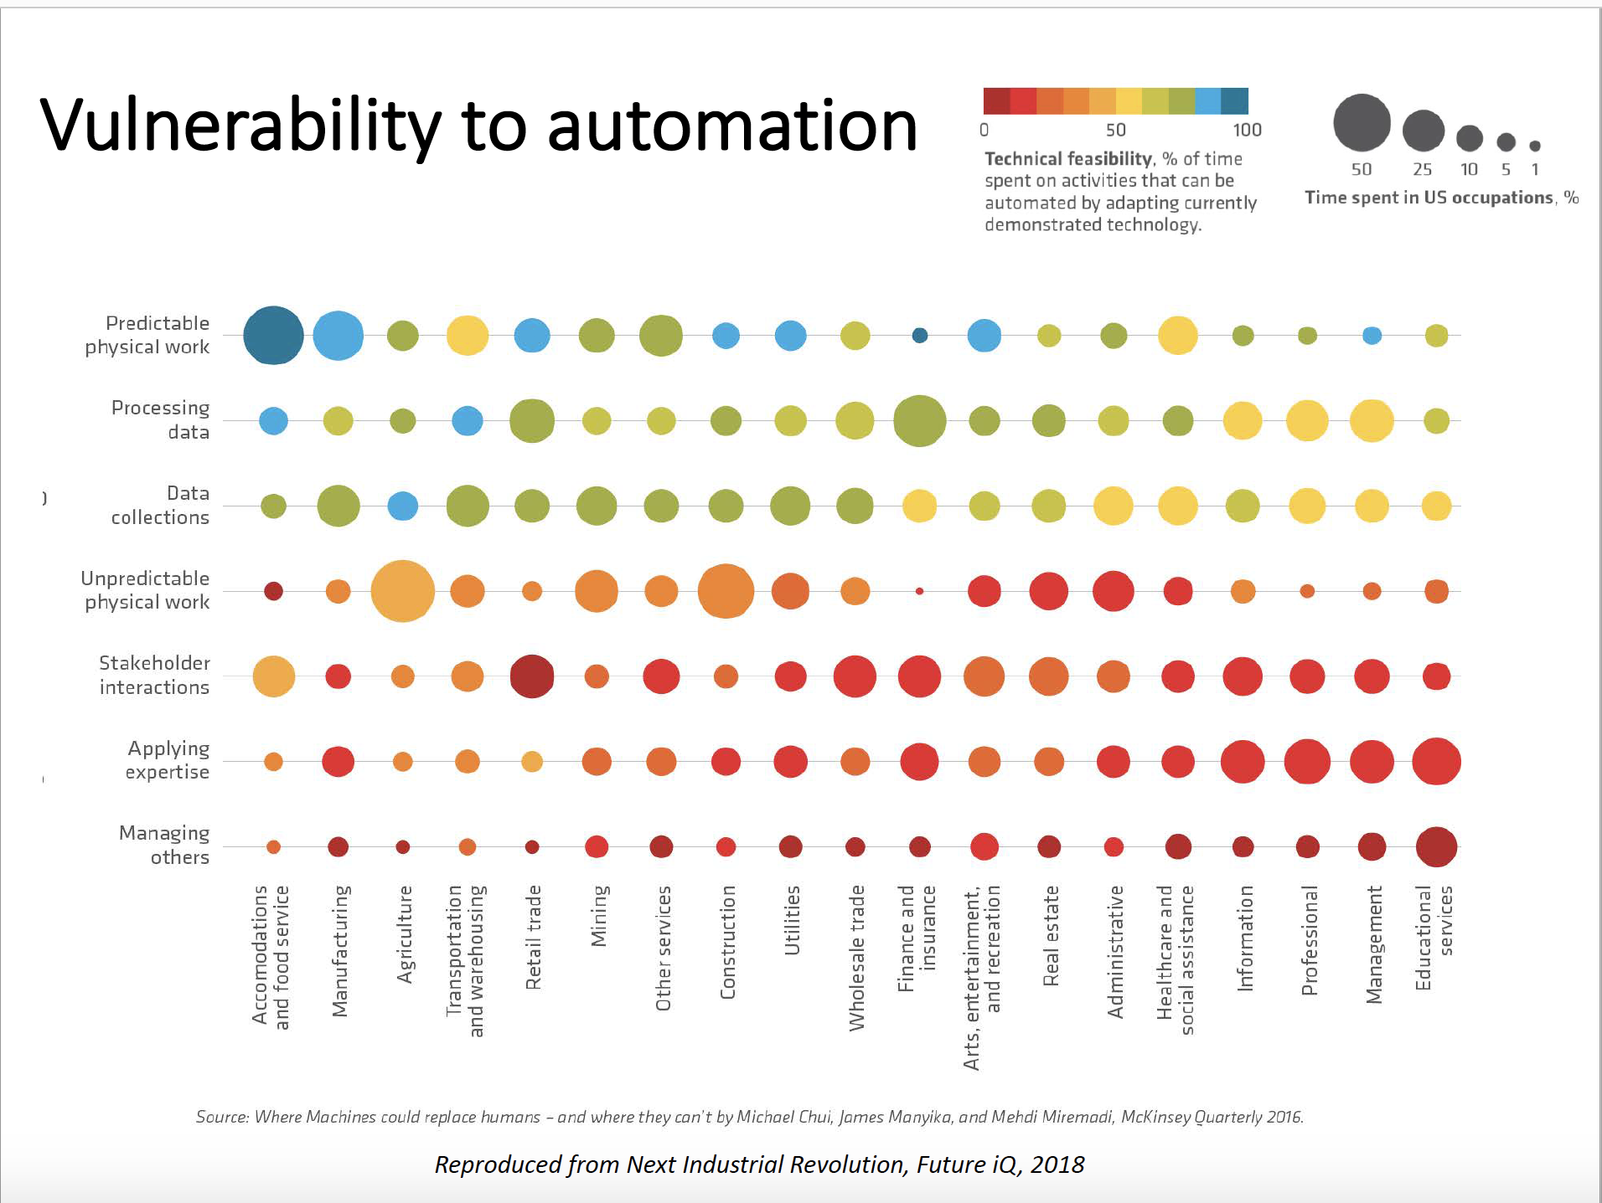
Esteban
The Future with Automation
Notes:
Esteban
McKinnsey-Data research for Tech companies.

Slide 18
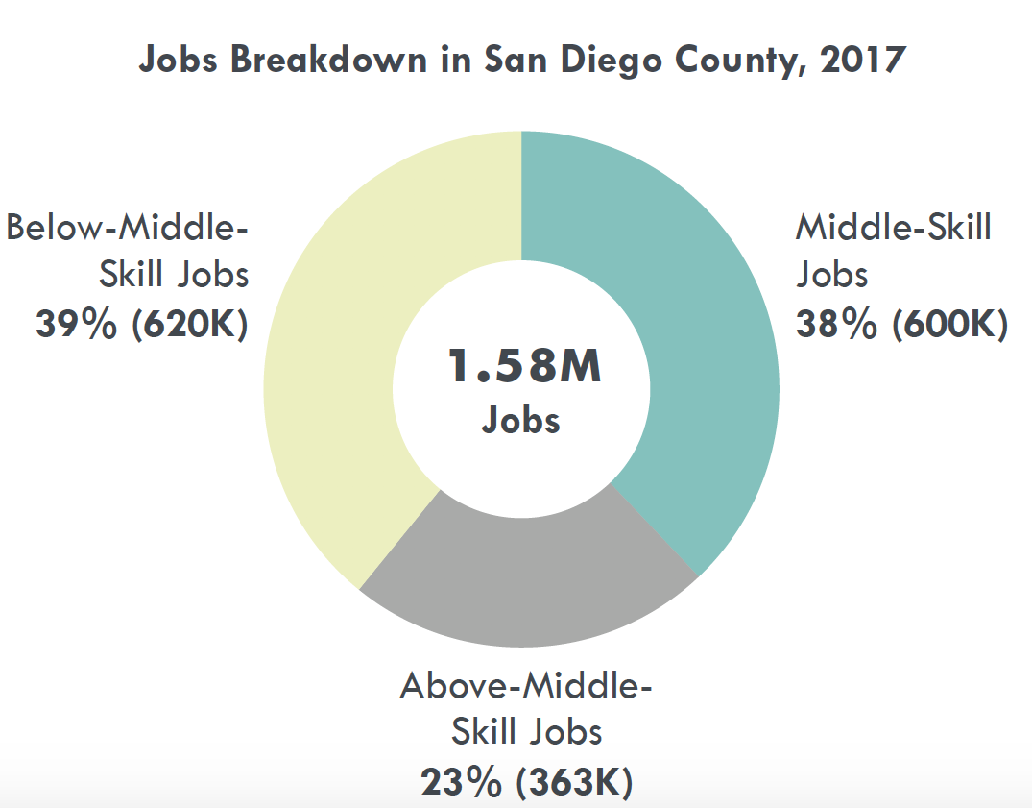
THE MIDDLE-SKILL JOB MARKET IN SAN DIEGO COUNTY
What is a Middle-Skill Job?
A middle-skill job has the following training requirements: Some college coursework, a postsecondary certificate, and/or an associate degree; or
High school diploma or equivalent with on-the-job training greater than 12 months; or Apprenticeship; or
Bachelor’s degree if at least 33% of workers in the occupation, age 25 or older, have completed, as their highest level of education, some college coursework or an associate degree.
Notes:
Esteban

Slide 19
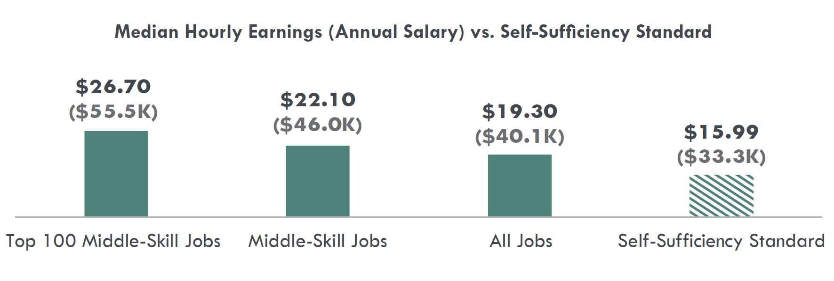
Of the top 100 middle-skill jobs identified in the Center of Excellence study, 88 have supply gaps and 12 have labor surpluses (an oversupply of labor).
Comparatively, the top 100 above-middle-skill jobs have 30 supply gaps, suggesting that middle-skill jobs have more opportunities to develop programs than above-middle-skill jobs.
Notes:
Esteban

Slide 20
The Career Development Continuum
Awareness
Exploration
Preparation
Training
Build awareness of the variety of careers available and the preparation required to obtain a career; Broaden student options.
Explore career and post-secondary options for the purpose of motivating students and to inform their decision making in HS through postsecondary education.
Apply learning through practical experience that develops the knowledge and skills necessary for success in careers and postsecondary education.
Train for employment and/or post-secondary education in a specific range of occupations.
Notes:
Jamie - Counselors should be familiar with what WBL their pathways are offering. Talk to CTE teachers about what WBL they do with students!

Slide 21
The Career Development Continuum
Awareness
Exploration
Preparation
Training
Guest Speakers
Industry Tours
Career Fairs
Industry Events
Job Shadows
Mentoring
PBL
PBL w/ Industry Panels
Competitions
Internships
Community Service Projects
Internships
Apprenticeships
Industry Certifications
Work-Ready Certifications
Early College Credit Options
Notes:
Jamie - Counselors should be familiar with what WBL their pathways are offering. Talk to CTE teachers about what WBL they do with students!

Slide 22
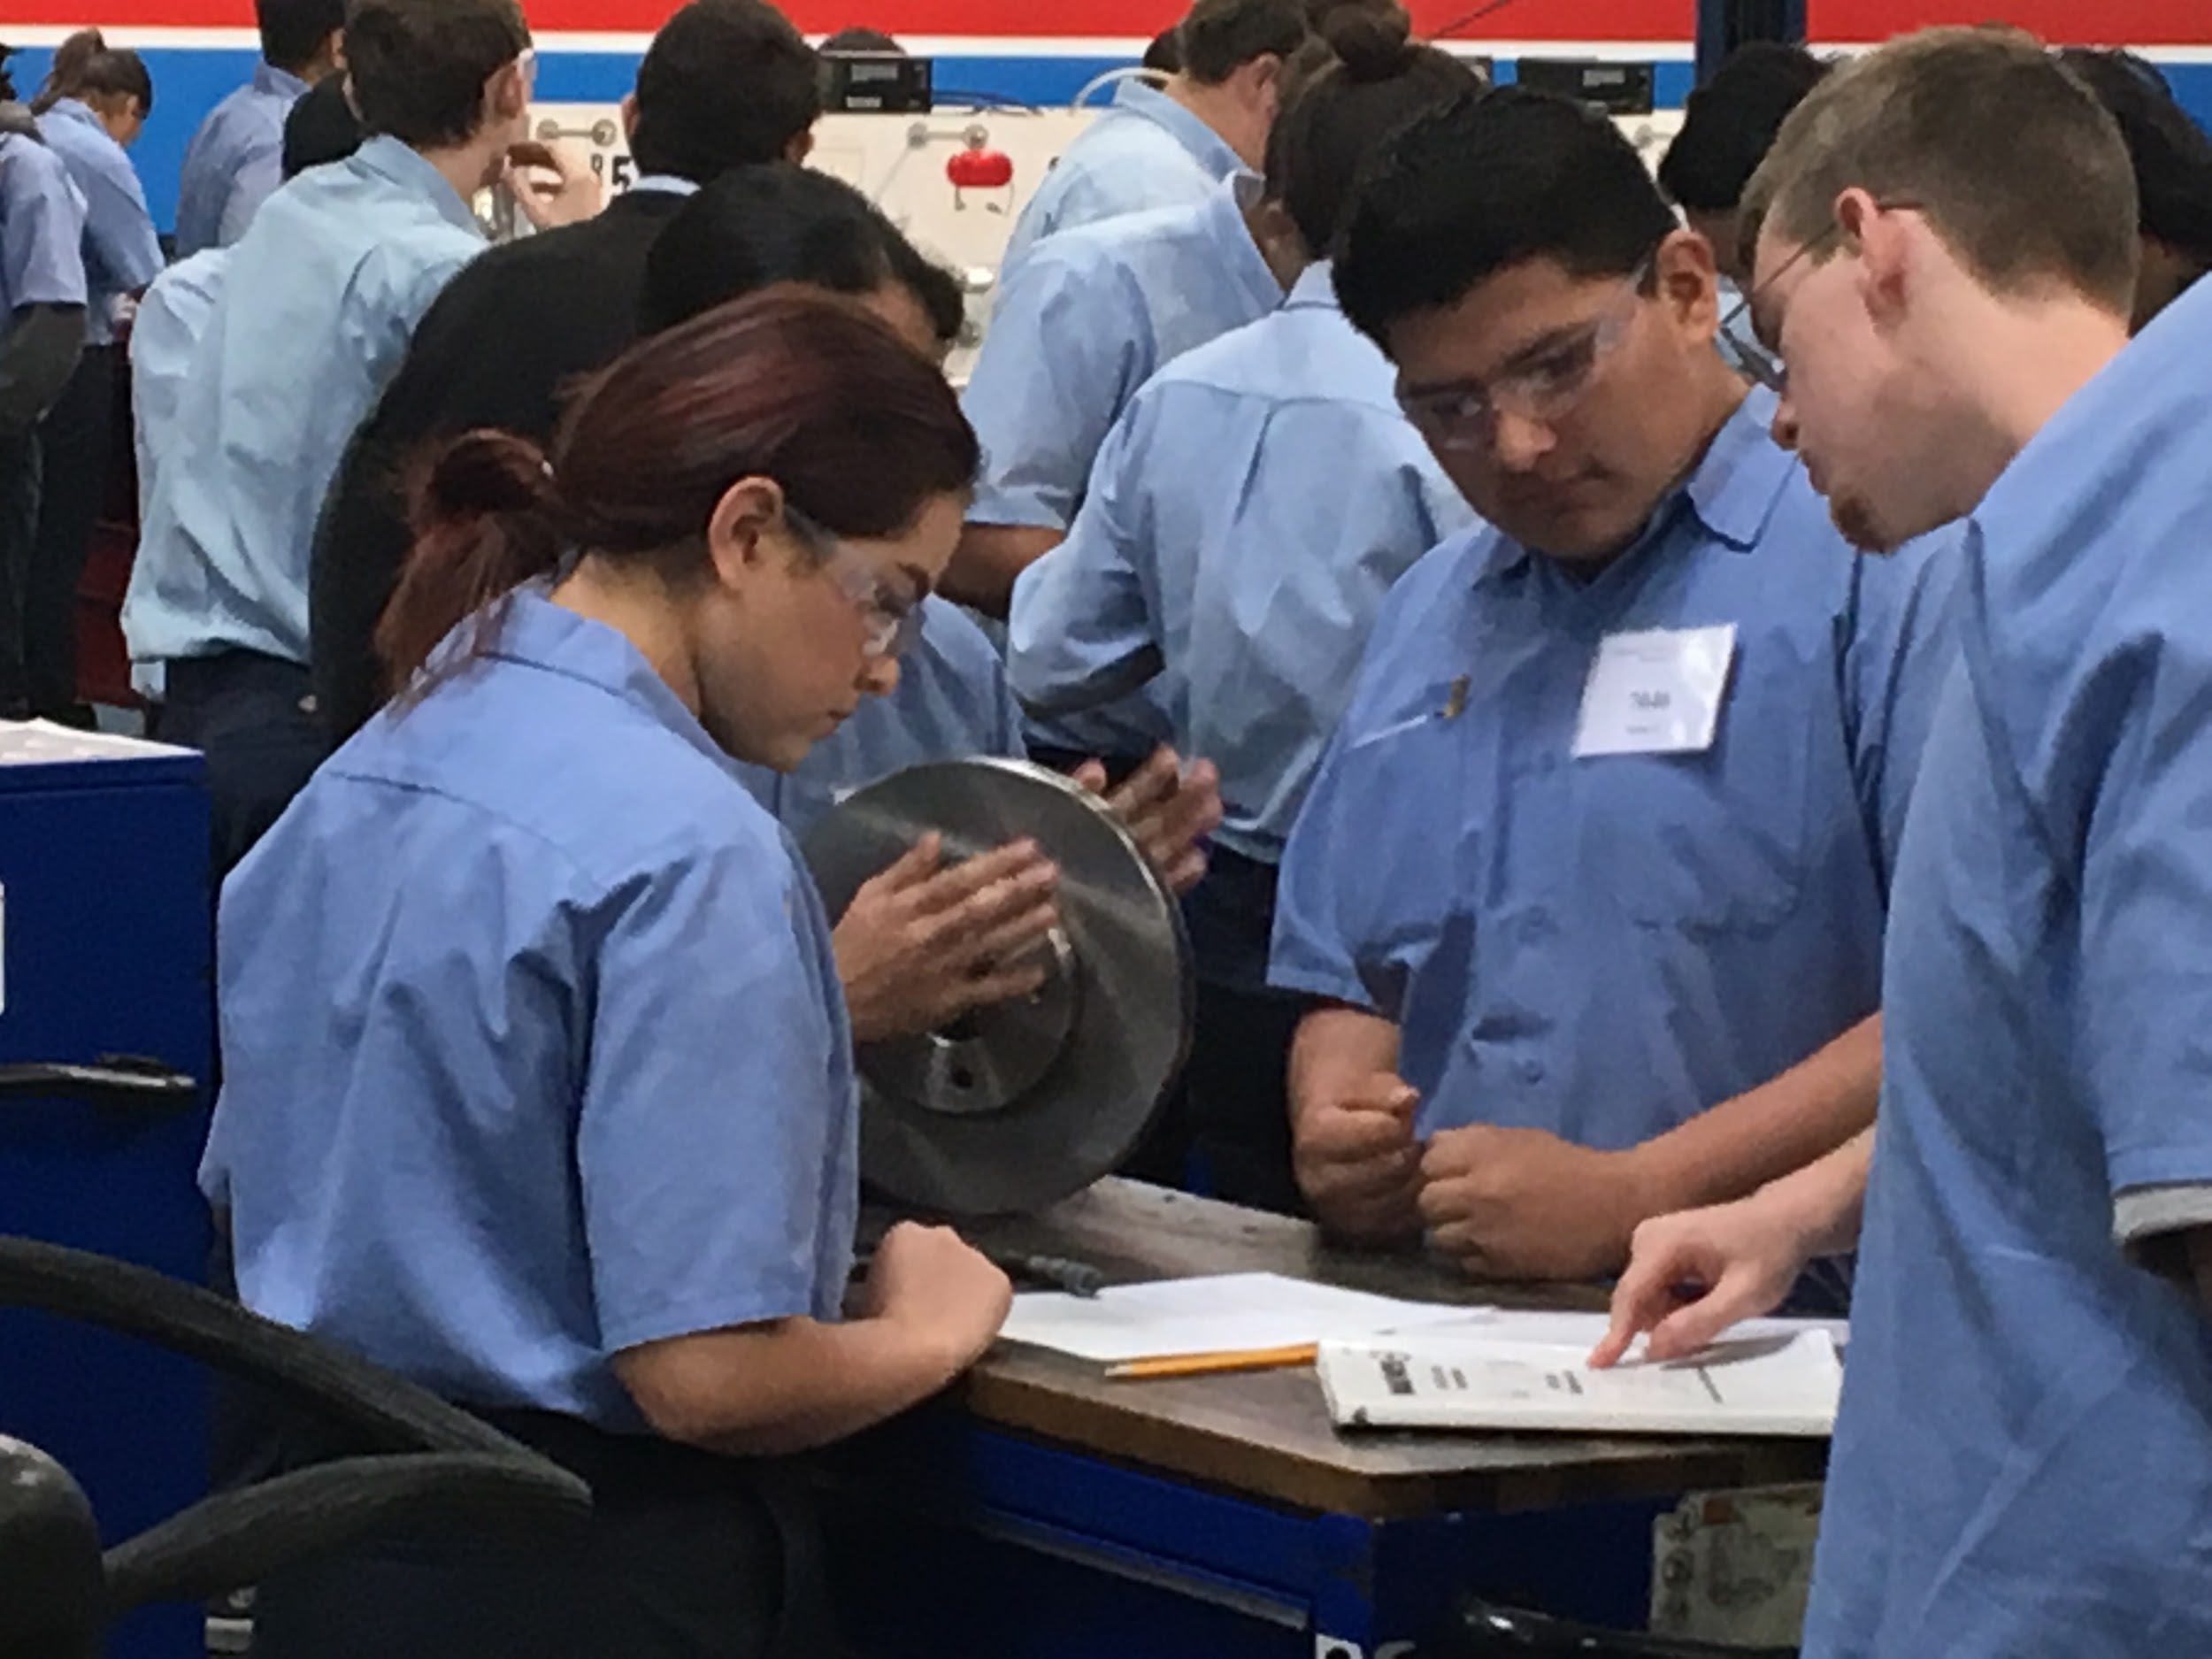
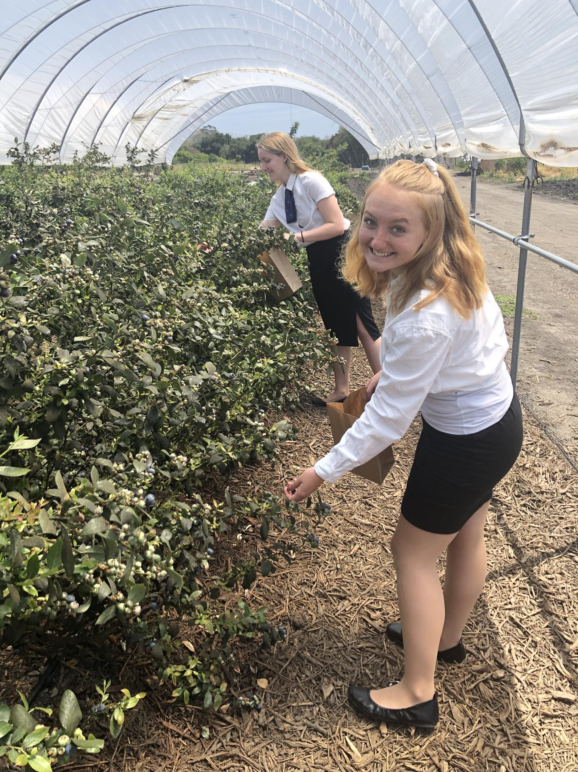
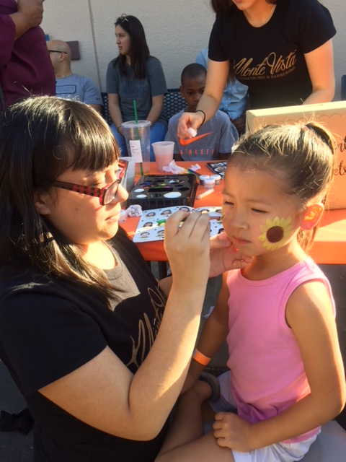
Career Awareness
What are you doing at your site to help students answer these questions?
  Who am I?
  What do I like to do?
  Where would like to do it? (WoW)
How is your site helping students progress through the career development continuum?
Notes:
Jamie

Slide 23

Zevely Zone Video
Notes:
Esteban

Slide 24
Who should be a CTE student?
3
Notes:
Esteban

Slide 25
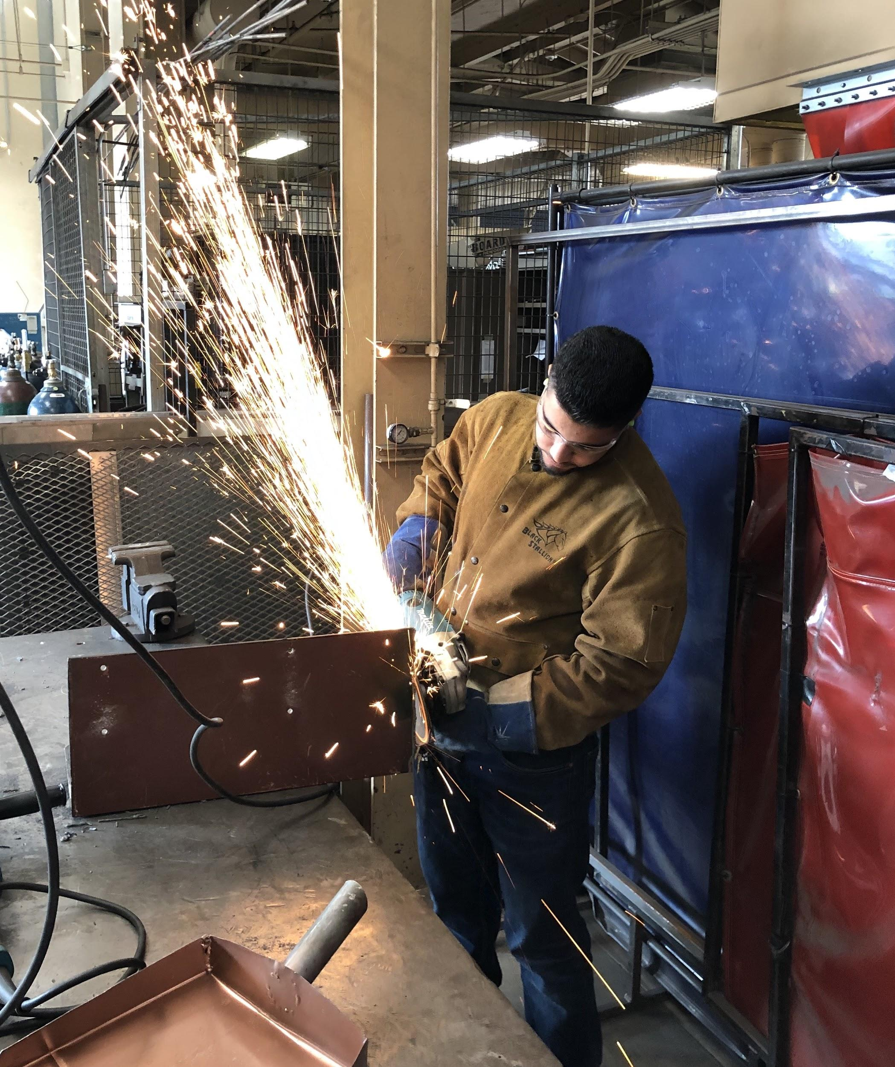
CTE is for EVERYONE!!!
Case Study #1
AP/Honor student enrolled in two-year Sports Medicine Pathway. Will be attending Drexel University to complete PA School.
“Sports Medicine taught me about rehab which I really loved and helped me find my career path as a physician assistant.”
- Morgan
Case Study #2
Average 2.5 GPA students in Teaching and Learning Pathway. Completed 32 units toward her AA degree at Grossmont in Child Development.
“Without CTE I would have never found my calling working with children, I have applied for a position at the Grossmont Child Development Center.”
- Tessa
Notes:
Esteban

Slide 26

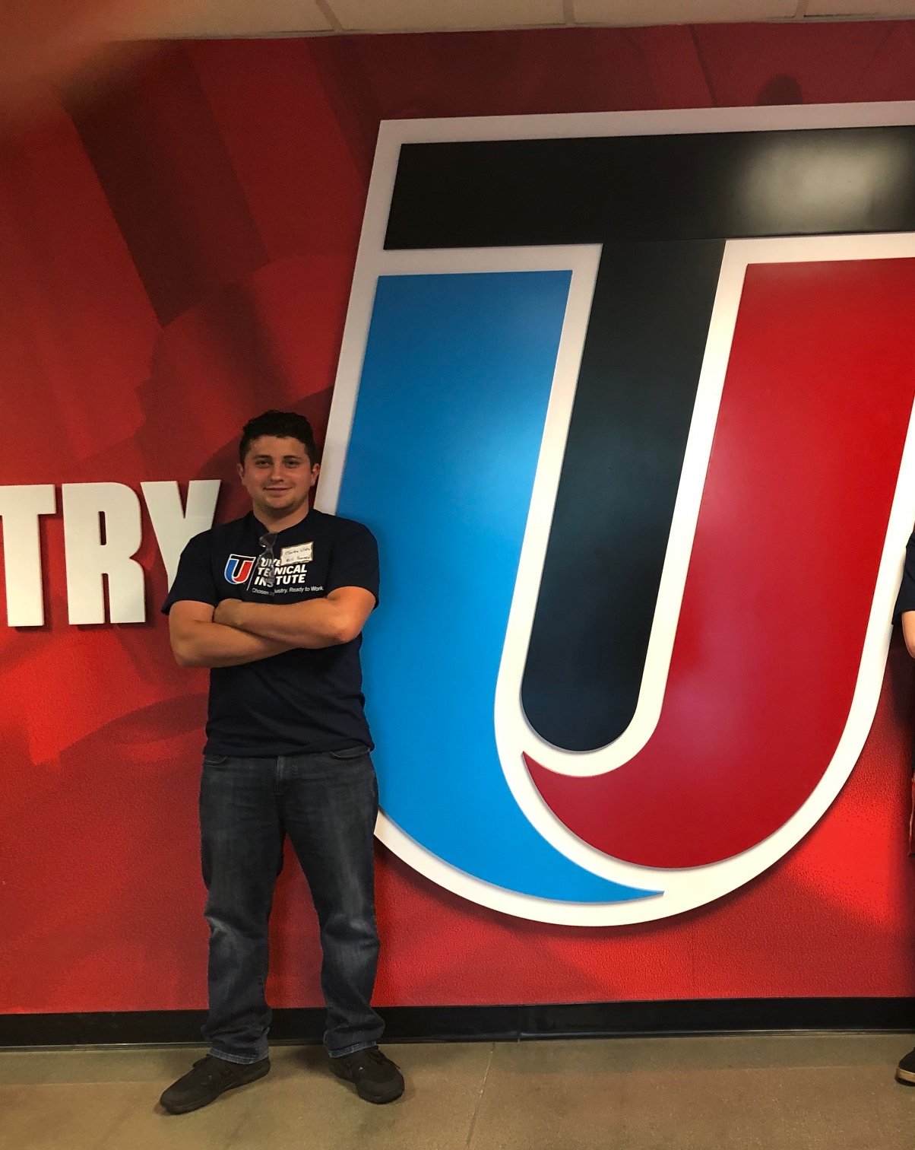
CTE is for EVERYONE!!!
Case Study #3
At-risk student, credit deficient. Dropping pathway to recover credits at the end of the semester. Now completing Diesel Technician program at Miramar College
“I really saw a change in Noah after he took part in the SkillsUSA competition, it changed his life”
Mike Fleming, Monte Vista
CTE Pathway Teacher
Notes:
Esteban

Slide 27
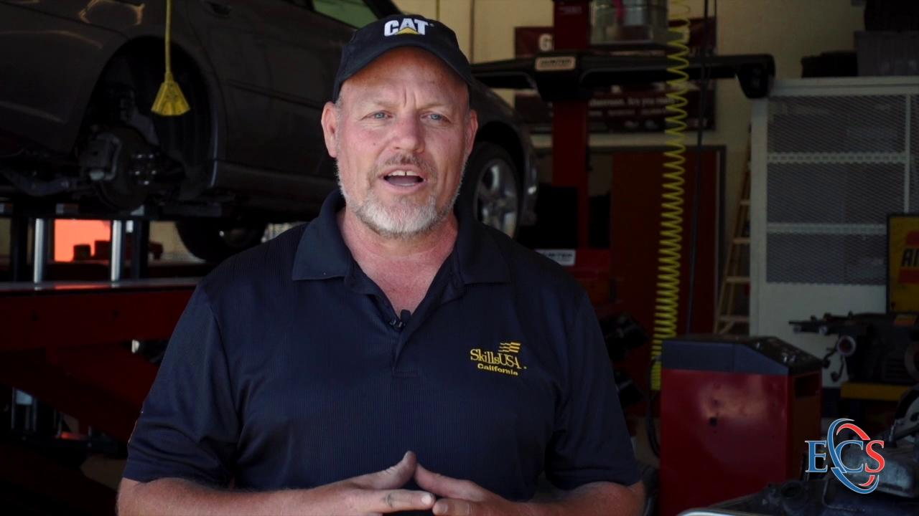

Monte Vista Transportation
Notes:
Esteban

Slide 28
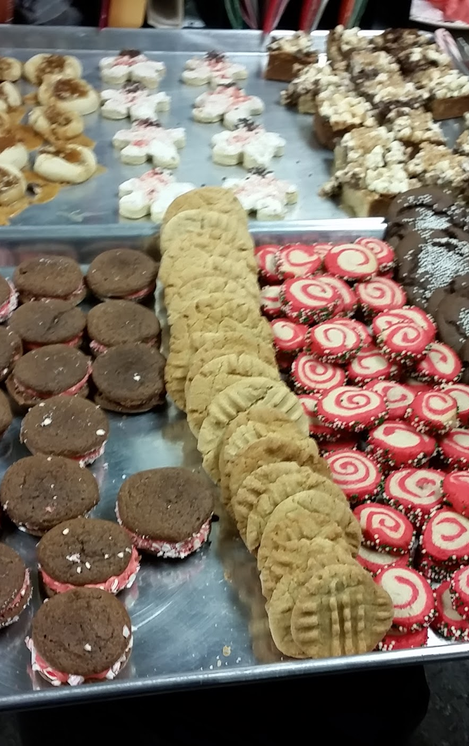
Thanks!
Remember to ask your students
  Who are you?
  What do you like to do?
  Where would you like to do it? (WoW)
Any questions?
Please feel free to contact us at:
emonge@guhsd.net
jndavenport@guhsd.net
Notes:
Jamie

