Slide 1
Regional Directors (DSNs)
What is industry saying and looking for?

Slide 2
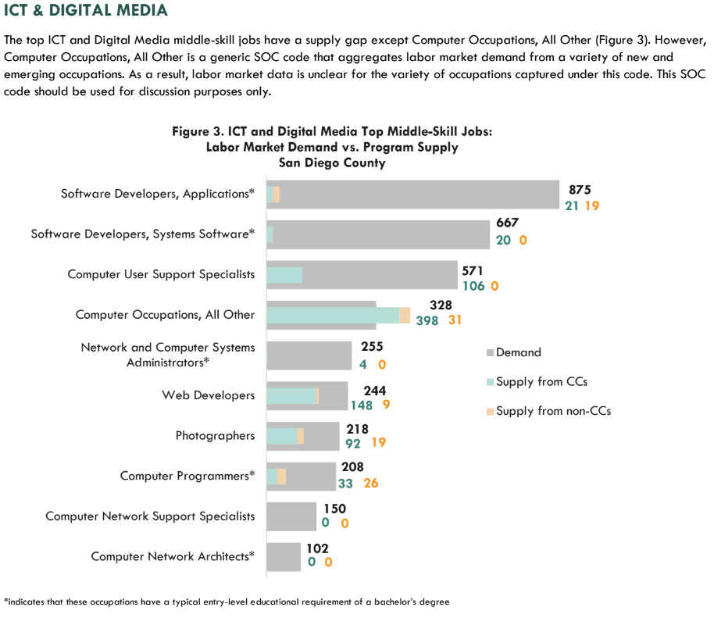
Regional Director’s current focus…
Sector Profiles and Strategies
Analysis of Labor Market Information
Exploration of the knowledge, skills and abilities from employers
K12 Initiatives (coordinated through Heather Cavazos and Monica Rosas)

Slide 3

Advanced Manufacturing- Ruishan Chow
Ms. Chow has over 7 years of professional experience in the field of Advanced Manufacturing and Industrial Technology. Her expertise includes: Lean Manufacturing, Process Optimization and Controls, High-Technology Manufacturing, Project Management, Leadership, Coaching, Training and Public Speaking. Ruishan plans to use utilize her networks, along with commitment to advocating for both schools and industries to focus on fulfilling the manufacturing industry's workforce needs. She wants to bring awareness of Industry 4.0 to explore and develop solutions for emerging workforce needs.

Slide 4
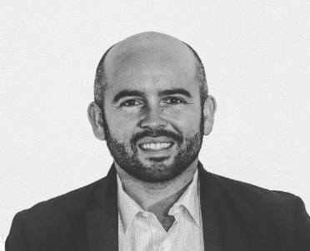
Advanced Transportation and Logistics- Jon Kropp
Jon has 10 years’ experience building energy related programs with industry as well as collaborating for environmental health and safety with companies like General Atomics, BAE Systems, and General Dynamics. The ATL sector is comprised of five industry clusters: Advanced Transportation, Alternative Energy, Logistics, Energy Storage, and Drones and will be focusing on the supply gaps in the following areas of focus: production, planning, and expediting clerks; logisticians; heavy equipment specialists; first-line supervisors of helpers, laborers, and material movers; and project management.

Slide 5
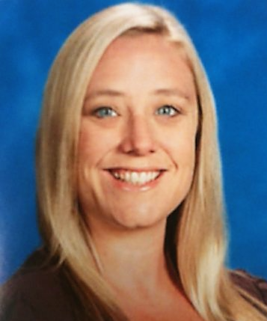
Business and Entrepreneurship- Jennifer Patel
With over fifteen years in K-14 education, Mrs. Patel has experience in developing curriculum and teaching Business and Entrepreneurship courses, possesses expertise in building pathways from K-12 to community college to university, and shares in the Vision for Success. As a small business owner and Angel Investor, Jennifer understands the challenges entrepreneurs face and this drives her work as the Regional Director of Business and Entrepreneurship. Current projects include Gig Economy research report, working with and mapping the startup community in the region, and providing resources and connections to community college faculty.

Slide 6
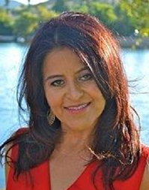
Health Care- Connie Lafuente
Connie Lafuente is a bilingual and bicultural public health professional with 20+ years of experience driving strategic initiatives to address public health issues; and leading the development and implementation of community programming to positively transform health outcomes of diverse populations. She has been successful in building and sustaining coalitions and partnerships with public sector/government officials, community based organizations, the healthcare industry, academia, school districts, and the private sector. Prior to her role as a DSN, Connie worked at Project Concern International (PCI) as a Director of Programs funded by the Centers for Disease Control and Prevention (CDC) REACH, California Endowment, and Alzheimer’s Association. Connie’s background and experience will allow her to expand the Allied Health programs within the region by building noncredit and credit programs of study in our colleges, and allow us to better meet the healthcare demands of our communities

Slide 7
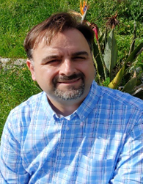
ICT and Digital Media- Duane Rinehart
Mr. Rinehart is a seasoned educator and consultant with over 15 years of experience servicing small and large organizations, to assist in the areas of strategy formulation, risk assessment, operations, and marketing. Mr. Rinehart is versed in multiple technologies to include PHP, Java, Javascript, jQuery, C#, C++, Python, Visual Basic, MySQL/Percona, MS SQL Server, R and SPSS, and others. Mr. Rinehart was a professor of Business Information Technology in San Diego Continuing Education where he designed curriculum, served on industry advisory and distance education committees; and provided input to Guided Pathways collateral. Current initiatives include helping colleges make job fairs more effective through employer pre/post surveys and identifying geographically-relevant attendees for potential engagement. In addition Mr. Rinehart is conducting a gap analysis of Networking, CIS, and Cybersecurity needs to regional program offerings to inform employers and faculty in curriculum development.

Slide 8
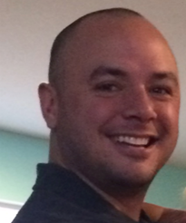
Life Sciences and Biotechnology- Keau Wong
Mr. Wong has worked in Translational Biomedical Research and Commercial Biotechnology for over a decade including the past 7 years in High-Throughput Clinical Genomics at Illumina Inc. Mr. Wong is focused on student success, program integration, and industry alignment with our Regional Strong Workforce goals and initiatives. He is committed to the development and progression of sector specific training in Quality, GXPs, Lean Techniques, and Advanced Therapy Medicinal Product Manufacturing, as well as industry recognized certifications to ensure the success of our students, colleges, and industry partners.

Slide 9
Questions?

