Slide 1

CAREER EDUCATION
San Diego and
Imperial Counties
Notes:
Replace white box with partner logo

Slide 2
Cuyamaca College
George Dowden
Notes:
Replace white box with partner logo (all-white, knocked out version preferred)

Slide 3
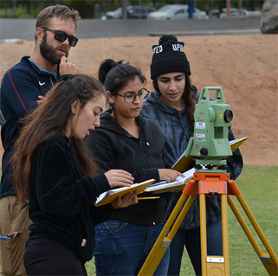
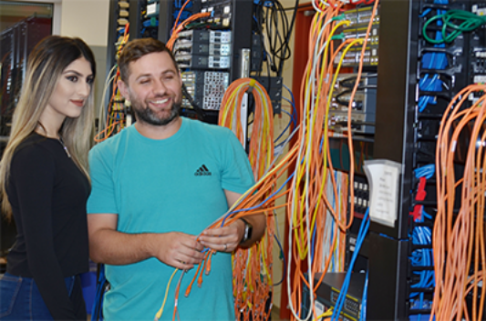
Advanced Manufacturing
Programs offered:
CADD Technology
Building Design Industry (Certs 30 units, Degrees 30 units+GE )
Manufacturing Industry (Certs 30 units, Degree 24units+GE)
Computer and Information Science
Networking, Security & Sys Admin
Surveying (Certs 27-28 units, Degree 27-28 +GE)
Career opportunities:
CADD Technician in the field of Architecture and Civil, Electronic, Mechanical, Structural Engineering – $28.23 hr
Computer programmers, network architects, computer operators - $51.00 hr
Surveying and mapping technicians, Surveyors - $33.18 hr
Surveying Engineering
Notes:
Replace white box with partner logo (all-white, knocked out version preferred)

Slide 4

Advanced Transportation and Logistics
Programs offered:
Automotive Technology:
Degrees
Automotive Technology (38-44 units +GE)
Automotive Technology ASCCA (IND.) (43-45 units +GE)
Automotive Technology ASEP (GM) (52.5 units +GE)
Automotive Technology ASSET (FORD) (38.5-46 units + GE)
Certificates
Automotive Technology (38-44 units)
Brakes and Front End (19 units)
Engine Performance and Drive Train (22 units)
Advanced Engine Performance and Emissions (25 units)
Career opportunities:
Automotive Service Technicians and Mechanics $22.58 hr
Notes:
Replace white box with partner logo (all-white, knocked out version preferred)

Slide 5
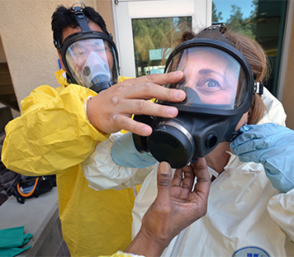

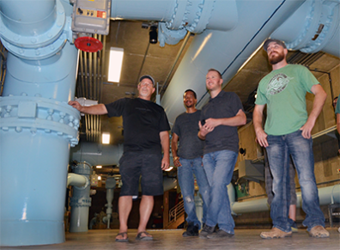
Agriculture, Water, and Environmental Technologies
Programs offered:
EHSM
Environmental Management (D, C) (40-45 units + GE)
Occupational Health and Safety Management (D, C) (40-45 units+GE)
Environmental Technician (C) (27-29 units)
Occupational Health and Safety Technician (C) (25-29 units)
Ornamental Horticulture: 9 degrees and certificates including Arboriculture (32units +GE), Floral design (33 units +GE), Golf Course and Sports Turf Management (32 units +GE), Irrigation (32units +GE), Landscape (37 units +GE), Nursery (32 units +GE), Sustainable URBAN landscape (32 units +GE)
Center for Water Studies: 6 degrees and certificates including Backflow and Cross Connection Control (29 units +GE), Water Resources Management(34-38 units +GE), Water Treatment Plant Operator(36-37 units +GE), Water Distribution Systems Operator(36-37 units + GE), Wastewater Collection Systems(36-37 units +GE), Wastewater Treatment Operator(36-37units+GE)
Career opportunities:
Environmental Science Technicians, Environmental Engineers, Health and Safety Engineers, OSHA Technicians - $35.48 hr
Landscape Architects, Tree Trimmers and Pruners, Floral Designers, Groundskeepers -$13.50 hr
Water and Wastewater Treatment Plant and System Operators - $32.38 hr
Notes:
Replace white box with partner logo (all-white, knocked out version preferred)

Slide 6
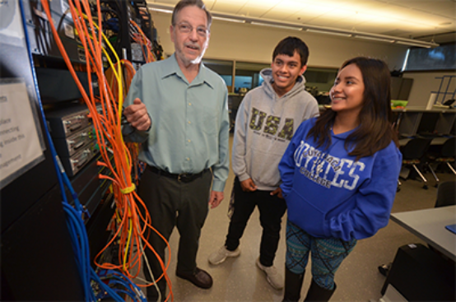
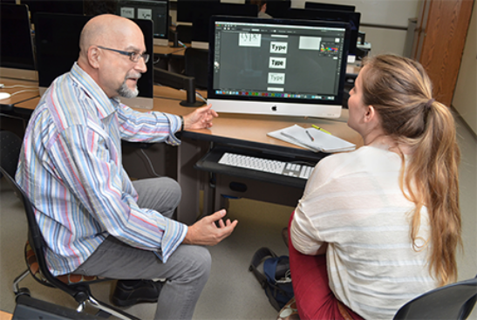
Information and Communication Technology (ICT)
and Digital Media
Programs offered:
CIS Degrees:
Networking, Security and System Administration(39-41 units +GE)
Web Development (29-34 units +GE)
Certificates of Specialization
  Cisco Certified Network Associate Certificate (15units)
  Cisco Network Professional Certificate (12 units)
  Cyber Security Specialist Certificate (15 units)
  Computer Programming Certificate (12 units)
  Computer Support Technician Certificate (15 units)
  Web Design Certificate (15 units)
  Web Programming Certificate (16 units)
Graphic Design Degrees:
Graphic Design (34-37 units +GE)
Certificates:
Graphic Design (34-37 units)
Digital Photography (15 units)
Web Graphics (15 units)
Career opportunities:
Network Support Specialists, Network Architects, CIS Managers, Computer programmers, Information Security analysts, Computer Operators - $51.00 hr
Graphic Designers, Desktop Publishers, Photographers - $18.76 hr
Notes:
Replace white box with partner logo (all-white, knocked out version preferred)

Slide 7
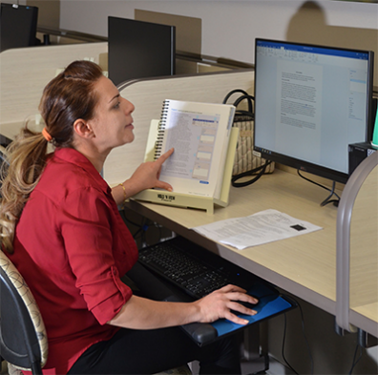

Business and Entrepreneurship
Programs offered:
Degrees
Accounting
Business Administration (32 units +GE)
Business (24-26 units + GE)
Business Office Technology (24 units+ GE)
Administrative Assistant, Executive Assistant (21-30 units + GE)
Entrepreneurship – Small Business Management (23-24 units +GE)
Certificates:
Account Clerk (8-9 units)
Front Office Receptionist (8 units)
Office Assistant I, II (9 units)
Office professional (12-15 units)
Office Software Specialist I (5-9 units)
Office Software Specialist II (12 units)
Career opportunities:
Business Operations Specialists - $37.34 hr.
Office and Administrative Support Specialists - $17.34 hr
Office Managers - $38.24 hr
Notes:
Replace white box with partner logo (all-white, knocked out version preferred)

Slide 8
George Dowden
Cuyamaca College
619-660-4607
george.dowden@gcccd.edu
Notes:
Replace white box with partner logo (all-white, knocked out version preferred)

Slide 9

CAREER EDUCATION
San Diego and
Imperial Counties
Campus Logo Here
Notes:
Replace white box with partner logo

Slide 10
Grossmont College
Presenter: Dr. Javier Ayala, Dean CE/WD
Renee Nasori- Career Services Supervisor
Erika Arangure- CTE Program Coordinator
Karl Cameron- Career Counselor
Campus Logo Here
Notes:
Replace white box with partner logo (all-white, knocked out version preferred)

Slide 11
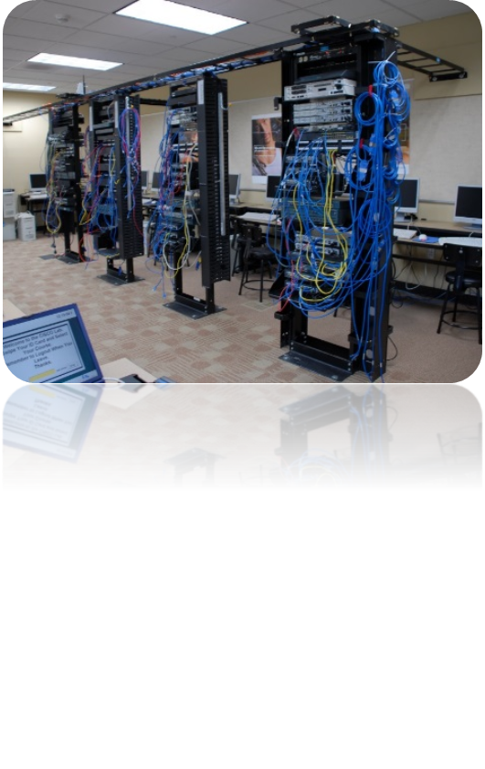


Computer Science & Information Systems
Associate Degrees & Certificates:
-Cybersecurity
-Information Technology Specialist
-Computer Programming
-Web Design
-Data Sciences
-Website Design
-PLCs
Median Salary: $100, 856
New Workers: $62, 849
Annual Job Openings: 6, 129
Computer System Analyst
ccc.emsicc.com
Campus log HERE
Notes:
Replace white box with partner logo (all-white, knocked out version preferred)

Slide 12
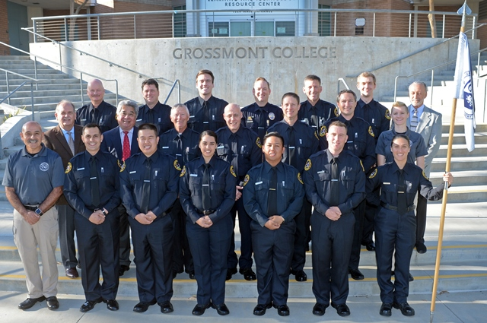
Administration of Justice
AOJ Department serves approximately 1,500 majors each semester with degrees and certificates in:
-Law Enforcement
-Corrections
-Forensic Technology
-Security Management
We also have state certified academies and courses including:
-Police Academy
-Corrections Academy
-Public Safety Dispatch
-Security Academy (spring semester only)
-PC 832 Laws of Arrest and Firearms
-Other POST Certified In-Service Training
Media Salary: $73, 067
New Workers: $31, 484
Annual Job Openings: 1,568
Criminal Justice
Law Enforcement Teachers
ccc.emsicc.com
Campus logo HERE
Notes:
Replace white box with partner logo (all-white, knocked out version preferred)

Slide 13

Business Marketing
Marketing consists of all the activities that direct the flow of goods and services from producer to consumer
Includes:-
Market research
Physical distribution
Wholesaling
Advertising
personal selling
Retailing
Media Salary: $132,889
New Workers: $69, 113
Annual Job Openings: 300
Marketing Manager
Communications and Marketing Specialist
Marketing Assistant
ccc.emsicc.com
Campus logo HERE
Notes:
Replace white box with partner logo (all-white, knocked out version preferred)

Slide 14


Business Office Technology
The BOT program will prepare you to become proficient in using computer software to perform a variety of essential administrative functions. Courses run the gamut from Business Office Correspondence and Office Professionalism to Comprehensive PowerPoint and Microsoft Publisher.
Median Salary: $64, 731
New Workers: $43, 433
Annual Job Openings: 613
Administrative Assistant
Medical Records Technician
ccc.emsicc.com
Campus logo HERE
Notes:
Replace white box with partner logo (all-white, knocked out version preferred)

Slide 15

Hospitality & Tourism Management
Provides students with a solid undergraduate program emphasizing basic business management principles and their specific application to the hospitality and tourism industry.
Associate Degree or Certificate of Achievement
Students completing the A.S. program are prepared to transfer to a Bachelor of Science program at a four-year institution
Media Salary: $31,866
New Workers: $24, 933
Annual Job Openings: 104
Concierges
Receptionists and Information Clerks
First-Line Supervisors
ccc.emsicc.com
Campus logo HERE
Notes:
Replace white box with partner logo (all-white, knocked out version preferred)

Slide 16
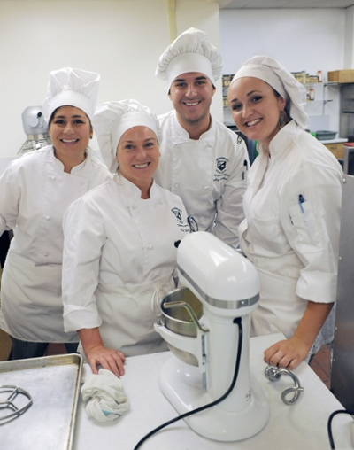

Culinary Arts
Associate Degree of Science
Culinary Arts
Baking
Pastry
Culinary Entrepreneurship
Certificates of Achievement:
Pastry Cook
Banquet Cook
Prep Cook
Line Cook
Media Salary: $47,541
New Workers: $36,251
Annual Job Openings: 245
Chefs and Head Cooks
ccc.emsicc.com
Campus logo HERE
Notes:
Replace white box with partner logo (all-white, knocked out version preferred)

Slide 17
International Business
The International Business program is designed to equip students with the necessary skills and expertise to move products across international borders. The program not only offers international business studies, but general business, culture and language as well.
This program will prepare students to enter into import and export activities. Many of these opportunities are with San Diego area businesses. The program also appeals to students planning to live and work in foreign countries. Furthermore, those students interested in starting their own import or export business have found the program particularly valuable. Internships can be arranged in some cases.
Media Salary: $46,799
New Workers: $29,954
Annual Job Openings: 1,878
Broker
Customs Broker
Freight Forwarder
Import-Export Agent
Import-Export Specialist
International Finance & Accounting
International Law
International Planning & Management
International Purchasing & Management
ccc.emsicc.com

Slide 18
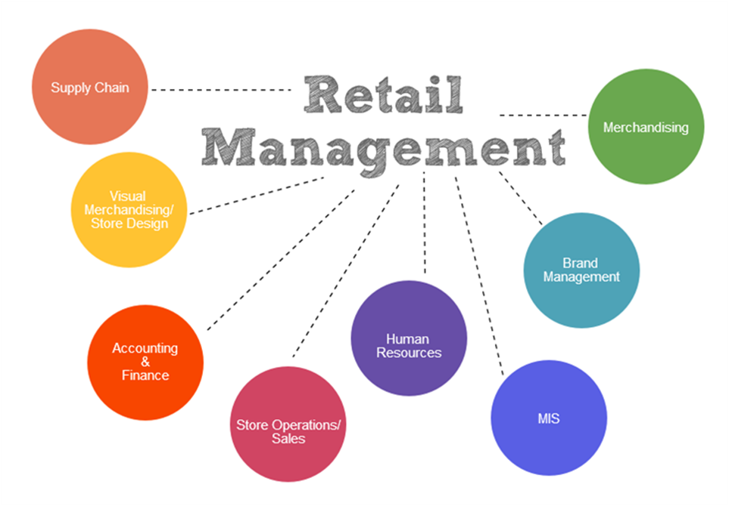
Retail Management
This program is designed to provide the foundation for advancement from entry level positions to management in retailing. Career opportunities are plentiful in food chains, department stores, specialized small and large retail outlets, and small stores.
Media Salary: $40,053
New Workers: $22,343
Annual Job Openings: 1,673
First-Line Supervisors
Merchandisers
ccc.emsicc.com
Campus logo HERE
Notes:
Replace white box with partner logo (all-white, knocked out version preferred)

Slide 19

Management
The management curriculum is designed to provide the student with the skills necessary for success as a manager in today's demanding organizational climate. The program is of benefit to the man or woman who aspires to a first-level or higher management position in any organization, including, business, government, or service organizations. Also, much of this curriculum is transferable to four-year institutions.
Media Salary: $75, 951
New Workers: $41,267
Annual Job Openings: 2,036
IT Service Manager
Loss Prevention Manager
ccc.emsicc.com
Campus logo HERE
Notes:
Replace white box with partner logo (all-white, knocked out version preferred)

Slide 20
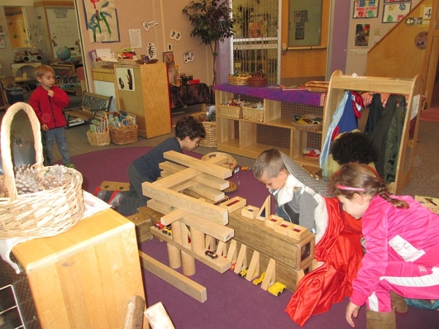
Child Development & Family Studies
Associate Degree and Certificate
Child Development offers certificates and associate degrees in the following areas: Associate Teacher (Certificate of Proficiency)
Child Development Master Teacher
Child Development Site Supervisor
Media Salary: $32,321
New Workers: $24,480
Annual Job Openings: 659
Preschool Teachers
Directors
Teachers Aid
ccc.emsicc.com
Campus logo HERE
Notes:
Replace white box with partner logo (all-white, knocked out version preferred)

Slide 21
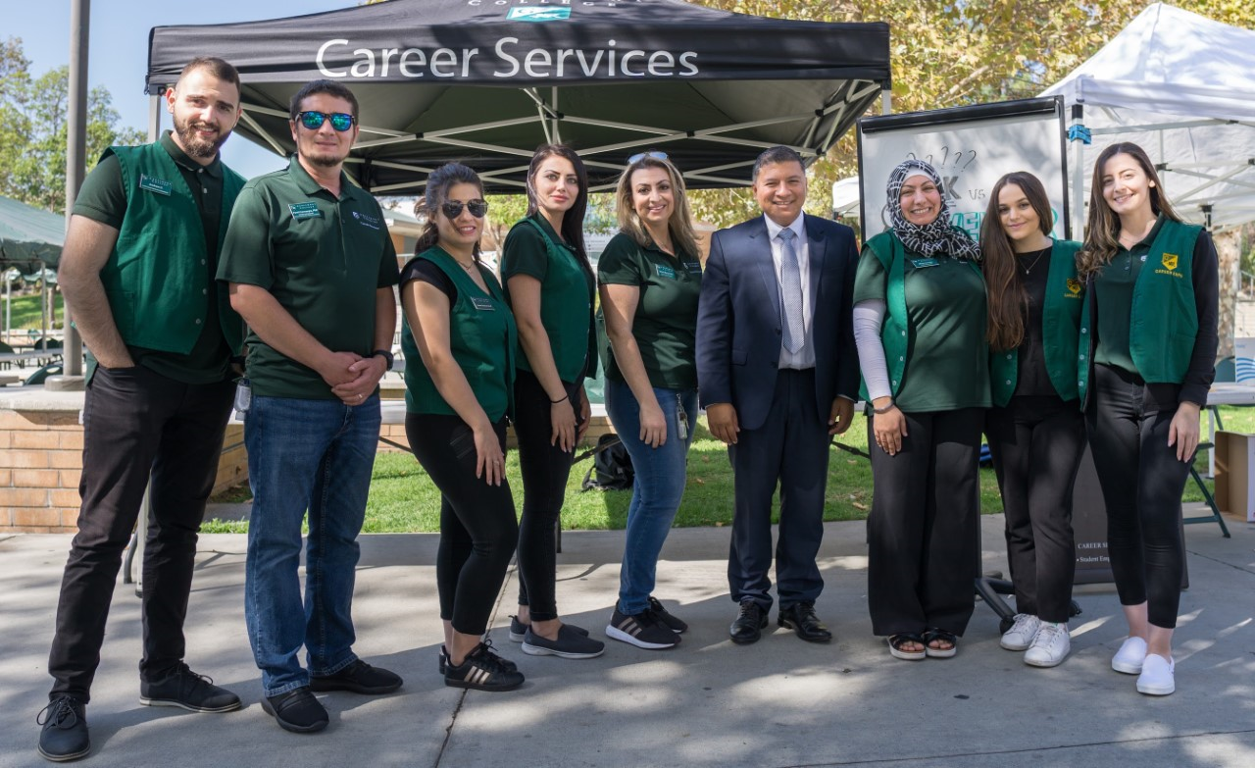
Career Services
Career Counseling
Career Assessments
Exploring Majors Workshops
Web Tools/Resources
Day in the Life
21st Century Skills Workshops
Job Readiness Training Academy Certificate
Online Job Board
Annual Career EXPO
Business Mixers
Hiring Events/On-Campus Recruitment
Career Ambassadors
Resume/Cover Letter Assistance
Mock Interviews
Your Grossmont College Career & Technical Education with Counseling and Career Center support gives you the education, training and tools you need to succeed.
Campus logo HERE
Notes:
Replace white box with partner logo (all-white, knocked out version preferred)

Slide 22
Dr. Javier Ayala
Javier.Ayala@gcccd.edu
Renee Nasori
Renee.Nasori@gcccd.edu
Erika Arangure
Erika.Arangure@gcccd.edu
Karl Cameron
Karl.Cameron@gcccd.edu
Campus Logo Here
Notes:
Replace white box with partner logo (all-white, knocked out version preferred)

Slide 23

CAREER EDUCATION
San Diego and
Imperial Counties
Notes:
Replace white box with partner logo

Slide 24
Southwestern College
Jennifer Lewis
Dean of Continuing Education and Workforce Development
Notes:
Replace white box with partner logo (all-white, knocked out version preferred)

Slide 25
Advanced Manufacturing
Programs Offered:
Computer Aided Design and Drafting (CADD)/Design Technology
Associates in Science
Certificates of Achievement
Certificates of Proficiency
Construction Inspection & Management
Associate in Science
Certificate of Achievement
Electronics Computer Technician
Certificate of Proficiency
Occupational Health and Safety
Associate in Science
Certificates of Achievement
Certificates of Proficiency
Career Opportunities:
Computer Aided Design and Drafting (CADD)/Design Technology
Mechanical Drafter $34.89
Construction Inspection & Management
Fire Inspector $43.23
Electronics Computer Technician
Computer Network Support Specialist $33.01
Information Security Specialist $46.84
Occupational Health and Safety
Occupational Health and Safety Technician $39.11
Notes:
Replace white box with partner logo (all-white, knocked out version preferred)

Slide 26
Advanced Transportation and Logistics
Programs Offered:
Automotive Technology
Associates in Science
Certificate of Achievement in Advanced Emission Specialist
Certificate of Achievement in Automotive Performance Systems
Certificate of Achievement in Automotive Technology
Certificate of Proficiency in Automotive Brake and Suspension Systems (ABS and Four-Wheel Alignment)
International Logistics and Transportation
Associates in Science
Certificates of Achievement
Career Opportunities:
Automotive Technology
Automotive Speciality Technician or Master Mechanic $21.80/hour
International Logistics and Transportation
Production, Planning, and Expediting Clerks $23.98/hour
Shipping/Receiving Supervisor, Terminal Operations Manager, Floor Supervisor $24.72/hour
Notes:
Replace white box with partner logo (all-white, knocked out version preferred)

Slide 27
Agriculture, Water, and Environmental Technologies
Programs Offered:
Environmental Management
Associate of Science
Certificate of Achievement
Floral Design
Associate in Science Degree
Certificate of Achievement
Landscape Architecture
Associate in Science
Certificate of Achievement
Career Opportunities:
Environmental Management
Environmental Compliance Inspector $27.32/hour
Environmental Engineering Technician $29.02/hour
Floral Design
Floral Designer $14.43/hour
Nursery Worker $12.22/hour
Landscape Architecture
Landscape Architect $45.76/hour
Soil and Water Conservationists $44.68/hour
Notes:
Replace white box with partner logo (all-white, knocked out version preferred)

Slide 28
Agriculture, Water, and Environmental Technologies cont.
Programs Offered:
Landscape/Nursery Occupations
Associate in Science Degree in Landscape Occupations
Associate in Science Degree in Retail Nursery and Plant Production
Associate in Science Degree in Golf & Turf Management
Certificate of Achievement in Golf & Turf Management
Certificate of Achievement in Landscape Occupations
Certificate of Achievement in Retail Nursery and Plant Production
Career Opportunities:
Landscape/Nursery Occupations
Soil and Plant Scientist $35.32/hour
Groundskeeping Workers $28.17/hour
Nursery and Greenhouse Manager $22.90/hour
Notes:
Replace white box with partner logo (all-white, knocked out version preferred)

Slide 29
Energy, Construction, and Utilities
Programs Offered:
Architecture
Associate in Science Degree
Certificate of Achievement
Construction Management
Associate in Science Degree
Certificate of Achievement
Construction Inspection
Associate in Science Degree
Certificate of Achievement
Career Opportunities:
Architecture
Extraction Worker $37.38/hour
Architectural Drafter $29.62/hour
Construction Management
Construction Manager $47.72/hour
Construction Inspection
Construction and Building Inspector $34.65/hour
Notes:
Replace white box with partner logo (all-white, knocked out version preferred)

Slide 30
Health
Programs Offered:
Central Service Technology
Certificate of Proficiency
Certified Nursing Assistant (CNA)
Certificate of Proficiency
Dental Hygiene
Associate of Science Degree in Dental Hygiene
Career Opportunities:
Central Service Technology
Medical Equipment Preparer $21.87/hour
Certified Nursing Assistant
Nursing Assistant $15.65/hour
Dental Hygiene
Dental Hygienist $ 48.25/hour
Notes:
Replace white box with partner logo (all-white, knocked out version preferred)

Slide 31
Health cont.
Programs Offered:
Emergency Medical Technology / Paramedic
Certificate of Emergency Medical Technology
Fitness Specialist
Certificate Of Proficiency, Fitness Specialist-Basic
Certificate of proficiency, Fitness Specialist-Advanced
Fitness Specialist Certification- Advanced- CT
Career Opportunities:
Emergency Medical Technology / Paramedic
First Responder $13.96/hour
Paramedic $22.91/hour
Fitness Specialist
Fitness and Wellness Coordinators $36.69/hour
Fitness Trainers $16.99/hour
Notes:
Replace white box with partner logo (all-white, knocked out version preferred)

Slide 32
Health cont.
Programs Offered:
Medical Assisting
Certificate of Achievement in Administrative Medical Assisting
Certificate of Achievement in Clinical Medical Assisting
Certificate of Achievement in Medical Insurance Billing and Coding
Medical Laboratory Technician
Associate of Science Degree in Medical Laboratory Technician
Nursing
Associate Degree in Nursing
Career Opportunities:
Medical Assisting
Medical Secretary $21.12/hour
Secretaries and Administrative Assistants $19.70/hour
Medical Laboratory Technician
Medical and Clinical Laboratory Technician $26.18/hour
Nursing
Critical Care Nurse $47.60/hour
Notes:
Replace white box with partner logo (all-white, knocked out version preferred)

Slide 33
Health cont.
Programs Offered:
Operating Room Nursing (ORN)
Certificate of Proficiency
Surgical Technology
Associate in Science Degree
Vocational Nursing
Associate in Science Degree
Certificate of Achievement
Career Opportunities:
Operating Room Nursing
Registered Nurse $47.60/hour
Surgical Technician
Surgical Technologist $28.81/hour
Medical Equipment Preparers $21.87/hour
Vocational Nursing
Licensed Practical and Licensed Vocational Nurse $27.29/hour
Notes:
Replace white box with partner logo (all-white, knocked out version preferred)

Slide 34
Information and Communication Technology (ICT) and Digital Media
Computer Information Systems
Programs Offered:
Computer Information Systems
Associate in Arts Degree in Information Systems
Associate in Science Degree in CIS: Computer Programming/Applications
Associate of Science Degree in CIS:eCommerce
Associate in Science Degree in CIS: Internet
Associate in Science Degree in CIS: Internetwork Technician
Associate in Science Degree in CIS: Microcomputer Applications
Associate in Science Degree in CIS: Microcomputer Office & Technical Support
Associate in Science Degree in CIS: Operations/PC Support Specialist
Associate in Science Degree in CIS: Systems Programming
Associate in Science Degree in CIS: Web and Gaming Animator
Associate in Science Degree in CIS: WebSite Designer and Developer
Associate in Science Degree in CIS: WebSite eCommerce Administrator
Career Opportunities:
Computer Information Systems
Computer Programmer $50.56/hour
Web Administrators $43.10/hour
Multimedia Arts and Animators $34.90/hour
Computer User Support Specialist $28.21/hour
Notes:
Replace white box with partner logo (all-white, knocked out version preferred)

Slide 35
Information and Communication Technology (ICT) and Digital Media Computer Information Systems cont.
Programs Offered:
Certificate of Achievement in CIS: Computer Programming/Applications
Certificate of Achievement in CIS: Internet Emphasis/Advanced
Certificate of Achievement in CIS: Systems Programming
Certificate of Achievement in CIS: Web & Gaming 2D/3D Animator
Certificate of Achievement in CIS: Web Search Engine Marketer
Certificate of Achievement in CIS: WebSite Designer & Developer
Certificate of Achievement in CIS: Web Shopping Cart Developer
Certificate of Proficiency in CIS: eCommerce
Certificate of Proficiency in CIS: Internet
Certificate of Proficiency in CIS: Internetwork Technician
Certificate of Proficiency in CIS: Microcomputer Applications
Certificate of Proficiency in CIS: Web Database Programmer/Administrator, LAMP
Certificate of Proficiency in CIS: Web Designer
Certificate of Proficiency in CIS: Web & Gaming Animator
Certificate of Proficiency in C++
Certificate of Proficiency in Project Management
Certificate of Proficiency in Social Media Marketer
Certificate of Proficiency in Software Quality Assurance
Career Opportunities:
Computer Information Systems
Software Developers, Applications $53.33/hour
Software Developer, Systems Software $55.13/hour
Computer Systems Analyst $44.77/hour
Database Administrator $48.47
Notes:
Replace white box with partner logo (all-white, knocked out version preferred)

Slide 36
Information and Communication Technology (ICT) and Digital Media Computer Information Systems cont.
Programs Offered:
Computer Science
Associate in Arts Degree in Computer Science
Associate in Science Degree in Computer Science
Associate in Science Degree in Computer Science (SB1440)
Certificate of Achievement in Computer Science
Drone Technology (Coming soon)
Graphic Design
Associate in Arts Degree: Graphic Design
Geospatial Technology Technician
Certificate of Achievement, Geospatial Technology Technician
Certificate of Proficiency in Geographic information Science
Career Opportunities:
Computer Science
Software Developers, Applications $53.33/hour
Software Developer, Systems Software $55.13/hour
Drone Technology (coming soon)
Graphic Design
Multimedia Artist and Animator $34.90/hour
Graphic Designer $26.04/hour
Art Director $49.45/hour
Geospatial Technology Technician
Geographic Information Systems Technician $43.18/hour
Surveying Technician $29.30/hour
Notes:
Replace white box with partner logo (all-white, knocked out version preferred)

Slide 37
Information and Communication Technology (ICT) and Digital Media Office Information Systems
Programs Offered:
Information Systems
Associate in Science Degree:OIS: Office Information Systems Professional
Associate in Science Degree: Virtual Business Office Professional
Certificate of Achievement: Office information Systems Professional -Advanced
Certificate of Achievement: Microsoft Office Specialist (MOS)- Advanced
Certificates of Achievement: Virtual Business Professional
Certificates of Achievement: Virtual Business Office Support Professional
Certificates of Proficiency: Office Information Systems Professional -Basic
Certificate of Proficiency: Microsoft Office Specialist (MOS)- Basic
Certificate of Proficiency: Microsoft Office Specialist (MOS) - Advanced
Office Information Systems Prof- Bilingual- Basic
Office Information Systems Prof- Bilingual- Adv
Office Information Systems Professional - Adv
Career Opportunities:
Information Systems
Executive Secretary and Executive Administrative Assistant $31.30/hour
Secretary and Administrative Assistant, Except Legal, Medical, and Executive $19.70/hour
Interpreter and Translator $30.03/hour
Notes:
Replace white box with partner logo (all-white, knocked out version preferred)

Slide 38
Information and Communication Technology (ICT) and Digital Media Visual Arts
Programs Offered:
Music – Commercial
Certificate of Proficiency
Photography and Digital Imaging
Associate in Arts Degree: Photography and Digital Imaging
Certificate of Achievement: Professional Photography
Project Management
Certificate of Proficiency
Career Opportunities:
Music – Commercial
Audio & Video Equipment Technician $20.28/hour
Sound Engineering Technician $19.16/hour
Radio And Television Announcer $24.76/hour
Photography and Digital Imaging
Photographer $19.00/hour
Multimedia Artist and Animator $34.90/hour
Photographic Process Worker $16.89/hour
Project Management
Information Technology Project Manager $43.18/hour
Notes:
Replace white box with partner logo (all-white, knocked out version preferred)

Slide 39
Information and Communication Technology (ICT) and Digital Media Visual Arts cont.
Programs offered:
Film, Television, and Media Arts
Associate in Arts Degree: Transfer Preparation
Associate in Science Degree: Production Specialist
Associate in Science Degree: Telemedia Technology
Certificate of Achievement: Telemedia Technology
Certificate of Achievement: Telemedia Production Specialist
Recording Arts & Technology
Associate in Science Degree
Certificate of Achievement
Virtual Business Professional (coming soon)
Career Opportunities:
Film, Television, and Media Arts
Camera Operator $26.92/hour
Film and Video Editor $ 23.43/hour
Producer & Director $26.53/hour
Recording Arts & Technology
Sound Engineering Technician $19.16/hour
Audio and Video Equipment Technician $20.28/hour
Broadcast Technician $19.19/hour
Virtual Business Professional (coming soon)
Notes:
Replace white box with partner logo (all-white, knocked out version preferred)

Slide 40
Life Sciences and Biotechnology
Programs Offered:
Biotechnology
Associate of Science Degree in Biotechnology
Certificate of Achievement in Biotechnology
Career Opportunities:
Biotechnology
Biological Technician $23.90/hour
Life, Physical, and Social Science Technician $27.32/hour
Notes:
Replace white box with partner logo (all-white, knocked out version preferred)

Slide 41
Business and Entrepreneurship
Programs Offered:
Accounting
Certificate of Achievement in Accounting
Associate in Arts Degree in Accounting
Associate in Science Degree in Accounting
Certificate of proficiency of Micro Technician Bookkeeper
Certificate of Proficiency for Payroll Clerk
Business Administration
Associate in Arts Degree: Business Administration
Career Opportunities:
Accounting
Bookkeeping, Accounting & Auditing Clerk $21.56/hour
Brokerage Clerk $27.32/hour
Billing, Cost & Rate Clerks $22.52/hour
Business Administration
General and Operations Manager $54.00/hour
Sales Manager $48.89/hour
Notes:
Replace white box with partner logo (all-white, knocked out version preferred)

Slide 42
Business and Entrepreneurship cont.
Programs Offered:
Business Management
Associate in Science Degree: Leadership and Supervision
Certificate of Achievement: Leadership and Supervision-Intermediate
Certificate of Proficiency: Leadership and Supervision-Basic
Community, Economic and Urban Development
Associate in Science Degree: Community, Econ & Urban Development
Certificate of Achievement: Community, Econ & Urban Development - Basic
Certificate of Achievement: Community, Econ & Urban Development - Intermediate
Career Opportunities:
Business Management
Industrial Production Manager $49.89/hour
Community, Economic and Urban Development
Administrative Services Manager $46.01/hour
Human Resources Assistant $21.22/hour
Notes:
Replace white box with partner logo (all-white, knocked out version preferred)

Slide 43
Business and Entrepreneurship cont.
Programs Offered:
Event and Convention Planning
Certificate of Proficiency in Event and Convention Planning- Basic
Certificate of Proficiency in Event and Convention Planning- Advanced
Insurance (coming soon)
Marketing
Associate in Arts
Paralegal
Associate in Science Degree in Paralegal Studies
Certificate of Achievement in Paralegal Studies
Associate in Science Degree in Paralegal Studies- Bilingual
Certificate of Achievement in Paralegal Studies- Bilingual
Career Opportunities:
Event and Convention Planning
Meeting, Convention and Event Planners $22.49/hour
Insurance (coming soon)
Marketing
Advertising and Promotions Manager $52.53/hour
Paralegal
Paralegal and Legal Assistant $32.67/hour
Legal Secretary $25.63/hour
Notes:
Replace white box with partner logo (all-white, knocked out version preferred)

Slide 44
Business and Entrepreneurship cont.
Programs Offered:
Real Estate
Associate in Arts Degree: Transfer Preparation - Real Estate
Associate in Science Degree: Career/Technical - Real Estate
Certificates of Achievement: Broker License
Certificate of Achievement: Real Estate
Certificate of Achievement: Salesperson License
Certificates of Proficiency: Real Estate
Travel and Tourism
Associate in Science degree: Career/Technical - Travel & Tourism
Certificate of Achievement: Travel & Tourism - Basic
Certificate of Achievement: Travel & Tourism - Advanced
Career Opportunities:
Real Estate
Property, Real Estate and Community Association Manager $30.13/hour
Real Estate Agent $24.37/hour
Travel and Tourism
Travel Agent $23.91/hour
Ticket Agent and Travel Clerk $19.67/hour
Notes:
Replace white box with partner logo (all-white, knocked out version preferred)

Slide 45
Global Trade
Programs Offered:
Business Administration - International Business Emphasis
  Associates in Arts
International Logistics and Transportation
  Associates in Science
  Certificates of Achievement
Career Opportunities:
Business Administration
Production, Planning, and Expediting Clerks $23.98/hour
International Logistics and Transportation
Cargo and Freight Agents $20.52/hour
Shipping/Receiving Supervisor, Terminal Operations Manager, Floor Supervisor $24.72/hour
Notes:
Replace white box with partner logo (all-white, knocked out version preferred)

Slide 46
Other Sectors - Culinary Arts
Programs Offered:
Culinary Arts
Associate in Science Degree in Culinary Arts, Cooking & Baking
Certificate of Achievement in Culinary Arts, Cooking & Baking, Advanced
Certificate of Achievement in Culinary Arts, Professional Baking Baking
Certificate of proficiency in Culinary Arts, Cooking Essentials, Baking
Career Opportunities:
Culinary Arts
Chef & Head Cook $24.18/hour
Food Service Manager $28.10/hour
Bakers $13.36/hour
Notes:
Replace white box with partner logo (all-white, knocked out version preferred)

Slide 47
Other Sectors - Hospitality and Tourism
Programs Offered:
Hospitality and Tourism
Associate in Science Degree: Event and Convention Mgt.
Associate in Science Degree: Hotel Operations Mgt.
Associate in Science Degree: Travel and Tourism Mgt.
Certificate of Achievement: Event and Convention Management-Basic or Advanced
Certificate of Achievement: Hotel Operations Management-Basic or Advanced
Certificate of Achievement: Travel and Tourism Management-Basic
Certificate of Achievement: Travel and Tourism Management-Advanced
Career Opportunities:
Hospitality and Tourism
Meeting Convention and Event Planners $22.49/hour
Food Service Manager $28.10/hour
Lodging Managers $35.56/hour
Notes:
Replace white box with partner logo (all-white, knocked out version preferred)

Slide 48
Other Sectors - Child Development/Family Studies
Programs Offered:
Child Development/Family Studies
Associate in Arts Degree in Child and Adolescent Development
Associate in Arts Degree in Child Development
Certificate of Proficiency Spanish-to-English Associate Teacher Certificate
Elementary Teacher Education
Associate in Arts Degree Elementary Teacher Education
Certificate of Achievement Teacher Education Preparation
Career Opportunities:
Child Development/Family Studies
Child Care Worker $12.64/hour
Preschool Teacher, except Special Education $15.16/hour
Elementary Teacher Education
Elementary School Teacher, except Special Education $34.03/hour
Notes:
Replace white box with partner logo (all-white, knocked out version preferred)

Slide 49
Other Sectors - Public Safety (Fire/Police)
Programs Offered:
Fire Science
Associate in Science Degree
Certificate of Achievement
Law Enforcement Training Academy
Certificate of Proficiency Law Enforcement Training Academy
Career Opportunities:
Fire Science
Prevention Supervisor $54.01/hour
Forest Firefighter $32.36/hour
Municipal Firefighter $32.36/hour
Law Enforcement Training Academy
Sheriffs and Deputy Sheriffs $44.15/hour
Police Patrol Officer $44.15/hour
Private Detective and Criminal Investigator $34.73/hour
Notes:
Replace white box with partner logo (all-white, knocked out version preferred)

Slide 50
Other Sectors - Administration of Justice
Programs Offered:
Administration of Justice
Associate in Science Degree in Administration of Justice
Associate in Arts Degree in Criminal Justice
Associate Degree in Administration of Justice, Corrections Emphasis
Associate in Arts Degree in Administration of Justice, Law Enforcement Emphasis
Associate in Arts Degree in Administration of Justice, Crime Scene investigator
Certificate of Achievement, Crime Scene Investigator
Cyber Security (Coming Soon)
Career Opportunities:
Administration of Justice
Police Detective $45.61/hour
Correctional Officer and Jailer $34.46/hour
Forensic Science Technician $35.09/hour
Cyber Security (Coming Soon)
Notes:
Replace white box with partner logo (all-white, knocked out version preferred)

Slide 51
Jennifer Lewis
Dean of Continuing Education and Workforce Development
Email| jlewis2@swccd.edu
Phone| 619-482-6375
Southwestern College
900 Otay Lakes Road
Chula Vista, Ca 91910
Website| www.swccd.edu
Notes:
Replace white box with partner logo (all-white, knocked out version preferred)

Slide 52
CAREER EDUCATION
San Diego and
Imperial Counties
Notes:
Replace white box with partner logo

Slide 53
Imperial Valley College
Dean Efrain Silva
Notes:
Replace white box with partner logo (all-white, knocked out version preferred)

Slide 54
Advanced Manufacturing
Welding Technology, AS (60 units), CERT (21units)
Diesel Farm Machinery and Heavy Equipment, CERT (20units)
Machinists
Industrial Machinery Mechanics $17.38 $28.57
Welders, Cutters, Solderers, and Brazers
$15.95 $18.74
Bus and Truck Mechanics and Diesel Engine Specialists
Farm Equipment Mechanics and Service Technicians Operating Engineers and Other Construction
Equipment Operators $16.72 $23.15
Notes:
Replace white box with partner logo (all-white, knocked out version preferred)

Slide 55
Advanced Transportation and Logistics
Automotive Technology, AS (60 units), CERT (39 units)
Automotive Technology: Brakes, Suspension and steering specialization, CERT (20 units)
Automotive Technology: Electrical/Electronic and Air Conditioning Specialization, CERT (18 units)
Automotive Technology: Engine Performance and Drivability Specialization, CERT (22 units)
Automotive Technology: Engine Repair and Machinist Specialization, CERT (22 units)
Automotive Technology: Transmission and Power Train Specialization, CERT (20 units)
Automotive Body and Related Repairers
$13.40
Production, Planning, and Expediting Clerks First-Line Supervisors of Helpers, Laborers, $18.88
Material Movers, Hand $24.75
First-Line Supervisors of Transportation and Material-
Moving Machine $26.49
First-Line Supervisors of Mechanics, Installers,
and Repairers $36.64
Vehicle Operators Industrial Production Managers $42.15
Notes:
Replace white box with partner logo (all-white, knocked out version preferred)

Slide 56
Agriculture, Water, and Environmental Technologies
Agriculture Business for Transfer, AS-T (22-30 major units and 30-39 transferrable units)
Agriculture Business Management, CERT (18-19 units)
Agriculture Plant Science for Transfer, AS-T (21-28 major units and 37-39 transferrable units)
Agriculture Plant Science, AS (60 units), CERT (19 units)
Water Treatment Systems Technology, AS (60 units), CERT (18 units)
Water Treatment Systems Technology: Wastewater Treatment Specialization, CERT (12 units)
First-Line Supervisors of Farming, Fishing, and Forestry Workers $14.49
First-Line Supervisors of Landscaping, Lawn 81 Service, and Groundskeeping Workers
$15.87
Pesticide Handlers, Sprayers, and Applicators, Vegetation
$17.88
Forest and Conservation Technicians
$17.97
Water and Wastewater Treatment Plant 98 and System Operators
$29.04
Notes:
Replace white box with partner logo (all-white, knocked out version preferred)

Slide 57
Energy, Construction, and Utilities
Air Conditioning and Refrigeration, AS (60 units), CERT (17 units)
Alternative Energy-Solar Technology, CERT (22 units)
Apprenticeship-Control Operator, CERT (32 units)
Apprenticeship-Electrician, AS (60 units), CERT (32 units)
Apprenticeship-Generation Mechanic, AS (60 units), CERT (32 units)
Apprenticeship-Hydro Operator, CERT (32 units)
Heating, Air Conditioning, and Refrigeration
Mechanics and Installers $20.75
Electrical Power-Line Installers and Repairers
$39.73
Electrical and Electronics Repairers,
Powerhouse, Substation, and Relay $37.69
Notes:
Replace white box with partner logo (all-white, knocked out version preferred)

Slide 58
Energy, Construction, and Utilities Cont.
Apprenticeship-Instrument Technician, CERT (32 units)
Apprenticeship-Meter Technician, AS (60 units), CERT (32 units)
Apprenticeship-Power Lineman, AS (60 units), CERT (32 units)
Apprenticeship-Relays Technician, AS (60 units), CERT (32 units)
Apprenticeship- SCADA/Telecommunication Technician, AS (60 units), CERT (32 units)
Apprenticeship-Substation-Electrician, AS (60 units), CERT (32 units)
Apprenticeship-Telecommunications Technician, CERT (32 units)
Operating Engineers and Other Construction
Equipment Operators $23.15
Telecommunications Equipment Installers $21.12
and Repairers, Except Line Installers
Power Plant Operators $35.12
Notes:
Replace white box with partner logo (all-white, knocked out version preferred)

Slide 59
Energy, Construction, and Utilities Cont.
Building Construction Technology, AS (60 units), CERT (25 units)
Building Construction Technology-Carpentry Specialization, CERT (25 units)
Building Construction Technology-Concrete Masonry Specialization, CERT (25 units)
Electrical Technology, AS (60 units), CERT (20 units)
Electrical Technology: Electrical Wiring Specialization, CERT (20 units)
Electrical Trades, AS (60 units), CERT (16 units)
Electricians $30.01
Carpenters $15.49
First-Line Supervisors of Construction Trades
and Extraction Workers $31.45
Industrial Machinery Mechanics $28.57
Plumbers, Pipefitters, and Steamfitters $21.12
Construction Managers $23.59
Notes:
Replace white box with partner logo (all-white, knocked out version preferred)

Slide 60
Health
Medical Assisting, AS (60 units), CERT (26.5 units)
Emergency Medical Services, AS (60 units), CERT (39.5 units)
Nursing RN, AS (60 units)
Nursing VN, AS (60 units), CERT (37 units)
Pharmacy Technician, AS (60 units), CERT (18.5 units)
Registered Nurses $38.86
Medical Assistants $13.94
Medical Secretaries $14.81
Nursing Assistants $13.63
Licensed Practical and Licensed Vocational
Nurses $26.71
Pharmacy Technicians $18.26
Emergency Medical Technicians
and Paramedics $18.53
Medical Records and Health Information
Technicians $15.03
Phlebotomists $17.28
Healthcare Support Workers, All Other $15.61
Notes:
Replace white box with partner logo (all-white, knocked out version preferred)

Slide 61
Information and Communication Technology (ICT)
and Digital Media
Computer & Information Systems, AS (60 units)
Computer Science for Transfer, AS (60 units)
Digital Design and Production, AS (60 units), CERT (22-23 units)
Studio Arts for Transfer, AS-T (24 major units and 37-39 transferrable units)
Graphic Designers $18.41
Network and Computer Systems
Administrators $35.23
Computer Network Support Specialists $32.45
Computer operations all other $35.31
Computer User Support Specialists $21.88
Notes:
Replace white box with partner logo (all-white, knocked out version preferred)

Slide 62
Life Sciences and Biotechnology
Addiction Disorders Studies, AS (60 units), CERT (36 units)
Behavioral Science, AA (60 units)
Social and Human Service Assistants $21.97
Training and Development Specialists $23.33
Community Health Workers $22.35
First-Line Supervisors of Personal
Service Workers $17.34
Notes:
Replace white box with partner logo (all-white, knocked out version preferred)

Slide 63
Business and Entrepreneurship
Business Accounting Technician, AS (60 units), CERT (28 units)
Business Administration for Transfer, AS-T (26-27 major units and 37-39 transferrable units)
Business Administrative Assistant, AS (60 units), CERT (26 units)
Business Management, AS (60 units), CERT (25 units)
Business Office Technician, AS (60 units), CERT (26 units)
Cisco CCNA Discovery, CERT (14-17 units)
Payroll and Timekeeping Clerks Bookkeeping, Accounting, and Auditing Clerks $16.61
Tellers
Loan Interviewers and Clerks $16.17
Management Development and Supervision $27.10
Marketing and Distribution $29.38
Data Entry Keyers $14.94
Secretaries and Administrative Assistants, Except
Legal, Medical, and Executive $18.15
Executive Secretaries and Executive Administrative
Assistants $28.42
Office Management $37.75
Notes:
Replace white box with partner logo (all-white, knocked out version preferred)

Slide 64
Other Sectors (please limit to ONE slide)
Child Development, AS (60 units)
Child Development- Administration Specialization, CERT (39-49units)
Child Development Associate Teacher, CERT (16 units)
Child Development- Children with Special Needs, CERT (36-37 units)
Child Development- Infant/Toddler Specialization, CERT (36-37 units)
Early Childhood Education for Transfer, AS-T (25 major units and 37-39 transferrable units)
Kinesiology for Transfer, AA-T (21-23 major units and 37-39 transferrable units)
Preschool Teachers, Except Special Education $16.90
Fitness Trainers and Aerobics Instructors $18.76
Notes:
Replace white box with partner logo (all-white, knocked out version preferred)

Slide 65
Efrain Silva
Dean of Economic and Workforce Development
Notes:
Replace white box with partner logo (all-white, knocked out version preferred)

Slide 66

CAREER EDUCATION
San Diego and
Imperial Counties
Notes:
Replace white box with partner logo

Slide 67
San Diego Continuing Education, Michelle Gray
Campus Logo Here
Notes:
Replace white box with partner logo (all-white, knocked out version preferred)

Slide 68
Advanced Manufacturing
Programs offered
Upholstery
Shielded Metal Arc Welding
Gas Metal and Flux Cored Arc Welding
Pipe Welding
Metal Fabrication I and II
Structural Welding Program
Gas Tungsten Arc Welding
Career opportunities (include median wage/salary) and connection to in-demand jobs
Welding, Soldering, and Brazing Machine Setters, Operators, and Tenders ($24/hr.)
Welders, Cutters, Solderers, and Brazers ($23/hr.)
Upholsterers ($20/hr.)
Notes:
Replace white box with partner logo (all-white, knocked out version preferred)

Slide 69
Advanced Transportation and Logistics
Programs offered
Auto Body and Paint Technician
Brake/Suspension & Light Service Technician Program
Quick Service Inspection Technician
Auto Technician
Service Advisor
Career opportunities (include median wage/salary) and connection to in-demand jobs
Automotive Service Technicians ($20/hr.)
Automotive Body Repairer ($18/hr.)
Service advisor ($19.50/hr.)
Campus logo HERE
Notes:
Replace white box with partner logo (all-white, knocked out version preferred)

Slide 70
Energy, Construction, and Utilities
Programs offered
Electronics Technician
Air Conditioning and Heating I
Air Conditioning and Heating II
Plumbing I
Plumbing II
Plumbing III
Career opportunities (include median wage/salary) and connection to in-demand jobs
Electrical and Electronic Repairers ($31/hr.)
Heating, Air Conditioning, and Refrigeration Mechanics and Installers ($27/hr.)
Plumber ($17/hr.)
Campus logo HERE
Notes:
Replace white box with partner logo (all-white, knocked out version preferred)

Slide 71
Health
Programs offered
Personal Care Assistant/Caregiver
Nursing Assistant Training
Nurse Assistant (Rehabilitative)
Nurse Assistant (Acute Care)
Behavioral Health Aide
Health Unit Coordinator
Career opportunities (include median wage/salary) and connection to in-demand jobs
Certified Nurse Assistant ($16/hr.)
Home Health Aide ($14/hr.)
Medical Secretaries ($21/hr.)
Campus logo HERE
Notes:
Replace white box with partner logo (all-white, knocked out version preferred)

Slide 72
Information and Communication Technology (ICT)
and Digital Media
Programs offered
Mobile Application Development Program
Desktop Technician
Network Technician (CCENT)
CCNA Routing and Switching
CCNA Security/Network Security Specialist
Windows System Administration
Server Essentials
Linux Server Administration
Web Server Technologies and Applications
Web Server Program
Virtual Datacenter
Security Essentials
Cybersecurity Analyst
Python Programming
Digital Media & Vector Graphics
Front End Web Developer I Program
Front End Web Developer II Program
Career opportunities (include median wage/salary) and connection to in-demand jobs
Desktop Support Specialists ($28/hr.)
Network Support Specialists ($33/hr.)
Network Security & Cyber Administrator ($45 - $75/hr.)
Web Developers ($26/hr.)
Campus logo HERE
Notes:
Replace white box with partner logo (all-white, knocked out version preferred)

Slide 73
Business and Entrepreneurship
Programs offered
Business Information Worker 1 Program
Business Information Worker 2 Program
Business Information Worker 3 Program
Administrative Assistant
Account Clerk
Small Business Planning
Small Business Growth
Project Management
Career opportunities (include median wage/salary) and connection to in-demand jobs
Administrative Assistants & Customer Service Specialist ($20/hr.)
Bookkeeping, Accounting, and Auditing ($22/hr.)
Business Operations Specialists ($37/hr.)
Business Ownership ($40 - $150 Hr)
Project Managers ($50/hr.)
Campus logo HERE
Notes:
Replace white box with partner logo (all-white, knocked out version preferred)

Slide 74
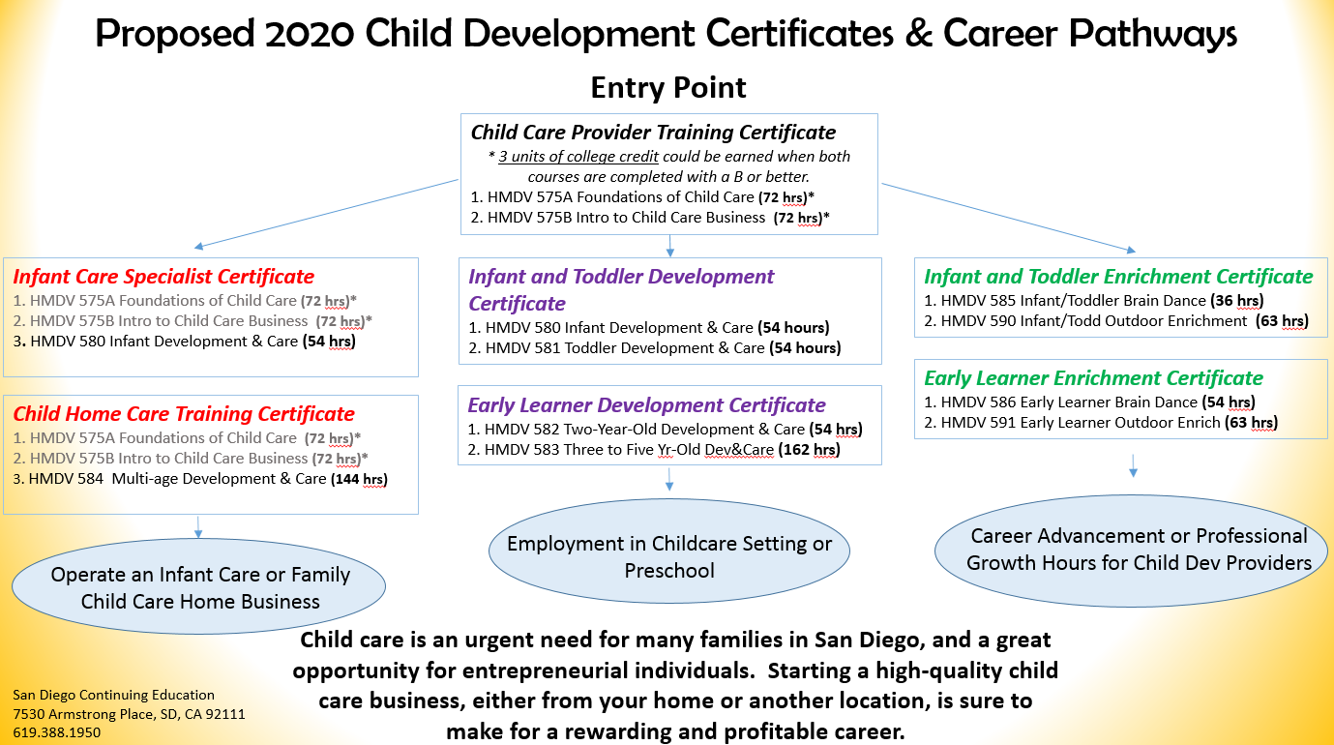
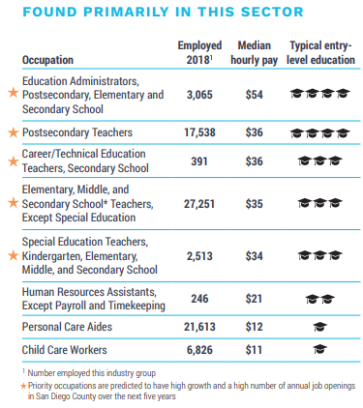

Education & Human Development
Programs offered (include certificate or degree and # of units to complete)
Campus logo HERE
Notes:
Replace white box with partner logo (all-white, knocked out version preferred)

Slide 75
Other Sectors
Programs offered
Child Development 1 Program
Child Development 2 Program
Culinary Arts Advanced Program
Culinary Arts & Sciences Program
Culinary Arts Program
Professional Bakeshop Skills Program
Clothing Construction Program
Fashion Retail Business Program
Sewn Product Business Program
Career opportunities (include median wage/salary) and connection to in-demand jobs
Childcare Workers ($12/hr.)
Chefs and Head cooks ($23/hr.)
Supervisors of Food Preparation Workers ($17/hr.)
Clothing Production Worker ($19/hr.)
Fabric and Apparel Patternmaker ($29/hr.)
Campus logo HERE
Notes:
Replace white box with partner logo (all-white, knocked out version preferred)

Slide 76
Michelle Gray
Dean, Business and Information Technology
& Distance Education
San Diego Continuing Education | SDCCD
North City Campus
619.388.1800
Campus Logo Here
Notes:
Replace white box with partner logo (all-white, knocked out version preferred)

Slide 77

LEARN MORE.
EARN MORE.
WITH CAREER EDUCATION.
Visit: mycareer-education
/mycareered
Notes:
Replace white box with partner logo (all-white, knocked out version preferred)

