Slide 1

CAREER EDUCATION
San Diego and
Imperial Counties
Notes:
Replace white box with partner logo

Slide 2
Palomar College
Dr. Glyn Bongolan,
Counseling Department Chair
Notes:
Replace white box with partner logo (all-white, knocked out version preferred)

Slide 3
Advanced Manufacturing
Apprenticeship-Carpentry C.A./A.S.
Apprenticeship-Drywall/Lather C.A./A.S.
Apprenticeship-Inside Wireman C.A./A.S.
Apprenticeship-Plasterer C.P.
Apprenticeship-Sheet Metal C.A./A.S.
Cabinetmaking and Millwork C.A./A.S.
Carving Technology C.A./A.S.
Case Furniture Construction/Manufacturing C.A./A.S.
Guitar Making Technology C.A./A.S.
Lathe Turning Technology C.A./A.S.
Table and Chair Manufacturing C.A./A.S.
Veneering Technology C.A./A.S.
Woodworking Fundamentals C.A./A.S.
Woodworking Skills Technology C.A./A.S.
Construction Inspection C.A./A.S.
Computer Assisted Drafting C.A./A.S.
Drafting Technology: Multimedia C.A./A.S.
Drafting Technology: Technical C.A./A.S.
Electro-Mechanical Drafting and Design C.A./A.S.
Fashion Design C.A./A.S.
Advanced Geographic Information Systems C.A./A.S.
Geographic Information Systems C.P.
Unmanned Aircraft Systems (UAS) Technician C.P.
Foundations in Technical Careers C.P.
Public Works Management - Level I C.P.
Public Works Management - Level II C.A./A.S.
Entry-Level Gas Metal/Flux Cored Arc Weld C.P.
Entry-Level Gas Tungsten Arc Welding C.P.
Entry-Level Shielded Metal Arc Welding C.P.
Welding Technology C.A./A.S.
Campus logo HERE
Notes:
Replace white box with partner logo (all-white, knocked out version preferred)

Slide 4
Advanced Manufacturing
Program
Apprenticeship-Carpentry C.A./A.S.
Apprenticeship-Inside Wireman C.A./A.S.
Electro-Mechanical Drafting and Design C.A./A.S.
Fashion Design C.A./A.S.
Geographic Information Systems C.P.
Public Works Management - Level II C.A./A.S.
Welding Technology C.A./A.S.
Units Median Salary Annual Job Openings
28 $46, 755 1,439
56 $57,987 1,145
27 $70,764 61
27 $68,762 25
14 $88,510 717
33 $110,568 * 2,286 *
30 $48,261 452
Campus logo HERE
Notes:
Replace white box with partner logo (all-white, knocked out version preferred)

Slide 5
Advanced Transportation and Logistics
Program
Apprenticeship-Inside Wireman, Intelligent Transport C.A./A.S.
Auto Chassis and Drive Lines C.A./A.S.
Auto Collision Repair C.A./A.S.
Electronic Tune-Up and Computer Control Systems C.A./A.S.
Mechanics-General C.A./A.S.
Diesel Technology C.A./A.S.
Units Median Salary Annual Job Openings
48 $57,497 11
23 $42,054 803
21 $37,695 156
30 $44,723 20
29 $42,054 803
32 $52,034 259
Campus logo HERE
Notes:
Replace white box with partner logo (all-white, knocked out version preferred)

Slide 6
Agriculture, Water, and Environmental Technologies
Program
Water Technology Education C.A./A.S.
Wastewater Technology Education C.A./A.S.
Units Median Salary Annual Job Openings
30 $96,354 76
27 $96,354 76
Campus logo HERE
Notes:
Replace white box with partner logo (all-white, knocked out version preferred)

Slide 7
Energy, Construction, and Utilities
Air Conditioning/Heating/Refrigeration A.S.
Apprenticeship-Acoustical Installer C.A./A.S.
Apprenticeship-Carpentry C.A./A.S.
Apprenticeship-Drywall/Lather C.A./A.S.
Apprenticeship-Inside Wireman C.A./A.S.
Apprenticeship-Plasterer C.A./A.S.
Apprenticeship-Sound Technician C.A./A.S.
Apprenticeship-Sheet Metal C.A./A.S.
Architecture C.A./A.S.
Architectural Drafting C.A./A.S.
Eco-Building Professional C.A./A.S.
Construction Inspection C.A./A.S.
Computer Assisted Drafting C.A./A.S.
Drafting Technology: Multimedia C.A./A.S.
Drafting Technology: Technical C.A./A.S.
Electro-Mechanical Drafting and Design C.A./A.S.
Foundations in Technical Careers C.P.
Public Works Management - Level I C.P.
Public Works Management - Level II C.A./A.S.
Water Technology Education C.A./A.S.
Wastewater Technology Education C.A./A.S.
Entry-Level Gas Metal/Flux Cored Arc Weld C.P.
Entry-Level Gas Tungsten Arc Welding C.P.
Entry-Level Shielded Metal Arc Welding C.P.
Welding Technology C.A./A.S.
Campus logo HERE
Notes:
Replace white box with partner logo (all-white, knocked out version preferred)

Slide 8
Energy, Construction, and Utilities
Program
Air Conditioning/Heating/Refrigeration C.A./A.S.
Apprenticeship-Plasterer C.A./A.S.
Apprenticeship-Sound Technician C.A./A.S.
Architectural Drafting C.A./A.S.
Units Median Salary Annual Job Openings
16 $54,681 348
26 $68,918 164
48 $49,126 23
24 $60,379 156
Campus logo HERE
Notes:
Replace white box with partner logo (all-white, knocked out version preferred)

Slide 9
Health
Programs
Alcohol and Other Drug Studies C.A./A.S.
Medical Office Specialist C.A./A.S.
Registered Dental Assisting C.A./A.S.
EMT Basic C.P.
Paramedic Training C.A./A.S.
Adult Fitness and Health C.A./A.S.
Nursing A.S.
Nursing (LVN-RN) A.S.
Units Median Salary Annual Job Openings
38 $44,004 393
19 $43,596 1,219
37 $38,552 689
10.5 $29,328 155
44 $29,328 155
34 $38,255 1,126
77 $98,248 2,123
59 $98,248 2,123
Campus logo HERE
Notes:
Replace white box with partner logo (all-white, knocked out version preferred)

Slide 10
Information and Communication Technology (ICT)
and Digital Media
Graphic Design A.S.
Illustration C.A./A.S.
Administrative Assistant C.A./A.S.
Business Information Worker C.P.
E-Marketing C.A./A.S.
Medical Office Specialist C.A./A.S.
Retail Management C.P.
Social Media C.P.
Cinema C.A./A.S.
Computer Science with Emphasis in Video Gaming C.A./A.S.
Video Game Developer C.P.
Computer Information Systems C.A./A.S.
Information Technology C.A./A.S.
Management Information Systems C.A./A.S.
Computer Network Administration with Emphasis: Cisco, Linux, Microsoft C.A./A.S.
Web Developer with Emphasis in Java/Open Source, Windows
Broadcast Journalism C.P.
Digital Media C.P.
Digital Video C.A./A.S.
Entertainment Technology C.P.
Radio and Television C.A./A.S.
Advanced Geographic Information Systems C.A./A.S.
Geographic Information Systems C.P.
Unmanned Aircraft Systems (UAS) Technician C.P.
Digital Imaging C.A./A.S.
Digital Prepress Operator C.P.
Electronic Publisher C.P.
Graphic Communications: Emphasis in Digital Distribution C.A./A.S.
Graphic Communications: Emphasis in Management C.A./A.S.
Graphic Communications: Emphasis in Production C.A./A.S.
Screen Printer C.P.
Screen Printing C.A./A.S.
Campus logo HERE
Notes:
Replace white box with partner logo (all-white, knocked out version preferred)

Slide 11
Information and Communication Technology (ICT)
and Digital Media
Digital Animation, Compositing, and Music C.P.
Digital Media C.P.
Digital Video C.A./A.S.
E-Commerce Design C.P.
Interactive Media Design: Emphasis in 3D Modeling and Animation C.A./A.S.
Interactive Media Design: Emphasis in Multimedia Design C.A./A.S.
Interactive Web Multimedia and Audio C.A./A.S.
Internet: Graphic Communication Emphasis C.A./A.S.
New Media Compositing, Authoring, and Distribution C.A./A.S.
Web Data Base Design C.P.
Foundations in Technical Careers C.P.
Multimedia Journalism C.A./A.S.
Library and Information Technology C.A./A.S.
Alternative Process Photography C.P.
Commercial Photography Certificate C.P.
Fine Art Traditional Photography C.P.
Photography C.A./A.S.
Drone Technology C.A./A.S.
Campus logo HERE
Notes:
Replace white box with partner logo (all-white, knocked out version preferred)

Slide 12
Information and Communication Technology (ICT)
and Digital Media
Program
Graphic Design
Retail ManagemenC.A./A.S.t C.P.
Computer Science with Emphasis in Video Gaming C.A./A.S.
Management Information Systems C.A./A.S.
Computer Network Administration, Emphasis: Cisco C.A./A.S.
Web Design and Development C.A./A.S.
Broadcast Journalism C.P.
Digital Media C.P.
Digital Video C.A./A.S.
Library and Information Technology C.A./A.S.
Commercial Photography Certificate C.P.
Units Median Salary Annual Job Openings
37 $51,757 371
25 $40.053 1,673
31 $88,510 717
38 $100,121 86
28 $68,550 139
28 $54,581 227
15 $71,154 9
15 $55,632 51
30 $55,455 30
25 $42,995 183
15 $45,594 193
Campus logo HERE
Notes:
Replace white box with partner logo (all-white, knocked out version preferred)

Slide 13
Life Sciences and Biotechnology
Program
Biology (C.S./A.S.)
Units Median Salary Annual Job Openings
39 $81,392 207
Campus logo HERE
Notes:
Replace white box with partner logo (all-white, knocked out version preferred)

Slide 14
Business and Entrepreneurship
Business Management C.A./A.S.
Advertising, Marketing, and Merchandising C.A./A.S.
Business: General C.A./A.S.
E-Marketing C.A./A.S.
Medical Office Specialist C.A./A.S.
Retail Management C.P.
Child and Family Services C.A./A.S.
Public Relations C.P.
Fashion Design C.A./A.S.
Fashion Merchandising C.A./A.S.
Fashion: Buying and Management C.A./A.S.
Visual Merchandising C.A./A.S.
Interior Design C.A./A.S.
Real Estate Appraisal License Preparation C.P.
Real Estate Broker License Preparation C.A./A.S.
Real Estate Salesperson License Preparation C.P.
Campus logo HERE
Notes:
Replace white box with partner logo (all-white, knocked out version preferred)

Slide 15
Business and Entrepreneurship
Program
Preschool Teacher C.A./A.S.
Public Relations C.P.
Visual Merchandising C.A./A.S.
Interior Design C.A./A.S.
Real Estate Broker License Preparation C.A./A.S.
Units Median Salary Annual Job Openings
40 $32,321 659
15 $68,172 278
33 $30,243 104
30 $55,492 165
28 $67,599 218
Campus logo HERE
Notes:
Replace white box with partner logo (all-white, knocked out version preferred)

Slide 16
Global Trade
Program
International Business C.A./A.S.
Units Median Salary Annual Job Openings
37 $132,889 300
Campus logo HERE
Notes:
Replace white box with partner logo (all-white, knocked out version preferred)

Slide 17
Dr. Glyn Bongolan
Counseling Department Chair
(760) 744-1150 x3636
gbongolan@palomar.edu
Campus Logo Here
Notes:
Replace white box with partner logo (all-white, knocked out version preferred)

Slide 18

CAREER EDUCATION
MiraCosta College
Notes:
Replace white box with partner logo

Slide 19

MiraCosta College
Zhenya Lindstrom
Associate Dean, Career Education
Notes:
Replace white box with partner logo (all-white, knocked out version preferred)

Slide 20

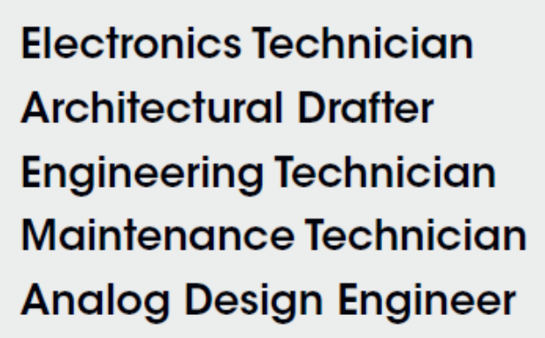
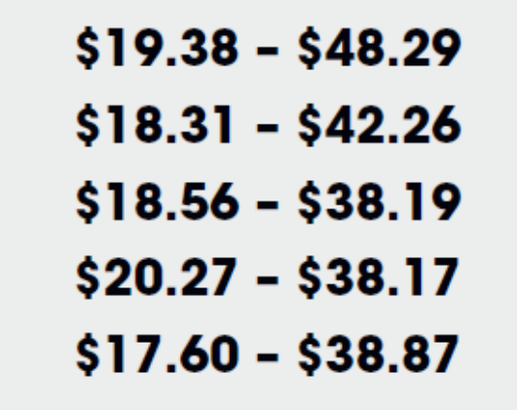


Advanced Manufacturing
Certificates:
Solid Works Certified User (7 units)
AutoCAD Certified User (8)
Drafting Fundamentals (10)
Engineering Design Graphics (16)
Applied Design (16)
3D Modeling and Prototyping (17)
Mechanical Design (26)
Computer-Aided Drafting & Design (29)
Top Jobs and Hourly Wages
Associate Degrees:
Engineering Technology
Computer-Aided Drafting & Design
Mechanical Design
Our Student:
John Hayfield – hired at NASA with AA degree for a job that typically requires Bachelor’s
Notes:
Replace white box with partner logo (all-white, knocked out version preferred)

Slide 21
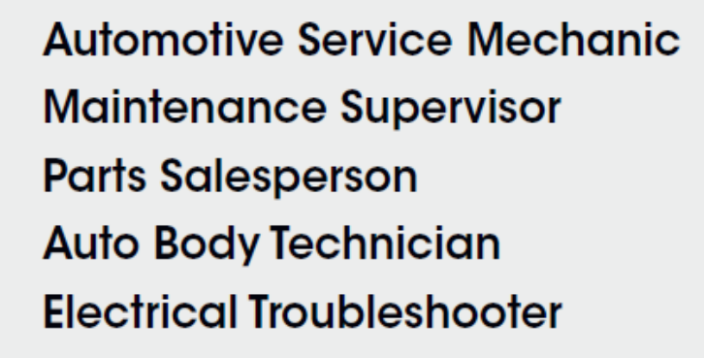
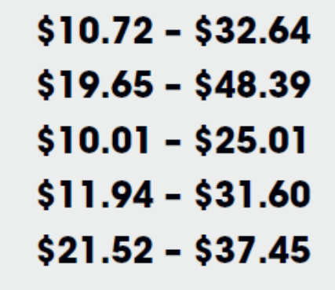
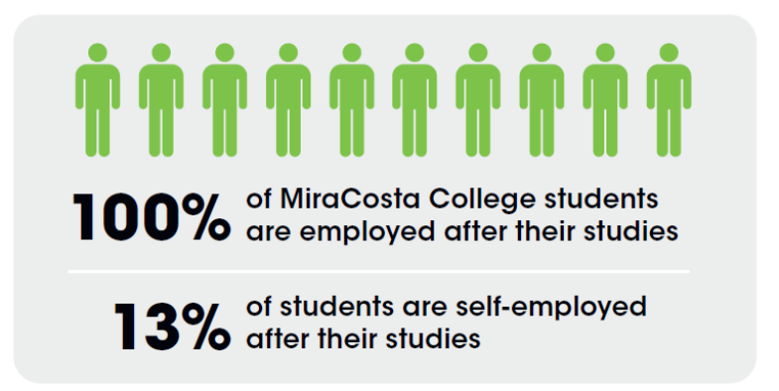

Advanced Transportation and Logistics
Certificates:
Automotive Electronics, Computers, and Emissions and/or HVAC (13-16 units)
Automotive Technology (24)
California Smog Check Technician (13-14)
Master Technician (41-43)
Automotive Electronics (8)
Automotive Quick Service Assistant (7)
Automotive Repair: Drive-Train Specialist (16)
Automotive Alignment, Brakes, and Suspension (8)
Basic Engine Performance (8)
Top Jobs and Hourly Wages
Associate Degrees:
Automotive Technology
Notes:
Replace white box with partner logo (all-white, knocked out version preferred)

Slide 22
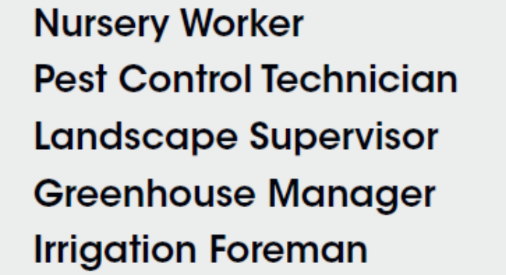
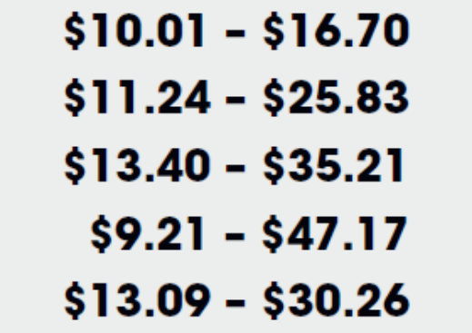

Agriculture, Water, and Environmental Technologies
Certificates:
Irrigation Technology (13 units)
Landscape Architecture (26-29)
Nursery/Horticulture Crop Production (28)
Viticulture and Enology (29.5)
Sustainable Agriculture (31)
Sustainable Landscape and Turf Management (31)
Pest Control Adviser (44)
Top Jobs and Hourly Wages
Associate Degrees:
Landscape Architecture AA
Sustainable Landscape and Turf Management AA
Nursery/Horticulture Crop Production AA
Viticulture and Enology AS
Sustainable Agriculture AS
Pest Control Adviser AS
Notes:
Replace white box with partner logo (all-white, knocked out version preferred)

Slide 23
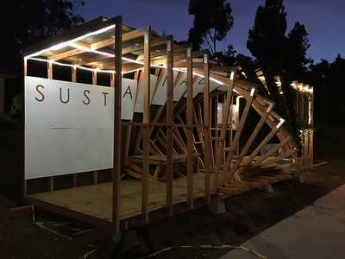
Energy, Construction, and Utilities
Certificates:
Solid Works Certified User (7 units)
AutoCAD Certified User (8)
Drafting Fundamentals (10)
Construction Management (15-17)
Computer-Aided Drafting (24-25)
Architectural Design (32)
Top Jobs and Hourly Wages
“My objectives are to teach sustainable practices in a very practical way, to involve the students with a real problem and have them solve that problem through design and construction.”
(Professor David Parker)
Associate Degrees:
Architectural Design AA
Computer-Aided Drafting AA
Notes:
Replace white box with partner logo (all-white, knocked out version preferred)

Slide 24
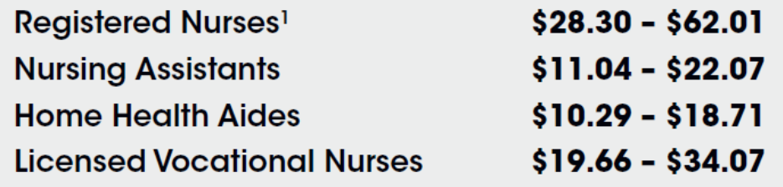
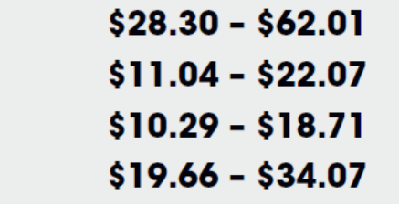
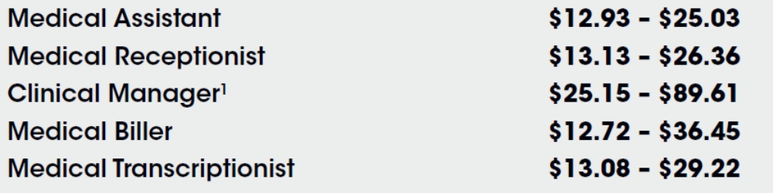
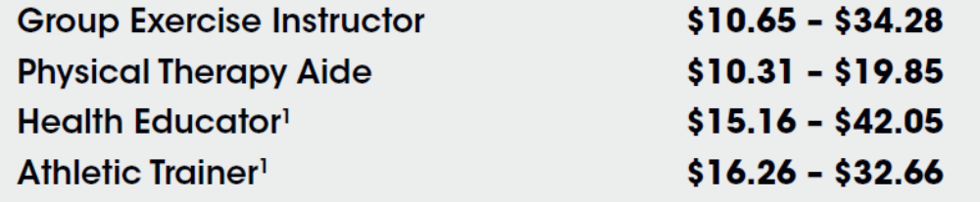
Health
Certificates:
CNA (6.5)
Yoga Instructor 200 hours (7)
Home Health Aide (8.5)
Yoga Instructor 300 hours (12-14)
Medical Office Specialist (13)
Medical Insurance & Coding Specialist (13)
Personal Fitness Trainer (23-24)
Medical Office Clinical Professional (15-17)
Medical Office Professional (22)
Medical Office Clinical & Admin Professional (30)
LVN (58)
Top Jobs and Hourly Wages
Associate Degrees:
LVN
Registered Nursing
Medical Office Professional
Notes:
Replace white box with partner logo (all-white, knocked out version preferred)

Slide 25
Information and Communication Technology (ICT)
and Digital Media
Certificates:
Business Productivity Software Essentials (9 units)
Certiport IC3 Digital Literacy (9)
Emerging Technologies (9-10)
CompTIA IT Core Essentials (10)
Certiport Microsoft Office (12)
+ all AS degree are also certificates (20-30)
Top Jobs and Hourly Wages
Associate Degrees:
Business and Information Worker AS
Business Productivity Software Applications AS
Cybersecurity AS
Information Technology AS
Internet and E-Commerce AS
Management Information Systems AS
Systems Administration AS
Tech Support AS
Our student - Ricardo
got employed with Booz Allen Hamilton as a Cyber Security Risk Assessor
Notes:
Replace white box with partner logo (all-white, knocked out version preferred)

Slide 26
Information and Communication Technology (ICT)
and Digital Media (cont’d)
Certificates:
Digital Media Foundations (12 units)
Digital and Print Publishing (12)
Web Design (15)
Video and Animation (15)
Graphic Communication (15)
+ all AS degree are also certificates of achievement (30)
Top Jobs and Hourly Wages
Associate Degrees:
Graphic Design AA
Web Development and Design AA
Student Wages After Studies
Notes:
Replace white box with partner logo (all-white, knocked out version preferred)

Slide 27
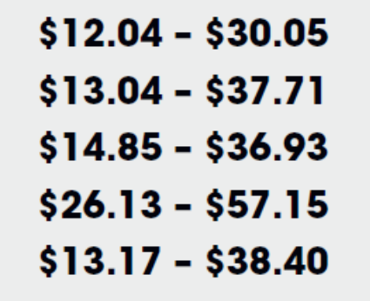
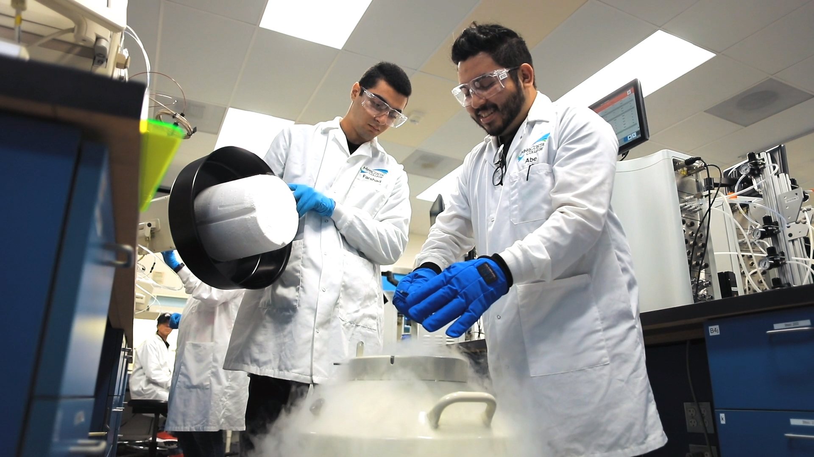

Life Sciences and Biotechnology
Top Jobs and Hourly Wages
Certificates:
Laboratory Skills (11 units)
Bioprocess Technology (13)
Research and Development (32-34)
Biomanufacturing (36)
Associate Degrees:
Research and Development AS
Biomanufacturing AS
Bachelor of Science Degree:
Biomanufacturing
Notes:
Replace white box with partner logo (all-white, knocked out version preferred)

Slide 28
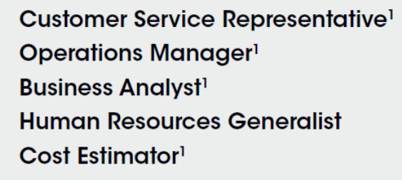
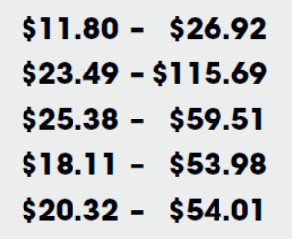
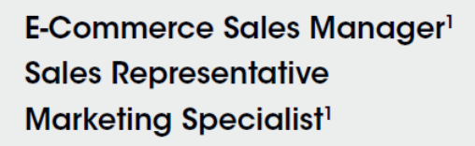
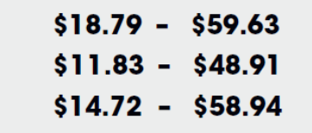
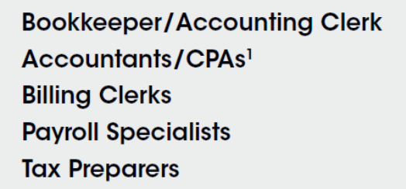
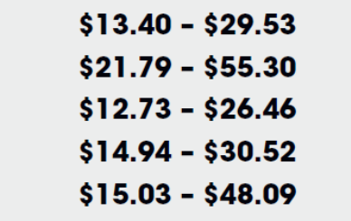

Business and Entrepreneurship
Certificates:
Income Tax Preparer (6)
Business Fundamentals (9)
Payroll Professional (10)
Business Quick Startup (12)
Entrepreneurship Fundamentals (13)
Accounting Assistant (13-14)
Project Management (15)
Income Tax Professional (17)
Social Media for Business (18)
+ all AA degrees are also certificates (21-30)
Top Jobs and Hourly Wages
Associate Degrees:
Accounting AA
Bookkeeping AA Entrepreneurship AA
Management AA
Marketing AA
Retail Management AA
Business Administration for Transfer AS
Notes:
Replace white box with partner logo (all-white, knocked out version preferred)

Slide 29

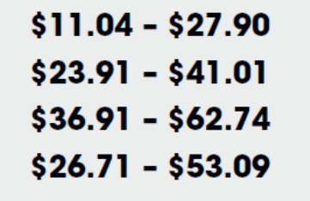
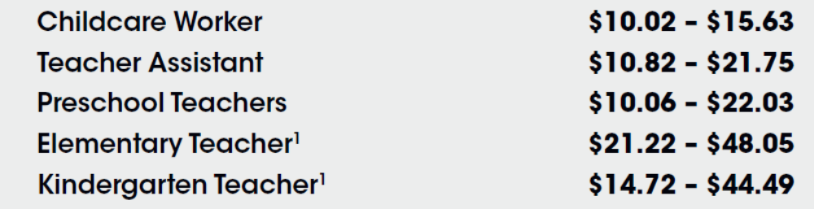
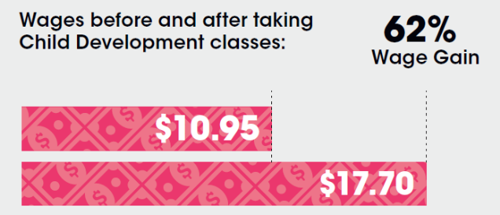
Other (Public Administration and Education Sectors)
Certificates:
Child Development Assistant Teacher (12 units)
Law Enforcement (27)
Early Intervention and Inclusion (27)
+ all AA degrees are also certificates (18-52)
Top Jobs and Hourly Wages
Associate Degrees:
Law Enforcement AA
Administration of Justice for Transfer AS
Child Development Associate Teacher AA
Child Development Master Teacher AA
Child Development Site Supervisor AA
Child Development Teacher AA
Child & Adolescent Development for Transfer AS
Early Childhood Education for Transfer AS
Notes:
Replace white box with partner logo (all-white, knocked out version preferred)

Slide 30
More Info:
CareerEd.miracosta.edu
Amy Pimentel
Career Education Pathways Coordinator apimentel@miracosta.edu
Zhenya Lindstrom
Assoc. Dean of Career Education
zlindstrom@miracosta.edu
Notes:
Replace white box with partner logo (all-white, knocked out version preferred)

Slide 31

CAREER EDUCATION
San Diego and
Imperial Counties
Notes:
Replace white box with partner logo

Slide 32
San Diego Mesa College
Monica Romero
Notes:
Replace white box with partner logo (all-white, knocked out version preferred)

Slide 33
Agriculture, Water, and Environmental Technologies
Animal Health Technology
Associate of Science
42 units in the major
20-40* units of general education
Program Application Period
Opens: 10/1/2019 Closes: 01/31/2020
Information Session
1/24/20 @ 5:30 pm
*GE units can vary
Mesa’s program is in process for the American Veterinary Association program accreditation.
Veterinary Technician
  Diagnostic Imaging
  Laboratory Procedures
  Veterinary Office
  Animal Nursing
Starting Range: $21,000 - $26,000
Experienced: $32,000 - $42,000
Notes:
Replace white box with partner logo (all-white, knocked out version preferred)

Slide 34
Business and Entrepreneurship
Accounting
Associate of Science
39 units in the major
20-40* units of general education
Accounting
Certificate of Achievement
23 units
Governmental/Nonprofit Accounting
Certificate of Completion
14 units
*GE units can vary
Career Opportunities Median Wage
Brokerage Clerks $26.35
Payroll and Timekeeping Clerks $24.21
Tax Prepares $22.68
Bookkeeping, Accounting, & Auditing Clerks $20.95
Annual Openings in San Diego 2,446
Notes:
Replace white box with partner logo (all-white, knocked out version preferred)

Slide 35
Business and Entrepreneurship
Business Administration
Associate of Science
33 units in the major
20-40* units of general education
Business Administration
Certificate of Achievement
30 units
Small Business Management & Entrepreneurship
Certificate of Achievement
18 units
*GE units can vary
**Associate in Science for Transfer available
Wide range of occupational opportunities and income:
Booking Agent
Buyer
Claims Adjuster/Agent /Examiner
Compensation Analyst
Credit and Collections Officer
Data Entry
Financial Planner
Loan Officer
Wholesale Sales Representative
Small Business Owner
Notes:
Replace white box with partner logo (all-white, knocked out version preferred)

Slide 36
Business and Entrepreneurship
Business Management
Associate of Science
41-42 units in the major
21-40* units of general education
Business Management
Certificate of Achievement
34-35 units
Retail Management
Certificate of Achievement
24 units
*GE units can vary
Wide range of occupational opportunities and income:
Administrator, Non-Profit Organization
Department/Office Manager
Facility Manager
Human Resources Manager
Industrial Relations Director
International Business/Trade/Commerce
Labor Relations Manager
Operations Management
Production Development Manger
Project Manager
Retail Operations Manager
Training and Development Specialist
Notes:
Replace white box with partner logo (all-white, knocked out version preferred)

Slide 37
Business and Entrepreneurship
Computer Business Technology: Administrative Assistant
Associate of Science
29 units in the major
20-40* units of general education
Computer Business Technology: Business Information Worker I
Certificate of Achievement
16-17 units
*GE units can vary
Career Opportunities
Data Entry Clerk
Human Resources Assistant
Information Clerks
Office Clerks
Receptionists
Records Clerk
Secretaries and Administrative Assistants
Notes:
Replace white box with partner logo (all-white, knocked out version preferred)

Slide 38
Business and Entrepreneurship
Interior Design
Associate of Science
60 units in the major
20-40* units of general education
Interior Design
Certificate of Achievement
46-49 units
*GE units can vary
Career Opportunities Median Wage
Interior Designers $21.10
Residential and Commercial Design
Lighting Design
Textiles
Computer Aided Design
Sole Proprietors Based on Experience
Data provided by the Centers Of Excellence, October 2018
Notes:
Replace white box with partner logo (all-white, knocked out version preferred)

Slide 39
Business and Entrepreneurship
Journalism
Associate of Arts
21 units in the major
20-40* units of general education
Journalism
Certificate of Achievement
21 units
*GE units can vary
Journalism prepares students for entry-level jobs in journalism and public relations.
Career Opportunities
Reporter
News Editor
Copy Editor
Photojournalist
Page Designer
Online Content Producer
Media Relations
Specialist
Speech Writer
Community Relations Specialist
Government Relations Specialist
Financial Relations Specialist
Lobbyist
Crisis Communications Specialist
Notes:
Replace white box with partner logo (all-white, knocked out version preferred)

Slide 40
Business and Entrepreneurship
Marketing
Associate of Science
42 units in the major
20-40* units of general education
Marketing
Certificate of Achievement
29 units
*GE units can vary
Career Opportunities
Advertising Account Executive
Advertising Sales Agent
Advertising Production Manager
Booking Agent
Brand Manager
Competitive Intelligence Analyst
Marketing Communications Analyst
Marketing Specialist
Merchandise Manager
Promotions Director
Public Relations Manager
Sales Manager
Survey Researcher
Notes:
Replace white box with partner logo (m.all-white, knocked out version preferred)

Slide 41
Business and Entrepreneurship
Real Estate
Associate of Science
27-28 units in the major
20-40* units of general education
Upon degree completion, students are eligible to sit for both the California Real Estate and Broker’s Licensure.
*GE units can vary
*GE units can vary
Career Opportunities Median Wage
Real Estate Salesperson/Broker $24.85
Real Estate Appraiser $24.00
Real Estate Property Manager $23.66
Real Estate Loan Officer $31.37
Many Real Estate professionals are independent contractors or sole proprietors.
Notes:
Replace white box with partner logo (all-white, knocked out version preferred)

Slide 42
Education and Human Development
American Sign Language – English Interpretation
Associate of Arts
32 units in the major
20-40* units of general education
American Sign Language – English Interpretation
Certificate of Achievement
32 units
*GE units can vary
American Sign Language Interpreters have a projected 7% growth potential and a median hourly wage of $23.60.
Professional interpreters have opportunities to work in a variety of private and public sector settings, including:
Performing Arts (concerts, theatre)
Media Arts (television and film)
Telecommunications (remote video interpreting, video relay)
Medical and Mental Health settings(hospitals, doctors’ offices, group sessions, individual therapy, testing)
Education (K-12 and college)
Business (meetings, trainings)
Religious (church services, weddings, funerals)
Notes:
Replace white box with partner logo (all-white, knocked out version preferred)

Slide 43
Education and Human Development
Child Development
Associate of Science
25-26 units in the major
20-40* units of general education
Child Development: Master Teacher
Certificate of Achievement - 25-27 units
Child Development: Teacher
Certificate of Achievement - 24-25 units
Child Development: Associate Teacher
Certificate of Achievement - 21-22 units
Certificate of Performance - 10-13 units
Child Development: Home Day Care
Certificate of Performance - 12 units
*GE units can vary
Career Fields
Child Development Associate in Science Degree prepares students for positions as teacher, master teacher, and director in the field of Child Development/Early Childhood Education.
Associate Teacher, Teacher, and Master Teacher Certificates of Achievement, prepare students for higher levels of instructional positions and meet the requirements for the State of California Child Development Permits.
Assistant Teacher Certificate of Performance prepares students to work in public and private childcare settings.
Home Day Care Certificate of Performance provides student with skills and knowledge for childcare in family settings.
Notes:
Replace white box with partner logo (all-white, knocked out version preferred)

Slide 44
Energy, Construction, and Utilities
Architecture Design
Associate of Science
41 units in the major
20-40* units of general education
Architecture Technician
Associate of Science
23 units in the major
20-40* units of general education
*GE units can vary
The Architecture Program at Mesa College has two main focuses: transfer to university Architecture programs and preparation for direct employment in architecture or a related design office.
Career Opportunities Median Wage
Architectural and Civil Drafters $28.31
Mechanical Drafters $24.43
Architectural Technicians $22.59
Notes:
Replace white box with partner logo (all-white, knocked out version preferred)

Slide 45
Energy, Construction, and Utilities
Construction Management
Associate of Science
30 units in the major
20-40* units of general education
Building Construction Technology - Inspection
Associate of Science
28 units in the major
20-40* units of general education
Building Construction Technology – Inspection
Certificate of Achievement
28 units
*GE units can vary
Career Opportunities Median Wage
Construction Managers $35.00
Construction & Building Inspectors $39.26
First-Line Supervisor - Construction $30.20
Cost Estimators $31.00
Notes:
Replace white box with partner logo (all-white, knocked out version preferred)

Slide 46
Health
Dental Assisting (RDA, CDA)
Associate of Science
37 units in the major
20-40* units of general education
Dental Assisting (RDA, CDA)
Certificate of Achievement
37 units
Program Application Deadline
Opens: February 1st Closes: April 1st
Information Sessions
12/3/19 @ 6:00 pm 3/18/20 @ 6:30 pm
*GE units can vary
Dental Assistants average salary range in San Diego is $32,00 - $42,00 per year.
After completion, students are eligible to take the state and national Dental Assisting boards for:
Certified Dental Assisting (CDA)
Registered Dental Assisting (RDA)
Mesa’s Dental Assisting program is accredited by the Dental Board of California (DBC) and the Commission of Dental Accreditation (CODA) of the American Dental Association.
Notes:
Replace white box with partner logo (all-white, knocked out version preferred)

Slide 47

Health
Health Information Management
Bachelor of Science
130-132 units for the major and in general education
Application Deadline
Opens: February 1st Closes: April 30th
Information Session
11/19/19 @ 5:00 pm
*GE units can vary
Health Information Management graduates obtaining their Registered Health Information Administrator (RHIA) certification are qualified to be:
Health Information Manager $104,000/year
Coding Supervisor $ 71,600/year
Release of Information On-Site Supervisor
              $ 52,000/year
Mesa’s College Health Information Management program is accredited by the Commission on Accreditation for Health Informatics and Information Management (CAHIIM).
Notes:
Replace white box with partner logo (all-white, knocked out version preferred)

Slide 48
Health
Health Information Technology
Associate of Science
33 Units in the major
20-40* units of general education
Application Deadline
Opens: 09/01/19 Closes: 01/31/20
Information Session
11/19/19 @ 5:00 pm
*GE units can vary
Health Information Technology graduates are eligible to sit for the national board examination to become Registered Health Information Technicians (RHIT's) to be employed as:
Health Information Technician $37,800/year
Health Information analyst: $41,600/year
Release of Information Specialist $45,760/year
Coder I $52,000/year
The Mesa College Health Information Technology program is accredited by the Commission on Accreditation for Health Informatics and Information Management (CAHIIM).
Notes:
Replace white box with partner logo (all-white, knocked out version preferred)

Slide 49
Health
Medical Assisting
Associate of Science
29-30 units in the major
20-40* units of general education
Medical Assisting
Certificate of Achievement
29-30 units
Application Deadline
Opens: 03/02/20 Closes: 04/10/20
Information Session
11/18/19
*GE units can vary
The average salary range in San Diego for Medical Assisting is $31,000 to $37,000 annually.
Graduates are qualified to sit for the following exams:
Clinical Medical Assistant – CCMA (NHA)
Medical Administrative Assistant – CCMA (NHA)
Registered Medical Assistant - RMA (AMT)
California Medical Assistant – CCMA (CCBMDA)
Employment Opportunities in:
Hospitals
Nursing Care Facilities
Outpatient Care Centers
Medical Research Centers
Insurance Carriers
Notes:
Replace white box with partner logo (all-white, knocked out version preferred)

Slide 50
Health
Nutrition
Associate of Science
27-30 units in the major
20-40* units of general education
Nutrition
Certificate of Achievement: 27-30 units
Nutrition and Fitness
Associate of Science
18.5-23 units in the major
20-40* units of general education
Nutrition and Fitness
Certificate of Achievement: 18.5-23 units
*GE units can vary
Career Opportunities Median Wage
Dietetic Technicians $13.44
Employment Opportunities in:
Healthcare
Sports Nutrition
Education
Research
Food Science
Food Service
Mesa’s Nutrition program also offers an Associate Degree for Transfer in Nutrition and Dietetics.
Notes:
Replace white box with partner logo (all-white, knocked out version preferred)

Slide 51
Health
Personal Trainer
Certificate of Achievement
19-22 units
This program prepares candidates for American College of Sports Medicine (ACSM) or American Council of Exercise (ACE) certification exams.
*GE units can vary
Personal Trainers have a projected 13% growth potential and a median hourly wage of $19.68. Many Personal Trainers own their own business or work as independent contractors.
Job titles include:
Personal Trainer
Exercise Testing Technicians
Group Fitness Instructor
Fitness Specialist
Strength Training Instructors
Worksite Wellness Specialist
Data provided by the Centers Of Excellence, May 2019
Notes:
Replace white box with partner logo (all-white, knocked out version preferred)

Slide 52
Health
Phlebotomy provides a firm entry level position with the potential for growth in health care.
The average salary for Phlebotomists in San Diego is $25,000 to $30,000 annually.
Job titles include:
Lab Assistant
Phlebotomy Technician
Registered Phlebotomist
Phlebotomy Supervisor
Completers will be eligible to apply for State of California certification as a Certified Phlebotomy Technician 1 (CPT 1) and sit for several state and national examinations.
Phlebotomy Training Program
Certificate of Performance
6 units
Application Deadline
Opens: November 1st Closes: December 3rd
*GE units can vary
Notes:
Replace white box with partner logo (all-white, knocked out version preferred)

Slide 53

Health
Physical Therapist Assistant
Associate of Science
46 units in the major
20-40* units of general education
Application Deadline (open every other year)
Opens: 04/05/21 Closes: 04/26/21
Information Sessions
11/02/19 @ 10:30 am
02/04/20 @ 5:30 pm
04/16/20 @ 5:30 pm
*GE units can vary
Physical Therapist Assistants are an in demand job with a projected 31% growth potential and an average salary in San Diego of $52,000 to $57,000 annually.
Program graduates are eligible to take the Physical Therapist Assistant licensure examination.
Mesa’s Physical Therapist Assistant program is accredited by the Commission on Accreditation in Physical Education (CAPTE).
Notes:
Replace white box with partner logo (all-white, knocked out version preferred)

Slide 54

Health
Radiologic Technology
Associate of Science
76 units in the major
20-40* units of general education
Radiologic Technology
Certificate of Achievement
76 units
Application Deadline (open every other year)
Opens: 02/03/20 Closes: 03/02/20
Information Sessions
11/15/19 @ 8:00 am
01/24/20 @ 11:00 am
*GE units can vary
Radiologic Technicians are an in demand job with a projected 13% growth potential and an average salary in San Diego of $52,000 to $78,000 annually.
Program graduates are eligible for the national certification by the American Registration of Radiologic Technologist and sate licensure.
Mesa’s Radiologic Technology program is accredited by the Joint Review Committee on Education in Radiologic Technology (JRCERT).
Notes:
Replace white box with partner logo (all-white, knocked out version preferred)

Slide 55
Information and Communication Technology (ICT)
and Digital Media
Computer and Information Sciences
Associate of Science
31-32 units in the major
20-40* units of general education
Computer and Information Sciences
Certificate of Achievement
31-32 units
Computer Programming
Certificate of Performance
15 units
*GE units can vary
**Associate in Science for Transfer coming soon.
Mesa’s Computer and Information Sciences program is primarily designed for transfer to a four-year institution, however employment opportunities are available with our stackable certificates.
Career Opportunities (2 & 4 Year Degrees) Median Wage
Web Developers $27.24
Computer Programmers $40.26
Software Developers, Applications $51.85
Software Developers, System Software $58.04
Notes:
Replace white box with partner logo (all-white, knocked out version preferred)

Slide 56
Information and Communication Technology (ICT)
and Digital Media
Fashion: Computer Technology Design
Associate of Science
45-46 units in the major
20-40* units of general education
Fashion: Computer Technology Design
Certificate of Achievement - 31 units
Fashion: Computer Technology Merchandising
Associate of Science
41-42 units in the major
20-40* units of general education
Fashion: Computer Technology Merchandising
Certificate of Achievement - 30 units
*GE units can vary
Career Opportunities
Interior Designers
Residential and Commercial Design
Lighting Design
Textiles
Computer Aided Design
Sole Proprietor
Notes:
Replace white box with partner logo (all-white, knocked out version preferred)

Slide 57
Information and Communication Technology (ICT)
and Digital Media
Geographic Information Systems
Associate of Science
30-34 units in the major
20-40* units of general education
Geographic Information Systems Technician
Certificate of Achievement
13-16 units
*GE units can vary
Geographic Information Systems Technician in San Diego have an average salary of $48,000 to $53,000 annually.
Career Opportunities in:
Business
Marketing
Public Health
Government
Environmental Manager
Emergency Management
Cultural Resources Management
Education
Public Safety
Notes:
Replace white box with partner logo (all-white, knocked out version preferred)

Slide 58
Information and Communication Technology (ICT)
and Digital Media
Multimedia: Video Game Design & Development
Associate of Science
45 units in the major
20-40*units of general education
Multimedia: Video Game Design & Development
Certificate of Achievement
31 units
Multimedia: 3D Animation and Modeling
Certificate of Achievement
28 units
*GE units can vary
Career Opportunities
Video Game Design and Development
Game Developer, Game Designer, 3D Artist, Gameplay Programmer, Game Tester, Environmental Artist, 3D Character Artist, 3D Modeler, Level Designer, Cinematic Animator, Concept Artist, Character Rigger/Animator, Software Engineer/Programmer
3D Modeling & Animation
3D Animator, 3D Character Artist, Asset Design, Production Modeler, 3D Generalist, Modeling and Texture Artist, Character Rigging, Medical Modeler & Animator, Gameplay Animator, Environment Artist
Notes:
Replace white box with partner logo (all-white, knocked out version preferred)

Slide 59
Information and Communication Technology (ICT)
and Digital Media
Multimedia: Visual Communication
Associate of Science
30-32 units in the major
20-40* units of general education
Multimedia: Interactive Media Production
Certificate of Achievement
30-31 units
*GE units can vary
Career Opportunities
Visual Communication
Graphic Designer, Animator, Web Content Design, Video Content Producer, Game Asset Design, Character Design, Sales & Advertising Presentation Developer
Notes:
Replace white box with partner logo (all-white, knocked out version preferred)

Slide 60
Information and Communication Technology (ICT)
and Digital Media
Web Design
Associate of Science
33 units in the major
20-40* units of general education
Web Design
Certificate of Achievement
24 units
*GE units can vary
Web Development have a projected 6% growth potential and a median hourly wage of $22.67. Many Web Developers own their own business or work as independent contractors.
Job titles include:
Web Designer or Developer
Front End or Back End Developer
Full Stack Developer
Content Manager
Search Engine Optimizer
Data Model Engineer
Web Programmer, HTML, and CSS Coders
Internet Concept Developer
Notes:
Replace white box with partner logo (all-white, knocked out version preferred)

Slide 61
Retail, Hospitality and Tourism
Dance
Associate of Arts
26 units in the major
20-40* units of general education
Dance
Certificate of Performance - 17 units
Choreography
Certificate of Achievement - 22 units
Commercial Dance
Certificate of Achievement - 23-26.5 units
*GE units can vary
Career Opportunities
Professional Dancer
Choreographer
Dance Production Technician
Recreational Leader
Company Director
Movement Notator
Dance Therapist
Dance Teacher
Dance Critic
Fitness Instructor
Dance Promoter
Median hourly earning range from $16.90 - $20.17.
Notes:
Replace white box with partner logo (all-white, knocked out version preferred)

Slide 62
Retail, Hospitality and Tourism
Culinary Arts/Culinary Management in Hospitality
Associate of Science
48 units in the major
20-40* units of general education
Culinary Arts/Culinary Management in Hospitality
Certificate of Achievement
31 units
*GE units can vary
Career Opportunities
Caterer
Line Cook
Restaurateur
Executive Chef
Food Stylist
Pastry Chef
Kitchen Manager
Restaurant Manager
Private Chef
Entrepreneur
Food Writer or Editor
Product Research and Development Specialist
Sous Chef
Notes:
Replace white box with partner logo (all-white, knocked out version preferred)

Slide 63
Retail, Hospitality and Tourism
Fashion Design
Associate of Science
46-52 units in the major
20-40* units of general education
Fashion Design
Certificate of Achievement - 31-37 units
Fashion Merchandising
Associate of Science
39.5-44.5 units in the major
20-40* units of general education
Fashion Merchandising
Certificate of Achievement - 33.5-38.5 units
*GE units can vary
Career Opportunities
Sewing Machine Operators
Merchandise Displayers
Window Trimmers
Tailors, Dressmakers, and Custom Sewers
Fashion Designers
Costume Attendants
Fabric and Apparel Patternmakers
Median hourly earnings range from $11.45 to $29.32
Notes:
Replace white box with partner logo (all-white, knocked out version preferred)

Slide 64
Retail, Hospitality and Tourism
Hospitality Management
Associate of Science
36 units in the major
20-40* units of general education
Hospitality Management
Certificate of Achievement
35 units
*GE units can vary
Career Opportunities
Meeting Planners
  seminars, conferences, trade shows, and expositions
Event Planners
fairs, parties, and specials events
Certified entertainment managers
artists, music, and amusement
Destination Specialist
location expert
Incentive Travel Specialist
tours, group tours, and enticement
Notes:
Replace white box with partner logo (all-white, knocked out version preferred)

Slide 65
LEARNING SUCCESS
State-of-the-Art Facilities
Industry Experienced Faculty
Work-Based Learning
Career Center
Tutoring

Slide 66
Monica Romero
Associate Dean of CTE
San Diego Mesa College
mdromero@sdccd.edu
619-388-5025
Notes:
Replace white box with partner logo (all-white, knocked out version preferred)

Slide 67

CAREER EDUCATION
San Diego and
Imperial Counties
Notes:
Replace white box with partner logo

Slide 68
Benjamin Gamboa
  Associate Dean, Strong Workforce Programs
Notes:
Replace white box with partner logo (all-white, knocked out version preferred)

Slide 69
Advanced Manufacturing
Associates of Science & Certificates of Achievement:
  Aviation Maintenance Technology
  Airframe & Powerplant
  Aviation General Studies
  18 to 78 units
Aircraft Structure, Surfaces, Rigging, and Systems Assemblers
Mechanical Engineering Technicians
Aerospace Engineers
$19/hr
$28/hr
$52/hr
Notes:
Replace white box with partner logo (all-white, knocked out version preferred)

Slide 70
Advanced Transportation and Logistics
Associates of Science & Certificates of Achievement/Performance:
  Automotive Technology
    General, Manufacturer-Specific, Electrical, Transmission & Chassis
  Aviation Maintenance Technology
  Airframe & Powerplant
  Diesel Technology
    Engines, Equipment & Apprenticeships
  Professional Aeronautics
    Private, Commercial, Instrument, Remote & Helicopter
  5 to 78 units
Automotive Service Technicians and Mechanics
Aircraft Mechanics and Service Technicians
Diesel Technicians
Unmanned Aerial Vehicle Pilot
Commercial Pilot
Transportation, Storage, & Distribution Managers
$19/hr
$30/hr
$25/hr
$25/hr
$34/hr
$41/hr
Notes:
Replace white box with partner logo (all-white, knocked out version preferred)

Slide 71
Health
Associates of Science & Certificates of Achievement/Performance:
  Emergency Medical Services
  Medical Laboratory Technology
  7.5 to 60 units
EMT & Paramedics
Medical Laboratory Technicians
144 EMT students saw a median percent increase in earnings of 30% after graduation.
$14/hr
$26/hr
Notes:
Replace white box with partner logo (all-white, knocked out version preferred)

Slide 72
Information and Communication Technology (ICT)
and Digital Media
Associates in Science for Transfer, Associates of Science & Certificates of Achievement/ Performance:
  Computer Science
  Computer and Information Sciences
  Computer Programming
  12 to 60 units
Web Developers
Graphic Designers
Desktop Publishers
Computer User Support Specialists
$21/hr
$21/hr
$25/hr
$27/hr
Notes:
Replace white box with partner logo (all-white, knocked out version preferred)

Slide 73
Life Sciences and Biotechnology
Associates of Science & Certificates of Achievement/Performance:
  Applied Biology
  Biology for Allied Health
  Biotechnology
  Medical Laboratory Technology
  8 to 60 units
Inspectors, Testers, Sorters, Samplers, and Weighers
Biological Technicians
Life, Physical, and Social Science Technicians
Engineering Technicians
Clinical Laboratory Technologists and Technicians
$19/hr
$24/hr
$26/hr
$33/hr
$37/hr
Notes:
Replace white box with partner logo (all-white, knocked out version preferred)

Slide 74
Business and Entrepreneurship
Associates of Science & Certificates of Achievement/Performance:
  Accounting
  Business Administration & Management
  Computer Business Technology
    Administrative Assistant, Legal Secretary & Website Designer
  Entrepreneurship
  Independent Business Ownership
  8 to 60 units
Customer Service Representatives
Secretaries & Administrative Assistants
Supervisors of Office & Administrative Support Workers
Accountants & Auditors
General & Operations Managers
106 business management students saw a median percent increase in earnings of 36% after graduation.
$18/hr
$21/hr
$27/hr
$35/hr
$52/hr
Notes:
Replace white box with partner logo (all-white, knocked out version preferred)

Slide 75
Other Sectors
Associates of Science & Certificates of Achievement/Performance:
  Administration of Justice
  Child Development
  Fire Technology
  Paralegal
  Personal Training/Yoga
  5 to 78 units
Fitness Trainers
Firefighters
Paralegals & Legal Assistants
Police & Sheriff’s Patrol Officers
94 child development students saw a median percent increase in earnings of 30% after graduation.
$20/hr
$30/hr
$30/hr
$44/hr
Notes:
Replace white box with partner logo (all-white, knocked out version preferred)

Slide 76
Benjamin Gamboa
  Associate Dean, Strong Workforce Programs
bgamboa@sdccd.edu
619-388-7392
Notes:
Replace white box with partner logo (all-white, knocked out version preferred)

Slide 77

CAREER EDUCATION
San Diego and
Imperial Counties
Notes:
Replace white box with partner logo

Slide 78
Sasha Knox, M.A.
Job Placement Coordinator
San Diego City College
Notes:
Replace white box with partner logo (all-white, knocked out version preferred)

Slide 79

Advanced Manufacturing
Associate of Science Degree:
Manufacturing Engineering Technology
Fabrication and/or Electronics Options
Requires 36 units for each Major (Option)
Program offers 2 Certificates of Achievement
Program offers 4 Certificates of Performance
  Introduction to Manufacturing (7 units)
    STEM Guitar Building where each student can design and build their own electric guitar and amplifier
  Manufacturing Fundamentals (13 units)
  Advanced Manufacturing (11 units)
  Lean Six Sigma Certificate (9 units)
Career Opportunities:
Most common career options with a degree in Manufacturing Engineering Technology include:
  Manufacturing Engineering Technician, Engineering Technician, Manufacturing Operator, Industrial Engineering Technician, Industrial Production Manager, and Production and Operating Supervisor.
MFET Technicians in San Diego County expect significant growth. The regional trend is markedly greater than California or even Nation-wide. Jobs projected in the county are 4,020 for 2020. Median pay rate is $34/hour.
Notes:
Replace white box with partner logo (all-white, knocked out version preferred)

Slide 80
Agriculture, Water, and Environmental Technologies
Agriculture
Associates Degree
  Sustainable Urban Agriculture (23 units required for major)
Certificate of Achievement
  Urban Farming Professional (27-30 units)
  Urban Gardening (12 units)
Certificate of Performance
  Organic Gardening for the Culinary Arts
  (7 units)
All Agriculture courses at City College spend time applying theoretical skills learned in the classroom to real-world scenarios at one of 4 growing spaces on campus.
Provides career opportunities at organic farms, nurseries, or commercial greenhouses.
Notes:
Replace white box with partner logo (all-white, knocked out version preferred)

Slide 81
Energy, Construction, and Utilities
Air Conditioning, Refrigeration, and Environmental Control Technology (AIRE)
Certificate of Achievement
  Basic Mechanical Systems Installation
  Advanced HVAC/R Mechanical Installation and Repair
  Mechanical Systems and Solid-State Electronics Technician
  Mechanical Systems Project Development
  Advanced Air Conditioning and Direct Digital Control
  Air Conditioning, Heating, and Advanced Refrigeration
  Heating, Ventilation, and Air Conditioning Systems Design
These occupations’ median earnings are higher than the Self-Sufficiency Standard, suggesting that students who successfully complete a program and obtain employment in a related field may earn a living wage.
On average, the median hourly earnings for Energy and Geo-Environmental Engineering Occupations is $28.67
Occupations trained by this program:
Building Operations Specialists, Energy Auditors, Solar Energy Installation Managers, Heating, Air Conditioning, and Refrigeration Mechanics and Installers
Campus logo HERE
Notes:
Replace white box with partner logo (all-white, knocked out version preferred)

Slide 82
Energy, Construction, and Utilities
Air Conditioning, Refrigeration, and Environmental Control Technology (AIRE)
Associate of Science
  HVAC/R Mechanical Systems Installation and Repair
  Mechanical Systems and Solid-State Electronics Technician
  Mechanical Systems Project Development
  Air Conditioning, Refrigeration, and Environmental Control Technology
These occupations’ median earnings are higher than the Self-Sufficiency Standard, suggesting that students who successfully complete a program and obtain employment in a related field may earn a living wage.
On average, the median hourly earnings for Energy and Geo-Environmental Engineering Occupations is $28.67
Occupations trained by this program:
Building Operations Specialists, Energy Auditors, Solar Energy Installation Managers, Heating, Air Conditioning, and Refrigeration Mechanics and Installers
Campus logo HERE
Notes:
Replace white box with partner logo (all-white, knocked out version preferred)

Slide 83
Energy, Construction, and Utilities
Energy and Geo-Environmental Engineering (EGEE)
Certificate of Achievement
  Green Building Energy Professional
  Energy Analysis and Consultation
Associate of Science
  Green Building Energy Professional
  Energy Analysis and Consultation
  (Note - The required courses in these programs are offered online)
These occupations’ median earnings are higher than the Self-Sufficiency Standard, suggesting that students who successfully complete a program and obtain employment in a related field may earn a living wage.
On average, the median hourly earnings for Energy and Geo-Environmental Engineering Occupations is $28.67
Occupations trained by this program:
Building Operations Specialists, Energy Auditors, Solar Energy Installation Managers, Heating, Air Conditioning, and Refrigeration Mechanics and Installers
Campus logo HERE
Notes:
Replace white box with partner logo (all-white, knocked out version preferred)

Slide 84
Information and Communication Technology (ICT)
and Digital Media
San Diego City College offers degrees and certificates in the following areas of the ICT and Digital Media Sector:
Graphic Design
Computer Business Technology
Computer Information Systems – to include Cybersecurity
Digital Journalism
Commercial Music (production)
Photography
Radio, Television, and Film
The area of ICT and Digital Media is the perfect blend of technological skills and creativity.
San Diego City College has been accredited by the EC-Council as an approved training center for Cybersecurity.
City College student in Graphic Design have worked with Qualcomm and the joint firms heading up the San Diego Seaport Village project to provide signage and marketing materials.
Campus logo HERE
Notes:
Replace white box with partner logo (all-white, knocked out version preferred)

Slide 85
Business and Entrepreneurship
Business Studies
Associates Degree
  Business Administration (36 units for major)
  Small Business Management Entrepreneur (36-36.5 units for major)
Certificate of Achievement
  Small Business Management Entrepreneur (18 units)
Certificates of Performance
  Business Communications and Cultural Competence
  Business Operations – Cannabis Dispensary
  Business Presentations
  Customer Relationship Management
  Job Skills
  Management and Team Building
  Starting and Managing a Small Business
  Writing and Computational Skills for Business
The certificates of performance provide students with stackable certifications that can lead to skill development or employment.
Campus logo HERE
Notes:
Replace white box with partner logo (all-white, knocked out version preferred)

Slide 86
For more information on Career Education Programs at San Diego City College, please contact:
Rose LaMuraglia, Dean
San Diego City College
rlamurag@sdccd.edu
619-388-3488
Sasha Knox, Job Placement Coordinator
San Diego City College
sknox@sdccd.edu
619-388-3722
Campus Logo Here
Notes:
Replace white box with partner logo (all-white, knocked out version preferred)

Slide 87

LEARN MORE.
EARN MORE.
WITH CAREER EDUCATION.
Visit CareerEd.org
/mycareered
Notes:
Replace white box with partner logo (all-white, knocked out version preferred)

