Slide 1

Building a K-Life College/Career
Readiness Connection Framework
@PowayCTE

Slide 2
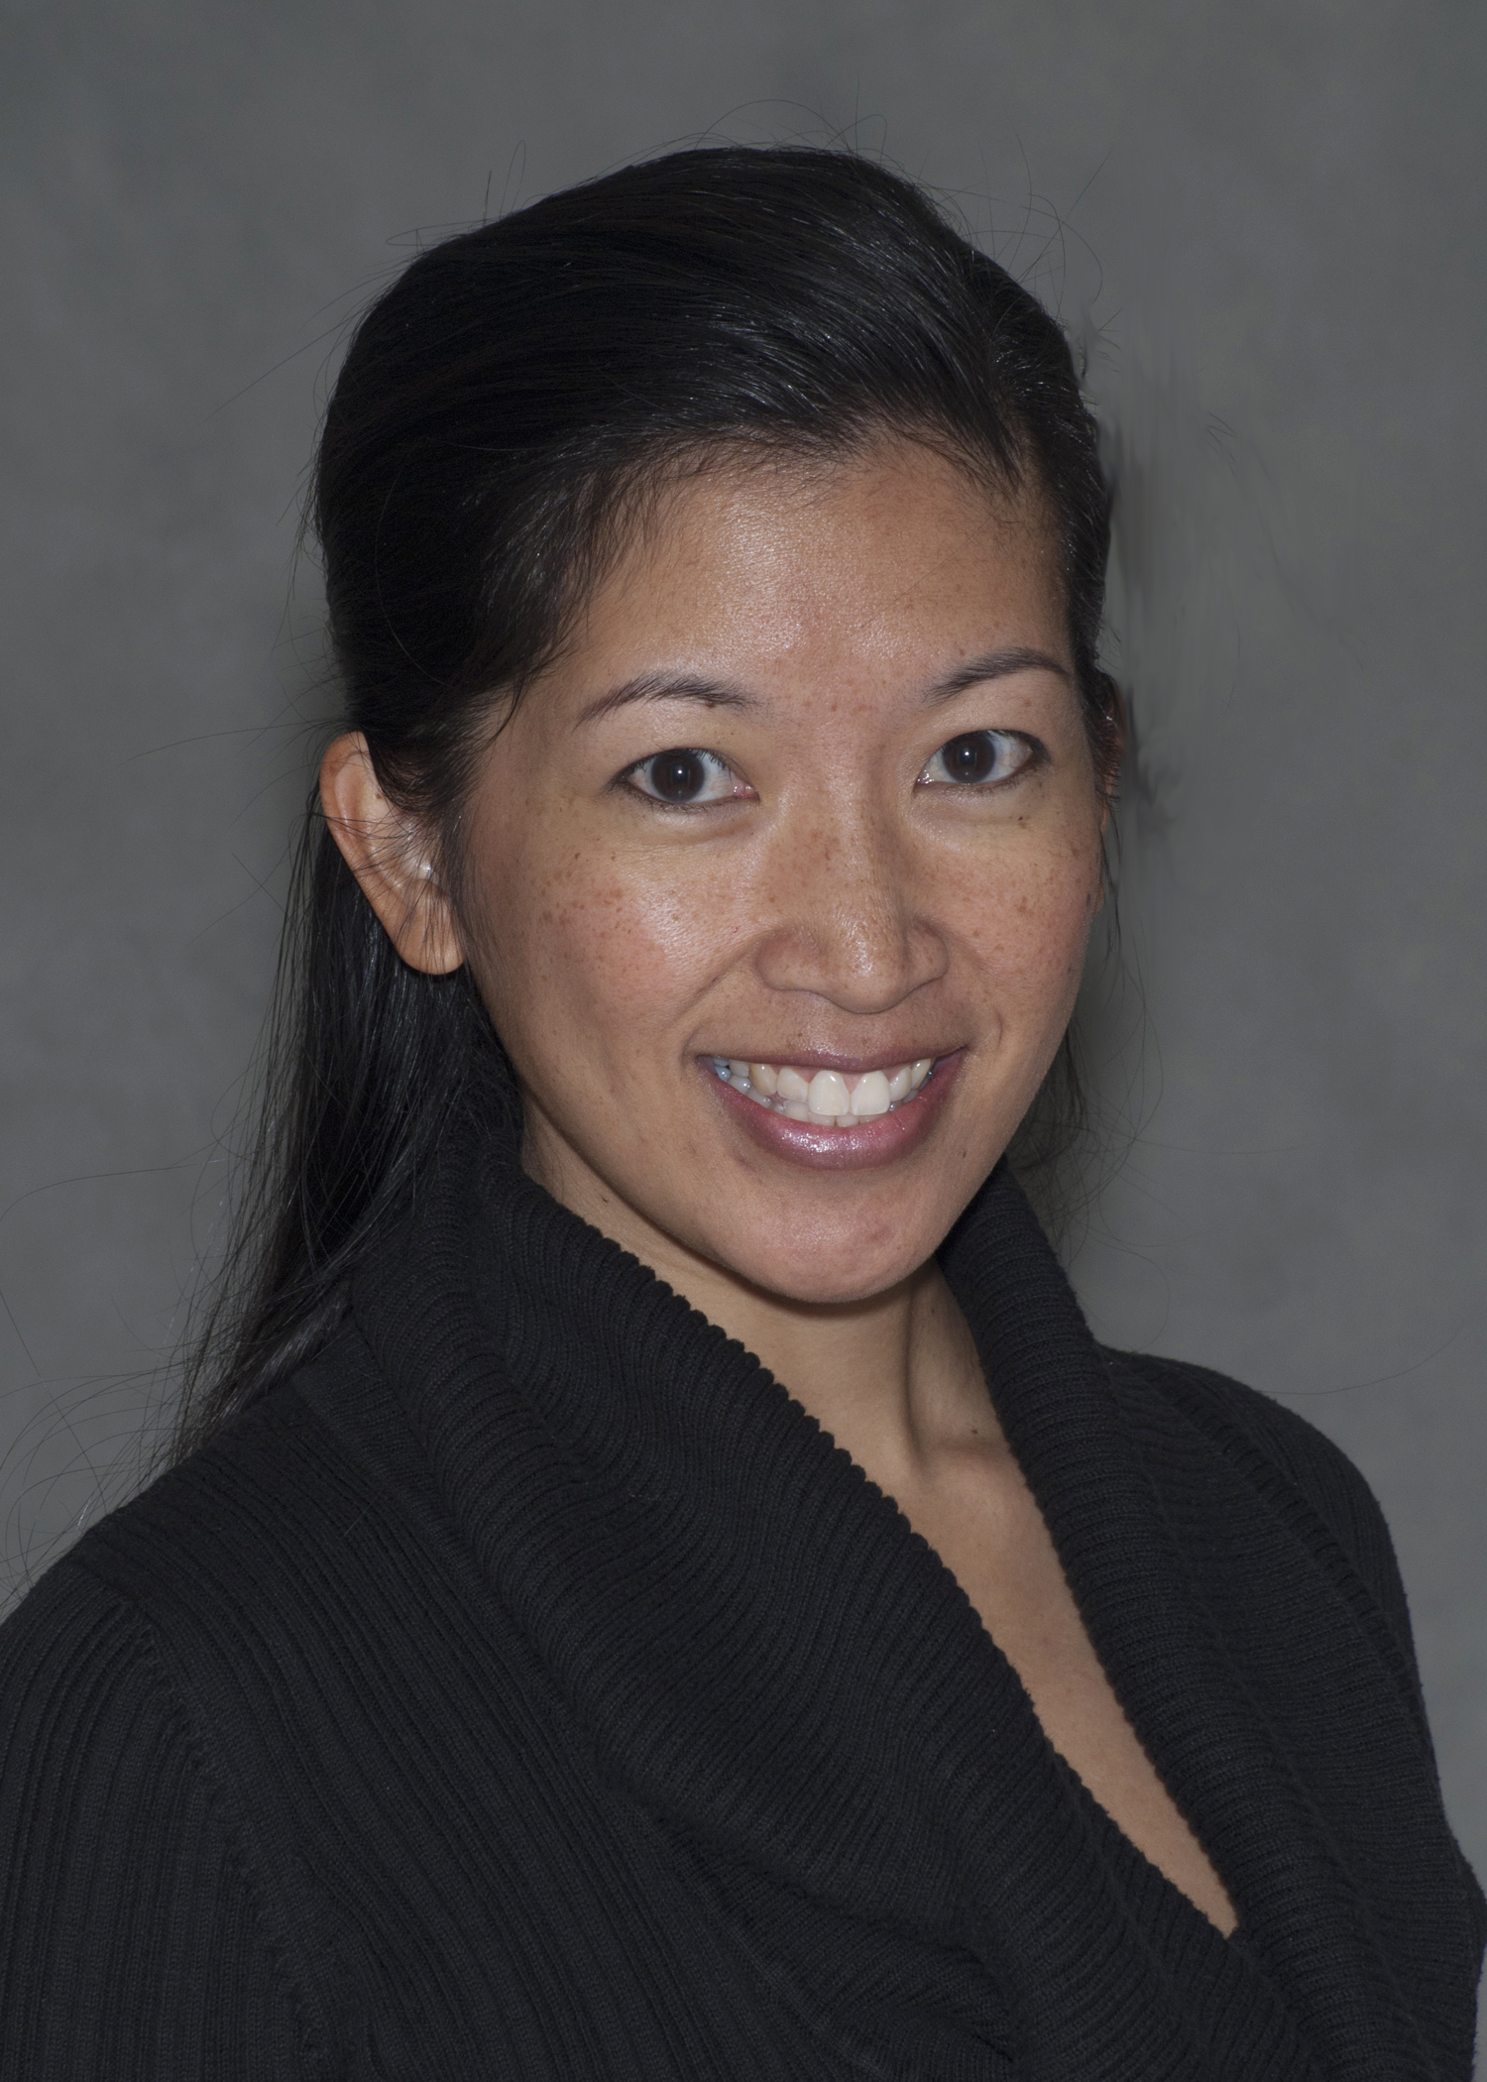
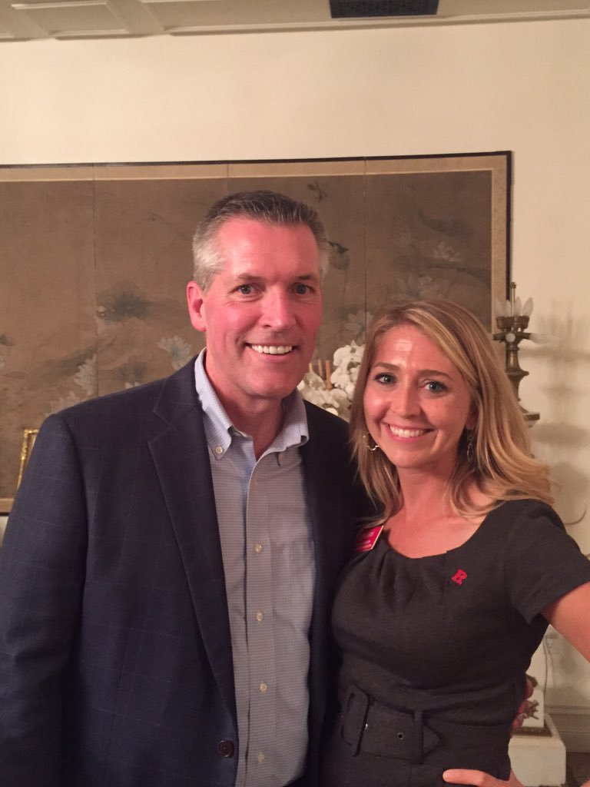
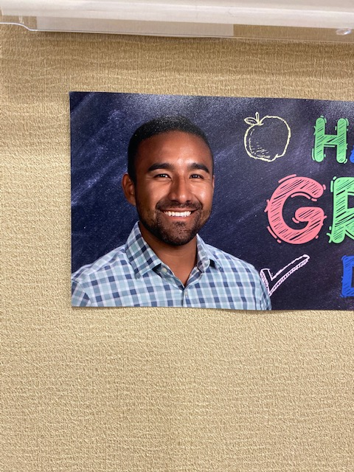
WHO ARE WE?
Poway Unified School District & Palomar College
Glyn Bongolan, Ed.D.
Associate Professor/Counselor Palomar College
gbongolan@palomar.edu
Emily Stevenson
Counselor
Poway Unified School District
estevenson@powayusd.com
powayusd.com/CTE
Jesse Luna
School Counselor Del Norte High School
jluna@powayusd.com
Notes:
All – introduce and talk about background

Slide 3
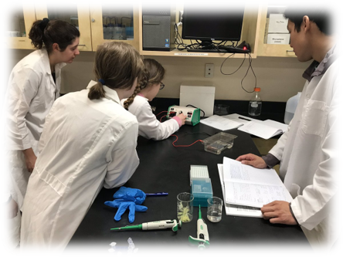
AGENDA
Strong Workforce Program Partnership
CTE in PUSD
Career Continuum implementation
Site perspective and implementation
Palomar College Partnership
What’s Next?
Notes:
Jesse

Slide 4
PUSD’s Mission Statement
“Inspiring passion and preparing every student to thrive in college, career, and life by providing personalized, rich, and rigorous learning experiences.”
Notes:
Jesse
We are fortunate - CTE is valued as part of a well-rounded education in PUSD

Slide 5

PUSD Career Technical Education Vision
Early experiences, gain exposure to and explore a full array of post-secondary, college and career choices.
Reinforces, integrates and delivers core academic content
Well-defined, articulated course sequences and experiences, acquisition of knowledge, skills and attitudes necessary to prepare students for post-secondary study and careers in well paying, high-demand professions and occupations.
Opportunities for authentic, relevant, work-based experiences to students and staff.
Maximizes and leverages Systematically collects and shares data to drive decisions and promote student achievement.
The Results - Every Student:
Develops an awareness of self and a vision for the future that connects to the educational experience.
Creates meaningful and relevant projects as a part of all academic areas.
Has multiple and non-traditional choices available to meet educational requirements.
Graduates from high school with the knowledge, skills and attitudes necessary to be successful in college and careers.
Completes high school with college credit.
Notes:
Emily
Many people’s notion of Career Technical Education (CTE) is dated.
Unlike its historical roots (Vocational Ed, ROP, etc.), today’s CTE offerings target all students, and aim to prepare them with skills that will insure their success in college and career.
Previously isolated CTE “electives” have evolved into “Pathways”, or a sequence of courses within a particular industry.
PUSD has a solid vision of what CTE should provide to students.

Slide 6
Strong Workforce Program Partnership
PUSD CTE Vision aligns with the work of the Strong Workforce Program
PUSD Involvement:
  Executive Director, K12 Chair
  CTE staff serve on SWP workgroups
  CTE staff on selection committee, one of two is the chair of the committee
  PUSD staff involved in the development of the Middle and High School Career Continuums
  Awarded K-12 SWP Grant, work around implementation of elements of the career continuum
    Site based CTE counselors
    Career Planning Tool,
    Career Education Specialist
    Increased Opportunity for WBL
Notes:
Emily
Fortunate to be very involved in this regional work
Glyn – I can talk about overarching structure of SWP in our region.

Slide 7
Strong Workforce Program Partnership
SWP funded Strategies
Middle School Career Development
High School Career Development
Pathway Development and Improvement
Notes:
Partner work
Palomar professors and staff joined us for professional development
Increased articulation agreements and the number of students earning credit
Opened conversation with Palomar to change the articulation process

Slide 8
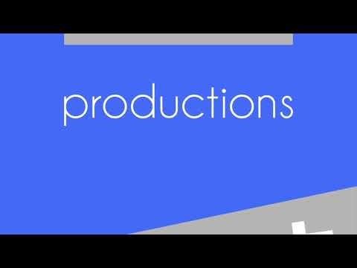
CTE Implementation in PUSD
Early exposure, self-awareness and a vision of future
Academically challenging courses and programs
Courses that are responsive to student, parent, community and workforce development needs
Provides opportunities for authentic, relevant, work-based experiences for each and every students
Prepares students for high-demand professions and occupations
Notes:
Emily
Early Exposure: Thrively, Xello, CTE Counselors, Student Ambassadors, Speaker Series
Academically Challenging: PLTW Honors Courses, Courses reinforce and integrate core academic content, Graduation designation for pathway completion, Meaningful and relevant projects, Courses for College Credit
For Teachers/counselors: PD, Career Education Specialists, Business Advisor Support
Responsive to Need: Alignment to Pathways and curriculum with CC partners and Career Ed Specialists
Graduates from high school with the knowledge, skills and attitudes necessary to be successful in college and careers, Courses for college credit
Authentic WBL Experiences: WBL for both students and teachers, business partnerships
Prepares for High Demand Professions: Problem solving and critical thinking; technical skills; social and verbal communication; industry-specific knowledge; business partnerships/advisory; internships

Slide 9
Alignment to Priority Industry Sectors
We offer 12 of the 15 high-growth industry sectors identified by the State of California:
Agriculture & Natural Resources
Arts, Media, and Entertainment
Building and Construction Trades
Business and Finance*
Education, Child Development & Family Services
Engineering and Architecture*
Health Science and Medical Technologies*
Information and Communication Technologies*
Manufacturing and Product Development*
Marketing, Sales and Services*
Public Services
Transportation*
Notes:
Jesse
7 of the 12 have been identified by the State of California as emergent industry sectors for SD County by the California Community College Chancellor’s Office

Slide 10



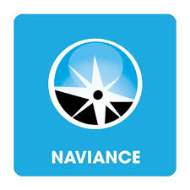
College and Career Continuum
Career Assessment Tools
  Thrively available to all K-12 Students
  Implementation of Xello
  Naviance
  California Career Zone
  CaliforniaColleges.edu
Vertical Articulation to assist in a smooth transition from elementary to middle to high school and beyond
Cross-curricular partnerships
Better Self-Awareness, Career Awareness, Career Exploration, Career Preparation, and Career Training and more opportunities for our students
Notes:
Emily

Slide 11
Implementing the Career Continuum in PUSD
CTE Site Based Counselors, Career Education Specialists, Counselors and Teachers
What’s Happening at Every Level
    Elementary School – Pomerado Elementary and Poway High School Collaboration, Guest speakers
    Middle School - Career Fairs, Speakers, High School Specific CTE Events
    High School – Career Speaker Series, Tarde de Familia
Work based learning opportunities and site tours
Support for CTE teachers and counselors
More exposure and experience results in students being better prepared for the future
Notes:
Emily
CTE Site Based Counselors:
Increasing the number of students who enroll in CTE courses
Increasing the number of students who are CTE Pathway Completers
Increasing the number of students who earn college credit
Develop a plan and begin implementation of the career development continuum

Slide 12
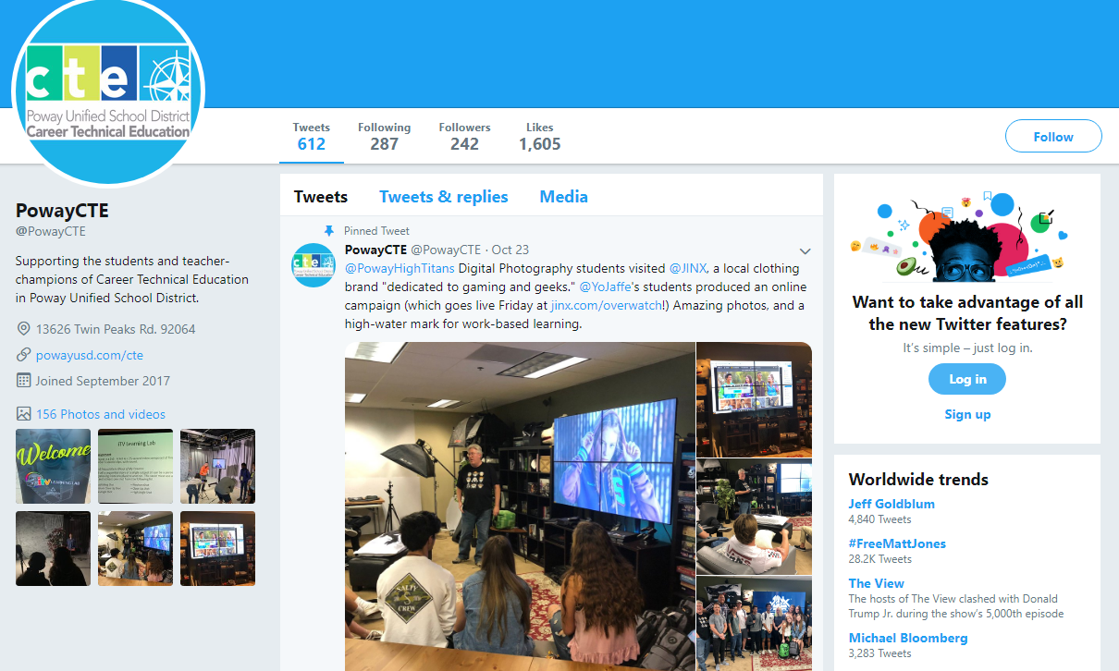

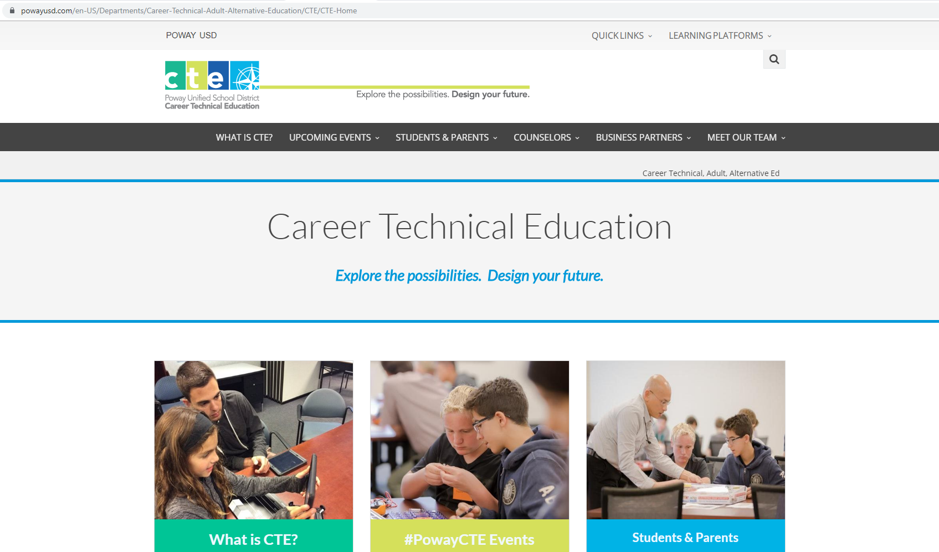
Raising Community Awareness of CTE
Website
Social media – Instagram, Facebook, Twitter
Promotional videos – Studio 701
CTE Counselor at each school site
College and Career Indicator Tool
Implementation of Xello
Use of Thrively
CTE Pathway Course Sequence promotional flyers
CTE Family Events
Career Speaker Series
Notes:
Emily

Slide 13
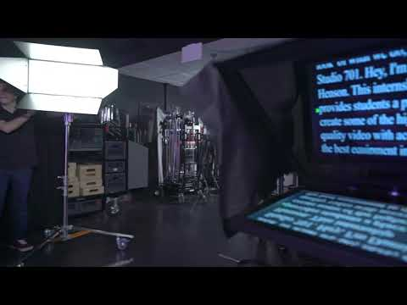
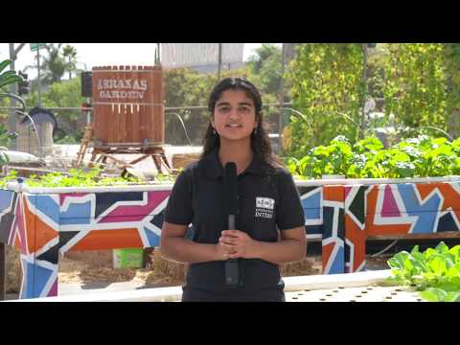
Studio 701
Abraxas High School Garden
Notes:
Emily

Slide 14





Site implementation of the CTE Vision
Del Norte High School
  1:1 quarterly with CTE Teachers
  CTE Course Sequence Awareness
  Master Scheduling
  Improving CTE Pathway Completers
  Career/College/Life Lesson Plans in Homerooms
  Internship opportunities
  "a-g" course submission support
Other PUSD High Schools
  Integrating Career Education into Homerooms/Subject Courses
  Partnerships with feeder middle schools
  Highlight videos of pathways
  CTE open house for middle school students
  Career speakers based on student interest
Notes:
Jesse (Emily to add on about other schools)

Slide 15

PUSD Partnership with Palomar College
Articulated Courses
North County Meeting with CTE Directors/CTE Counselors
Tarde de Familia
  (Originated by Dr. Rodolfo Jacobo, Jr.) but introduced to PUSD by Mr. Carmelino Cruz, Non-Credit Matriculation Assistant, English as a Second Language
Monthly Palomar College and PUSD meetings
Abraxas High School Non-CCAP dual enrollment program
Middle College High School at Palomar's Rancho Bernardo Education Center
Notes:
Glyn

Slide 16
Palomar College
Pathway Navigation Project: Onboarding students into CCC
  Intake forms: What do the students need?
  Differentiated Orientation: Specializing services for students’ needs
  Career Planning before education planning: Can we start in K12 system and continue the process at the college?
Communication with equity in mind always
  What do your students need?
  What CTE pathways can we connect to?
  What curriculum is missing in your system?
Notes:
Glyn

Slide 17
Deltas and Benefits
Positives
Deltas
Securing quality WBL and internship opportunities for students
So much to do and so little time
Increasing awareness - marketing
Educating Families that CTE is not for the other students but for ALL students
Many courses are approved for college credit but very few students take advantage of the opportunity
Each high school has a CTE counselor on site to support CTE initiatives
Courses for College Credit
Industry Partnerships
Students making better informed choices
Notes:
Jesse

Slide 18
What’s next
Continued implementation of Xello
Piloting one PLTW Honors course at each high school
College and Career Fair
More Middle School Career Fairs
More pathway exposure for middle school students
AP and CTE working together
Increasing awareness
Continuing to build vertical alignment
Thrively Project Development
Notes:
Emily and Glyn – Jesse do you want to add to this one?
CTE counselors developing 9-12 grade curriculum
Working with middle schools to align career education curriculum
CTE exposure at middle school level
Elective Wheel
Career Expo
Videos with teachers/highlighting pathway courses

Slide 19
Questions?

