Slide 1


San Diego Imperial Counties
Strong Workforce Program Deep Dive: What will we do differently?
December 5, 2018
Mollie Smith, Regional Chair
San Diego/Imperial Counties Regional Consortium
Kathleen Porter, Executive Director
Poway Unified School District

Slide 2


San Diego & Imperial Counties Regional Consortium
Session Overview
Welcome! (and Introductions)
Session Overview
Context
  K-12 SWP Review
Regional Goals and Focus Areas
    Career Pathways
    Career Development
    Middle and High School Engagement
Career Development Continuum
Timeline and Next Steps
Discussion

Slide 3
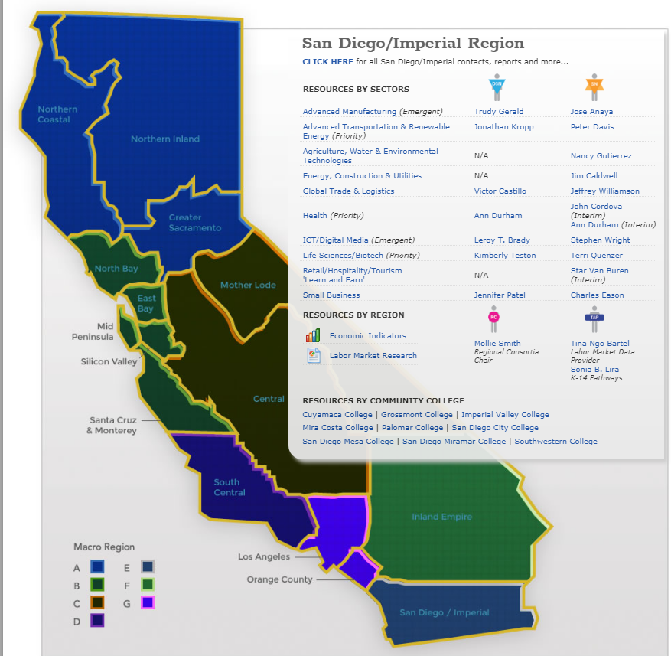
San Diego & Imperial Counties Regional Consortium
  CONTEXT
  Regional economies: Sector approach
  Advanced Manufacturing
  Advanced Transportation & Logistics
  Agriculture, Water & Environmental Technologies
  Energy, Construction & Utilities
  Global Trade
  Health
  Information & Communication Technologies (ICT)/Digital Media
  Life Sciences/Biotech
  Retail/Hospitality/Tourism
  Small Business
Doing What Matters for Jobs and the Economy
2012

Slide 4
San Diego & Imperial Counties Regional Consortium
State Task Force
Strong Workforce Recommendations
Adopted by the Board of Governors in Fall 2015
25 Recommendations
Student Success
Career Pathways
Workforce Data & Outcomes
Curriculum
CTE Faculty
Regional Coordination
Funding

Slide 5
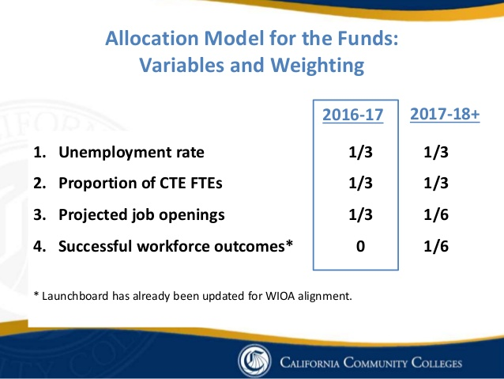
San Diego & Imperial Counties Regional Consortium
More and Better CE
Regional funding: 60% local/40% regional
Allocation model (⅓, ⅓, ⅙, ⅙)
San Diego Imperial Counties = $16,510,427
Colleges = $9,910,427
2016-17
Strong Workforce
$248 million
ongoing funding for
Career Education

Slide 6
San Diego & Imperial Counties Regional Consortium
MORE = Increased CE enrollments
BETTER =
  Completion (certificate, degree or transfer)
  Employment
  Employment in the field of study
  Increase in earnings
  % of students who attained living wage
Metrics =
Performance Based Funding

Slide 7
San Diego Imperial Counties
Governance
Regional Infrastructure

Slide 8
Large infrastructure projects
    Career Pathways
    Work-based Learning
    Pathway Navigation
    Job Placement
    Labor Market Information
    Marketing
Regional Investments

Slide 9
Labor
Market Information
Sector Analysis
Evaluate labor market gaps and oversupply
Evaluate program performance
Create a strategy to meet labor market gaps
Disseminate labor market information to K-12 and Adult Education

Slide 10
Regional
Marketing
June 2018
Common CE branding
Focus on careers
Prioritization of target CE programs & audiences
Matching media format with audience
Marketing high-wage/high-demand careers
Measure effective marketing

Slide 11
Document career pathways from HS/AE to CC’s within the region
Create a regional career pathways design
Align curriculum and course sequences from HS, AE to colleges
Build awareness of careers in middle school and high school
Provide technology for access to career pathways
Career Pathways

Slide 12
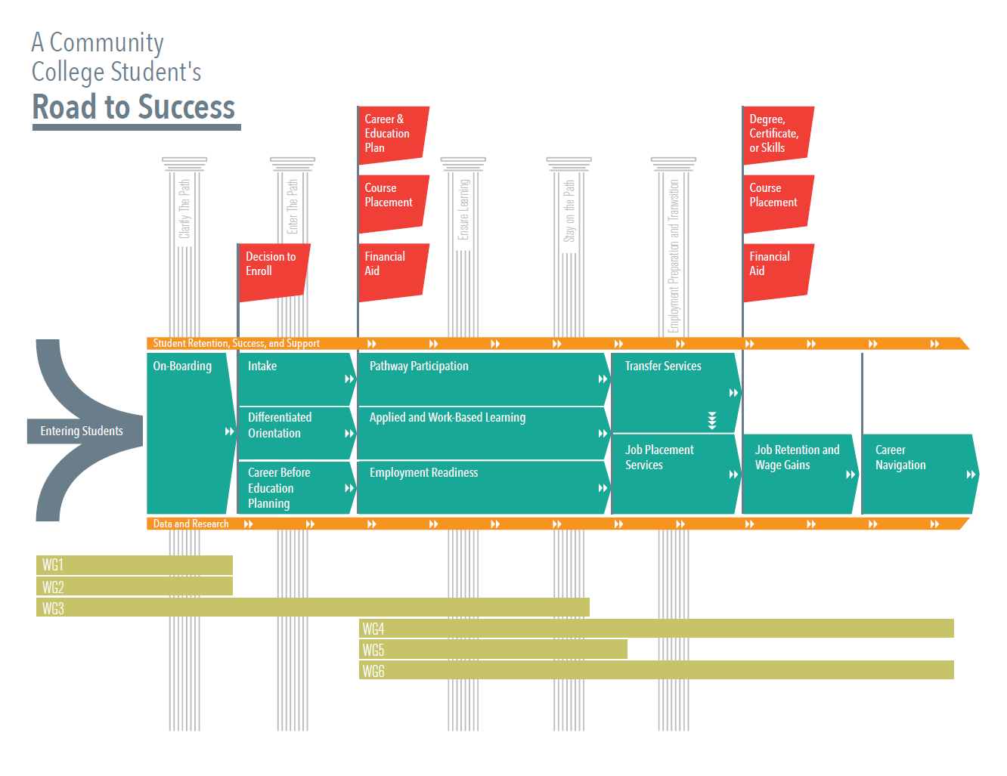
Context

Slide 13
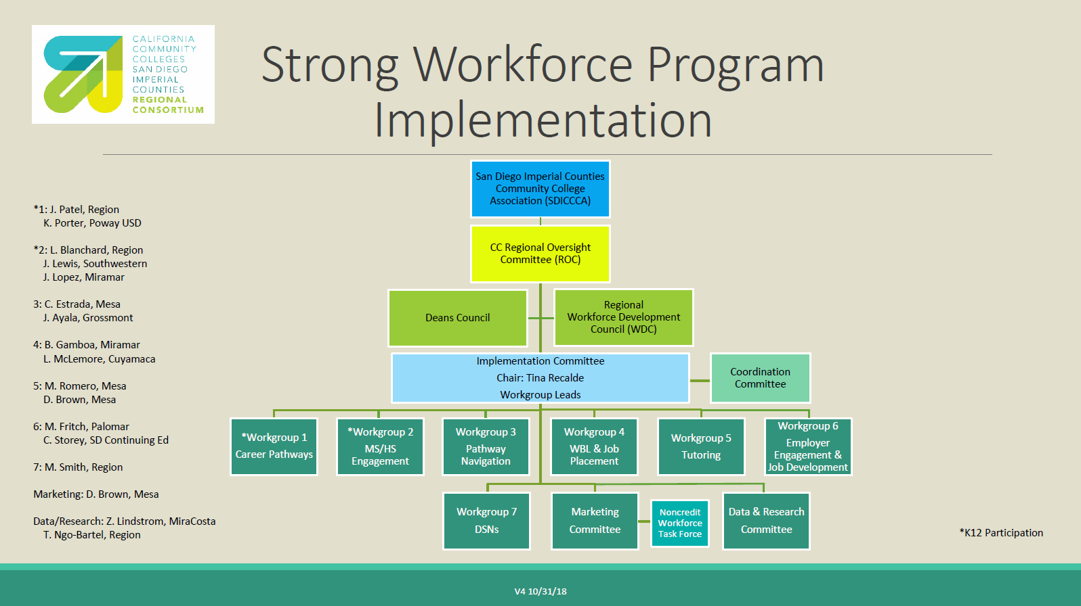
Strong Workforce
Regional
Implementation

Slide 14
K-12 Strong Workforce

Slide 15
2018-19 Funding Administered by CCCCO
$150M
$14M
$150 million – administered by the Chancellor’s Office, partnered w/CDE
Emphasis on collaborative approach between systems
Create, support, and/or expand high-quality career technical education programs at the K-12 level that are aligned with and the workforce development efforts occurring through the Strong Workforce Program and regional priorities
Increase the transition from secondary to post secondary and career
Competitive; available only to K12
$14 million – administered by the Chancellor’s Office, partnered w/CDE
  K-12 Workforce Pathway Coordinators (est. 114)
  Network of K-14 Regional Technical Assistance Provider (est. 8)
  Statewide K-14 Regional Technical Assistance Provider (est. 1)
  CTE Regional Consortia administrative costs

Slide 16
Regional Allocation* Model Weighted Factors
$150M
Regional unemployment rate 33%
Regional average daily attendance for pupils in grades 7-12 33%
Regional proportion of job openings 34%
(Formula for small school district LEA ada)
(Data sources: EMSI and CalPADS)
*Chancellor’s Office will flow dollars to fiscal agent of
CTE Regional Consortia to administer.

Slide 17
$150 million Statewide
$14,701,200 Allocation to the Southern Border Region
January 7, 2019 - Letters of Intent due
TBD (January – March) – Selection Committee application and selection
March 15, 2019 – Applications due
April 30, 2019 – LEA’s receive notice of allocation
June 15, 2019 – Funding disbursed
K-12 Strong Workforce
in the
Southern Border Region

Slide 18
K12 Strong Workforce Selection Committee
Each CTE Regional Consortium shall form a K-12 Selection Committee made up of individuals with expertise in K-12 career technical education and workforce development:
Current or former K-12 career technical education teachers and administrators.
Charter school representatives, including representatives of charters operating pursuant to Education Code Section 47612.1(a).
Career guidance counselors.
Representatives of industries that are prioritized by the consortium.
At least one community college faculty or administrator.
Other K-12 education or other stakeholders as determined by the consortium. (b) The K-14 Technical Assistance Provider* in each consortium shall serve as a consultant to the K-12 Selection Committee.

Slide 19

Overview of Efforts to Date
1. Areas of Focus
2. Workgroup Goals
3. Products
4. Framework for Next Steps
WORK TO DATE

Slide 20

Areas of Focus
1. Middle School Engagement
2. High School Engagement
3. Improved or Expanded
Career Pathways
WORK TO DATE

Slide 21

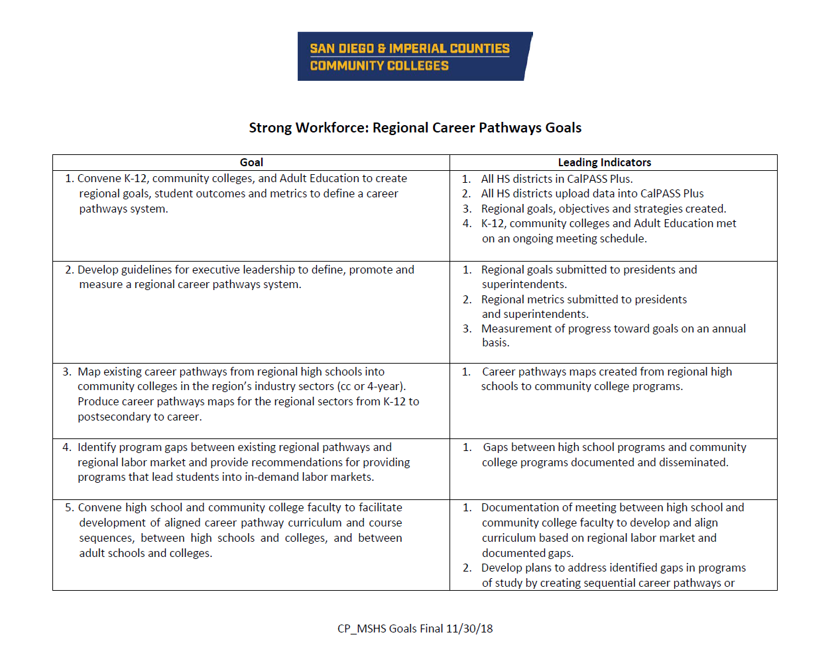
Career Pathways Regional Goals and
Middle and High School Engagement Regional Goals
WORK TO DATE

Slide 22
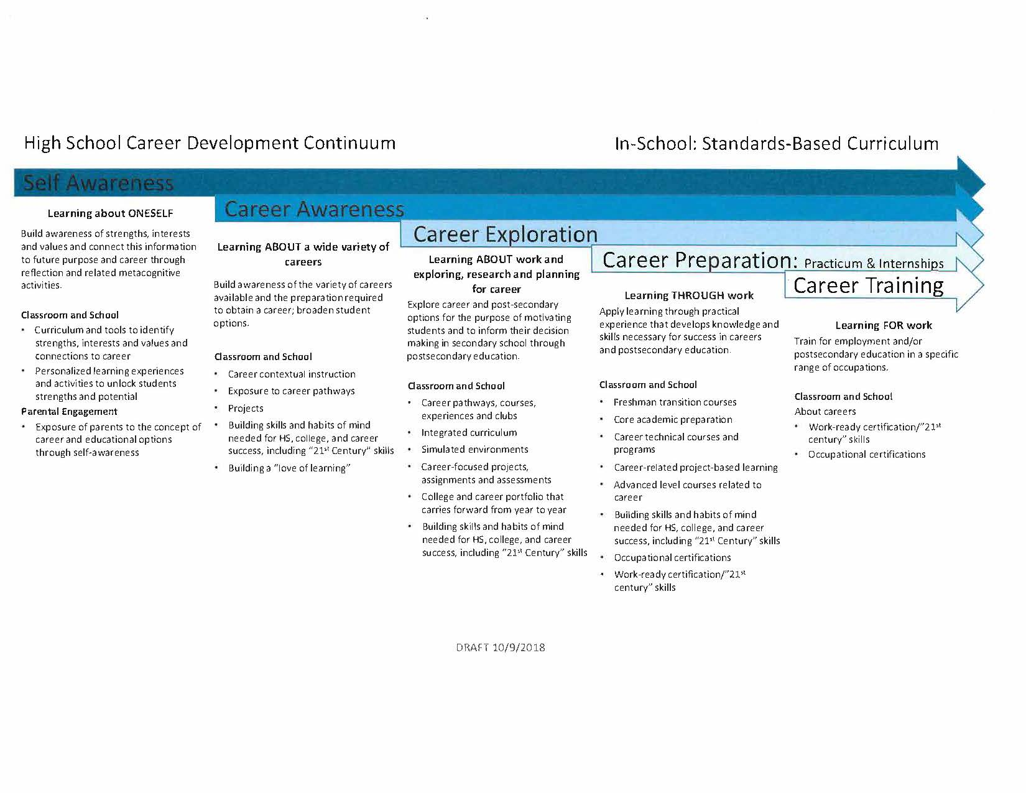
Career Development Continuum
WORK TO DATE

Slide 23
Discussion
1. I like …
2. I suggest …
3. I wonder …
WORK TO DATE

Slide 24

Proposed Framework for Next Steps
1. Career Pathways Workgroup monthly (3rd Wednesdays)
2. MS/HS Engagement Workgroup monthly (2nd Thursdays)
3. Regional Convening every other month (odd months)
4. Regular Updates and Communication (K12 SWP and Regional listserv)
5. Next meeting: Wednesday, January 16 1-3 PM
(Location TBD)
WORK TO DATE

Slide 25
Stay Informed
Subscribe to the statewide K12 SWP listserv to receive information by email
Visit the K12 SWP timeline for important dates
Review the Regional List of Eligible LEAs and register to attend an upcoming regional engagement meeting
Bookmark the K12 SWP website at: http://doingwhatmatters.cccco.edu/StrongWorkforce.aspx as the official source of information for the K12 SWP

Slide 26
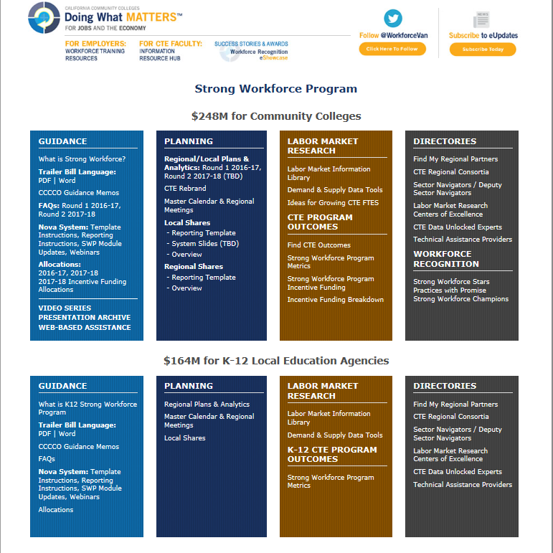
Information and Updates
http://doingwhatmatters.cccco.edu/
StrongWorkforce.aspx

Slide 27
San Diego & Imperial Counties Regional Consortium
?
Questions

