Slide 1

From Super to Holland to Krumboltz: Applying Historical and Contemporary Theories of Career Development
Mona Patel: career counselor and career center director-Miramar College
Kellie Corbisiero: career counselor- southwestern college and connect career consulting
Notes:
KELLIE

Slide 2
“Career counseling is the process of assisting individuals in the development of a life-career with focus on the definition of the worker role and how that role interacts with other life roles.” NCDA
Notes:
KELLIE

Slide 3

Presentation overview
Traditional Approach to Career Selection
Self-Concept Theory: Donald Super
Personality Theory: John Holland
Happenstance Theory: John Krumboltz
Generational Focus
5 minute Assessment
Career Coaching vs. Career Counseling
Career Theoretical and Coaching Training Resources
Notes:
KELLIE

Slide 4
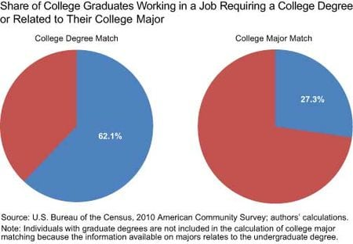
1. Traditional approach to career selection
Underfunding career exploration
Primary focus college/major
Why this approach doesn’t work….
Notes:
KELLIE
Think back to high school……
Most schools lack money for career counselor
Most schools focuses on college/major
Why this approach doesn’t work.

Slide 5
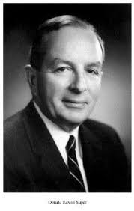
2. Self Concept Theory: Donald Super
Stage 1: Growth Age 0–14
Stage 2: Exploration Age 15–24
Stage 3: Establishment Age 25–44
Stage 4: Maintenance Age 45-64
Stage 5: Decline Age 65+
Notes:
KELLIE
Stage 1: Growth Age 0–14 Characteristics: Development of self-concept, attitudes, needs and general world of work
Stage 2: Exploration Age 15–24 Characteristics: “Trying out” through classes, work experience, hobbies. Tentative choice and skill development
Stage 3: Establishment Age 25–44 Characteristics: Entry-level skill building and stabilization through work experience
Stage 4: Maintenance Age 45-64 Characteristics: Continual adjustment process to improve position
Stage 5: Decline Age 65+ Characteristics: Reduced output, prepare for retirement

Slide 6
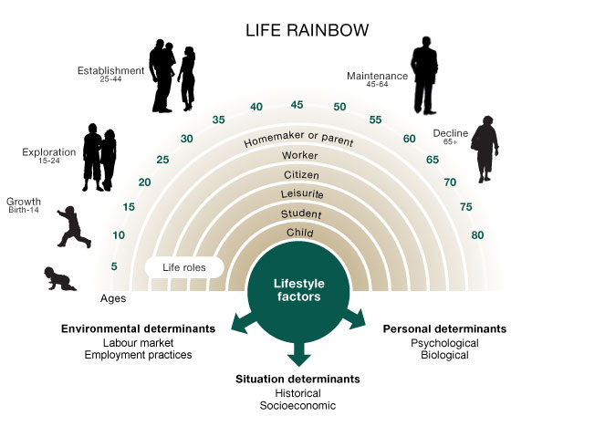
2. Self concept theory: Donald Super
Notes:
KELLIE

Slide 7
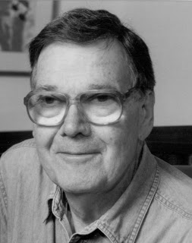
3. Personality theory: john Holland
Dr. Holland reasoned that people work best in work environments that match their preferences.
Holland Codes are a set of personality types developed by psychologist John L. Holland in the 1970s.
Notes:
MONA

Slide 8
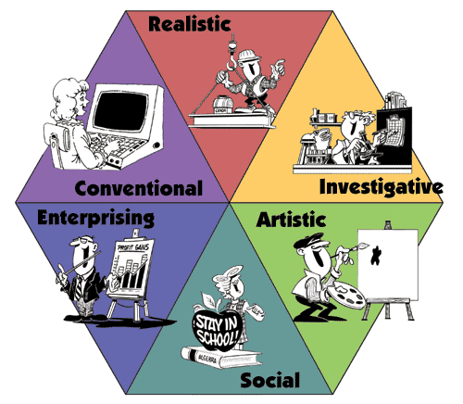
Personality theory: john Holland
Most people possess one of six modal personality types:
Realistic (R)
Investigative (I)
Artistic (A)
Social (S)
Enterprising (E)
Conventional (C)
Notes:
MONA

Slide 9
4. Happenstance Theory- John Krumboltz
“Career counselors can teach their clients to act in ways that generate a higher frequency of beneficial chance events on which clients can capitalize.” (Mitchell/Levin/Krumboltz 1999)
Curiosity: exploring new learning opportunities
Persistence: exerting effort despite setbacks
Flexibility: changing attitudes and circumstances
Optimism: viewing new opportunities as possible and attainable
Risk Taking: taking action in the face of uncertain outcomes
Notes:
MONA

Slide 10
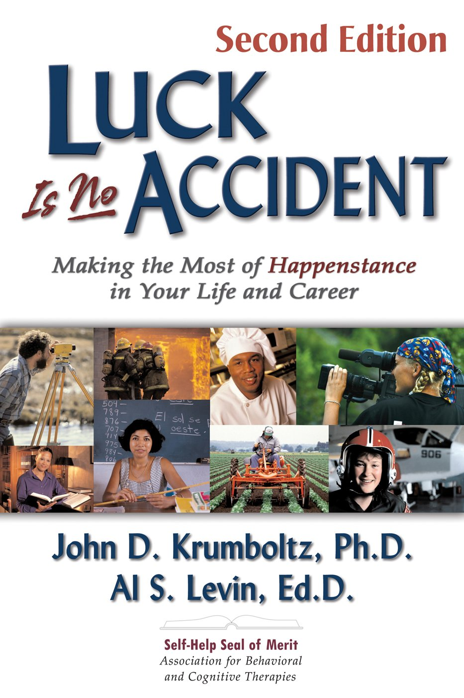
4. Happenstance theory: john krumboltz
“Planned happenstance theory is a conceptual framework extending career counseling to include the creating and transforming of unplanned events into opportunities for learning”
Planned happenstance theory includes two concepts:
Exploration generates chance opportunities for increasing quality of life
Skills enable people to seize opportunities.
Notes:
MONA

Slide 11

4. Happenstance theory: krumboltz
“I want you to find me the ideal job” Students Appeal
Student Expectations: Expect counselors to match them up with ideal jobs
“If I had the ideal job for you in my pocket, Id take it out and hand it to you right now.”
Teaching them how to enhance the quality of their lives.
Notes:
KELLIE
Clients often expect counselors to match them up with ideal jobs, and counselors often play into the clients unrealistic expectations by failing to challenge the assumption that a career counselor can actually meet this request.
Instead of playing along, perhaps it would be better for counselors to say, if I had the ideal job for you in my pocket, Id take it out and hand it to you right now. But that's not the way the system works.
It would imply we are robots and could be programed for a solution.
You want to build a satisfying life for yourself. Id like to help you LEARN how to do it. Instead of striving to help clients identify their one ideal job, career counselors may be of far more value to clients by teaching them how to enhance the quality of their lives.”
Teach them how to fish……,

Slide 12
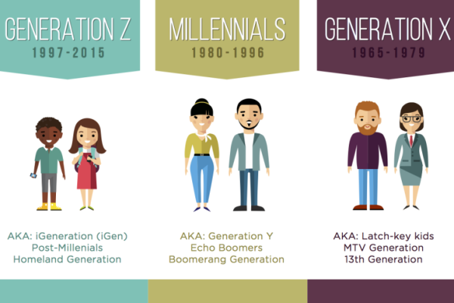
5. Generational focus
Baby Boomers: 1946-1964 (Ages 54-72)
Generation X: 1965-1979 (Ages 39-53)
Millennials/Gen Y: 1980-1994 (Ages 24-38)
iGen/Gen Z: 1995-2012 (Ages 6-23)
Notes:
MONA

Slide 13

6. 5 minute assessment
Undecided Student:
Let’s consider a career field and remove the major factor.
  Are there any career fields that interest you?
  Are you truly unsure of career options?
Decided Student:
That’s great that you have a major. Do you have any ideas about what you could do with that major? Do you have some careers in mind?
What do you know about the careers in the field?
Do you know anyone that does that job?
Notes:
KELLIE
Undecided Student:
Let’s consider a career field and remove the major factor.
Are there any career fields that interest you?
Are you truly unsure of career options?
AVOID: You like working in an office you should be a business major or you like Dance you should be a Dance major
Decided Student:
That’s great that you have a major. Do you have any ideas about what you could do with that major? Do you have some careers in mind?
What do you know about the careers in the field?
Do you know anyone that does that job?

Slide 14

7. Career coaching vs. career counseling
Career Coaching: Similar to an athletic coach.
Career Coaching—Focuses on solutions and skills needed in the job search.
Career Counseling: A holistic approach
Career Counseling—Focuses on utilizing resources to understand and make a career decision
Notes:
KELLIE
Career Coaching: Similar to an athletic coach. They are going to assess where you are and encourage/challenge you, to a better you. They may focus on outcomes/results/accomplishments.
Career Counseling: A holistic approach exploring our past, present influences as they relate to internal barriers.
Career coaching—Focuses on solutions, insight, and action. It is a positive approach that focuses on a client’s capabilities, helping him or her to practice and hone skills needed in the job search. Coaching is active, focused, positive, and outcome-oriented.
Career counseling—Focuses on establishing a therapeutic and confidential alliance with clients using core counseling techniques requiring adherence to all state and federal regulations related to counseling.

Slide 15
8. Career Theoretical and coaching training
Career Theory Training (For Counselors):
  Connect Career Consulting: www.connectwithcareers.com
Career Coaching Options:
  NCDA: Facilitating Career Development Training
  UCSD extension: Career Advising Certificate
  NACE: Career Coaching
Career Counseling Programs:
  California State University, Sacramento
Additional Training Recommendations:
  MBTI Training- See Consulting Psychologist Press (CPP) for approved providers
    GS Consultants offers fully online option
Notes:
KELLIE: CAREER THEORY AND COACHING PROGRAMS
MONA: CAREER COUNSELING PROGRAMS AND ADDITIONAL TRAINGING

Slide 16

Questions
Notes:
MONA & KELLIE

