Slide 1

Career Counseling Techniques for the Student Veteran
Erik Moberly, Veteran & Academic Counselor, Southwestern College
Kellie Corbisiero, Career & Academic Counselor, Southwestern College

Slide 2
Presentation Topics
The Student Veteran Experience
Veteran Transition Experience
College Experience
What it's Like
Mental and Physical Health Concerns
Career Process
Vocational Rehabilitation
Career Resources

Slide 3

The Student Veteran Experience
How are Student Veterans Unique and Different from other Students.
What is their overall experience or impression of College.
Why do most of them come to college?

Slide 4

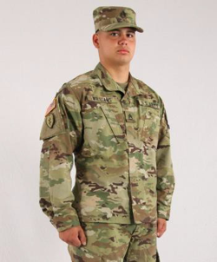
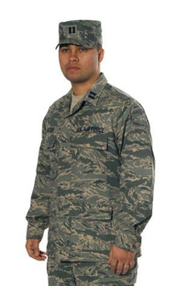
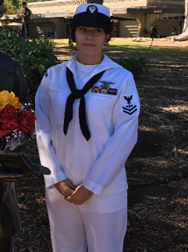

What's in a Name?
Marine Corps Marine | Army Soldier | Air Force Airman | Navy Sailor Ratings | Coast Guard Coast Guardsman

Slide 5

Getting Out is A Lifestyle Change
Becoming a Civilian
  Losing Structured Environment/Schedule
  Losing Camaraderie
  Getting a Job
  Choosing What to Wear
  Finding Housing
  Eating
Being a Veteran
  Pride in Service
  Silence About Service
  Seeking that “Band of Brothers”

Slide 6
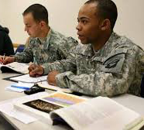
Student Veterans In High Education
Issues
Challenges
Concerns

Slide 7

What It's Like

Slide 8

Why are Veteran Students Different?
Job Experience
Peer Interaction
Responsibility for People
Family
High Training Tempo
Deployments
Combat

Slide 9
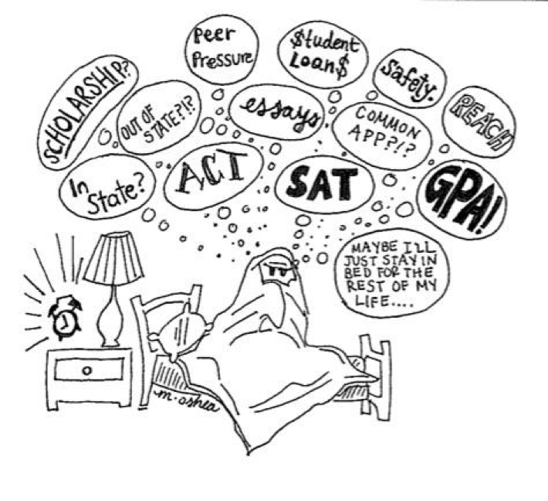
Misunderstanding
62% of Student Veterans are First Generation College Students
Lack Cultural Capital
No “Mentorship”

Slide 10
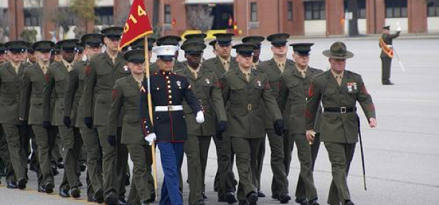

Student Life-Culture Shock
Becoming a Student
Choosing a Major
Selecting Classes
Studying
Questioning Authority
Being a Fellow Student

Slide 11
GI Bill
As of March 1 2019 the DVA has issued over 95,000,000,000 dollars in post 9/11 GI bill benefit payments to over 2,000,000 individuals since August 2009.
Chapter 33 post 9/11 GI bill (also called the forever GI bill) will pay students a housing stipend for 36 months based on their zip code and pay for tuition to any public college/university/trade school and up to 22,000 a year for private schools.
There is a 9 month extension for STEM majors
Full time vs above part time enrollment will affect housing stipend
Required courses vs recommended courses on S.E.P.
Only paid for courses while they are taking the class, (late start classes)

Slide 12
Health Concerns
Military Sexual Trauma (Experienced by Men and Women)
  MST is defined by Title 38 U.S. Code 120D.
  It states MST is:
  Psychological trauma resulting from a physical assault of a sexual nature
  Battery of a sexual nature
  Sexual harassment which occurred while the Veteran was serving on:
    Active Duty
    Active Duty for Training
    In Active Duty Training

Slide 13
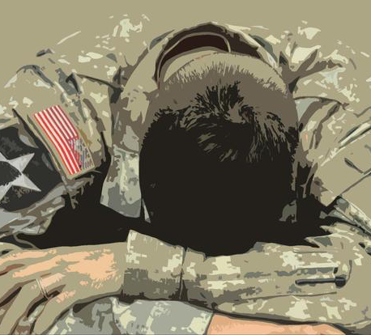
Mental Health Concerns
Posttraumatic Stress Disorder (PTSD)
  An anxiety disorder that can occur following the experience or witnessing of a traumatic event such as:
  Combat (War or Conflict)
  Childhood abuse, rape, torture, captivity
  Car accidents, train/plane crash, bombings
  Assault, mugging, Natural disasters
  TBI traumatic Brain Injury
Posttraumatic Stress (PTS)
  Most people experience some type of Post-Traumatic Stress during their Lifetime
Substance abuse

Slide 14
Anxiety and Depression
http://www.halfofus.com/video/anxiety-disorders/

Slide 15


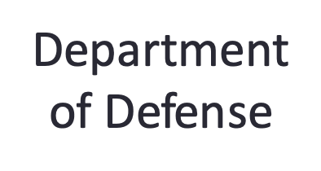


Transitioning
Civilian
Career

Slide 16

Career Process
Not their first Career
Need Direct Support
  Practical Clear Steps
Personal Hand-off
Beginning to End Steps to Success
  Understanding the Job Market
  Importance of education & experience

Slide 17

Not Their First Career
College was an Afterthought
Need to use Benefits
Goal Refocus
Goal Identification
Structure
Notes:
*A lot of veterans went into the military because they thought college was not for them, they may have had a negative experience in HS
*Clear definition of career path and goals-identify a job vs career field
*Clear instructions on what to do. Step 1, Step 2, Step 3 (First we do an assessment, then we go over the results, then we meet to research careers. ) Walk student to make an appt, do not send them out into the world)
*Often a bit more hand holding at first.

Slide 18
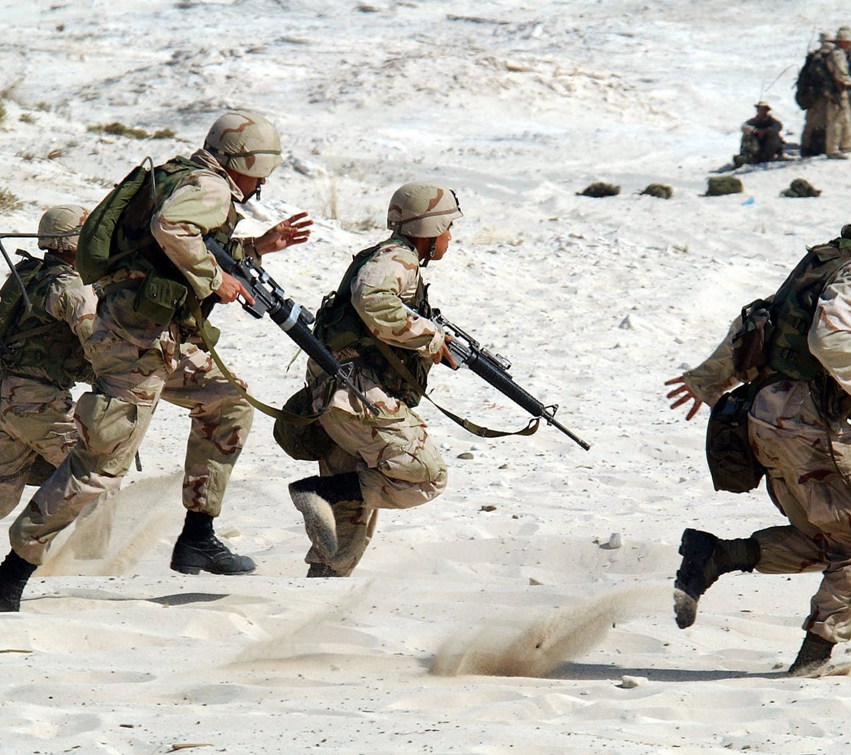
Life Career Experience
Possible Trauma Associated with Military Experience
Military Experiece may be negative or positive
What life experience do they have that you can incorporate into a resume
  Time Management
  Following Instructions
  Understanding of the translation of Military associated duties to transferable skills.

Slide 19

Their Unique Journey
Understand the Journey and Understand the Student Experience:
Tell me about your Transition into Civilian Life.
Tell me your story (Family, personal life, goals).
Tell me what you know about career development.
Build rapport and trust first!
Notes:
* Tell me about your transisition into civilian life, how is it going?
*Military culture compontent into building repport

Slide 20

Their Goals
Practical Resources:
How to Obtain a Job/Apply for One in Civilian Workforce.
How to remove military lingo and references from resume for non-military related jobs.
Switch to listing achievements, not duties.
Clear steps and instructions and direct approach.

Slide 21

Vocational Rehabilitation
Must select a Career that they can physically do based on their abilities as assessed by their VA Vocational Rehabilitation Counselor
Must complete a comprehensive packet that needs to include:
  The complete SEP and SxS with estimated completion date.
  2-3 Jobs that are posted now that utilize the education the student would be receiving.

Slide 22
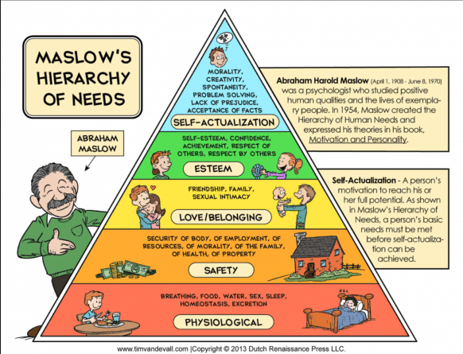

Slide 23
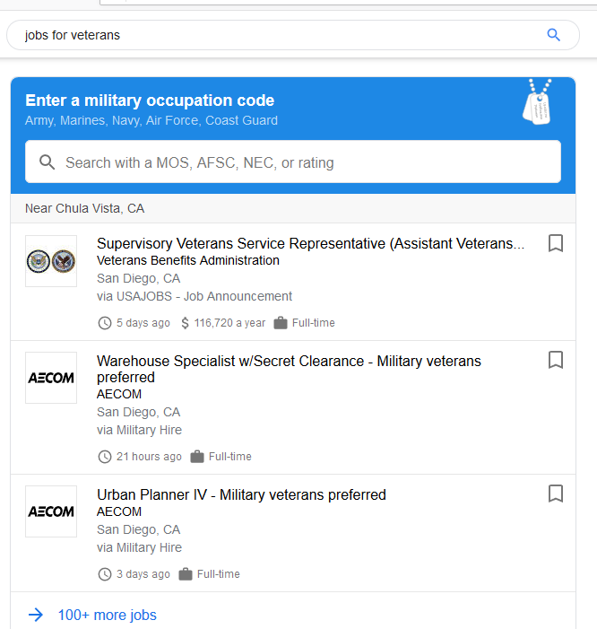


Slide 24
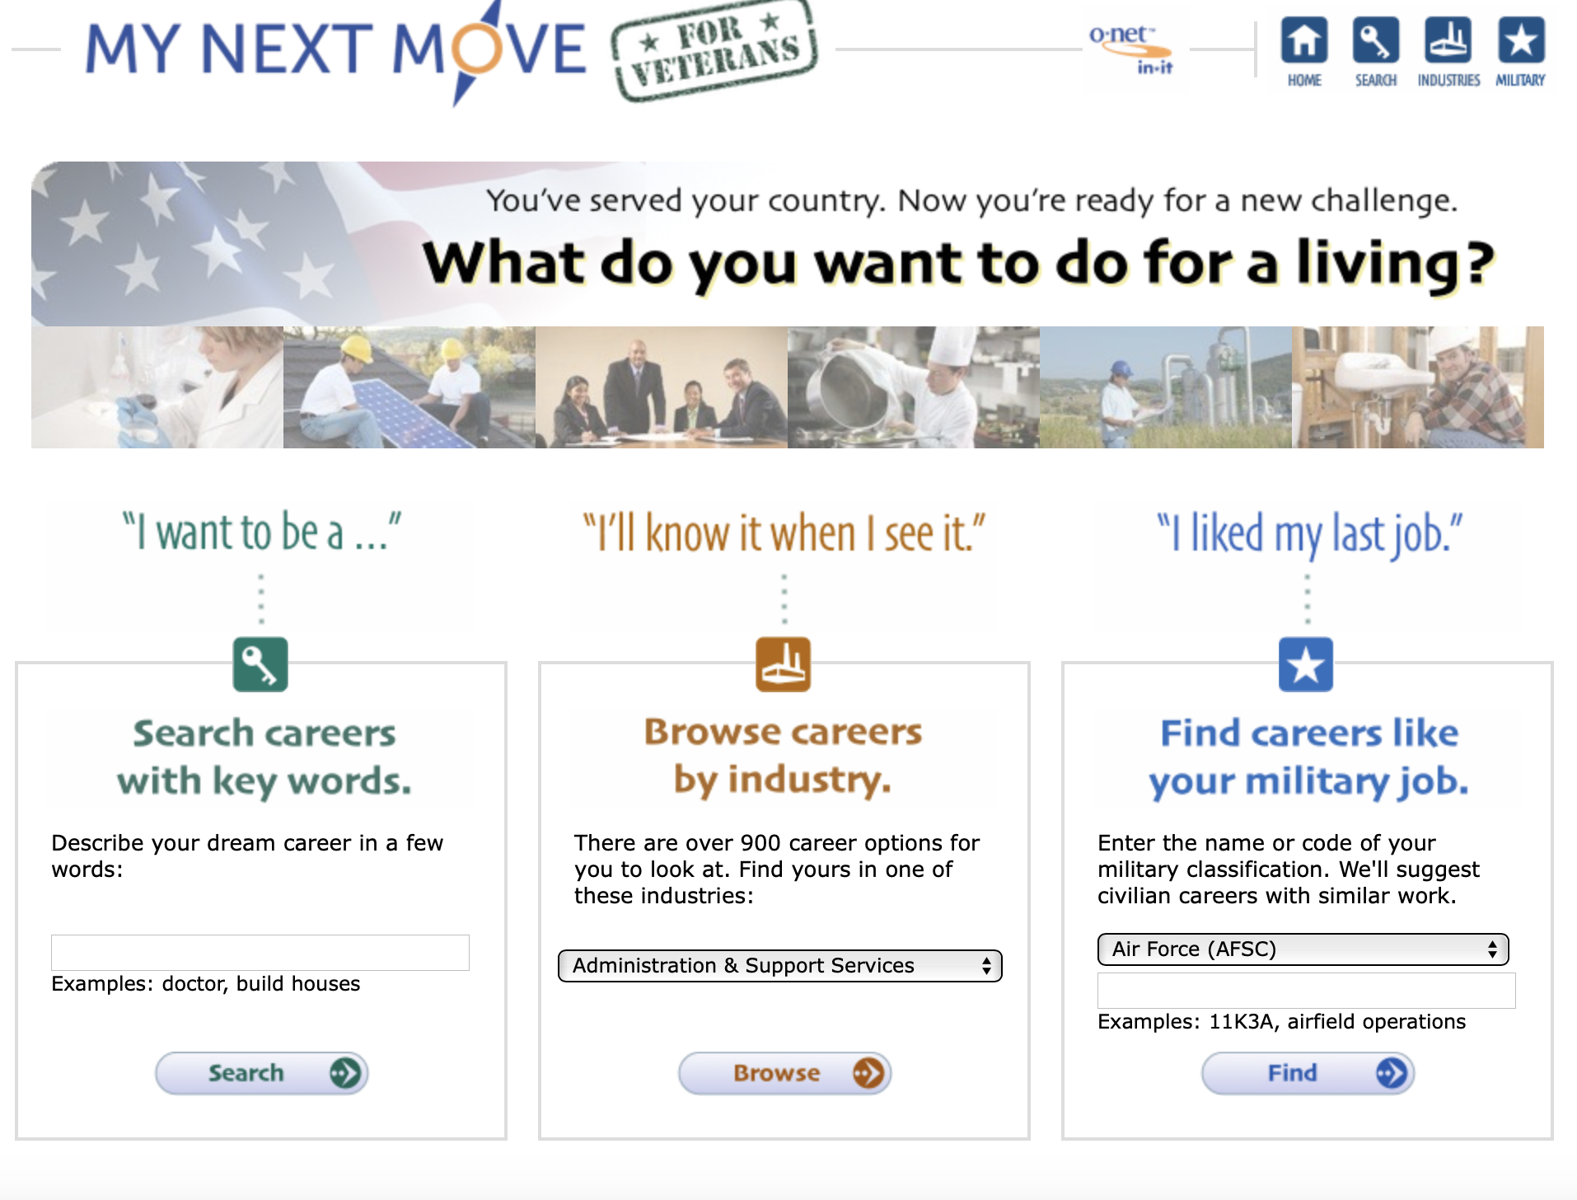

Slide 25
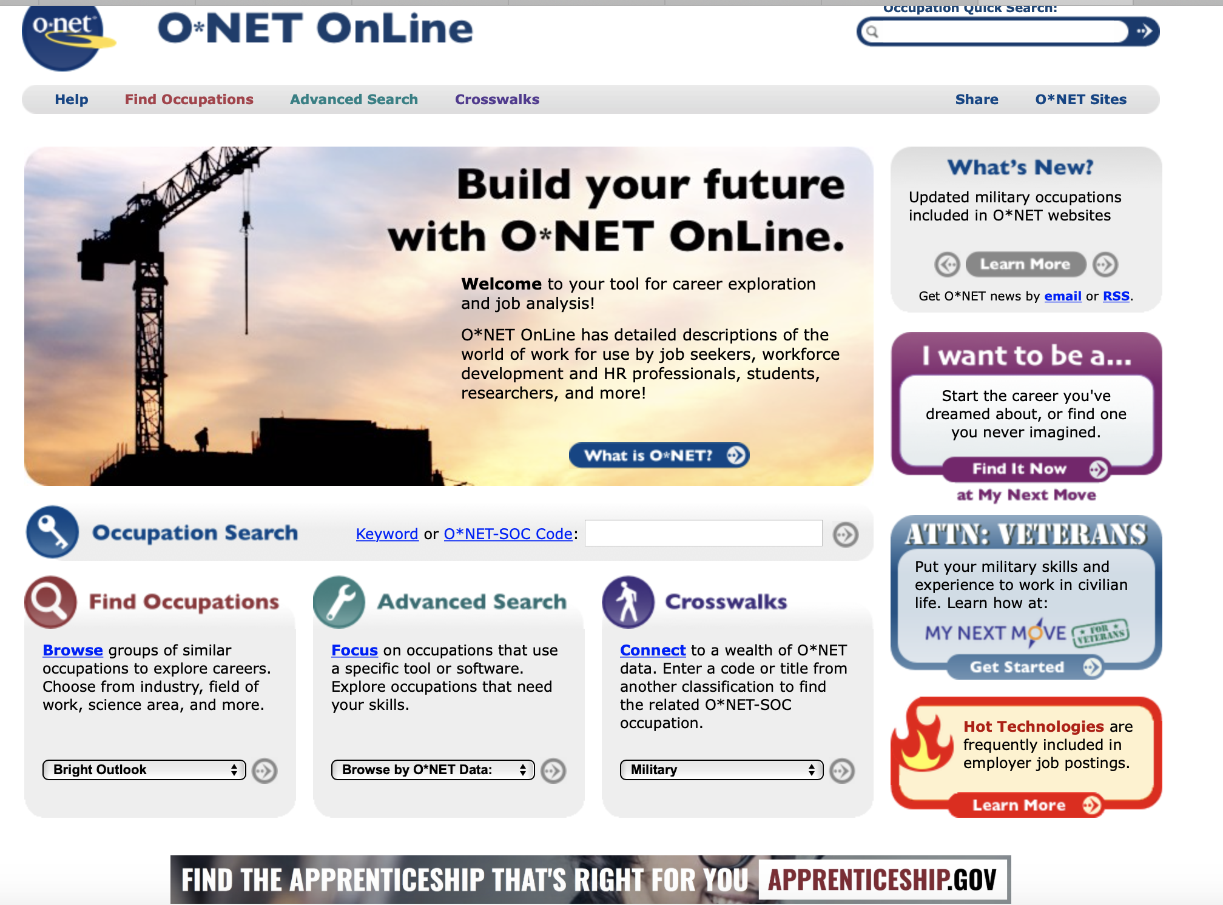

Slide 26


Federal and State Job Hiring Preference
Federal: Priority hiring and can finish retirement years if needed.
  Website uses scanning software to scan resume uploaded for a match to the job description.
  Difficult to get in without knowing someone.
  Government Contractor-> Government Employee
State: Priority consideration for all positions
  Uses an exam-based process.
  Exams are a combination of education and experience for most positions and can be done online.

Slide 27
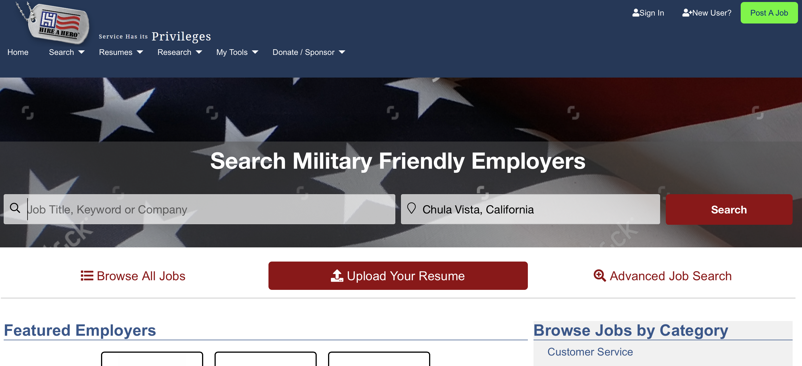
Hire a Hero- Non-Profit hireahero.org

Slide 28
Resources for Veterans
Google MOS Code Search
  Google "Jobs for Veterans" Enter MOS
My Next Move
  www.mynextmove.org/vets/
Hiring Preference State and Federal
https://www.benefits.va.gov/BENEFITS/factsheets/serviceconnected/MST.pdf
Hire a Hero
  Hireahero.org

