Slide 1









CTE Transitions and Opportunities for Early College Credit

Slide 2
The San Diego Region
CTE Transitions Contacts
Cuyamaca College Kate Miller
Grossmont College Erica Olmos
Imperial Valley College Roxanne Nunez
MiraCosta College Amy Pimentel
Palomar College Elena Chirkova-Sikora
San Diego City College Eric Anthony
San Diego Mesa College Eric Anthony
San Diego Miramar College Eric Anthony
Southwestern College Anthony Griffen

Slide 3
Who’s in the Room?
K-12 Counselors
K-12 Teachers
Adult Education partners
College Faculty
College Counselors
College Administrators

Slide 4
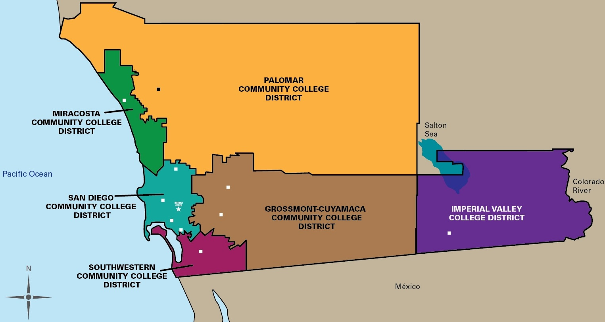
The San Diego Region

Slide 5
CTE Transitions
Articulation:
Articulation is the process of evaluating courses to determine whether course-work completed at a high school will meet the requirements at a community college for the purpose of advanced placement or credit by exam units.
    Reference: State Career Pathways, www.statewidepathways.org
Notes:
The articulation process is designed to help students advance from one course, program or educational level to the next without the unnecessary repetition of essentially similar courses for which credit has been received. When students obtain advanced placement in or credit for college while still enrolled in high school, it enables them to achieve their goal of completing a certificate or degree in a shorter time.
An articulation agreement is a formal, written, and published document that describs which coursework from the “sending” institution (typically the high school) is accepted as comparable to or in lieu of coursework at the “receiving” (community college) institution.
There are multiple processes to articulate classes, like concurrent enrollment, dual enrollment, or credit by exam.

Slide 6
CTE Transitions
Benefits to Articulation
  Accelerates college degree completion through advanced placement and/or college credit
  Saves students time in completing college certificates or degrees
  Minimizes course duplication
  Reduces costs to students
  Transitions students from high school to college
  Develops collaboration between institutions
  Credit optional; low risk to student’s financial aid eligibility
  Helps students get on a path, stay on a path

Slide 7
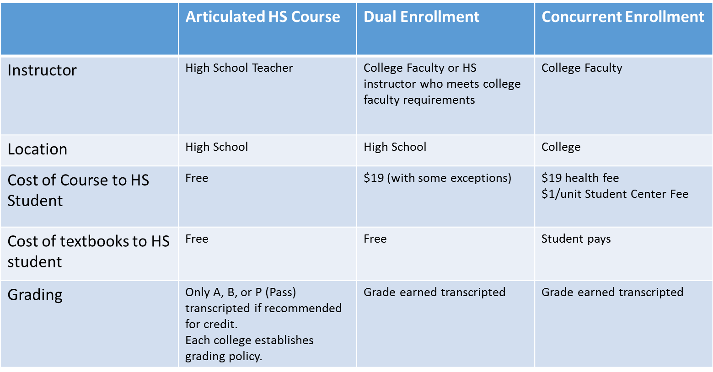
Other Methods of
Early College Credit

Slide 8
Methods of Articulation
Credit by Exam
  Through the credit by examination process, high school students may receive college credit for some articulated courses. Credit by examination means that a high school student has demonstrated proficiency in college-level studies by satisfactorily passing an exam approved or conducted by a discipline faculty member of the “receiving” community college, and that the student will receive college credit for the comparable community college course named in the articulation agreement. This process varies by college.
    Reference: State Career Pathways, www.statewidepathways.org

Slide 9
Career and Technology Education Management Application
CATEMA
  Web-based application and database used for student record keeping for the awarding of articulated college credit.
  CATEMA is used to:
    Minimize the tasks necessary for the students, teachers, and system staff
    Provide easily accessible and printable data in detail & summary reports
    Assure data is accurate and secure, with separation of student, teacher, and school information
    Validate all data at the point of entry to reduce entry errors
    Provides intersegmental access to everyone involved in the process

Slide 10
CTE Transitions Credit by Exam
Articulation Process/Practices
Agreement Development
Implementation
Awarding College Credit
Request agreement
Exchange curriculum
Agree on method of examination
Approved by college faculty
Agreement signed by all participating high school teachers and principals
High school teachers and students maintain CATEMA accounts
Student’s exam grades become college transcript grade
Valid CATEMA account
Earn grade of A or B in class and exam
Complete college admission application
Submit Petition for Credit form with signature
Submit official high school transcript

Slide 11
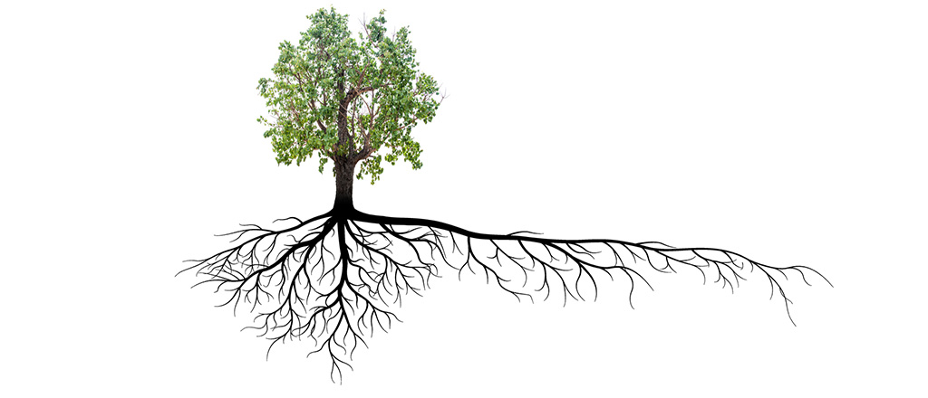
Areas for Growth

Slide 12

Success Stories

Slide 13

Questions

Slide 14
THANK YOU!

