Slide 1
Career Technical Education Completer Survey and Reporting Instructions
California Department of Education
Career and College Transition Division
Career Technical Education Leadership and Support Office
TONY THURMOND

Slide 2
Agenda
CTE Completer Data Reporting Overview
Postsecondary Status File Overview
Who should LEAs survey?
How can I identify these students?
CALPADS Reporting
CTE Completer Template Overview (with CALPADS Mapping)
Frequently Asked Questions
Open Discussion

Slide 3
CTE Completer Data Reporting Overview
The Strengthening Career and Technical education for the 21st Century Act (Perkins V), established new CTE performance indicators and modified federal reporting requirements (formerly, E2 reporting) for Career Technical Education (CTE) completers.
All local education agencies (LEAs) operating CTE programs are now required to submit postsecondary status data of their CTE Completers, regardless of whether they receive Perkins V funding.
Both the Career Technical Education Incentive Grant (CTEIG) and Strong Workforce Program (SWP) K–12 grant programs require LEAs to annually submit additional CTE completer information to the CDE to remain eligible for future funding. This survey template captures all the data required to be reported for all three programs (Perkins, CTEIG, and SWP K-12).
The CTE Completer data reporting period of the Postsecondary Status File (PSTS) begins on January 9, 2021 and must be submitted to the CDE by March 5, 2021.

Slide 4
CTE Completer Data Reporting Overview
Definition of CTE Completer:
For the purpose of PSTS reporting, CTE Completers are defined as any student who left secondary education in 2019–20, completed a CTE sequence of courses of 300 hours or more, and passed the capstone course (C- or better).

Slide 5
CTE Completer Data Reporting Overview
Pupils who were a CTE Completer at any time during high school, and exited secondary education in 2019–20 with a School Completion status, meeting one of the following:
Graduated, standard high school (HS) diploma (100)
Students with Disabilities Certification of Completion (120)
Adult education HS diploma (250)
Received a HS Equivalency Certificate (320)
Passed the California HS Proficiency Exam (and no standard diploma) (330)
Completed grade twelve without completing graduation requirements, not grad (360)

Slide 6
Postsecondary Status File Overview
The CALPADS File Specifications (CFS) includes a Postsecondary Status (PSTS) file that will be used by LEAs to submit postsecondary status data for:
  CTE Pathway Completers as required by Perkins V as part of Fall 2
  Students with Disabilities (SWD) as required by the Individuals with Disabilities Education Act (IDEA) as part of End-of-Year 4
Since the PSTS file will be used for two purposes, not all of the fields on the PSTS file are required for the CTE submission

Slide 7
Postsecondary Status File Overview
Fall 2 Deadline: March 5, 2021
PSTS File submission starts after January 9, 2020 when the Fall 2 window opens

Slide 8
Who should LEAs survey?
LEAs should survey CTE pathway completers, as currently defined, who exited secondary education in the 2019-20 academic year (regardless of cohort) and were not expected to return
This should include any student who was a CTE pathway completer at any time during high school in grades 9-12

Slide 9
How can I identify these students? (1)
Student Information Systems (SIS) may have functionality to identify these students, OR
LEAs can use CALPADS to assist in identifying these students:
  Step 1: Find students who exited secondary education in 2019-20
    Use ODS report 8.1a Student Profile – Exits
    Apply the following filters:
    Enrollment Status: 10, 30
    From Date: 8/16/2019
    Through Date: 8/15/2020
    School Completion Status = 100, 120, 250, 320, 330, or 360
      Make sure to run the Completion Status and Exit Reason filters in two different steps to make sure all students are identified

Slide 10
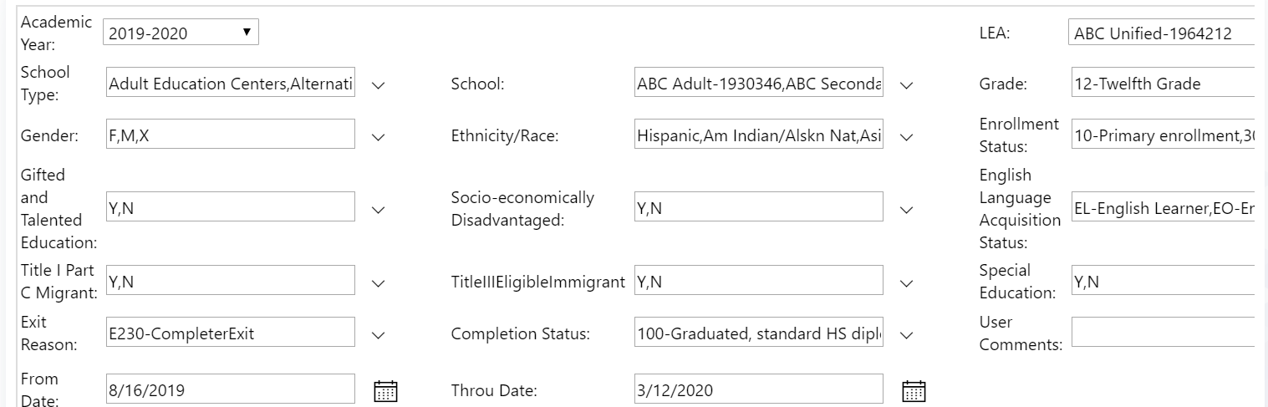
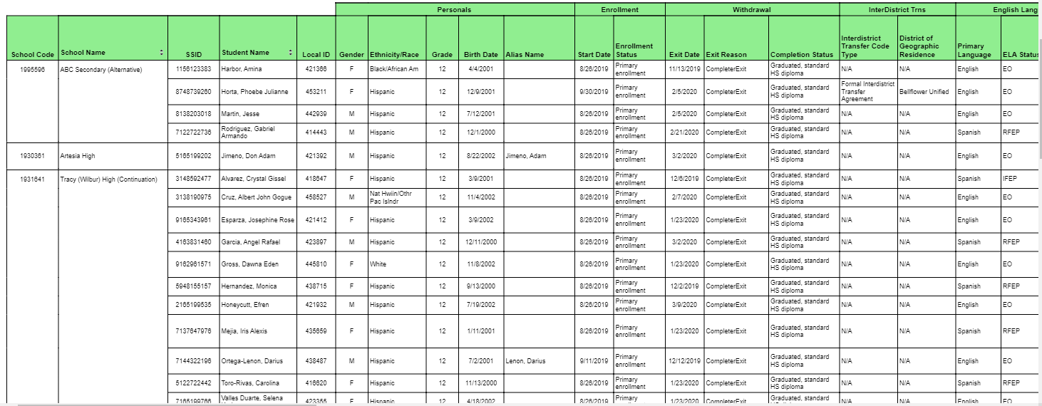
Review ODS Report 8.1a – Student Profile-Exits
Apply the following filters:
Enrollment Status: 10, 30
From Date: 8/16/2019
Through Date: 8/15/2020
Completion Status = 100, 120, 250, 320, 330, or 360

Slide 11
How can I identify these students? (2)
  Step 2: Find students who were identified as CTE Completers in any grades 9-12
    Run Snapshot Report 3.15 – Career Technical Education Concentrators and Completers – Student List, and filter as follows:
      Academic Year: 2019-20
      Grade: 12
      CTE Participation Type: Completers
      Perkins/CTEIG Fundable: All

Slide 12
How can I identify these students? (3)
  Step 3: Identify students who may have been a CTE completer in a prior year (e.g., grade 11 in 2018-19, grade 10 in 2017-18, etc.)
    Run Snapshot Report 3.15 – Career Technical Education Concentrators and Completers – Student List, and filter as follows:
      Academic Year = 2018-19
      Grade: 11
      CTE Participation Type: Completers
      Perkins/CTEIG Fundable: All

Slide 13
CALPADS Reporting:
Fields
LEAs must enter the student level data into their SIS and submit the PSTS file to CALPADS, and populate the following fields with the appropriate code when applicable:
  Field 17.11 – Education Program Participation Type Code with Code 20 – Career Technical Education
  Field 17.12 – Postsecondary Status Code with the appropriate code
  Field 17.13 – Educational Institution Type
  Field 17.14–Industry Field
  Field 17.15–Post-High School Credential

Slide 14
CALPADS Reporting:
CTE Completer Data Mapping Codes
Code | Name | New
200 | Enrolled in a Four-year college/university | no
210 | Enrolled in community college | no
220 | Enrolled in a vocational or technical school (two-year degree program) | no
300 | Enrolled in a High School Equivalency Test Preparation Program | no
310 | Enrolled in a vocational or technical school (certificate program) | no
320 | Enrolled in a Regional Occupational Program (ROP) | no
330 | Enrolled in a Work Force Innovation and Opportunity Act (WIOA) Supported Program | no
340 | Enrolled in a Non-Workability Employment Program | no
350 | Enrolled in an Adult Training Program | no
360 | State Apprentice Program | yes
370 | Other Job Training Program | yes
400 | Military Enlistment | no
500 | Peace Corps | yes
510 | Ameri Corps | yes
900 | Incarcerated | no
910 | Competitively Employed | no
920 | Not Competitively Employed | no
930 | Other employment | no
940 | Other | no
950 | Not able to contact | no
960 | Refused to answer | no

Slide 15
CALPADS Reporting:
CTE Completer Data
Additional Information:
See CALPADS Flash #196 for details on changes to the PSTS File, along with Code Set changes and additions.
LEAs should refer to the CALPADS Code Sets document, Version 12.1, for the following code sets:
  Career Technical Education Industry Sector (Question #8)
  Post-High School Credential (Question #9)

Slide 16
CTE Completer Survey Template Overview with CALPADS mapping
To alleviate the administrative burden of collecting CTE completer data for three separate programs (CTEIG, K–12 SWP, and Perkins), the CDE has created the CTE Completer Survey template to be used by all LEAs to survey their CTE Completers.
Once all the data has been compiled, the LEA will submit the student level data for all survey template questions into their SIS and then export the data into CALPADS through the PSTS file.
The CTE Completer Survey Template includes statuses for all questions that can be mapped into a code in the CALPADS Postsecondary Status Code Set.

Slide 17
CTE Completer Survey Template (1)
1) Are you enrolled in one of the following educational or training programs? Select the one that best applies. If you are not enrolled in any educational or training program, do not check any. Populate Field 17.12–Postsecondary Status Code with the appropriate code from the Postsecondary Status Code Set as follows:
Four-year College/University (map to Code 200)
Community college (210)
Vocational or technical school (two-year degree program) (220)
High School Equivalency Test Preparation Program (300)
Vocational or technical school (certificate program) (310)
Regional Occupational Program (ROP) (320)
Work Force Innovation and Opportunity Act (WIOA) Supported Program (330)
Non-Workability Employment Program (340)
Adult Training Program (350)
State Apprenticeship Program (360)
Other Job Training Program (370)

Slide 18
CTE Completer Survey Template (2)
2) If you checked one of the above for question 1, was the program: Populate Field 17.13–Educational Institution Type with the appropriate code from the Educational Institution Type Code Set as follows:
Public (10)
Private Nonprofit (20)
For Profit (30)

Slide 19
CTE Completer Survey Template (3)
3) Are you enlisted in the military? If response is "yes" populate Field 17.12–Postsecondary Status Code with Code 400–Military Enlistment.
Yes (400)
No

Slide 20
CTE Completer Survey Template (4)
4) Are you incarcerated? If response is "yes" populate Field 17.12–Postsecondary Status Code with Code 900–Incarcerated.)
Yes (900)
No

Slide 21
CTE Completer Survey Template (5)
5) Are you employed? If response is “yes” populate Field 17.12–Postsecondary Status Code with the appropriate code from the Postsecondary Status Code Set as follows:
Yes, Full-time or part-time employment with compensation at or above minimum wage (910)
Yes, Full-time or part-time employment with compensation less than minimum wage (920)
No

Slide 22
CTE Completer Survey Template (6)
6) Are you enrolled in one of the following? (Only check if applicable) If checked, populate Field 17.12–Postsecondary Status Code with the appropriate code from the Postsecondary Status Code Set as follows:
Peace Corps (500)
Ameri Corps (510)

Slide 23
CTE Completer Survey Template (7)
7) If none of the above options apply, check one of the following: Populate Field 17.12–Postsecondary Status Code with the appropriate code from the Postsecondary Status Code Set as follows:
Other (940)
Not able to contact (950)
I decline to respond (960)

Slide 24
CTE Completer Survey Template (8)
8) If you are employed, what type of business or in what field are you employed? Check which industry best represents the type of employment) Populate Field 17.14–Industry Field, with the appropriate code from the Career Technical Education Industry Field Code Set as follows:
Agriculture and Natural Resources (Map to code AGR)
Arts, Media, and Entertainment (ART)
Building and Construction Trades (BLD)
Business and Finance (FIN)
Education, Child Development, and Family Services (EDU)
Energy, Environment, and Utilities (NRG)
Engineering and Architecture (ENG)
Fashion and Interior Design (FSN)
Information and Communication Technologies
Health Science and Medical Technology
Hospitality, Tourism, and Recreation (HOS)
Manufacturing and Product Development (MAN)
Marketing, Sales, and Service (MAR)
Transportation (TRA)
Public Services (PUB)
Other (OTH)

Slide 25
CTE Completer Survey Template (9)
9) Have you received one of the following? Populate Field 17.15–Post-High School Credential with the appropriate code from the Post-High School Credential Type Code Set as follows:
Industry-recognized credential (e.g. Serv-Safe, NIMS, AWS, etc.) (10)
Certificate issued by a post-secondary institution (20)
Degree awarded by a postsecondary institution (30)
License issued by the State of California (e.g. Cosmetology, CNA, etc.) (40)
Other measure of technical skill attainment (e.g. third-party certification, NOCTI, Certiport, etc.) (50)
None of the above

Slide 26
Frequently Asked Questions (1)
Question: If we already know where the majority of our students went because we have access to the information through the National Student Clearinghouse and our students received industry-recognized credentials while they were enrolled with our school, would we still need to send out a survey to students we have information about? If we are able to use data that we already have, do we only send out the survey to students who we have no data for?
Answer: Yes, provided data for items on the Survey Template is available from the National Student Clearinghouse, you can use it. For all other items, you would be required to survey students using the CTE Completer Survey template provided by the CDE.

Slide 27
Frequently Asked Questions (2)
Question: We noticed it seems that you can either be enrolled at an educational/training program or be employed, but not both. Is this correct? If it is, which should supersede the other?
Answer: No. Collect the information for both enrollment and employment when surveying completers. You can report both in CALPADS.

Slide 28
Frequently Asked Questions (3)
Question: If the school is an independent study charter school and a DASS school, are they still expected to complete these surveys for CTE completers?
Answer: Yes, and they will use their 19–20 12th grade students

Slide 29
Frequently Asked Questions (4)
Question: We only report the pathway completers or a program completer? There is a difference. The program completer could be in the ag department for 3/4 years. But a pathway completer would have taken all the 4 classes in that pathway. Could you please help clarify this for me?
Answer: For the purposes of satisfying the CTE Completer data reporting requirements, a “Completer” is considered anyone who completed 300 hours of instruction and passing the capstone course (C- or better) within a pathway, and exited secondary instruction in 2019–20.

Slide 30
Frequently Asked Questions (5)
Question: Should the requested survey information below be uploaded by each individual school district in the consortium (many have different student information systems) or by the consortium LEA?
Answer: Yes, individual school districts will upload their own information. If the consortium lead is an LEA with their own students, then they would report only their own students, and not the other members of the consortium.

Slide 31
Frequently Asked Questions (6)
Question: My question is about what students to survey. I have heard that we are to survey any 19-20 graduate who completed a pathway, no matter what year they completed. I’ve also heard that we will survey only 19-20 graduates that completed a pathway in 19-20. Which is it?
Answer: The students to be surveyed are those who exited secondary education with a specific designation in CALPADS (see slide 5), who completed a sequence of 300 hours, including the capstone course with a passing grade (C- or better), even if the capstone was completed prior to their senior year. These students should be included in the survey.

Slide 32
Frequently Asked Questions (7)
Question: Students from our regional occupational program are surveyed by their home schools and data is put into their school’s Student Information System. Our County Office of Education (COE) does not submit ROP data into CALPADS. Do we need to submit the same survey to students and send in the information, even if it is duplicative?
Answer: No, data reporting is done by individual LEAs. COEs would only report completer data if the students were CTE completers while enrolled directly with the COE. The home school would still be responsible for entering the data into CALPADS.

Slide 33
Frequently Asked Questions (8)
Question: We have only had a series of pathways for this current school year. Therefore, we have no students who have completed a pathway while we have several who have completed a course. Should we still survey students? Also, how does the CDE recommend surveying students who no longer attend our schools as they have graduated?
Answer: All students to be surveyed are CTE completers as previously defined.
To survey students, you may need to revisit your Student Information Systems to retrieve phone, email address, physical address etc. Surveys can be done by phone call, social media, or any other method that allows the LEA to collect the information.

Slide 34
Frequently Asked Questions (9)
Question: If our LEA does NOT have any completers for the 19-20 school year, where do we state that information?
Answer: For reporting done in CALPADS, Report 17.1 will have zeros if LEAS do not report any students. LEAs can “approve” the report with zeros to indicate they have no responses, or they can submit a record for each student and use the CALPADS code 950 or 960 to indicate they surveyed students but did not get a response.

Slide 35
Frequently Asked Questions (10)
Question: The first year that we submitted an application for CTEIG funds was the 2020-21 CTEIG application. We did not apply, or receive, 2019-20 CTEIG funding. Are we correct in that we do not need to submit the PSTS file by the March 5, 2021 mandatory deadline, but will need to submit this data next year (March 2022)?
Answer: No. Independent of funding, all LEAs operating CTE programs must collect and submit the required data to CDE.

Slide 36
Frequently Asked Questions (11)
Question: Who do I work with to enter the CTE data into CALPADS once it’s collected.
Answer: As the CTE Coordinator or person responsible for completing the CTE Data Collection, it is important that you reach out to your LEAs CALPADS Coordinator and develop a relationship with them as they are responsible for entering your CTE data. Working with the CALPADS Coordinator will help ensure that not only is your CTE data reported, but it is reported correctly. You should review the CTE data reports with the CALPADS Coordinator to ensure the accuracy of these reports.

Slide 37
Frequently Asked Questions (12)
Question: How are other LEAs collecting this data?
Answer: CTE data is collected in a variety of ways including student information being collected in the spring (mobile number, email, social media account such as LinkedIN). Then contact the completers using phone banks of individuals calling students to get the answers over the phone; Google survey form emailed out to students; and students contacted through social media accounts to complete survey; etc.

Slide 38
Technical Assistance Information
For CTE Completer Template Questions:
Career & College Transition Division
CTEData@cde.ca.gov
For CALPADS Questions:
Educational Data Management Division
CALPADS@cde.ca.gov

Slide 39
Contact Information
CTEIG Regional Consultants:
https://www.cde.ca.gov/ci/ct/pk/cteigcontacts.asp
K-12 SWP Pathway Coordinators and Technical Assistance Providers Contact Information:
https://www.cccco.edu/About-Us/Chancellors-Office/Divisions/Workforce-and-Economic-Development/K12-Strong-Workforce/K12-Pathway-Coordinators

Slide 40
Open Discussion

