Slide 1


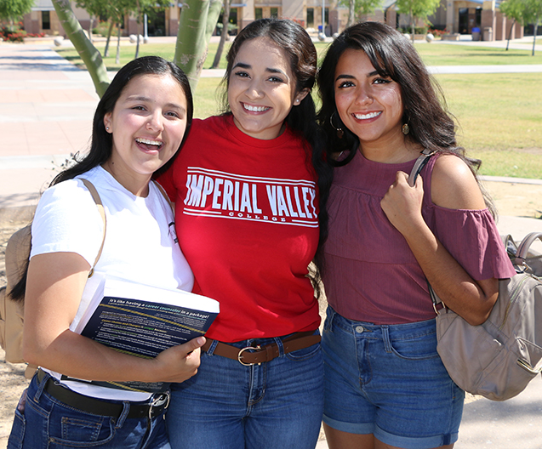
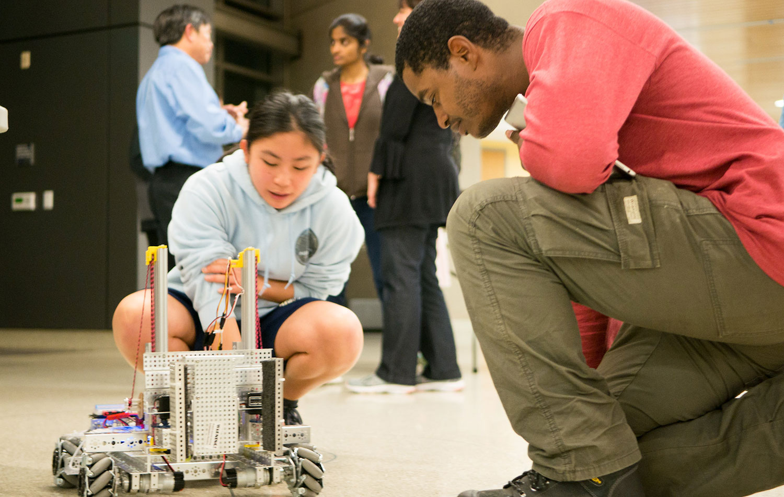

Border Region Inclusive Talent Pipeline Collaborative
Regional K16 Collaborative Grant Program

Slide 2
K16 Collaborative Grant
State Tagline: Streamlining equitable pathways from high school to postsecondary education and into the workforce
Components
Building pathways
K16 and Industry Alignment and Higher Ed Completion
Using the Recovery with Equity Report
Leveraging the California College Guidance Initiative

Slide 3
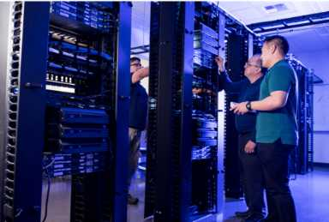
Our Regional Challenge
Low-income students and students of color are less likely to attend to post-secondary education and complete post-secondary education.
Black and Latinx student completers earn lower wages than White student completers in the workforce.
Black and Latinx workers earn less than White and Asian workers in San Diego and Imperial.
Regional employers are struggling to fill vacant positions, particularly in the targeted pathways.

Slide 4
Our Strategy
Connect our low-income, Black and Latinx students to high-wage, high-demand pathways.

Slide 5
Stated Goal
To increase access to high-wage, high-demand careers for diverse and underrepresented local talent and increase social mobility in San Diego and Imperial Counties
Pathways
Business
Computing & Engineering
Education and
Health Care

Slide 6
Partners
UC San Diego | 17 K12 Partners | United Way of San Diego
CSUSM | SD & IC County Offices of Education | MAAC Project
SDSU | SD & IC Economic Development Councils | Employers
10 Community Colleges | SD & IC Workforce Boards

Slide 7
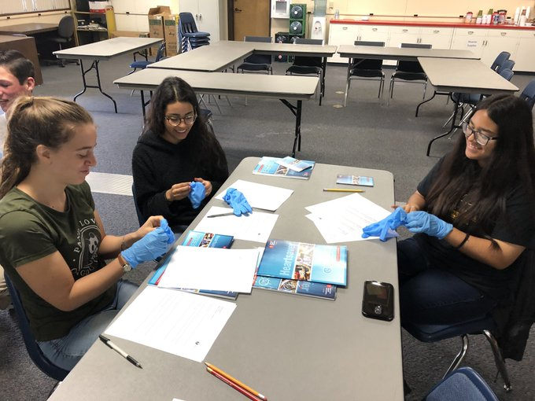
High School
Activities
K12 partners are required to implement the California College Guidance Initiative
Opportunity to start new programs
Opportunity participate in curriculum alignment work
Opportunity to fund dual enrollment/early college credit projects
Opportunity to implement inclusive student supports and high-tech, high-touch advising

Slide 8


High School
Activities
CCGI Engagement to begin!
New Programs and Curriculum Alignment in 5 pathways
Opportunity to fund dual enrollment/early college credit projects
Opportunity to implement inclusive student supports and high-tech, high-touch advising

Slide 9

High School
Activities
Funding available of $300,000 - $900,000 per district over the course of the grant

Slide 10
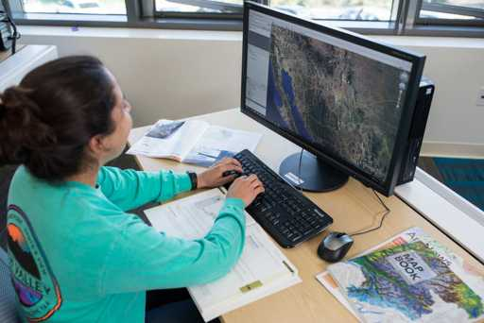
College
Activities
Curriculum alignment to industry standards & program support—funding available through Strong Workforce
Integrating equity minded teaching practice into curriculum
Opportunity to qualify to become a Preferred Provider of Talent
Student Access to Paid Internships
Continuing Advancing San Diego Activities

Slide 11
Timeline
4-Year Grant
Years 1 & 2—Business and Computing & Engineering Pathways
Years 3 & 4—Health and Education Pathways

Slide 12

The Team
Christine Jensen, Grant Director
Heather Cavazos, Program Coordinator – Communities of Practice
CCGI Focused Program Coordinator
Support and Business Office, Program Specialist

Slide 13
Next Steps
Prepare for Sector Projects in Business, Computing & Engineering
Internships this summer for previous Computing and Engineering Preferred Providers
Look out for Communities of Practice in Business, Computing & Engineering

