Slide 2


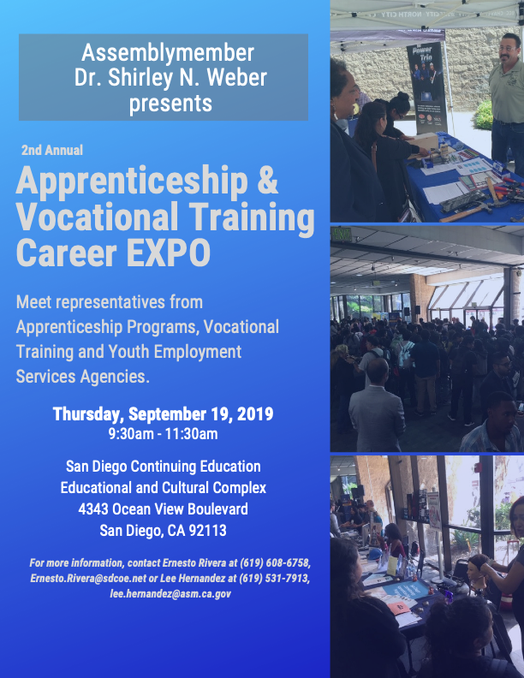
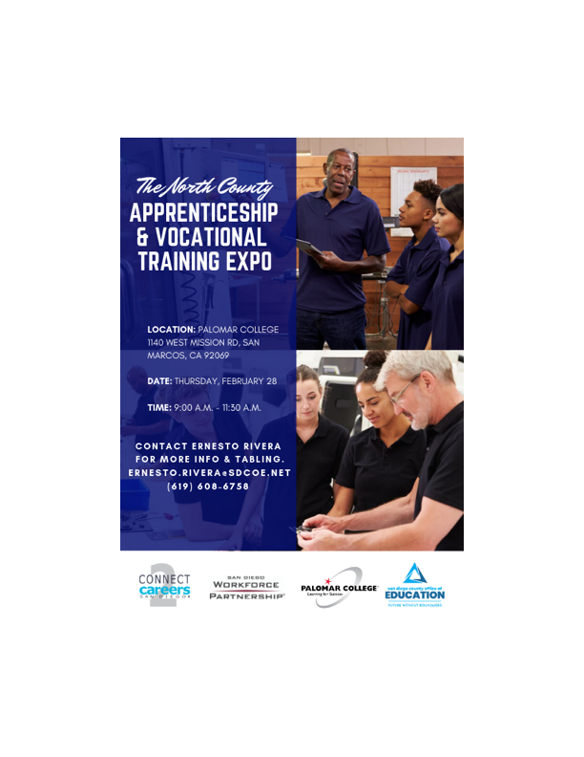
SDCOE- JCCS Culinary
Pre-Apprenticeship Program
How did it all start?
  Previous work around Apprenticeships
  Aligning training continuing training opportunities for JCCS students
  Identified possible CTE programs and partners… Kitchens for Good

Slide 3
SDCOE- JCCS Culinary
Pre-Apprenticeship Program
Program Implementation:
  Identified 3 sites of operation
  Scheduled introduction workshops with site faculty, students and Apprenticeship partner
  Set timeline for apprentice registration
  On-going support
      SDCOE CCR serves as program coordinator
      Handles all DAS reporting and tracking
      Responsible for Job Readiness services through WBL activities

Slide 4
SDCOE- JCCS Culinary
Pre-Apprenticeship Program
Program Development
  Pre-Apprenticeships are A LOT easier than Apprenticeships
    Design Pre-Apprenticeship Program
    Sign Linkage Agreement
    Work with Apprenticeship program to develop/approve training curriculum
    Complete DAS Application (Request for Approval form)
    Submit to DAS for approval

Slide 5
SDCOE- JCCS Culinary
Pre-Apprenticeship Program
Program Development
  Pre-Apprenticeships are A LOT easier than Apprenticeships
    Design Pre-Apprenticeship Program
    Sign Linkage Agreement
    Work with Apprenticeship program to develop/approve training curriculum
    Complete DAS Application (Request for Approval form)
    Submit to DAS for approval

Slide 6

JCCS Culinary
Pre-Apprenticeship Program
3 Training Sites- San Pasqual Academy, Youth Training Center (YTC) and 37ECB
80 hours- to be completed during JCCS CTE Culinary 1A Class
Broken into 4 Tiers
Supportive Services:
    Work Readiness Training
    Career Assessments & Exploration
    Employment Services
    Transportation Assistance
    Tools and Equipment
Supportive Services made available through CA Apprenticeship Initiative Pre-Apprenticeship grant- CA Community Colleges Chancellor's Office

Slide 7
SDCOE- JCCS Culinary
Pre-Apprenticeship Program
QUESTIONS?
Ernesto Rivera
Project Specialist- WBL
SDCOE College & Career Readiness
ernesto.rivera@sdcoe.net
(858) 298-2128

