Slide 1


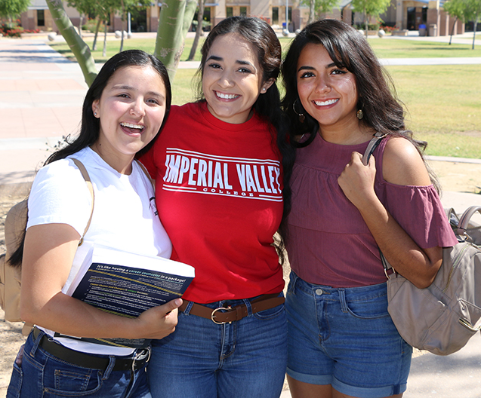
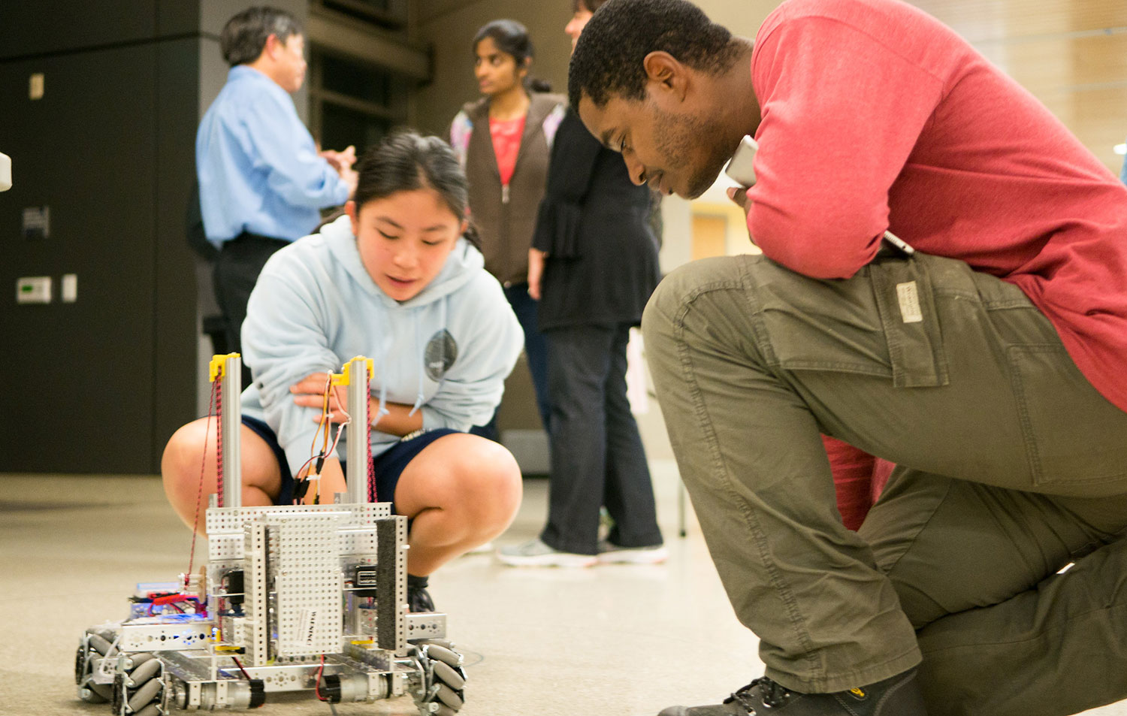

Border Region Inclusive Talent Pipeline Collaborative
Regional K16 Collaborative Grant Program

Slide 2
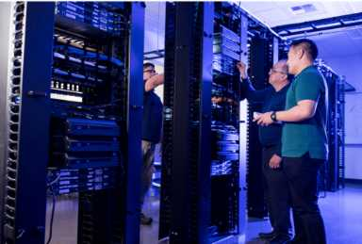
The Challenge
Low-income students and students of color are less likely to attend to post-secondary education and also less likely to complete post-secondary education.
Black and Latinx student completers earn lower wages than White student completers in the workforce.
Black and Latinx workers earn less than White and Asian workers in San Diego and Imperial.
Regional employers are struggling to fill positions, particularly in the targeted pathways.

Slide 3
Overall Goal
To increase access to high-wage, high-demand careers for diverse and underrepresented local talent and increase social mobility in San Diego and Imperial Counties
PATHWAYS
Business
Computing & Engineering
Education and
Health Care

Slide 4

Strategies
Curriculum Alignment
Student Outcome Evaluation
KSAs to Industry Standard
WBL
Equity-minded teaching
Paid Internships
Expanding opportunities to students
Expanding networks for students
Direct Support to Education
New and improved pathways
Curriculum Alignment
Dual Enrollment
Student supports for transition
Implementing CCGI
Advocacy
Expanding paid internships
Basic needs for students
Increasing diversity in industry
Joint Professional Development
DEI
Inclusive Supports
High-Tech, High-Touch Advising

Slide 5
Partners
UC San Diego | 17 K12 Partners | United Way of San Diego
CSUSM | SD & IC County Offices of Education | MAAC Project
SDSU | SD & IC Economic Development Councils | Employers
10 Community Colleges | SD & IC Workforce Boards

Slide 6
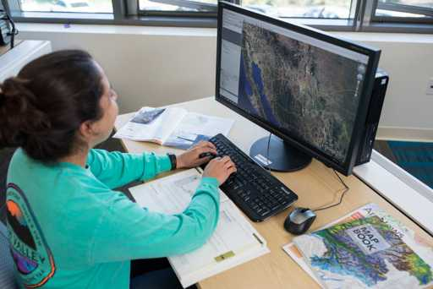
College
Activities
Curriculum alignment to industry standards & program support—funding available through Strong Workforce
Opportunity to qualify to become a Preferred Provider of Talent
Student Access to Paid Internships
Continuing Advancing San Diego Activities

Slide 7
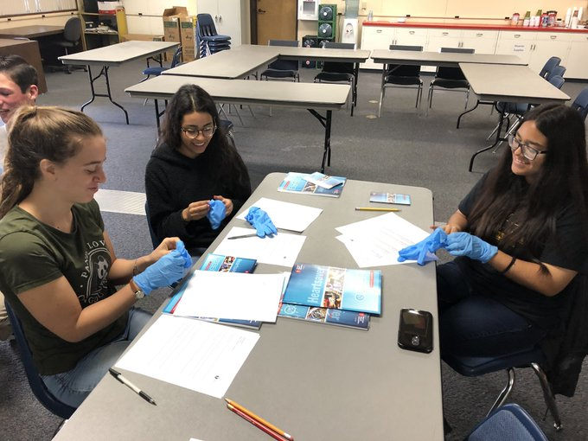
High School
Activities
K12s are required to implement the California College Guidance Initiative
Opportunity to participate in curriculum alignment work
Opportunity to fund dual enrollment/early college credit projects
Opportunity to implement inclusive student supports and high-tech, high-touch advising

Slide 8
Partner Activities
Partner | Activity
Economic Development | Working with employers to identify the knowledge, skills and abilities needed in industry Finding employers for internships
Workforce Development | Support with employer connections
County Offices | Provide professional development Technical assistance with California College Guidance Initiative Support with education pathways
United Way | Evaluation
MAAC Project | Case management for student interns in need

Slide 9
Timeline
4-Year Grant
Years 1 & 2—Business and Computing & Engineering Pathways
Years 3 & 4—Health and Education Pathways

Slide 10

Staffing
Grant Director
Program Coordinator
Program Specialist
.5 Business Office

