Slide 1

Using a career curriculum
to onboard students to
Guided Pathways
Research carried out for SCCRC by Karen Miles, Ed.D.

Slide 2
Methodology
28 interviewees from across the 8 SCCRC colleges
Deans, faculty, counselors, guided pathways team members, enrollment services, institutional researchers & many others
Research on best practices from early-implementing Guided Pathways colleges in California and other states
23 source documents

Slide 3
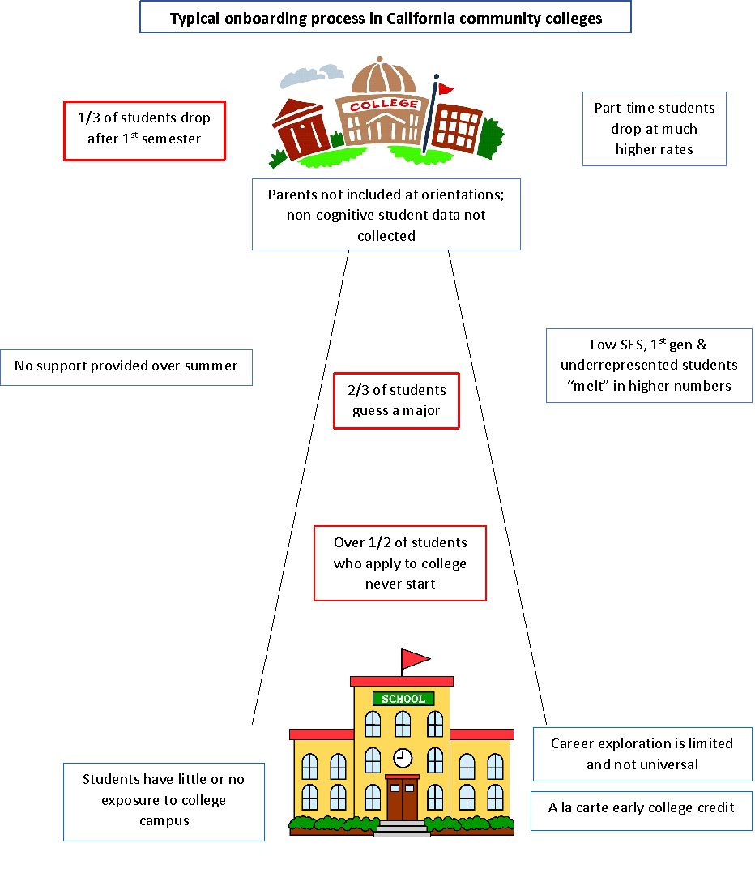

Slide 4
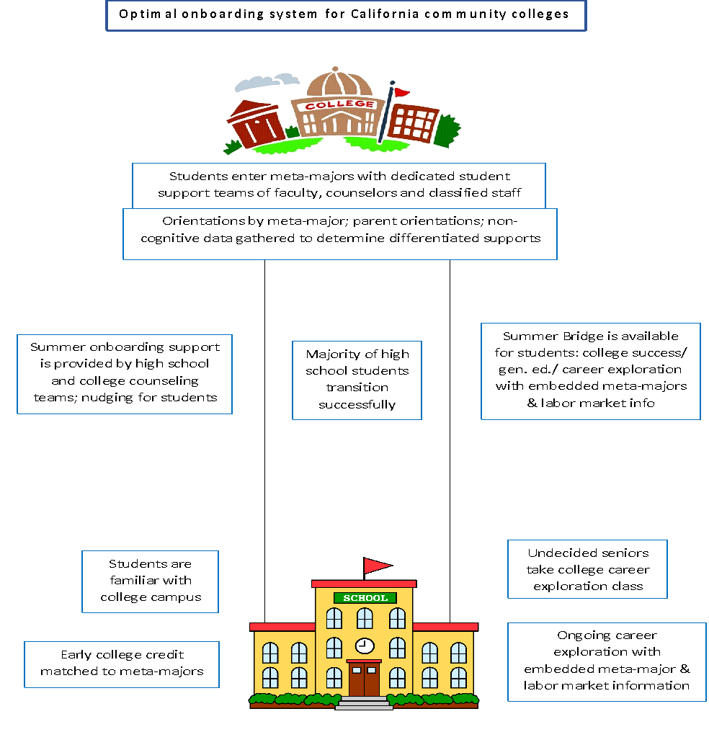

Slide 5
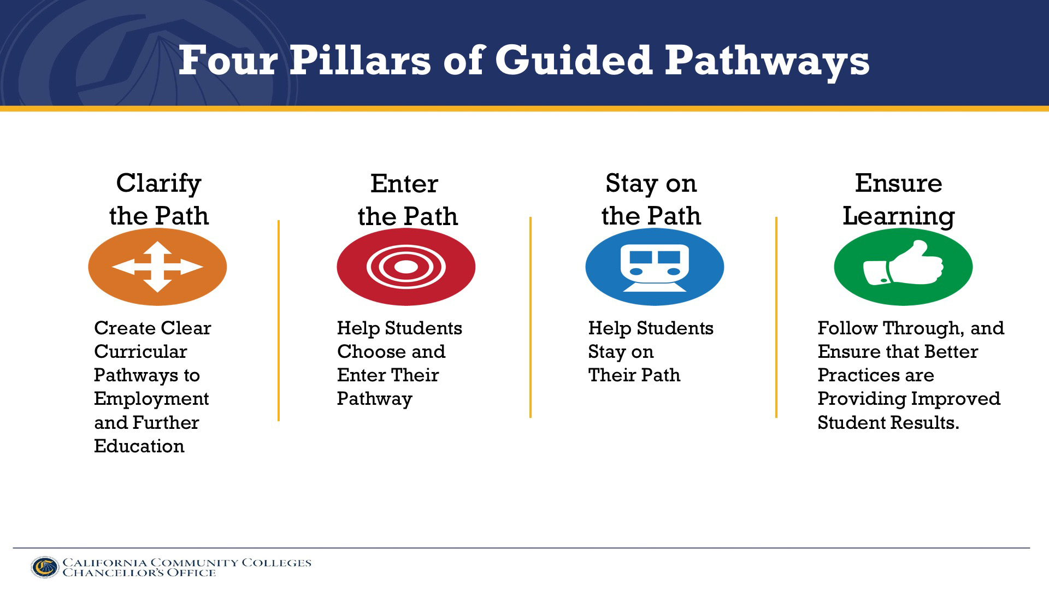
Models and ideas for community colleges and K12
Meta-majors nearly completed at colleges (Clarify the path)
Next phase: Enter the path
How to connect to K12 better?
We do not have a seamless system

Slide 6
Over 1/2 of the students who apply to community college never start –
129,024 were lost in the SCCRC colleges in fall 2017 (CalPASSplus)

Slide 7

How to get students into the right meta-major
Simply having meta-majors in place will not ensure that students select the correct one for them.
How can we improve understanding among high school students about the programs offered by the college and where they lead in terms of employment and further education? (Completion by Design)

Slide 8
“Essentially, the first time two thirds of students choose a major, they are guessing.” (EAB)

Slide 9

Undecided students
“Making them choose a major creates anxiety and cognitive dissonance.” (CCRC)
“Better guidance in picking appropriate programs … is clearly an important condition for providing college transition support directly to low-transition high schools.” (National Bureau of Economic Research)
Do our colleges have the capacity to help all undecided students carry out career exploration and decision-making?

Slide 10

Career exploration and the decision-making process
Career choice is developmental
“It is not realistic to expect most students to identify a major immediately upon matriculation.” (Karp, CCRC).
“Pre-nursing is our number one major - that is not an informed
decision.” (Counselor, Cuesta)

Slide 11
Reflection discussion 1:
How can we help undecided students “enter the correct path”?

Slide 12
Choose someone to report out
Top 3 ideas
2 minutes

Slide 13
Toolkit content on this topic:
College-provided career exploration classes p9
High school career exploration benefits p10
Labor market information p17

Slide 14
“Critical career conversations need to start in 6th and 7th grade with middle school teachers/ counselors and then be continued in the home”. (Counselor, Ventura College)

Slide 15

College-provided career and meta-major information
Imagine if our colleges were the go-to place for local labor market information.
“Many students report finding college-provided information confusing rather than helpful.”(CCRC)
How can we make sure they have understood the information and moved forward in their career decision-making?

Slide 16
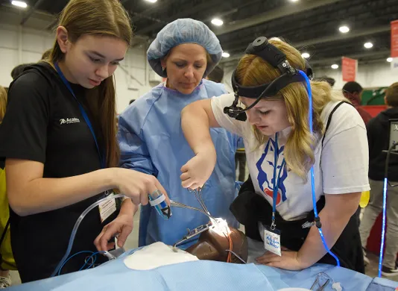
High school career exploration
“The opportunity to explore career fields while in high school at no cost to students and their families is invaluable.” (Jenkins, Lahr & Fink)
Are we encouraging our high schools to offer career exploration classes and to embed our meta-majors in them?

Slide 17
“I have seen a culture change in the last 2 years, with students having had exposure to career exploration in high school.” (Counselor, Ventura College)

Slide 18

College career exploration classes in high school
Several colleges across the state offer a 0.5 or 1 unit class for high school seniors to revise their 9th grade career plans and to complete their college student education plans. (Cuesta, ELAC, Lake Tahoe).
College of the Canyons offers a dual enrollment career exploration class and a student success class at each of its local high schools.

Slide 19
“High school counselors were able to conduct exit interviews with seniors in September/ October. They were able to identify which students wanted to go to Allan Hancock College, and the undecided group took a college career planning class during their senior year.”
(Counselor, Allan Hancock College)

Slide 20

Dual enrollment/ early college credit students
Santa Barbara City College created an agreement with their K12 schools to register all 8th grade students with City College – the process is built in to high school orientation and class selection. The consent form stays on file for the duration of high school unless a parent withdraws approval.
What can we do to develop a sense of belonging in our early college credit students?

Slide 21
Reflection discussion 2:
How can we better connect with “our” high school students and create a sense of belonging?

Slide 22
Choose someone to report out
Top 3 ideas
2 minutes

Slide 23
Toolkit content on this topic
Suggestions from Completion by Design p6
Dual enrollment/ early credit students p13
Early college credit offerings p13

Slide 24
Early college credit offerings in pathways
Early college credit opportunities at high schools still follow the à la carte system (Bakersfield Community College calls this “Random Acts of Dual Enrollment”)
Could colleges identify or create one explorer or introductory course for each meta-major area, and offer these classes at the school sites?
Santa Barbara City College is developing a list for department chairs of possible Dual Enrollment classes that meet high school needs for graduation i.e. American History

Slide 25

Campus connection
It is a “missed opportunity” (Dean, Cuesta) not to have the students visiting the college campus as often as possible.
Allan Hancock College has built a model whereby different campus activities have been designed for different grades of students in K12:
Bulldog Bound for 4th and 5th graders
CTE Carnival for 7th and 8th graders
CTE presentations for 8th and 9th graders
Launch to College for 12th graders

Slide 26
“The more positive experience they have on campus as high school students, the more positive their experience will be as college students.”
(Guided Pathway Lead Faculty, Santa Barbara City College)

Slide 27
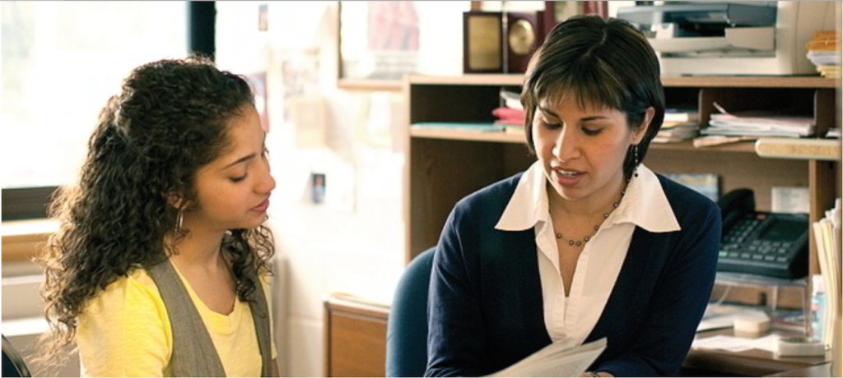
Hybrid counselors
College counselors/ advisors are based at the high schools part of the time in order to do academic planning (College of the Canyons; Oxnard College).
To keep dual enrollment students on-plan, Indian River State College has established a shared advising tool with local high schools that connects a high school counselor with a student’s college advisor.

Slide 28
“AVC has a bridge program. 16 counselors from K12 were hired and trained as adjuncts to be college counselors. They are critical to disseminating information to the high schools.” (Dean, Antelope Valley College)

Slide 29

Equity issues
“We found large differences in college knowledge, and in understanding what it takes to succeed in college, among students within schools by academic tracks and between schools by SES.” (Venezia, Kirst & Antonio)
EAB noted that if we focus on closing the achievement gap among part-time populations, the gap between black and white students would close by 13 points - a difference of 62% - and the gap between Hispanic and white students would improve by 7 points - closing the gap by 58%.

Slide 30
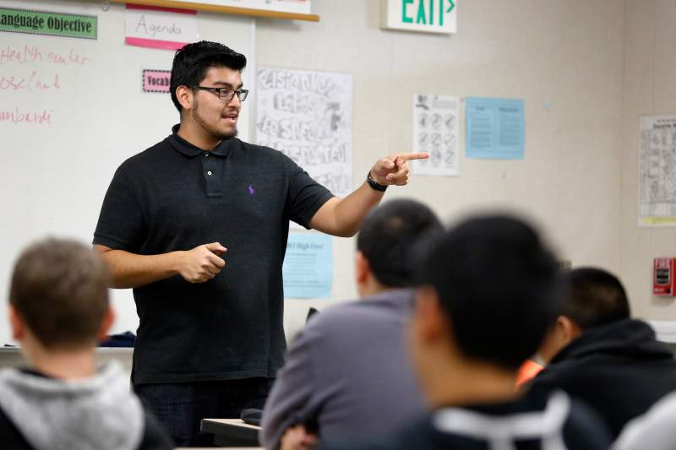
High school teachers
“After parents, high school teachers are the greatest influence on students as to whether they attend college or not.” (Canché, D’Amico, Rios-Aguilar & Salas)
“Teachers... reported that they get college information from graduates who are now in college, student teachers, newspapers, their own college experiences and their children - not from institutional sources”. (Venezia, Kirst and Antonio)

Slide 31
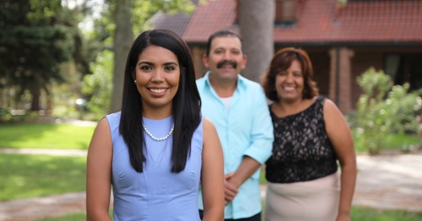
Parents
“Bringing in the families – it’s a part that’s missing from the community college experience”. (Dean, Oxnard College)
Santa Barbara City College have developed a Parent Resource Guide
Moorpark College is discussing different types of parent outreach – to high school PTAs or in parent newsletters.

Slide 32
“We need to team up with high school counselors to tackle parent college literacy to shift the mindset. The expectation of parents is that the students work”.
(Counselor, Allan Hancock College)

Slide 33

Students
Having students apply together to the college and for financial aid is very helpful, especially for students who are “indecisive, lack the confidence or motivation to engage in the application process, were otherwise disadvantaged,... and for those who don’t have parents urging them to apply”. (National Bureau of Economic Research)
How will our colleges change our recruitment and onboarding processes with the advent of guided pathways?

Slide 34

Summer melt
“Of 100 students who apply to a two-year college, 56 are lost during onboarding” (EAB)
The organizational decoupling of K12 and higher education...and the disincentives for either high schools or colleges to provide summer support are … factors that may thus contribute to high levels of melt” (Arnold, Chewning, Castleman & Page)
“Successfully navigating the post-high school summer requires a level of financial and college literacy that may be unrelated to their ability to succeed in the classroom.” (Castleman & Page)

Slide 35
Reflection discussion 3
What can we do to reduce this summer melt, which disproportionately impacts low SES students?

Slide 36
Choose someone to report out
Top 3 ideas
2 minutes

Slide 37
Toolkit content on this topic
Nudges p23
Summer transition support p25
Orientations by pathway p27
Summer bridge p28

Slide 38

Nudges
Nudging is a low-cost, scalable strategy
NACAC cites an 11% increase in matriculation, a 20% increase in persistence, a 20% decline in student loan borrowing, and a 60% reduction in administrative burden by using texting.
Santa Barbara City College bought Enrollment RX – a “Constant Contact” system for enrollment management. It sends automatic messages, runs reports, and sends reminders to students if they fall off track with the onboarding process.

Slide 39
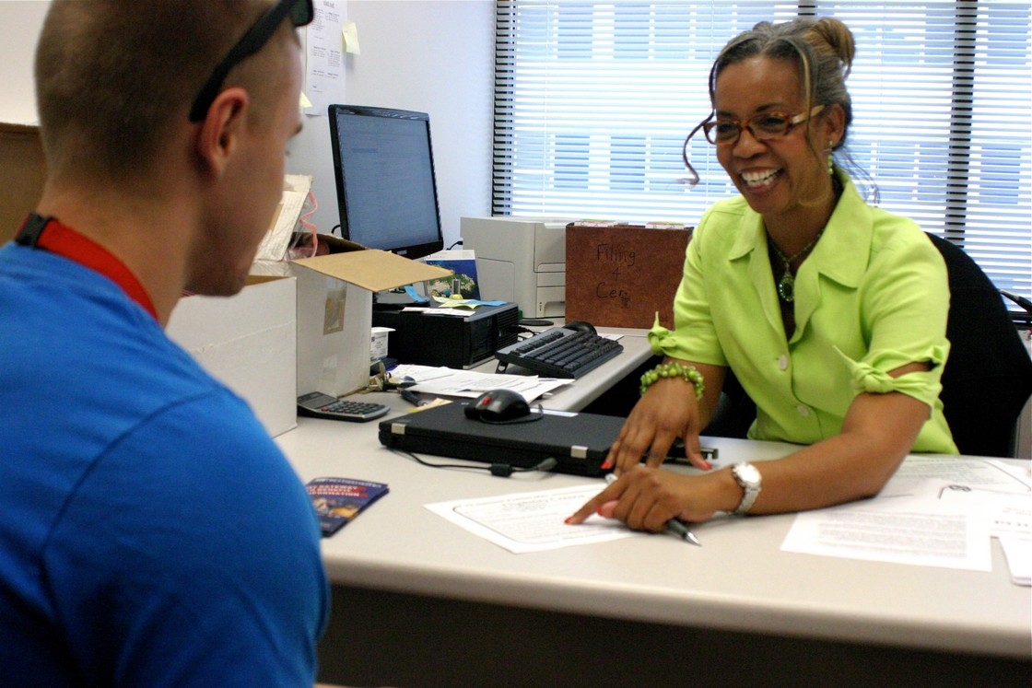
Summer transition support
“Share responsibility to ensure fall enrollment” (NACAC)
High schools “stay late” and colleges “start early” (Castleman, Arnold & Wartman)
Santa Barbara City College has introduced live chats with students for many of its offices – enrollment, academic counseling, admissions & records, EOPS etc. After hours the messages convert to emails.

Slide 40
“We need to increase and improve collaboration between K12 and the CCC. There have been some pockets here and there, but nothing as systematic as we really need to make lasting changes. This will require strong leadership willing to build systems instead of holding isolated meetings.”
(Counselor, Ventura College)

Slide 41
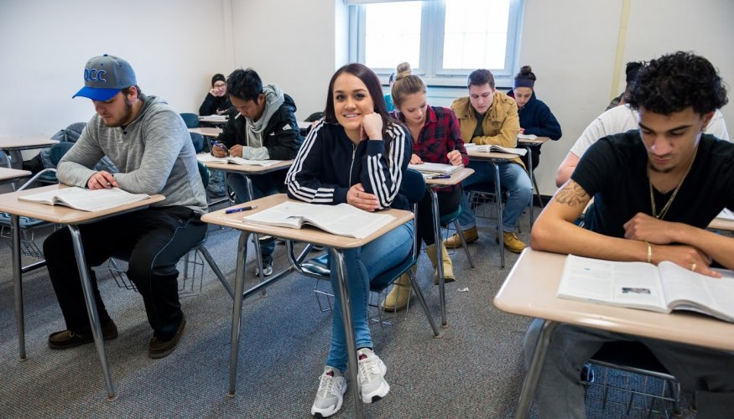
Orientations
“We should explore a different approach – stagger the matriculation steps. When they come to campus, it shouldn’t be first time they’ve heard that information.” Dean, Oxnard College
Non-cognitive assessments of academic engagement and self-efficacy, campus engagement, educational commitment, resiliency and social comfort help identify students at-risk of dropping out.
“Crosswalks” match student scores with resources at each campus. (Completion by Design)

Slide 42
“Thematic counseling was super successful”.
(Counselor, Ventura College)

Slide 43
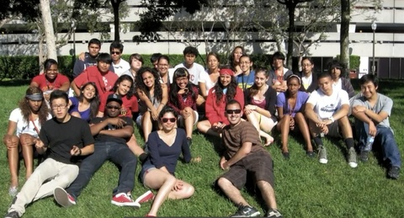
Summer Bridge
“Major expansion of summer bridge programs would be another useful systems-level change.” (Arnold, Chewning, Castleman & Page)
Bakersfield College has seen outcomes at about double/ more than double in the following areas for its Bridge students:
Units attempted/ units passed;
Transfer level English & math attempted/ passed;
College-level English & math attempted/ passed.
They have been scaling the program over the last 5 years.

Slide 44
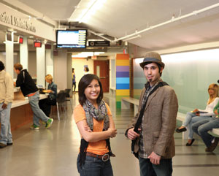
Differentiated student services
“Colleges should provide services to students based on their level of need.” (CCRC)
Moorpark College is piloting some questions to be added to the portal to identify their neediest students.

Slide 45
“The risk of guided pathways is that we continue helping those who don’t need help”.
(Guided pathways faculty lead, Moorpark College)

Slide 46
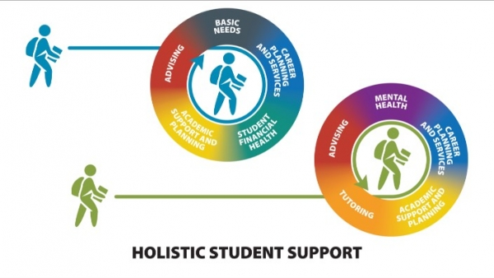
Ongoing support
“While technologies can automate the modification of academic maps, they do not solve failure rate issues.” (Completion by Design)
The next step for Antelope Valley College has been to add a Second Year Experience program, a model that other colleges in the region are considering.

Slide 47
“We know that low-income, first generation students are 4 times more likely to drop out after their first year as their peers without either risk factor.” (EAB)

Slide 48
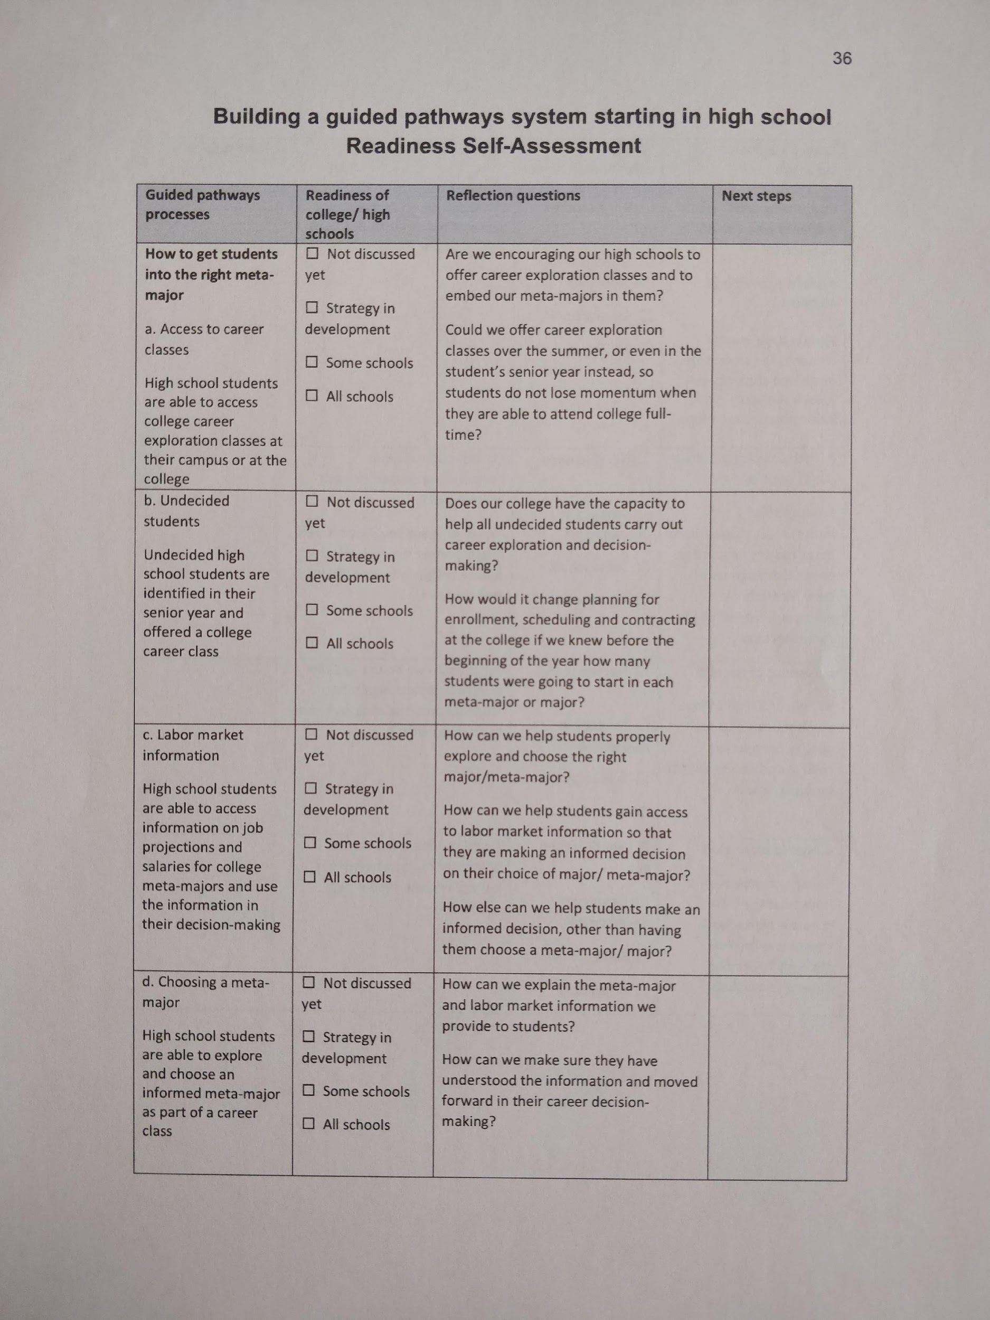
Next steps
Share toolkit with college colleagues
Colleges complete Readiness Self-Assessment and
decide top priorities for college
Colleges share K12 toolkit with partner high schools/ districts – have them complete their Readiness Self-Assessment and decide their top priorities
Leadership teams from colleges and K12 conduct action planning meetings (template in toolkit)

Slide 49
Feedback from SCCRC colleges
The biggest missing link for Guided Pathways is not bringing K12 to the table
We need to present the toolkit at the Admins’ council and at the Deans’ Council
We need to bring in the Guided Pathways team to do Readiness Self-assessment
We need to look at the campus goals and strategic plan for outreach & marketing
Early college credit options should be linked with Guided Pathways

Slide 50
More feedback from SCCRC colleges
The services we offer to K12 are not centralized
We need to offer workshops for families and parents
We really want to offer a senior seminar that complements Get Focused, Stay Focused that includes updating the students’ 10 year plan, financial aid, college essays, leadership and work experience
We want to offer a career class in high school for undecided seniors
We want to triage students using non-cognitive assessments as part of the early alert system
We need the college counselors to see the high school students as theirs

Slide 51
Feedback from SCCRC Guided Pathways TAPs
Summer transition support & shared responsibilities is a critical missing piece
Input, not feedback, from K12 is needed to develop Guided Pathways. Employers and 4-year universities should also be on Guided Pathways teams
Conversations with K12 around design of meta-majors could spark interest - which math for future career options?
Career-focused Guided Pathways might be good common ground.
Ask students what they need - don’t just design things for them. What services do you need from student services? Where do you get your college knowledge?
Outreach teams need to be part of Guided Pathways
If students have a career planning class in high school, the learning they need to undertake updating career plans in college is minimal

Slide 52

Thank you!
The toolkit can be downloaded at: https://sccrcolleges.org/resources/toolkit-for-community-college-k12-partnership-building/
Karen can be reached at KMilesConsulting@gmail.com
Or (805) 558-2866

