Slide 1
Understanding Integrated
Career Planning and Education Planning
A companion resource to the Integrated Career Planning and Education Planning Brief

Slide 2
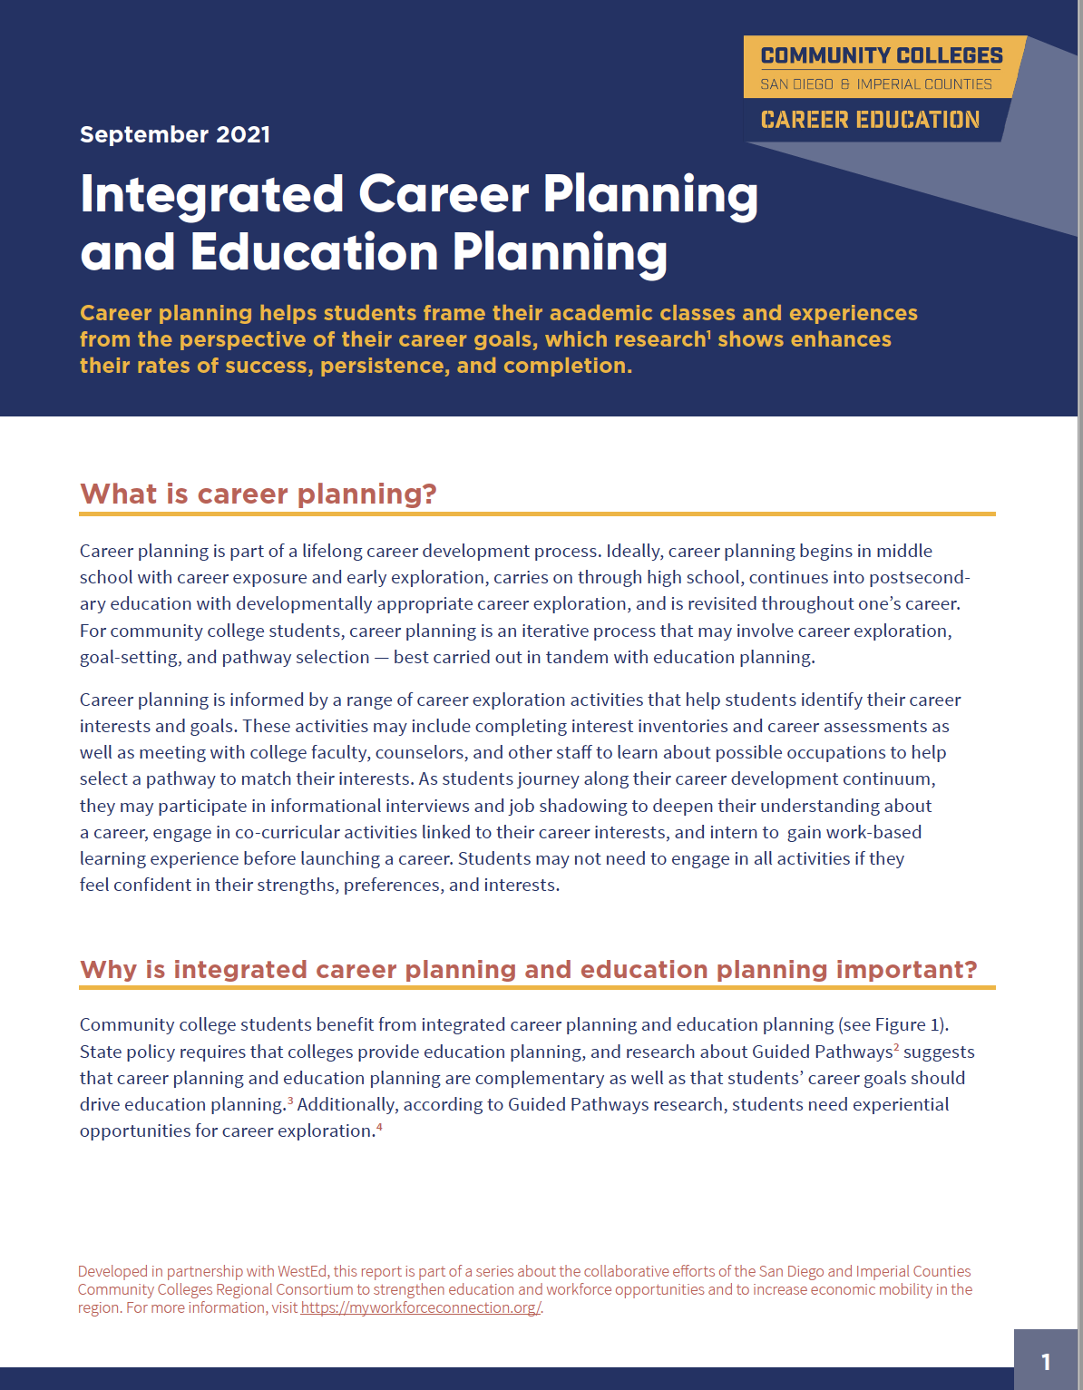
For more information, download the 4-page Brief from the Resource Library.
Develop in partnership with WestEd
https://myworkforceconnection.org/resources/integrating-career-and-ed-planning/

Slide 3
Articulating the Problem
Many students arrive to college unaware of
their strengths and interests
possible career options in a field of interest
the education pathways that lead to employment in those careers
labor market information about local industries and careers that yield a living-wage income

Slide 4
Articulating the Problem (continued)
Many students choose careers based on someone they
know in their community, which, for students of low
income, can limit their exposure to jobs that don’t pay
living wages or have little or no potential for
advancement — further reinforcing inequities of
economic and social mobility.

Slide 5
Articulating the Problem (continued)
Some community college students expend time and money taking courses that are not informed by both career and education goals.
Notes:
Wording and consider combining…

Slide 6
Career planning is an iterative process that can involve
Career exploration
Goal-setting
Pathway selection
Ongoing review of goals
What is Career Planning?

Slide 7
What is integrated career and education planning?
Notes:
Career planning is best carried out in tandem with education planning.

Slide 8
Why is integrated career and education planning important?
Career exploration and goal-setting before
education planning leads students to make informed
and intentional decisions about their program of
study or preferred pathway.

Slide 9
Students save time, frustration, and money while advancing toward career and education goals.
Students develop decision-making and metacognitive skills.
Students develop agency.
Students gain information about careers with high earning potential.
How does it help students?

Slide 10
What can it look like?
Best practices for integrated career and education planning . . .
Emphasize “front-loading” career planning during orientation
Include planned opportunities for ongoing review of career and education goals

Slide 11
Onboarding experiences include multiple measures.
Students complete interest inventories and career assessments and learn results to help them explore careers, set goals, and identify a program of study.
Example of Promising Practice

Slide 12
Present different pathway options for students to consider.
Students learn about CE programs and courses of study that can lead to certificates, associate degrees, or transfer opportunities. Students review and reflect on immediate and long-term goals. Students make informed decisions.
Example of Promising Practice

Slide 13
Systematically schedule career planning as part of the student experience.
Students engage in ongoing review of their education plans for alignment to current career and education goals.
Example of Promising Practice

Slide 14
What supports are needed?
Collaboration between academic counseling, career centers, CE programs, and academic programs.
College leadership can support:
Operational changes such as offering credit-bearing courses focused on career development experiences
Faculty and staff engage in:
Capacity building such as professional development opportunities around career exploration career planning, and work-based learning
Cross-functional planning teams and communities of practice for continuous improvement of integrated career and education planning

Slide 15
For more information, download the 4-page brief from the Resource Library.
https://myworkforceconnection.org/resources/integrating-career-and-ed-planning/

