Slide 1
SAN DIEGO MESA COLLEGE
Pathway Navigation: Career PLANNING Before Education Planning
SAWUBONA “I See You”
Promising Practices Serving
African-American and Latinx Students
Created by Counselors Leroy Johnson & Mary Eden

Slide 2

How did the effort to support students of color to engage in career planning before education planning come about at Mesa?

Slide 3
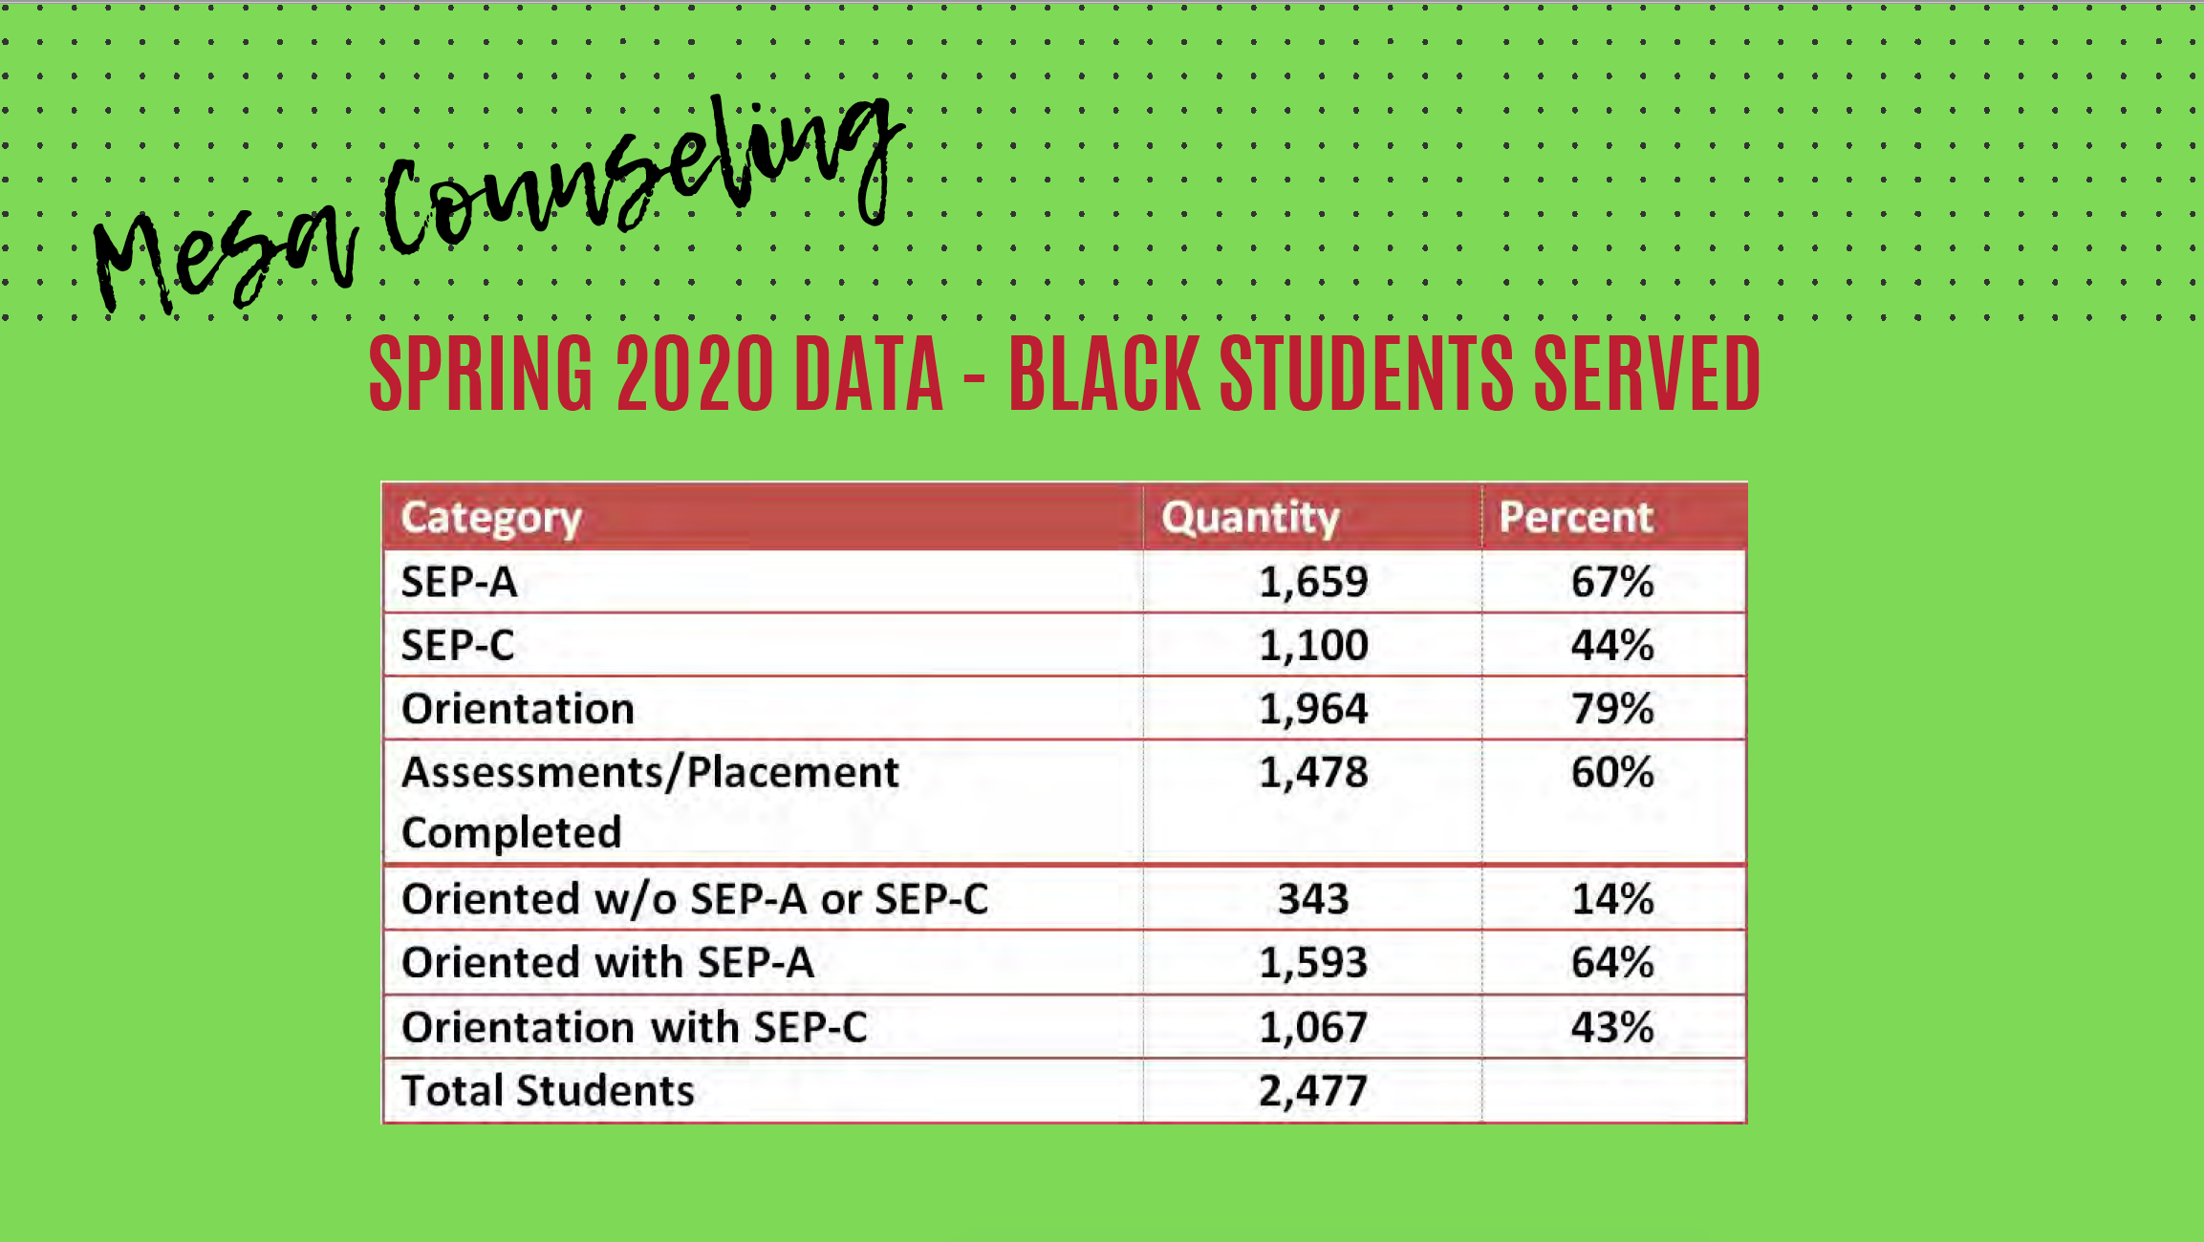
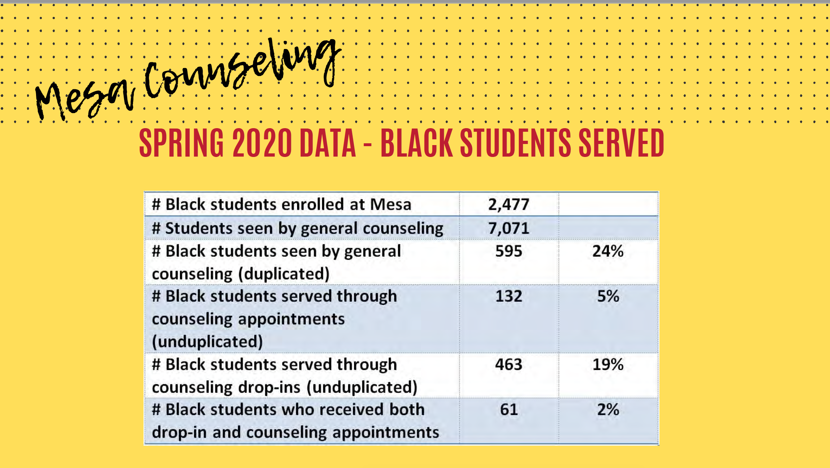
What data sources did you use to identify the needs of these students?

Slide 4
What types of collaborations and/or direct outreach, marketing and partnerships are we making to connect with students of color?
Black Faculty Counselors’ Collaborative (BFCC)
Counseling Equity Committee
Student Services Call to Action/Collaboration Committee
Contacted Marketing classes to request this as an assignment

Slide 5
Which people need to get involved to do this work?
  IT Department, utilizing our bots to spread an equity message to students of color
  All faculty (instructional and non instructional )
  Classified professionals
  Black Students

Slide 6
What are your next steps to see the initiative through?
Career/education planning workshops
Counseling Equity Committee Open House
Training instructional faculty
Training classified faculty

Slide 7
How will you know the effort is successful? What metrics will you use?
Career plans and education plans
Transfer rates
1st to 2nd semester success rates
Units acquired

Slide 8
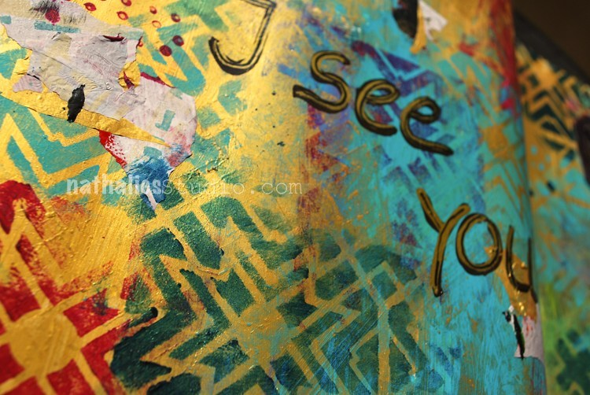
What is the translation of Sawubona?
“I see you”

