Slide 1
Welcome Career Pathways
August 19, 2020

Slide 2
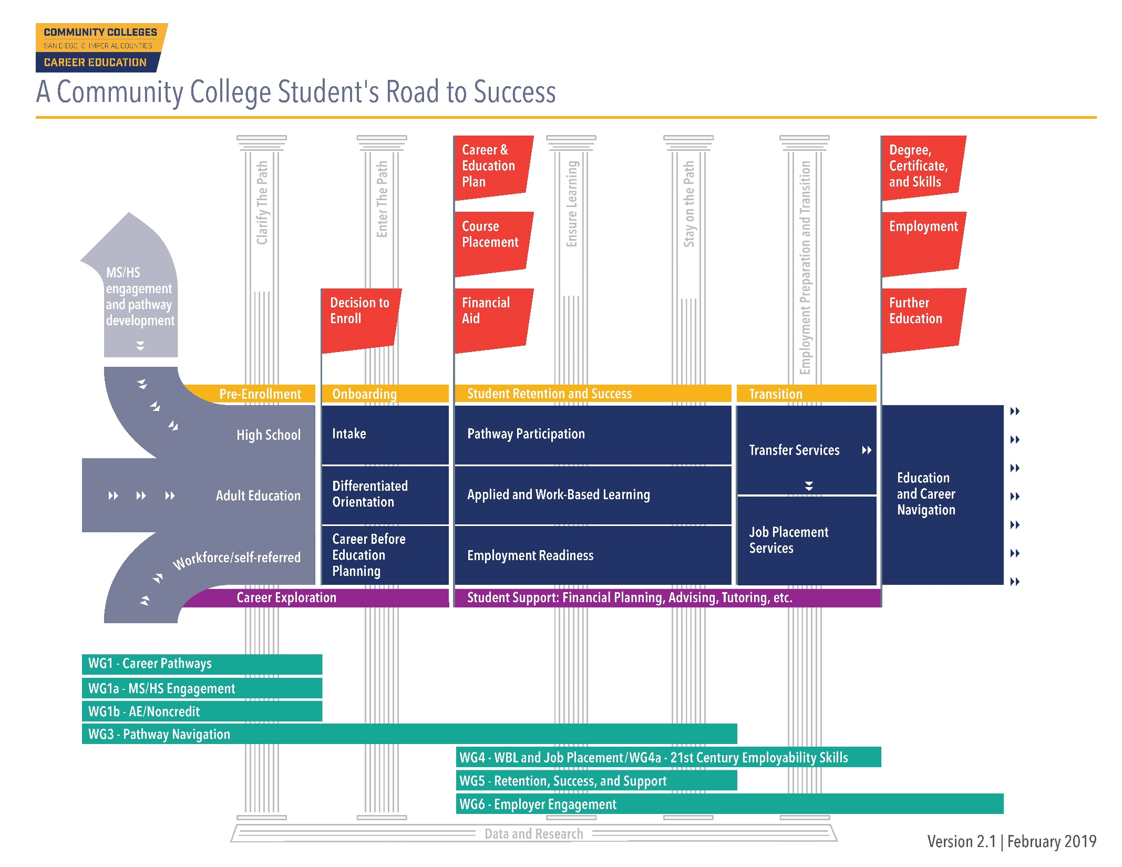

Slide 3
Pre-Enrollment & Career Exploration/Clarify the Path
WG1:-Career Pathways
WG1-K-14 Pathway Partnerships
WG1a -Middle Schools and High School Engagement
WG1b- Adult Education and Noncredit

Slide 4
Workgroup 1 Purpose
Develop a regional career pathways system
Facilitating K-12 & Adult School transition to Community Colleges, & success in pathways
Focus on structural features and on “clarifying the pathway” for students
Identify & map associated curriculum components, the continuum of work-based learning opportunities, & the comprehensive supports that students need to succeed

Slide 5
Scope of Work
Career Pathway Organization and Development Career
Pathway Awareness
Quality Career Pathway Components including pathway accelerators
Career Pathway Success
K12 SWP-support the work

Slide 6
Introduction of
2020-21 Workgroup
Leads

Slide 7
2020-21 Planning
WG1 followed a thorough goal setting process, which included:
Review and summary of 2019-2020 activities and accomplishments in relationship to the 2019-2020 goals.
Feedback on 2019-2020 goals and accomplishments including opportunities for representatives to express additional areas of interest, feedback for improvement, etc.
  Two rounds of feedback were held (April and May)
Third and final round of feedback included a summary of recommended activities for 2020-21 and comments shared previously (June 2020)

Slide 8
2020-21 Planning
Highlights include:
Overall support for the primary focus areas, but strong recommendation to re-write and/or re-organize goals and activities
Confusion over subcommittees and regular committees
Desire for improved communication and shared information/data (shared space with resources and best practices, unified language, etc.)
Uncertainty over what everyone is doing – seeking opportunities to better understand what everyone is doing

Slide 9
2020-21 Planning
Multiple requests for:
  Disaggregated data
  Shift towards equity minded explicit goals and activities
  More LMI and LMI integration
  More WBL integration
  Shared marketing and resources
  An increased focus on younger students (middle school), adult learners, and counselors

Slide 10
Proposed 2020-21 WG1 Goals
1. Facilitate intersegmental relationship building, communication, and monitoring of progress toward regional goals through regular collaborative engagements with K-12, community colleges, adult education/noncredit and other local workforce development representatives.
Desired Long-Term Outcome:
  Strong, collaborative, and integrated working relationships across K16 career education pathways focused on regional strong workforce goals and priority sectors.

Slide 11
Proposed 2020-21 WG1 Goals
2. Support the collaborative growth of quality regional existing and new career education pathways through increased awareness of existing pathways and opportunities for strengthened alignment with industry and across educational segments (MS to HS, HS to College, AE to College, etc.).
Desired Long-Term Outcome(s):
  Adaptable career pathways that meet regional priority workforce demands
  Accessible high quality career education pathways to high-wage, high-demand occupations that include career exploration, work-based learning, and pathway accelerators for all students

Slide 12
Proposed 2020-21 WG1 Goals
3. Develop, implement, regularly update and promote a career mapping program finder that helps facilitate program alignment, and increase practitioner awareness of labor market gaps.
Desired Long-Term Outcome:
  Accessible high quality career education pathways to high-wage, high-demand occupations that include career exploration, work-based learning, and pathway accelerators for all students

Slide 13
Proposed 2020-21 WG1 Goals
4. Increase K-12, adult education, noncredit and community college practitioners shared understanding of career pathway student success and equity issues.
Desired Long-Term Outcome:
  Equity in regional career education pathways’ student success

Slide 14
Proposed 2020-21 WG1 Goals
5. Support the work of regional middle and high schools, and adult education and noncredit programs to create and expand the integration of Work-Based Learning and career exploration into career education pathways.
Desired Long-Term Outcomes:
  Broad awareness and understanding of regional career pathways from middle school and high school, adult ed, and community college
  Accessible high quality career education pathways to high-wage, high-demand occupations that include career exploration, work-based learning, and pathway accelerators for all students

Slide 15
Proposed 2020-21 WG1 Goals
6. Support the improvement and expansion of early college credit opportunities for students.
Desired Long-Term Outcome:
  Accessible high quality career education pathways to high-wage, high-demand occupations that include career exploration, work-based learning, and pathway accelerators for all students

Slide 16
Transition to Proposed Priority Projects

