Slide 1
Early College Credit
Discussion and Next Steps

Slide 2
Career Pathways WORKGROUP 1
Goal 6: Expand early college credit opportunities for students throughout the region.
Planned Action Toward Goal:
Examine barriers to early college credit implementation and expansion.
Progress Made:
Presented research from WestEd and held Early College Credit discussion at the 12/12/19 K14 Pathway Partnership meeting
Presented themes from 12/12/19 discussion at 1/22/20 Career Pathways meeting
Handout

Slide 3
Today’s Work - in small groups
Review Best Practices and Obstacles Discussed at December Meeting
Review Themes
Culture - Structure - Instruction Framework
Next Best Steps
Collaboration at various levels between institutions | Students are “our” responsibility
Administrators Instructors Pathways/Courses Processes | Accountability Awareness Support Equity Early exposure to college
Handout

Slide 4
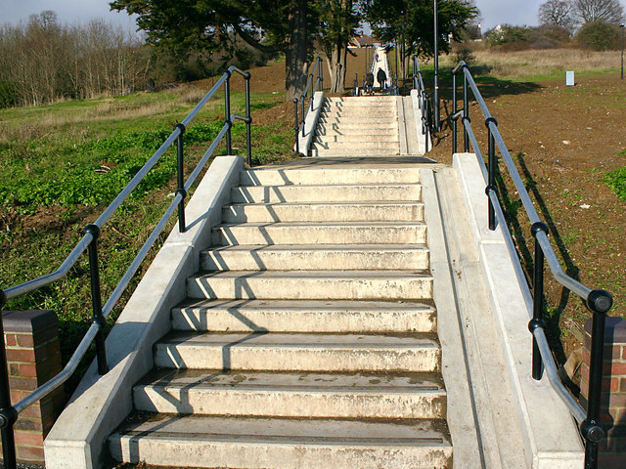
Next Best Steps

