Slide 1
K12 STRONG WORKFORCE PROGRAM
K14 Pathway Partnership Meeting
December 12, 2019

Slide 2
Overarching Intent of Strong Workforce
. . . . is for colleges to work together with workforce development providers, education partners and other stakeholders to be responsive to the needs of employers by aligning and expanding high-quality industry valued offerings, enabling students to access current and future job markets and promoting economic and social mobility.

Slide 3
Ed Code 88830
When determining grant recipients, K12 SWP Round 2 Selection
Committee shall consider past performance of grantees before
awarding additional funds to those reapplying for grants.

Slide 4
Ed Code 88830-Positive Consideration to:
Aligned programs serving unduplicated pupils
Programs that the subcommittee, in consultation with the consortium, determines most meet the needs of the local and regional economies.
Programs serving pupil subgroups that have higher than average dropout rates
Programs located in an area of the state with a high unemployment rate.

Slide 5
Ed Code 88830-Positive Consideration to:
(A) Programs that operate within rural school districts.
(B) Programs that make significant investments in CTE infrastructure, equipment & facilities.
Programs that successfully leverage:
  Existing structures, requirements and resources of the Carl D. Perkins CTE Improvement Act, Partnership Academies Program, or the Agriculture CTE Incentive Program.
  Contributions from industry, labor & philanthropic sources.

Slide 6
Why target geographic areas with need?

Slide 7


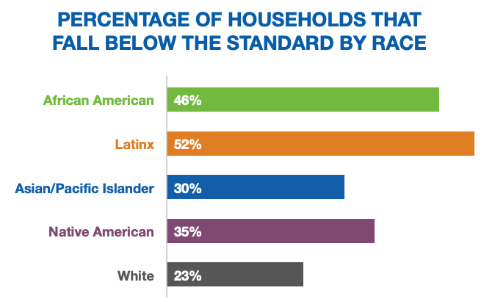
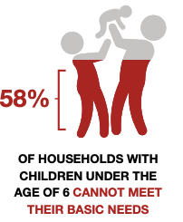
Notes:
Add language in the grant and insert the information in a slide before this one (if we have the information)
This is to show that this is what we’re supposed to be doing

Slide 8
California Family Needs Calculator
$15.99 per hour for a single adult in San Diego County
$31.87 per hour for a single adult + infant
$44.74 per hour for a single adult + infant + preschooler
    These are the minimum wages to cover basic expenses
The “living wage” is dependent on the family size and can be calculated at insightcced.org/2018-family-needs-calculator.
Notes:
$11.32 is the hourly wage that a single adult in a two-adult household with two children (1 preschooler and one

Slide 9
The COE analyzed 10 different metrics…
Single parent household
Less than A.A./A.S. educational attainment
Veteran status
Disability status
Not a U.S. citizen
Language other than English spoken at home
Households without a computer
Households without internet subscription
Unemployment rate
Low income

Slide 10
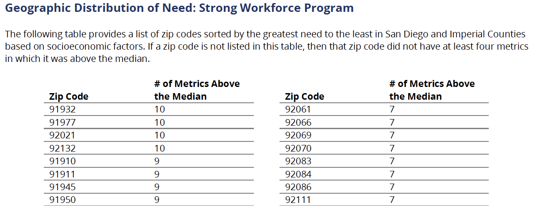
…and produced a list of need by zip code
Notes:
Need to redo the calculations. This screenshot is a placeholder

Slide 11
Regional Approach
    Our region’s approach to Strong Workforce is a transformational and focused on institutional change.
    Our expectation is that this work is sustainable and data-driven.
    We also value equity and social mobility.

