Slide 1
CEO Quarterly
SWP Workshop
September 9, 2019

Slide 2
Original Investments
  Data and Research
  Marketing
  Career Pathways
  Employment Readiness &
  Job Placement
2. New Investment
  Strong Workforce Faculty Institute
Today’s Update

Slide 3
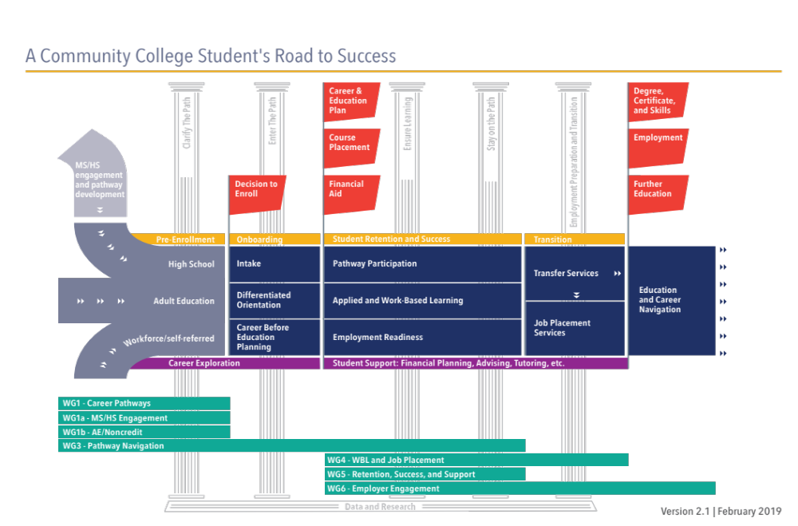

Slide 4
Accountability Outcomes | Vision Goals | Funding Formula | Student Success | Strong Workforce Program
9+ CTE Units in a Year |  | x | x | x
Completed Noncredit Workforce Milestone |  |  | x | x
Transfer-Level Math & English in a Year |  | x | x
Average Number of Units for Degree Earners | x |  | x
Completers/Completions Over 16 Units | x | x | x | x
Transfers to Four-Year Institutions/UC and CSU | x | x | x | x
Job in Field of Study | x |  | x | x
Living Wage Attainment |  | x | x | x
Median Annual Earnings |  |  | x | x
Change in Earnings |  |  | x | x
College Promise Grants/Pell Grants/ Perkins Economically Disadvantaged |  | x | x | x
Data Sources: CO MIS, CO Transfer Bucket, EDD Unemployment Insurance data, CTE Outcomes Survey,
Dept. of Apprenticeship Standards

Slide 5
DATA & RESEARCH

Slide 6
DATA & RESEARCH
Number of Requests for Labor Market Information

Slide 7
DATA & RESEARCH
Number of People Exposed to Research

Slide 8
MARKETING

Slide 9
GOALS
Increase awareness of Career Education programs
Create a unified regional brand for Career Education
Increase Career Education enrollments by 1%

Slide 10
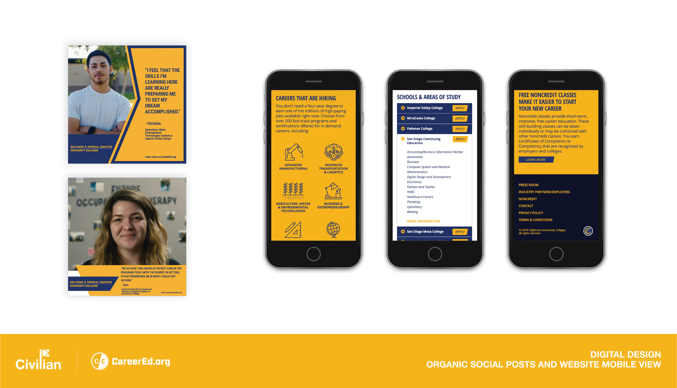

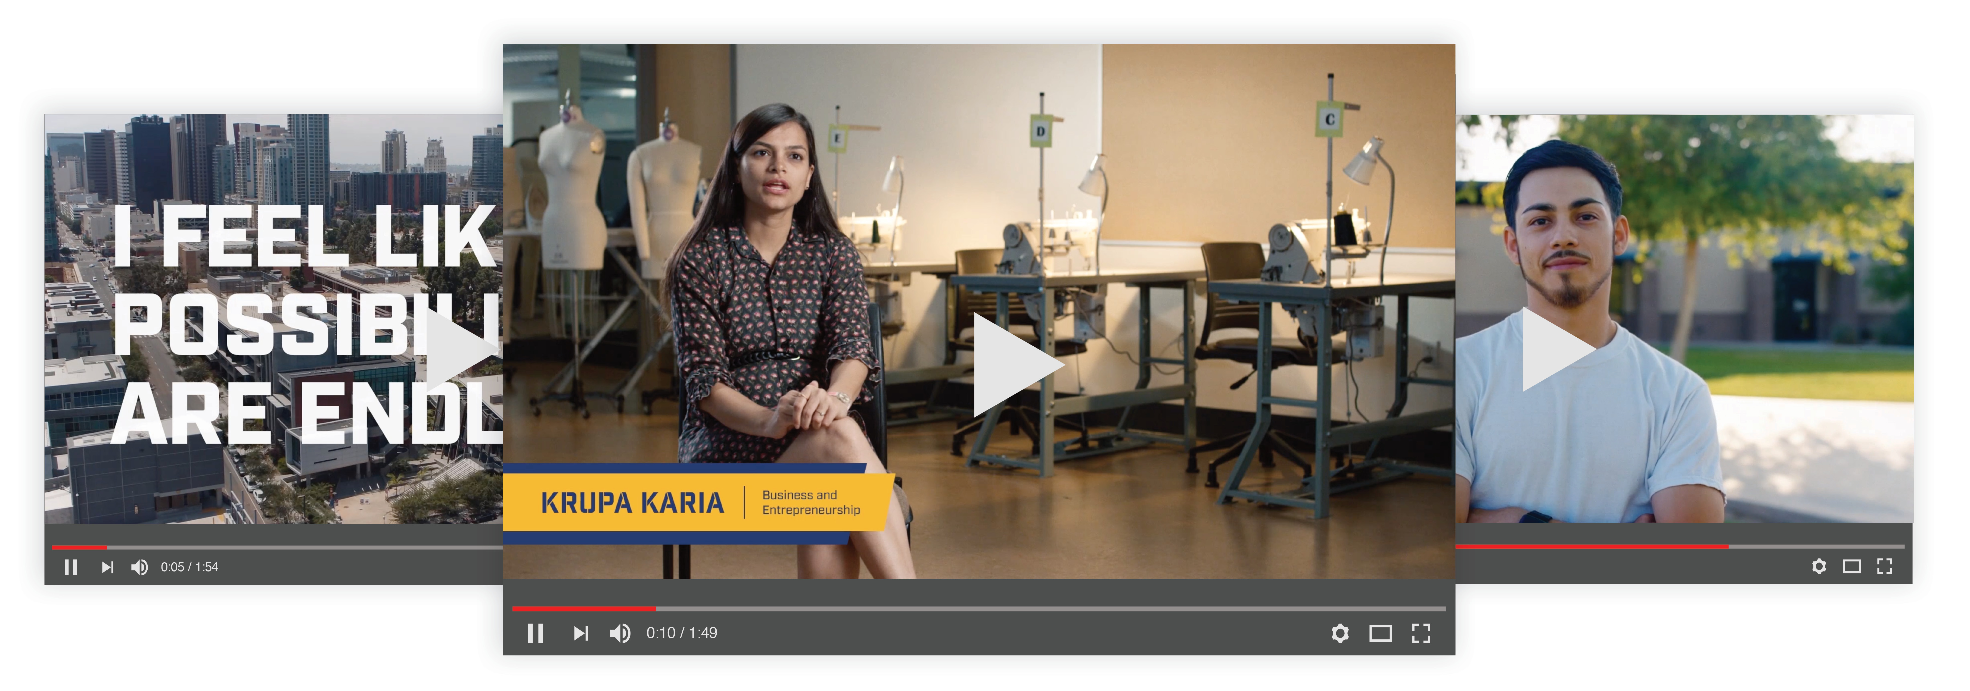
CAMPAIGN CREATIVE
MOBILE FIRST WEBSITE
SOCIAL
DIGITAL
VIDEO

Slide 11
MEASURING ROI
WHAT We Measure | 1. ADS TO CLICKS | 2. CLICKS TO APPLY | 3. APPLICATIONS TO ENROLL | 4. ENROLLMENTS TO COMPLETIONS
WHERE It Happens | CareerEd.org | All Institution Websites | CCCApply | All Institutions
HOW It Happens | Marketing Campaign | Referrals from CareerEd.org and other sources | Referrals from College Sites | All Institutions (Student Retention, Success & Support, On-boarding)
WHO Is Responsible | Marketing | Marketing | Individuals Institutions | All Institutions

Slide 12
ENROLLMENT DATA TOTALS (DataMart)
Number of
Total CTE
Enrollments

Slide 13
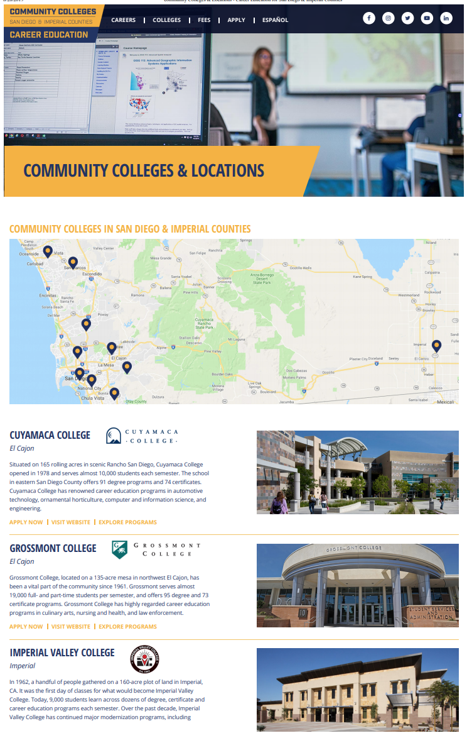
GOOGLE ANALYTICS
Click to apply metrics
Participation from all institutions
Needs from institutions
  Use Google Analytics to track/report activity
  Report to Civilian on a monthly basis
Fall training sessions available for PIOs/Webmasters

Slide 14
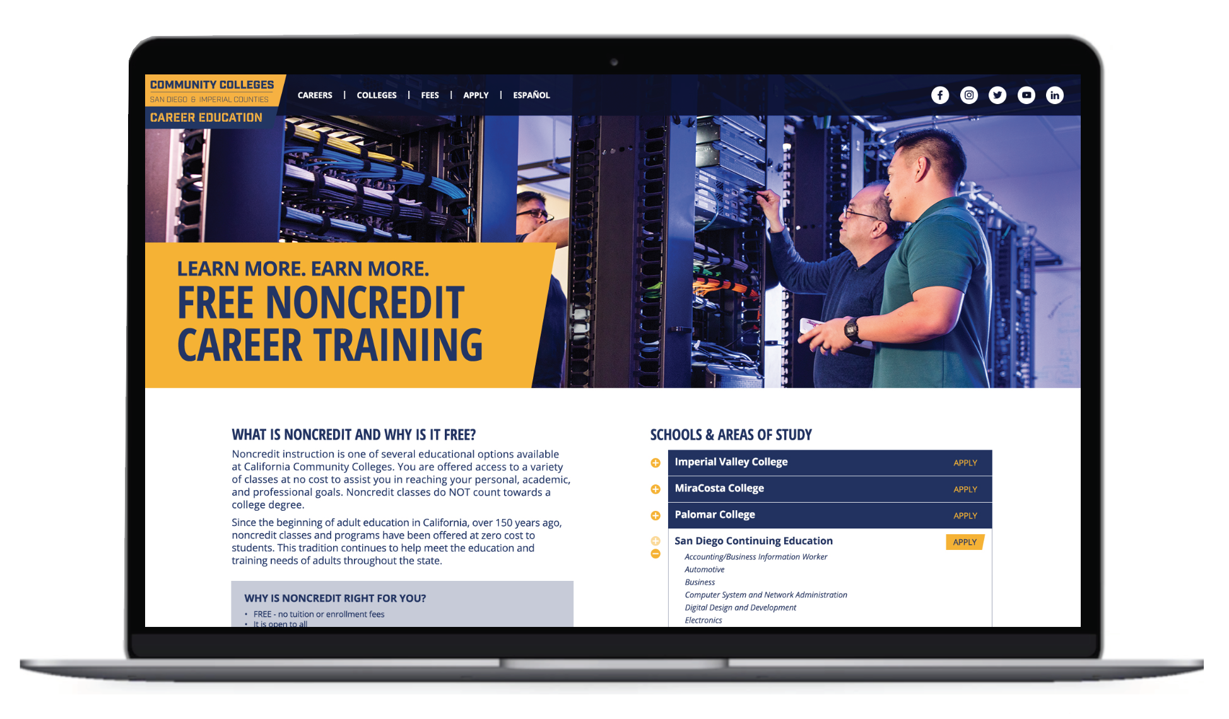
NONCREDIT

Slide 15
CAREER PATHWAYS

Slide 16
CAREER PATHWAYS
Number of Programs Recommended & Approved

Slide 17
CAREER PATHWAYS
Number of “Special Admit” Students

Slide 18
Number of K-12 Pathways by Sector for Districts in San Diego
And Imperial Counties (Source: WestEd Pathway Mapping 2019)
CAREER PATHWAYS
Sector | K-12 Pathways Across Districts
Arts, Media, and Entertainment | 99
Engineering and Architecture | 58
Information and Communication Technologies | 59
Health Sciences and Medical Technology | 57
Agriculture and Natural Resources | 36
Education, Child Development, Family Services | 30
Hospitality, Tourism, and Recreation | 28
Transportation | 27
Building and Construction Trades | 22
Business and Finance | 20
Manufacturing and Product Development | 18
Public Services | 13
Fashion and Interior Design | 10
Marketing, Sales, and Services | 7
Energy, Environment, and Utilities | 1
Grand Total | 485
Number of K-12 Pathways By Sector

Slide 19
EMPLOYMENT READINESS &
JOB PLACEMENT

Slide 20
EMPLOYMENT READINESS & JOB PLACEMENT
Career Development Activities
Career assessments
Career research
Workplace orientation
Resume building
Interview training
LinkedIn profile development

Slide 21
EMPLOYMENT READINESS & JOB PLACEMENT
Work-based Learning Activities
Informational interviewing
Industry speakers
Job shadowing
Service learning
Workplace tours
Career fairs
Internships
Clinical experiences

Slide 22
EMPLOYMENT READINESS & JOB PLACEMENT
Number of Students Exposed to Work Experience
Notes:
CONFIRM – BEN’S FEEDBACK WAS TO REMOVE THIS (currently not in list on slide #3)
NOTES ON DATA:
52% increase from 2015-16 to 2017-18, implying growing opportunities to teach 21st Century Skills and prepare students for future careers.

Slide 23
EMPLOYMENT READINESS & JOB PLACEMENT
CTE Degrees and Certificates Awarded

Slide 24
STRONG WORKFORCE FACULTY INSTITUTE:
RETENTION & SUCCESS

Slide 26
THE PURPOSE OF THE INVESTMENT
Examine enrollment to completion:
  Retention and success at the course level
  Classroom practices
  Retention and success of disproportionately impacted populations
  Target local resources and redesign practices

Slide 27
A PROFESSIONAL LEARNING OPPORTUNITY FOR FACULTY
SWP Institute participants will:
Attend 2 in-person professional learning events
  February 28, 2020
  Fall 2020
Engage in an investigative project
Develop an action plan for the classroom
Receive a $2,000 stipend
Min 20, max 25 faculty per college

Slide 28
AN INVESTMENT IN RESEARCH
Funding will be available through a Request for Applications (RFA) to support and build the research capacity at each campus
$250K over a period of 3 years
Sep 23, 2019: RFA released
Nov 22, 2019: RFA responses due
Dec 2019 – Jan 2020: Researchers prepare for SWP Institute

Slide 29
PROGRESS SO FAR…
Presented concept for feedback
16 project team members
19 advisory group members with representation from each institution
Questions for investigative project completed
RFA draft in process
Orientation for prospective participants scheduled

