Slide 1
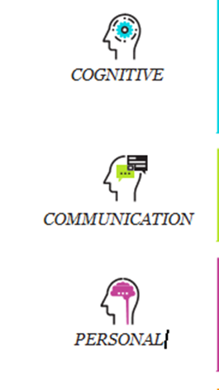
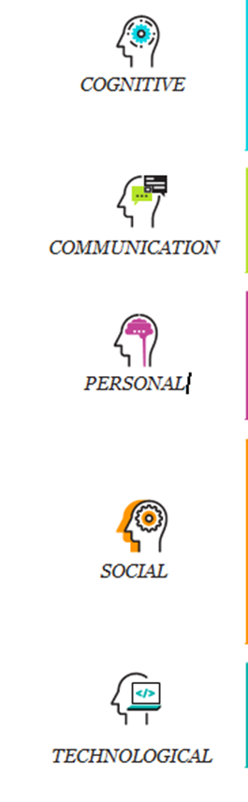
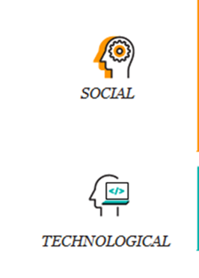

TEACHING & ARTICULATING SKILLS NEEDED FOR THE WORKFORCE:
A PSYCHOLOGICAL SCIENCE PERSPECTIVE
Jaye Van Kirk, M.A. (Psychology), M.A. (Zoology),
ABD (Psychobiology)
Professor of Psychology
jvankirk@sdccd.edu

Slide 2

objectives
Gain new perspective in teaching your course material
Increase awareness of skills you teach that prepare students for workforce
Help articulate skills that employers value
  Syllabus
  Assignments & activities
prepared
unprepared

Slide 3

Time to innovate!
How can knowledge and skills from fashion, business, psychology, sustainability, marketing & materials science be integrated into a product (or service) that can:
  Influence a person’s psychological state
  Respect limited earth resources
  Be desired by diverse consumers (culture, SES, gender, age, etc.)
  Evolve with changing trends, resources and needs
  Provide people with realistic and healthy perspectives

Slide 4
These disciplines (fashion, business, psychology, sustainability, marketing & materials science) can be applied to…
https://careersinpsychology.org/the-emergence-of-fashion-psychology/
https://www.businessoffashion.com/articles/careers/six-fashion-careers-of-the-future
Fashion psychology

Slide 5

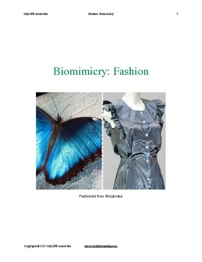

What does this say about:
1) Cross disciplinary collaborations?
2) What skills students learn to solve problems?
Where can this lead?
  https://www.sciencetimes.com/articles/18148/20190211/fashion-breakthrough-adaptive-clothing-material-dependent-environment.htm
    Smart clothing
      (e.g. thermochromic fabric)
  https://inhabitat.com/ecouterre/10-eco-fashion-garments-inspired-by-nature-and-biomimicry/
    biomimicry

Slide 6
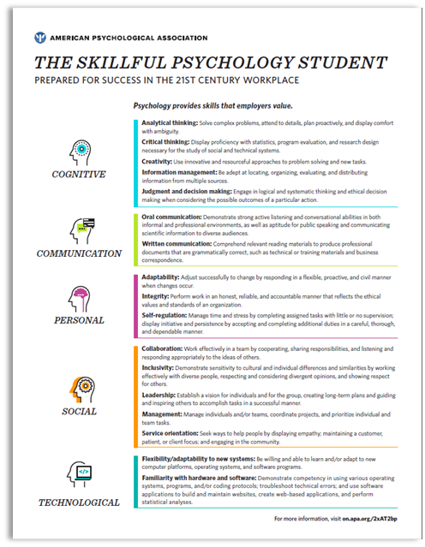


How do we connect coursework to career readiness ?
Discipline skill sets
What are the skills
unique to your
discipline?
Naufel, K. Z., Appleby, D. C., Young, J., Van Kirk, J. F., Spencer, S. M., Rudmann, J., Carducci, B.J., Hettich, P. and Richmond, A. S. (2018). The Skillful Psychology Student: Prepared for Success in the 21st Century Workplace. Retrieved from: https://www.apa.org/careers/resources/guides/transferable-skills.pdf

Slide 7

Origins of Committee on Associate & Baccalaureate Education (CABE) 21st Century Skills Task force
  Idea proposed to CABE (Aaron Richmond, Ph.D.)
    CABE highlighted the issue (stakeholders: students, faculty, counselors).
      Interest stemmed from faculty who are scientists and educators who have:
        expertise in career development
        created career courses
        conducted research in career exploration

Slide 8
Karen Z. Naufel
Georgia Southern University (CABE Liaison)
Drew C. Appleby
Indiana University-Purdue, Indianapolis
Jason Young
Hunter College of the City University of New York
Jaye F. Van Kirk
San Diego Mesa College
Stacie M. Spencer
MCPHS University
Jerry Rudman
Irvine Valley College
Bernardo J. Carducci
Indiana University Southeast
Paul Hettich
DePaul University
Aaron S. Richmond
Metropolitan State University of Denver (CABE Liaison)
Working
Group
Members

Slide 9


AIMS
Increase students’, teachers’, and advisors' awareness of :
  skills valued by employers
  where these skills are developed within the Psychology curriculum
  the diverse range of job options that require these skills
Support students in achieving career goals

Slide 10

What inspired me to incorporate skills into classes?
Providing education emphasizing content knowledge & career preparation
American Psychological Association
  Undergraduate Education in Psychology: A Blueprint for the Future of the Discipline
  R.Eric Landrum, Bernard C. Beins, Mukul Bhalla, Karen Brakke,
  Deborah S. Briihl, Rita M. Curl-Langager, Thomas P. Pusateri,
  and Jaye Jang Van Kirk (2009)
  Chapt 9: Desired Outcomes of an Undergraduate Education
  in Psychology From Departmental, Student, and
  Societal Perspectives
    Responsibility of faculty and administrators to teach the skills, knowledge, and values critical for success in today's world.

Slide 11
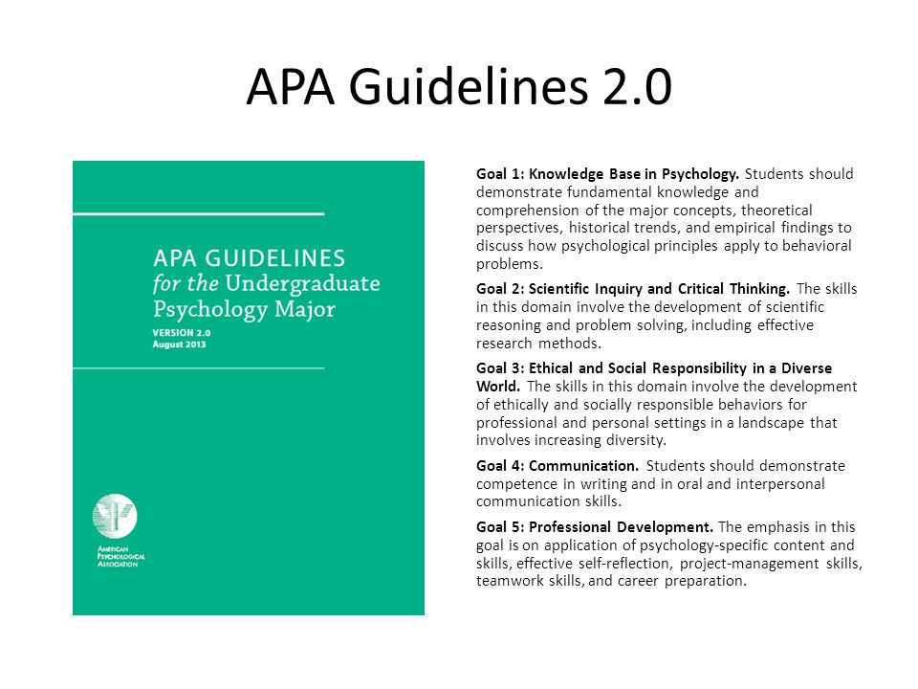
How did including skills in my syllabus begin?

Slide 12

1. IDENTIFYING WORKFORCE SKILLS FOR PSYCHOLOGY MAJORS

Slide 13

METHOD
Identified evidence-based sources of skills valued by employers
1
Organized skills into domains
4
Compiled lists of most frequently mentioned skills
3
Identified skills included in employer job descriptions
2
Described skills with terms used by employers
5

Slide 14





Five Skill Domains
Seventeen Skills

Slide 15

Completed Products
The Skillful Psychology Major poster/handout
The Skillful Psychology Student: Skills You Will Need to Succeed in the 21st-Century Workplace (APA Psychology Student Network)
The Skillful Psychology Student: How to Empower Students with Workforce-Ready Skills by Teaching Psychology (APA Psychology Teacher Network)
student
advisor
teacher

Slide 16
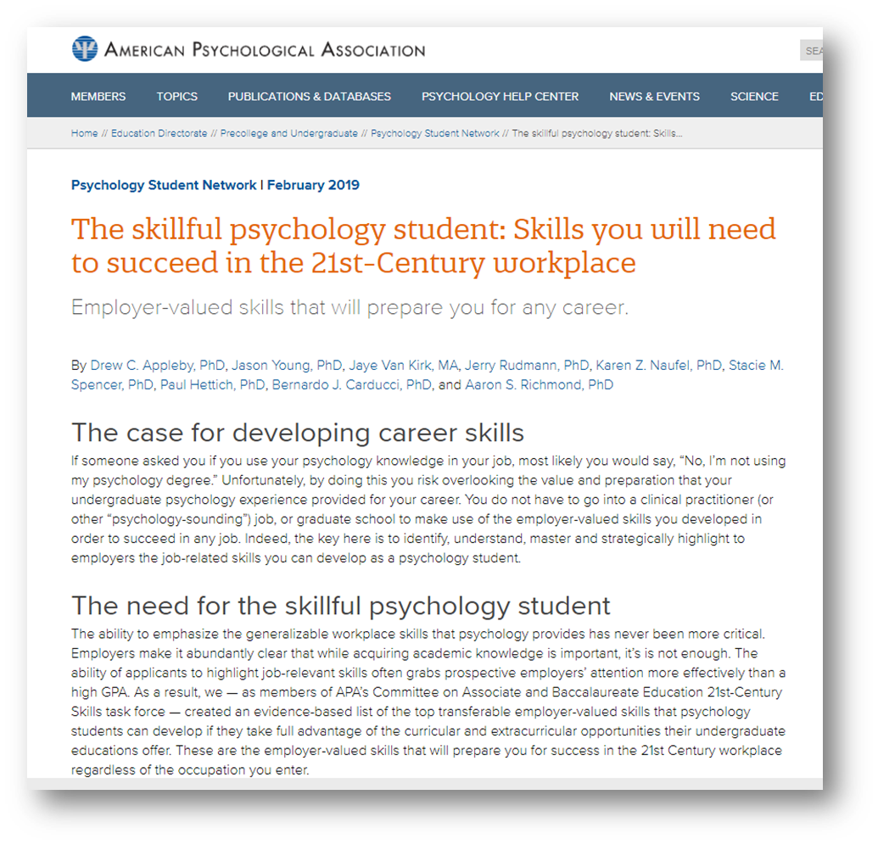
APA Psychology Student Network

Slide 17
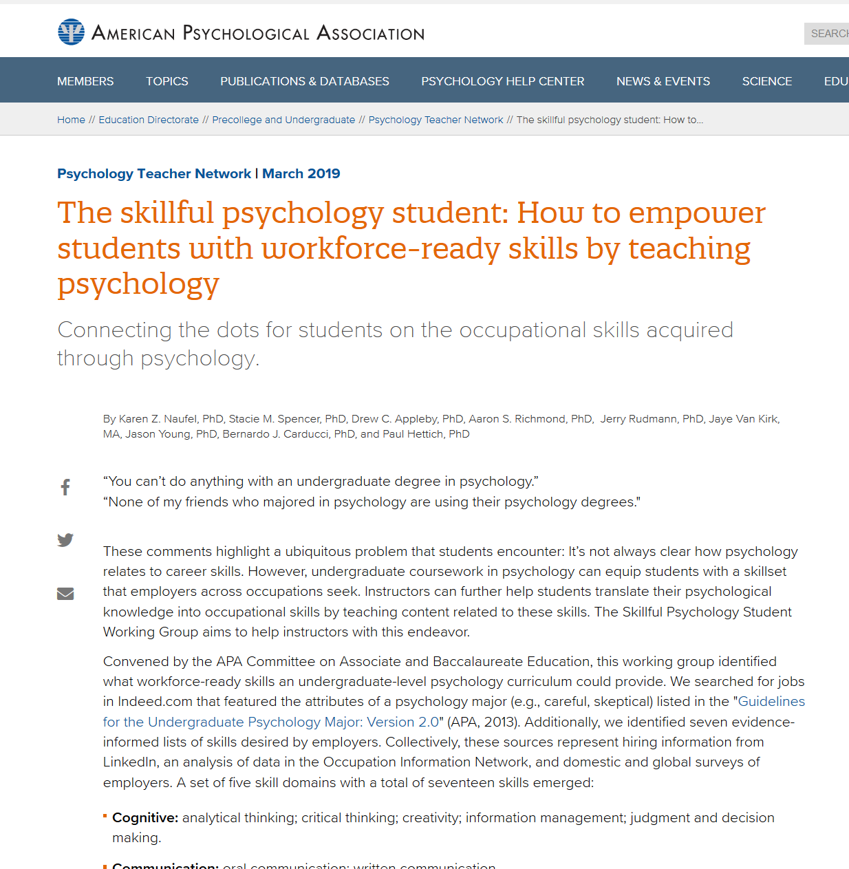
APA Psychology Teacher Network

Slide 18
Skills need to adapt to
Multiple Careers across one’s
professional life in order to
stay employable

Slide 19

2: INFUSE COURSES WITH TEACHING STRATEGIES FOR SKILLS ACQUIRED FROM PSYCHOLOGY
…or your discipline

Slide 20
Stakeholders + Skills Success
Student
Faculty
Advisor/counselor
Skills

Slide 21
How Stakeholders Can Use 21st Century Skill Sets
 | Faculty | Students
Syllabus: Emphasizing skill sets | X
Letters of recommendation: Articulate skill sets | X
Skills gained in course: Increase awareness | X | X
Resume, cover letter, interviews (Career preparedness) Articulate skill sets |  | X
Assignments: Emphasizing skill sets | X | X
Careers using Psychology skill sets: (BA level) Increase awareness | X | X

Slide 22
Why would it be important to know:
*the common skills
across disciplines?
from your
discipline?
*Unique skills

Slide 23
Technological
Personal
Social
Communication
What domains do your classes emphasize?
Cognitive
21st C skills are found across curriculum

Slide 24






These Psychology courses provide skill sets across several domains
COMMUNICATION
PERSONAL
TECHNOLOGICAL
COGNITIVE
SOCIAL
Intro Psych
Lifespan
Abnormal
Psychobiology
Social Psych
Statistics
Learning
Cognitive
Research Methods
Intro Psych
Lifespan
Abnormal
Psychobiology
Social Psych
Statistics
Learning
Cognitive
Research Methods
Psychobiology
Statistics
Cognitive
Research Methods
Intro Psych
Abnormal
Social Psych
Learning
Research methods
Intro Psych
Abnormal
Psychobiology
Statistics
Cognitive
Research Methods

Slide 25
What courses in your discipline fit into these domains?
COMMUNICATION
PERSONAL
TECHNOLOGICAL
COGNITIVE
SOCIAL
Research
Real estate
Architecture
Computer & Information science
Computer business technology
Web development
Speech
ASL
Communication
English
Business
Economics
Accounting
Nutrition
Fashion
Political science
hospitality
Child development
Black studies
Chicanx studies
Nutrition
Business

Slide 26
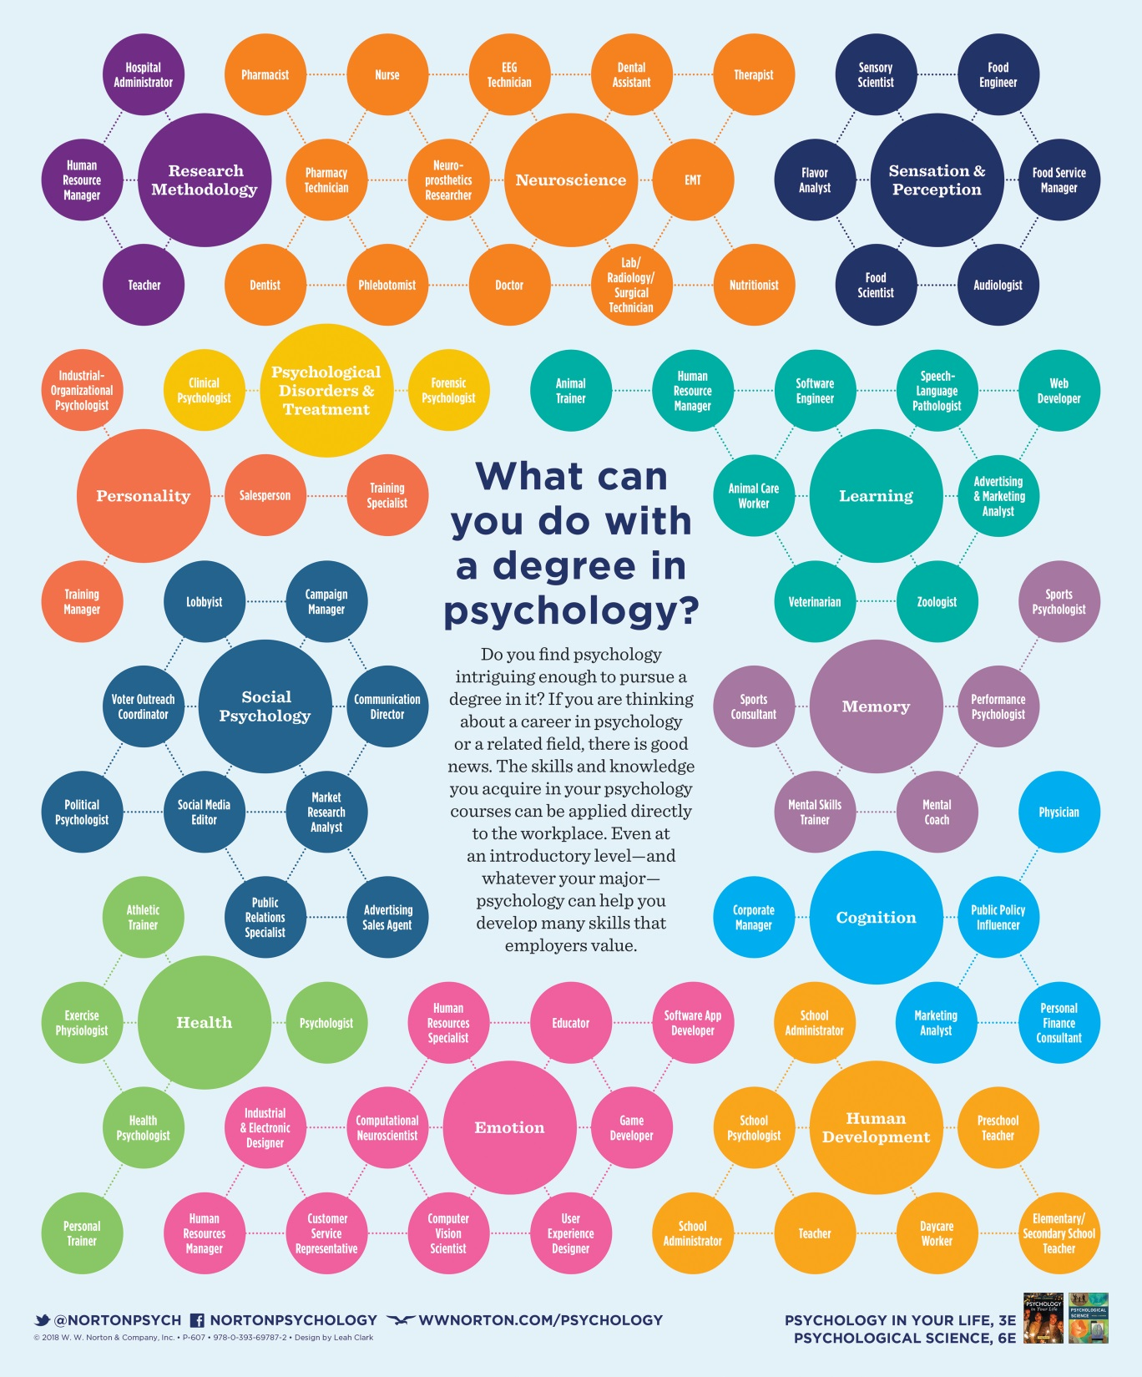
Courses & careers

Slide 27
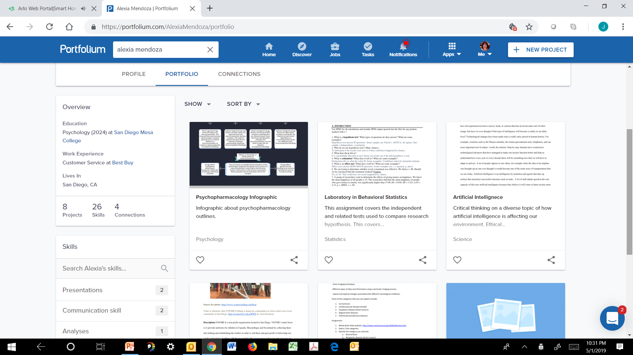
How do students acquire and learn to articulate the skills they have learned?
Assignments designed to highlight various skill sets
  Portfolium
  Infographics
  Resume & Cover letters
  Brochures
  Research…Papers
Extracurricular activities
  Clubs
Classroom interactions

Slide 28
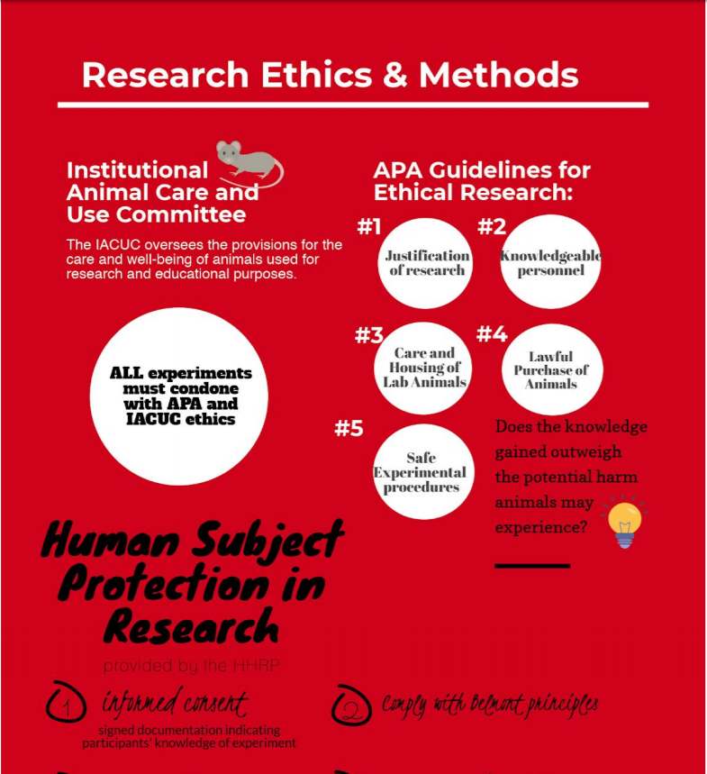
Section of infographic example demonstrating skills
Skills
Personal: integrity
Social: collaboration
Cognitive: critical thinking, creativity, information management
Communication: written
Technological: familiarity with software

Slide 29
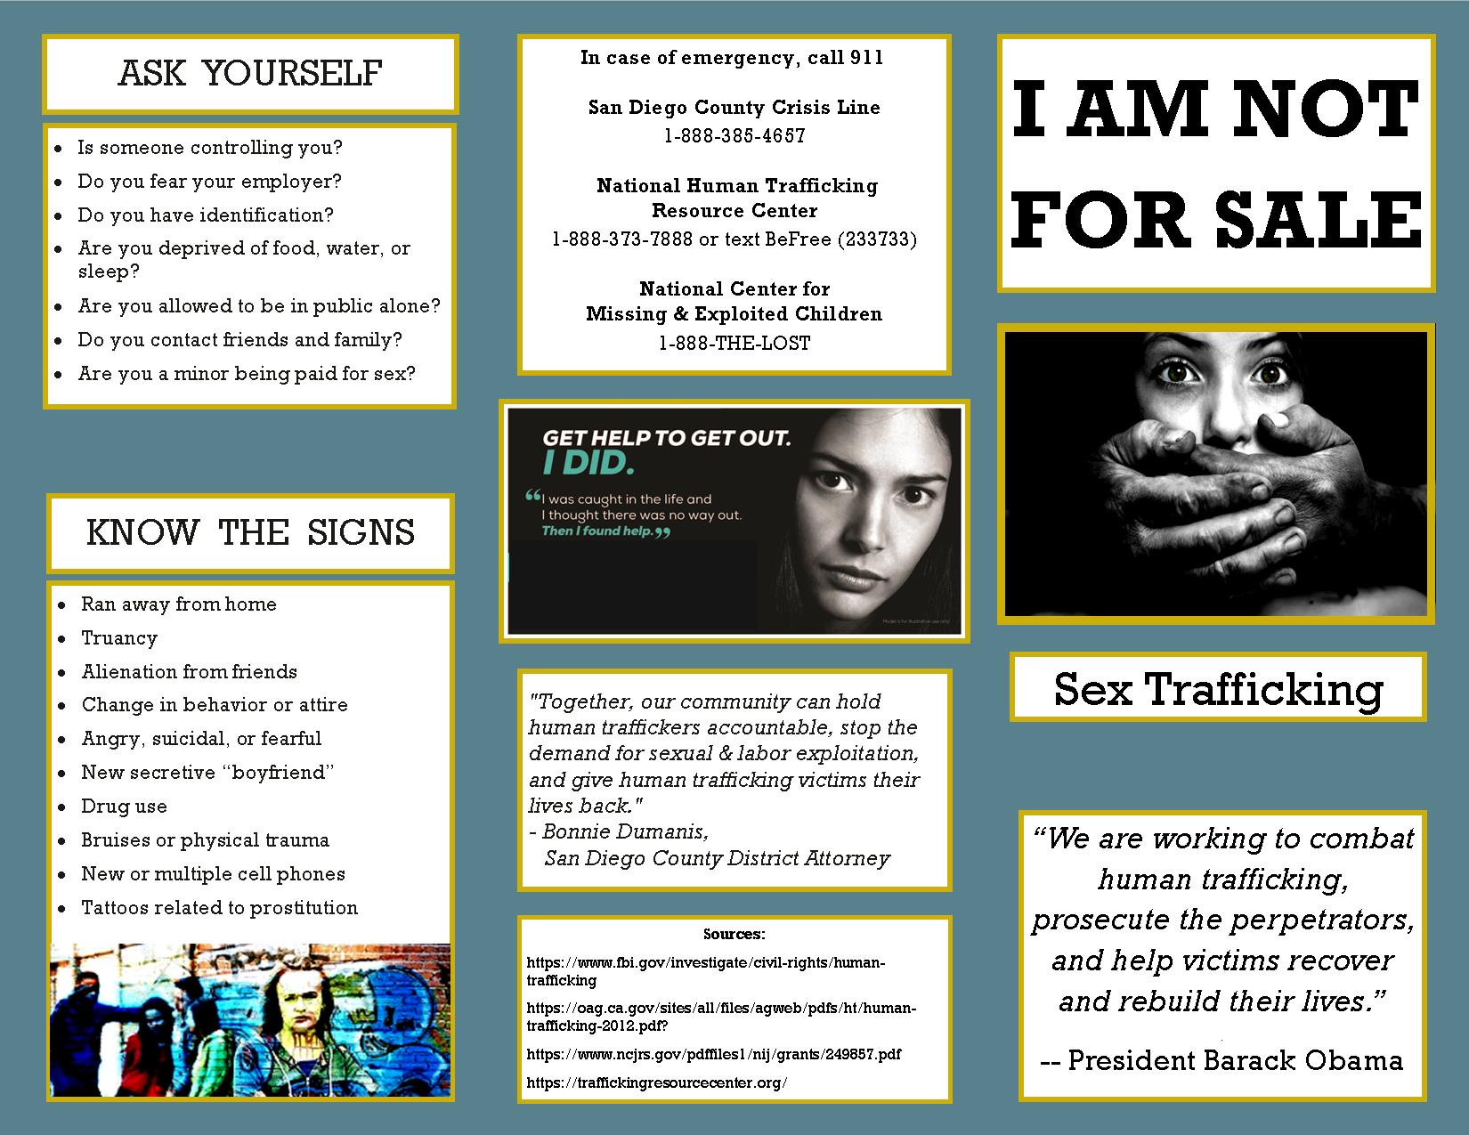
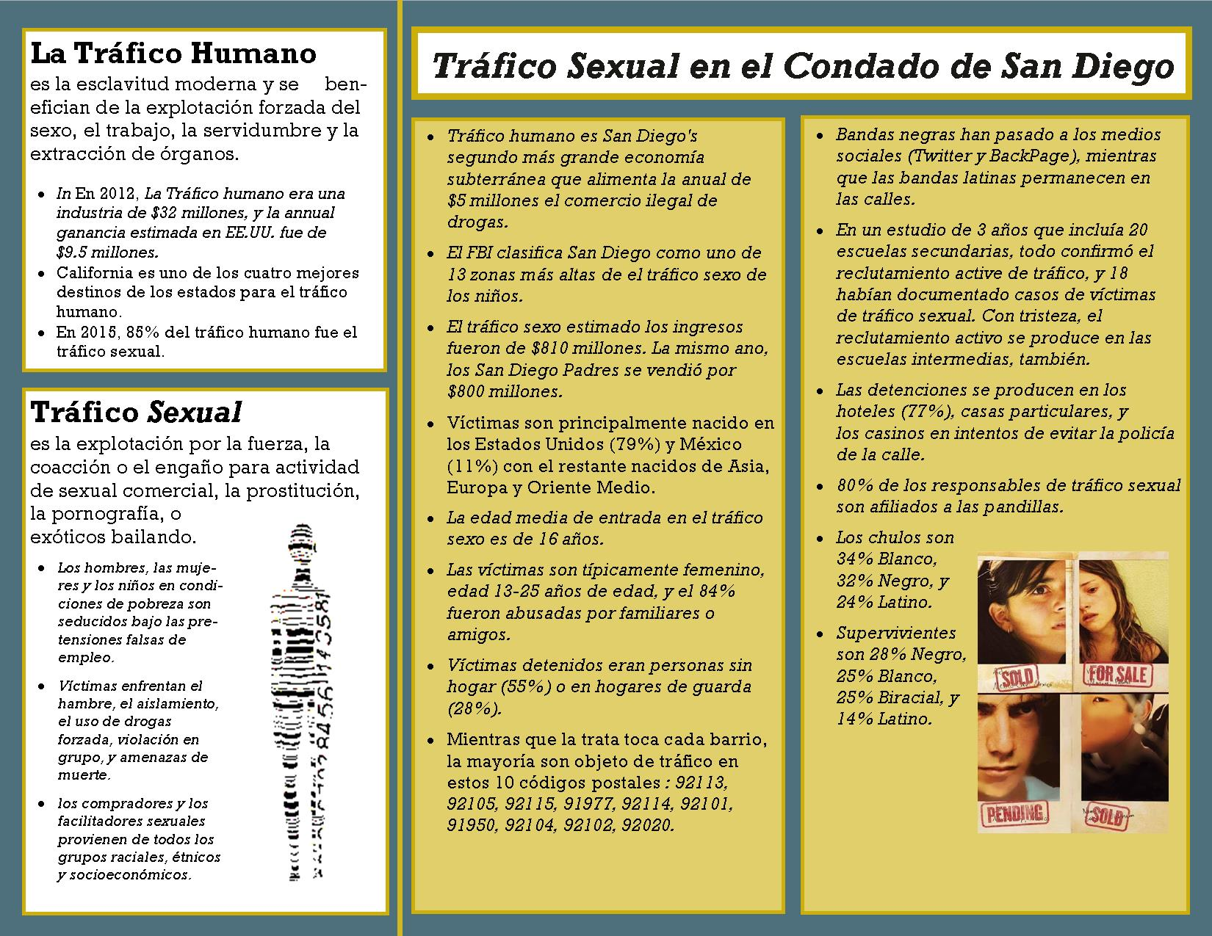
Brochure assignment: Sex Trafficking (English & Spanish)
What skills are used?

Slide 30
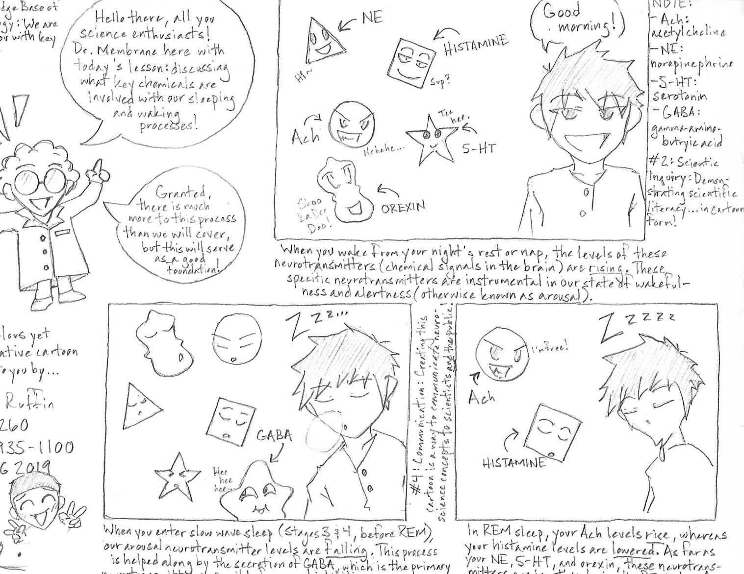
Cartoon assignment (neurotransmitters)
What skills are used ?

Slide 31
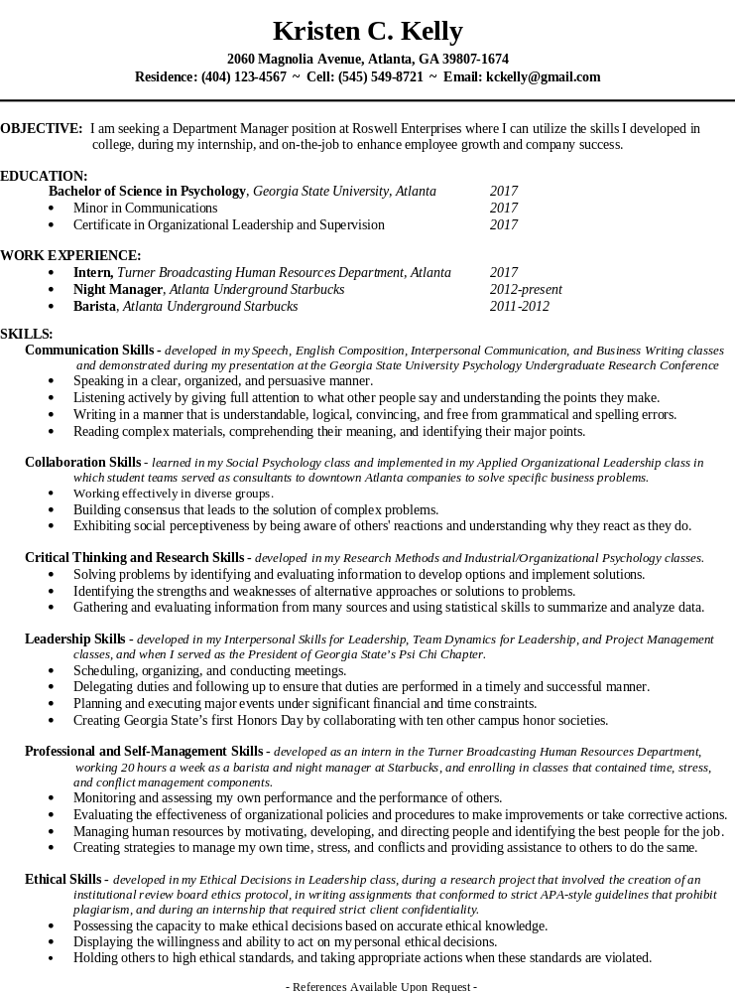
A skills focused resume assignment
skills

Slide 32
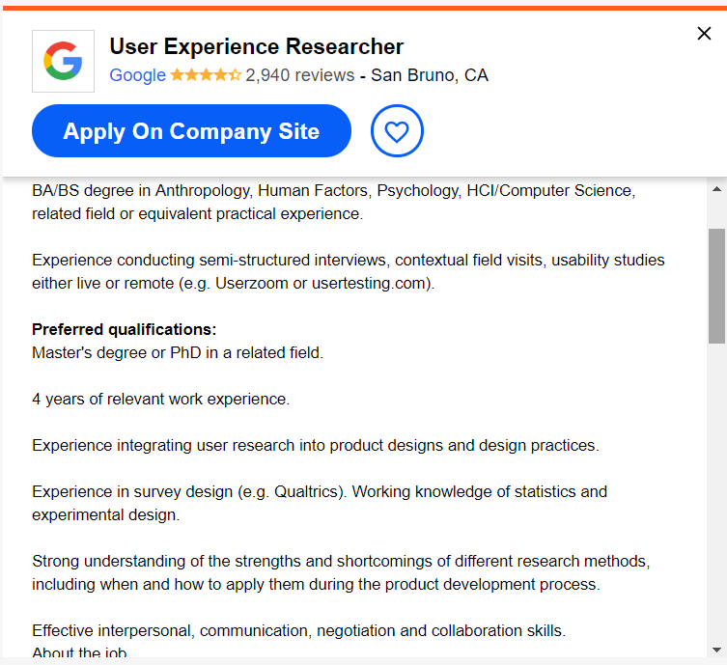
Connect course skills to skills that employers value
Identify skills

Slide 33

You’re probably already teaching some very valuable skills
Tips:
  Know the skills developed from your discipline
  Gain familiarity with the skills that employers value from your discipline.
  Help increase awareness of connecting skills from your courses to workforce skills

Slide 34

Now that you know these skills are valuable...

Slide 35
Let’s highlight skills they will acquire, broaden and strengthen
Stay tuned ☺

Slide 36
3. INCLUDING SKILLS INTO YOUR SYLLABUS

Slide 37
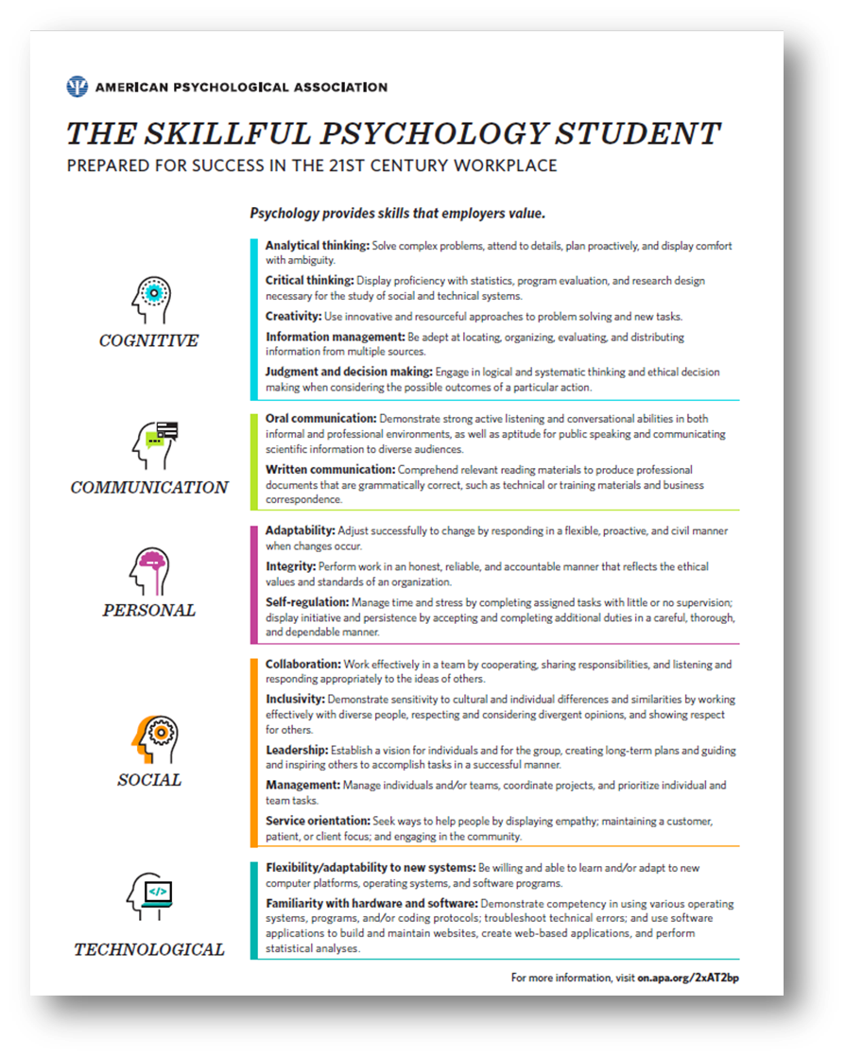
Including skills in your syllabus
Insert in learning goals/outcomes section
Goals: identify, acquire, strengthen
& articulate skill sets
Tie skills to:
  assignments in syllabus
  Skills employers value

Slide 38
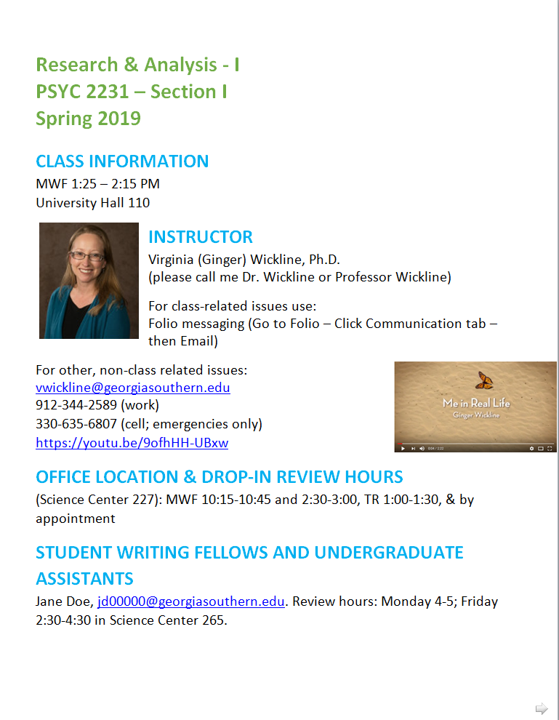
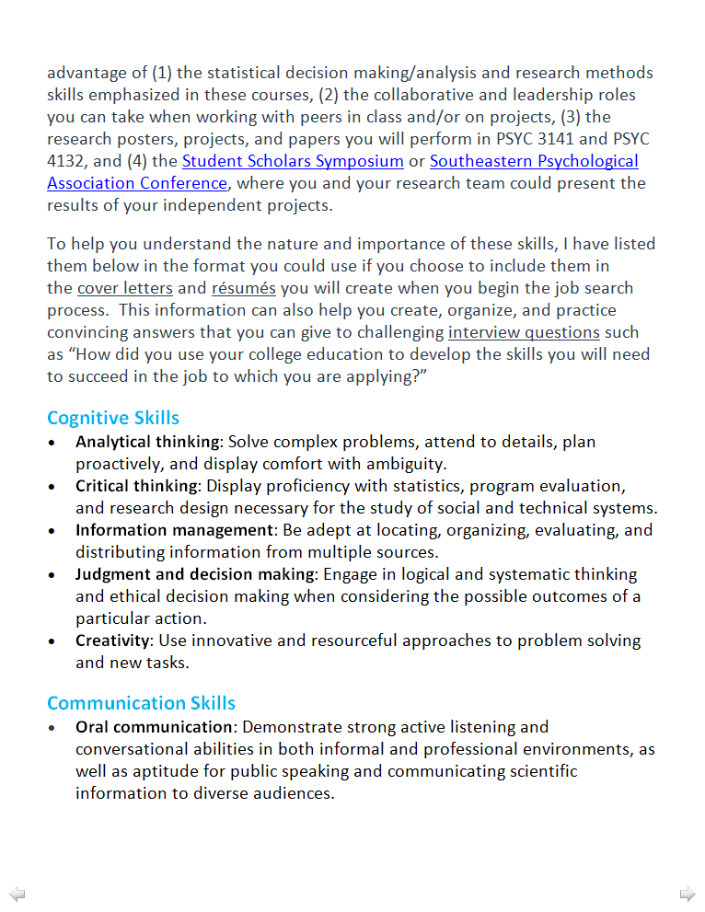
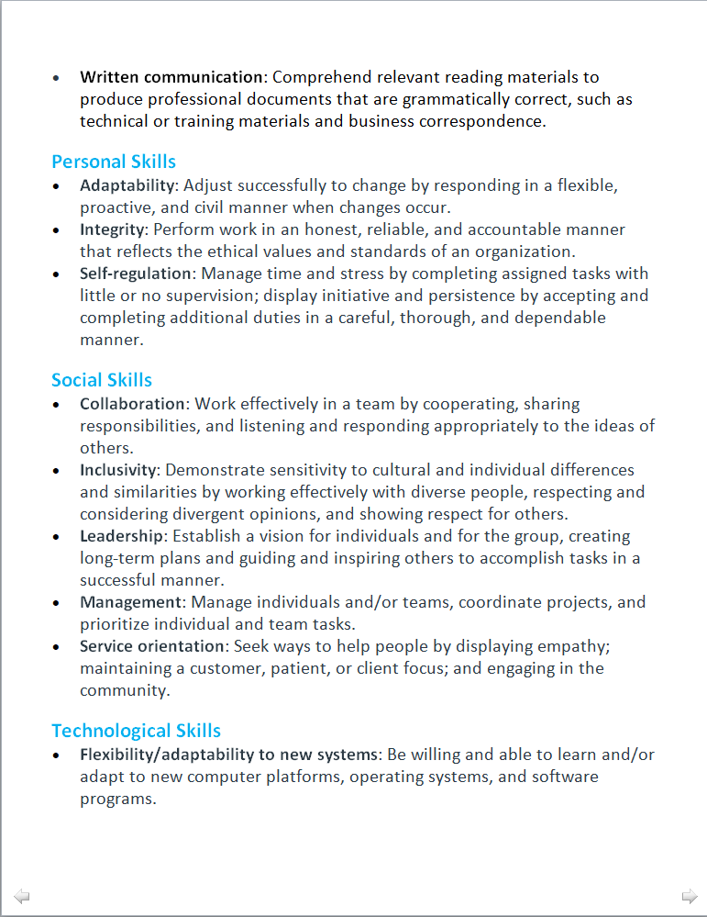
Example: syllabus highlighting skill sets
http://teachpsych.org/resources/Documents/otrp/syllabi/VW19stats.pdf

Slide 39
Syllabus activity
Identify terms associated with skill sets in syllabus
Example syllabus (White, 2017)
Learning Outcomes & Course Objectives:
By the end of the course, you should:
1) Have a basic understanding of psychological concepts as a science and as a discipline. You will be able to describe some of the key principles and themes in domain of psychology (1.1), have a basic understanding of different content areas in the field, and understand how we can apply psychology in and outside of academia.
2) Be able to evaluate some general aspects of psychology research methodologies & search out information related to the field, along with a basic understanding of how to design, conduct, & interpret psychological research.
3) Have a basic understanding of the ethical challenges as it relates to being a better informed consumer of psychological/scientific knowledge.
4) Have a beginning understanding of APA-style in general, along with writing for job & school applications.
5) Have a basic understanding of the career options in psychology & related fields, with a focus on learning how psychology courses & training at the undergraduate level can help in your career path, including knowing more about our psychology department and what it takes to be a psychology major or minor here at the U., along with how this course may help you post- graduation by making connections with faculty & other students in the department.
In this course, we will explore basic research issues and critical analysis of psychological science. We will discuss the methods of psychological research, along with the myths and images of psychology as a field. As part of this goal, you can participate in research conducted here at the university to give you more “hands-on” experience (more on this later) and we may do a small project together. By the end of the course, it is my hope that you will be able to cast a more critical eye toward how research findings and surveys are presented in the non-scientific world as well.
Analytical thinking, Critical thinking, Creativity, Information management, Judgment and decision making
Oral & written communication
Adaptability, Integrity, Self-regulation
Collaboration, Inclusivity, Leadership, Management, Service orientation
Flexibility/adaptability to new systems, Familiarity with hardware and software

Slide 40

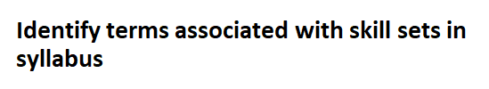

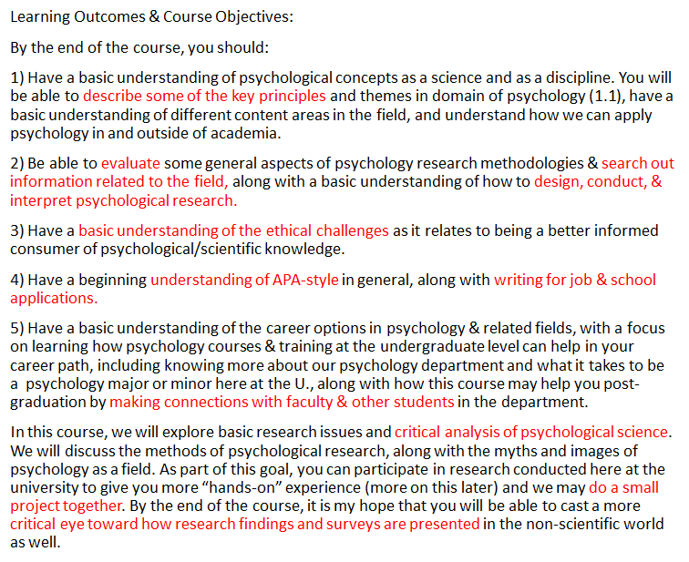
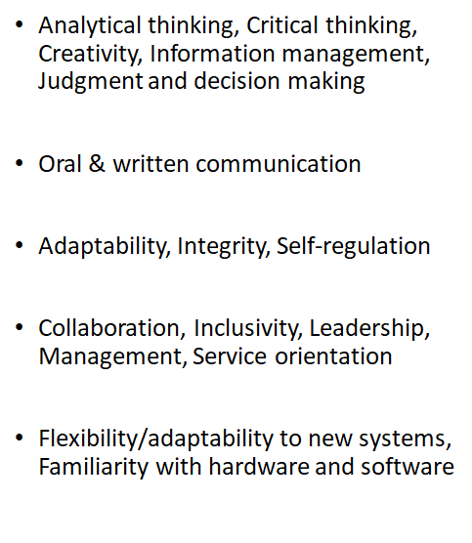

Slide 41
Examples of learning outcomes in syllabi
Identify skills:
Intro to Business (Northeastern Univ)
  Student Learning Outcomes
  Based on satisfactory completion of this course, a student should be able to:
  1. Identify and describe the competitive environments and forces that affect the internal and external operations of
  companies doing business in the global market.
  2. Define and describe free-market capitalism and how it differs from other economic systems, as well as the role of
  key U.S. economic indicators.
  3. Explain entrepreneurship and what it takes to be an entrepreneur.
  4. Discuss the challenges managers face to set ethical standards and encourage corporate social responsibility,
  structure organizations, manage production and operations, and human resources.
  5. Summarize the development and implementation of customer-oriented marketing plans, the four Ps of marketing
  and the main strategies in terms of pricing, promotion, distribution and product design.
  6. Describe the role of accounting and financial information and the challenges facing managers involved in the
  financial planning process.

Slide 42
Examples of learning outcomes in syllabi
Identify skills:
Intro to Business (Northeastern Univ)
  Student Learning Outcomes
  Based on satisfactory completion of this course, a student should be able to:
  1. Identify and describe the competitive environments and forces that affect the internal and external operations of companies doing business in the global market.
  2. Define and describe free-market capitalism and how it differs from other economic systems, as well as the role of key U.S. economic indicators.
  3. Explain entrepreneurship and what it takes to be an entrepreneur.
  4. Discuss the challenges managers face to set ethical standards and encourage corporate social responsibility,
  structure organizations, manage production and operations, and human resources.
  5. Summarize the development and implementation of customer-oriented marketing plans, the four Ps of marketing and the main strategies in terms of pricing, promotion, distribution and product design.
  6. Describe the role of accounting and financial information and the challenges facing managers involved in the financial planning process.

Slide 43
Example of learning outcomes in syllabi
(INFO 200 Information communities outcomes (SJSU))supports the following core competencies:
C Articulate the importance of designing programs and services supportive of diversity, inclusion, and equity for clientele and employees.
F Use the basic concepts and principles related to the selection, evaluation, organization, and preservation of physical and digital information items.
H Demonstrate proficiency in identifying, using, and evaluating current and emerging information and communication technologies.
J Describe the fundamental concepts of information-seeking behaviors and how they should be considered when connecting individuals or groups with accurate, relevant and appropriate information.
K Design collaborative/individual learning experiences based on learning principles and theories.
L Demonstrate understanding of quantitative and qualitative research methods, the ability to design a research project, and the ability to evaluate and synthesize research literature.
M Demonstrate professional leadership and communication skills.
O (For students entering from Spring 2015 onwards) Understand global perspectives on effective information practices that are supportive of cultural, economic, educational, or social well-being.

Slide 44
Example of learning outcomes in syllabi
(INFO 200 Information communities outcomes (SJSU))supports the following core competencies:
C Articulate the importance of designing programs and services supportive of diversity, inclusion, and equity for clientele and employees.
F Use the basic concepts and principles related to the selection, evaluation, organization, and preservation of physical and digital information items.
H Demonstrate proficiency in identifying, using, and evaluating current and emerging information and communication technologies.
J Describe the fundamental concepts of information-seeking behaviors and how they should be considered when connecting individuals or groups with accurate, relevant and appropriate information.
K Design collaborative/individual learning experiences based on learning principles and theories.
L Demonstrate understanding of quantitative and qualitative research methods, the ability to design a research project, and the ability to evaluate and synthesize research literature.
M Demonstrate professional leadership and communication skills.
O (For students entering from Spring 2015 onwards) Understand global perspectives on effective information practices that are supportive of cultural, economic, educational, or social well-being.

Slide 45
Your turn:
Using your syllabus, identify the following:
Skill based learning outcomes
Learning outcomes related to 5 domains of the 21st C Skill Sets
Assignments that develop skills

Slide 46
What students should know about their skill development

Slide 47
Milestone One: Understanding the Transferrable Career Skills from Your Psychology Curriculum
What are the skills you will need to enter and succeed in the 21st Century workplace that you can develop during your undergraduate education?
Milestone Two: Identifying and Utilizing Campus Career Resources
What resources are available at your school that can help you develop these skills, and how can you utilize these resources in a successful manner?
Milestone Three: Using Your Undergraduate Education to Develop Your Career Skills
How can you use both the curricular and extracurricular components of your undergraduate education to develop these skills in a successful manner?
Milestone Four: Searching for Jobs and Marketing Your Skills
What strategies can you use to search for potential jobs and then market your skills effectively during the job-search process? What campus resources can help you create these strategies?
Milestone Five: Transitioning Successfully from College to the Workplace
What skills will you need to adjust to, keep, and flourish in your job once you are hired?
Syllabus "Skillabus" (Appleby, 2019)
Emphasize perspective of multi-step strategy to identify, understand, value, develop, and market the skills to succeed in the 21st century workplace.
  Highlight skills acquired in your course in your syllabus
    Tie assignments to the 5 skill domains & skill sets.
  Know, identify and articulate skills acquired as a Psychology major
  Develop skills in coursework & extracurricular activities
  Effectively market skills (resume, cv)

Slide 48
Project syllabus
National discipline based resource for exemplary syllabi in Psychological Science.
Project Syllabus Best Practices of course objectives:
http://teachpsych.org/resources/Documents/otrp/syllabi/bpcourseobj.pdf

Slide 49
How can you strengthen the skill sets?
Have students reflect on skills used in the assignments
Include them during lecture
  Pose question: “What skills do these issues relate to?”
  Issues discussed

Slide 50
Skill & career resources
https://www.careeronestop.org/ExploreCareers/Assessments/skills.aspx (career onestop)
https://www.onetonline.org/skills/ (O*Net skills)
https://www.bls.gov/ooh/ (Bureau of Labor Statistics)

Slide 51


Professor’s letter of recommendation that mentions skills

Slide 52
You’re off to a great start!
What you already have:
  Syllabus
  Assignments
  Lectures
  In-class activities
All help student acquire, broaden
and deepen their skill sets

Slide 53
Summary
Increased awareness of skills from your discipline and courses
Incorporating skills into syllabus and course material
Increased awareness of what skills you teach to prepare students for workforce
Increase articulation of skills that employers value in
  Syllabus
  Assignments & activities

Slide 54
ujuzi
habildades
Skills
Thank you!
スキル
nā mākau
技能
δεξιότητες
abilità
مهارات
Kompetenzen

