Slide 1
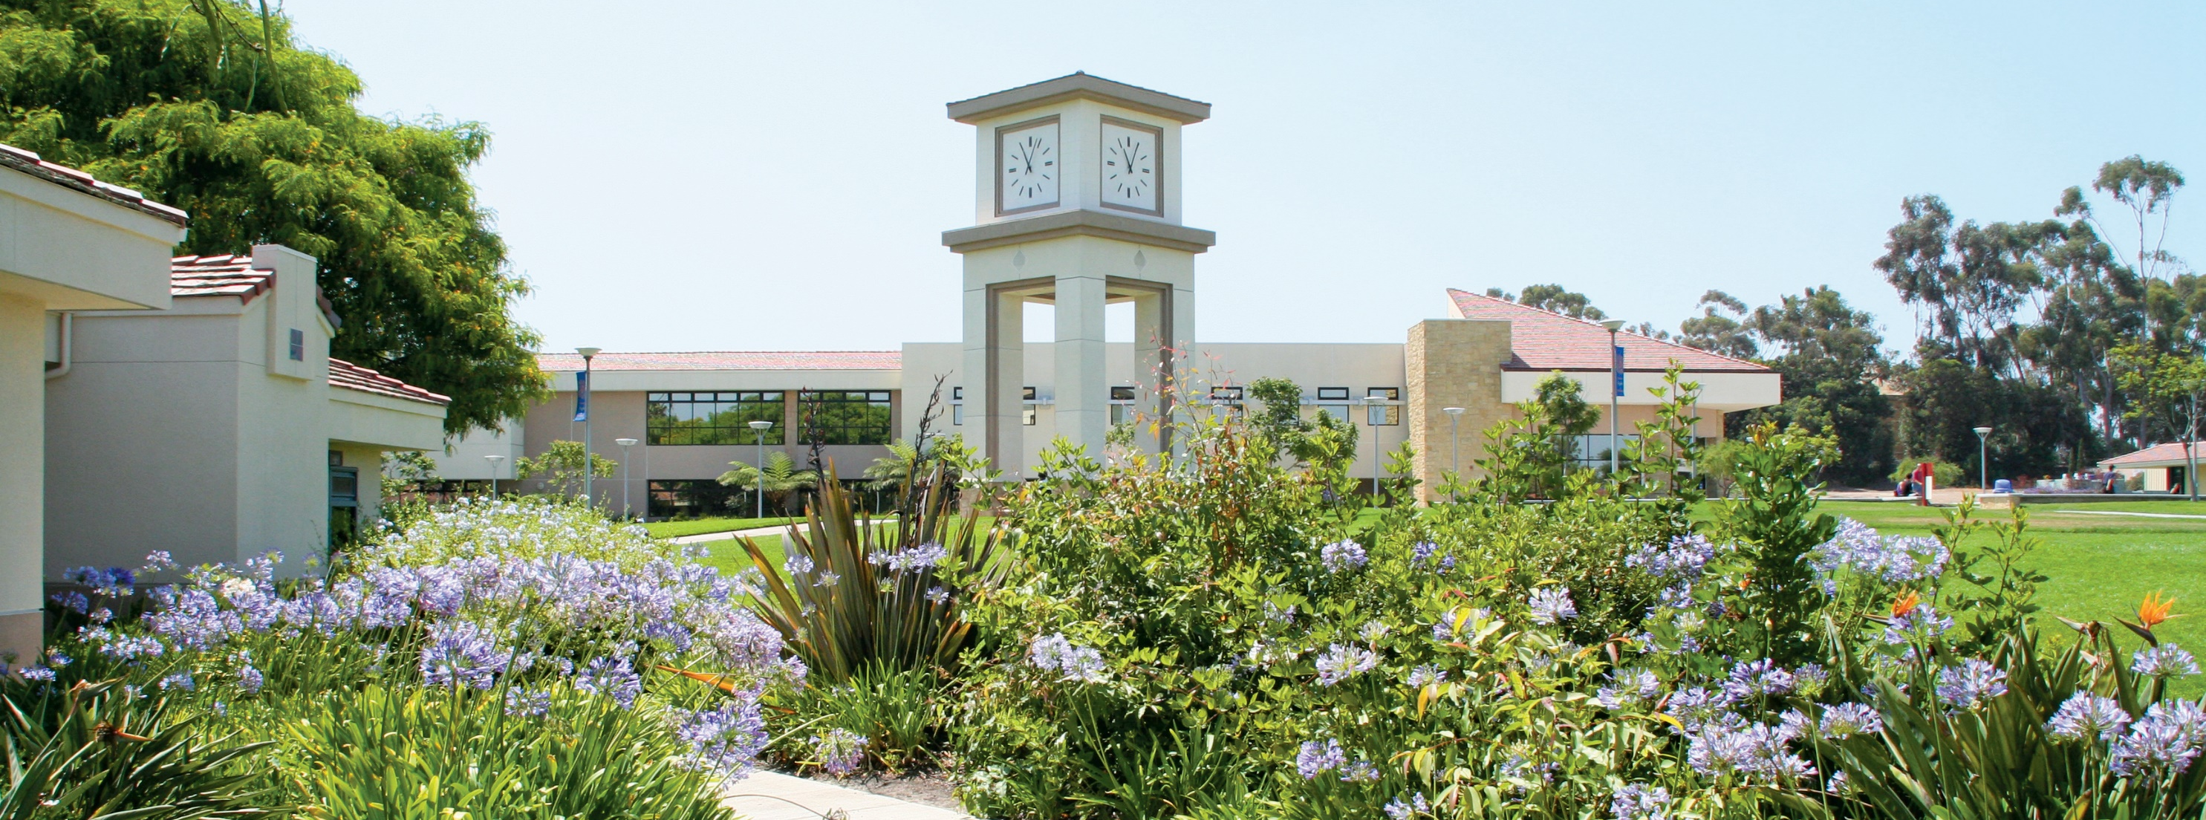
MODELING EFFECTIVE COMMUNICATION
Cheryl Wadeson, MiraCosta College

Slide 2

EPIC
Notes:
Experiential, Practical, Image-Rich, Connected

Slide 3
WHY?

Slide 4

communications skills
problem-solving skills
ability to work in a team
initiative
strong work ethic
analytical skills
Source: NACE Job Outlook 2018
Notes:
Communication skills has topped the list for the last decade. Do you realize we are now in a period of history, where you can have 4 different generations working side by side for the first time in American history (Vets, Baby Boomers, Gen X, and anyone born after 1981 = Millenials) and each generation has distinct attitudes, behaviors, expectations, habits and motivational buttons, all of which feed into communication.

Slide 5
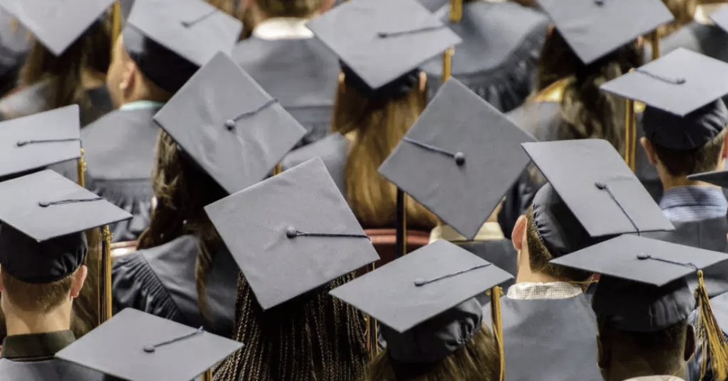
Student vs. Employer Perception of Proficiency
Professionalism
Source: NACE Job Outlook 2018 and NACE Class of 2017 Student Survey Report
Notes:
Massive divide between employers and student perception. According to employers, communication skills are lacking TACT.

Slide 6

Modeling
Photo: Peter White/FilmMagic
Notes:
The burden to close the career-readiness skills gap falls on everyone. Don’t listen to what people say, watch what they do. We are all models.
Brandon Maxwell is a fashion designer from . . . East Texas. He’s dressed Lady Gaga and Meghan Markle. "I grew up in East Texas, eating fried foods and going to Wal-Mart, so I'm in a world that I sometimes feel very uncomfortable in. I don't think I fit into fashion and don't think I ever will.“ If you were like me, you relate to this quote because being the first in my family to attend college, I remember that same feeling of feeling out of place. USC. College taught me how to interact professionally – how to assert myself when I needed, how to listen deeply, it opened my eyes and helped me to think bigger, but it also taught me that all of this came down to communication.

Slide 7
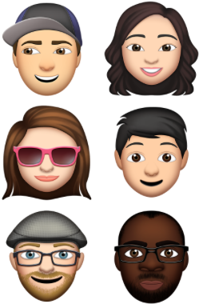
Unwavering focus on customer satisfaction
Notes:
Communication 101: We see things from our unique perspective based on our life experiences. Different filters. What I hope to bring to the table is a vantage point of not just an educator, but having worked for non-profits with 8 people, I’ve been a multi-unit franchise owner, I’ve worked a variety of health care organizations, and I’ve worked for two global, Fortune 500 airlines. 1) That means I’ve spent my entire career in service businesses, and 2) specifically businesses where people often feel vulnerable – healthcare, flying 30,000 feet in the air, stepping foot in a college classroom, and eating ice cream in public. Trust is critical.
My professional experiences with businesses all around the globe in various industries has taught me two things:
Customer-centric. People don’t care how much you know until they know how much you care. When I look at my class – which draw from all majors – I don’t see students, I see customers. Customers who are paying good $ for us to expand their minds, teach them skills to be more marketable, and help them grow. They can do it on their own – anything you can want to learn is on the internet. But they show up or sign on for guidance, experience, coaching, and connection, often with great sacrifice or challenges.
If they have a good experience, they will show up for another class, and another semester, and tell a friend or two. In short, by satisfying our customers (meaning ensuring that we achieve our learning outcomes, but also make it a positive experience), we create a positive feedback loop to keep motivation on high.

Slide 8






Change is constant
Notes:
2) change is constant (legal, economic, technological, demographic, competitive landscape, social preferences). As individuals, as businesses, and as academic institutions, we have to continuously evolve and adapt. Those who do not, get left behind. Customers go elsewhere – and there is no shortage of choices for education.
Ex/ 5 years ago I didn’t use emojis. I never use them in my personal life. But it matters to my customer so it matters to me. The more relatable you are, the more relevant you’ll be.

Slide 9

Body Language
Notes:
Would you give your hard earned $ to a business that didn’t show care toward you, greet you, respond to you? Unlikely.
If you wanted them to feel welcomed, be welcoming. I use a handshake on the first day to establish a low power distance.
55% of communication is body language, 38% is the tone of voice, and 7% is the actual words spoken.

Slide 10

Feedback
Notes:
Quality and Quantity
Catch them when they’re good
Boosts self-esteem and keeps motivation on high
This builds trust and influence

Slide 11
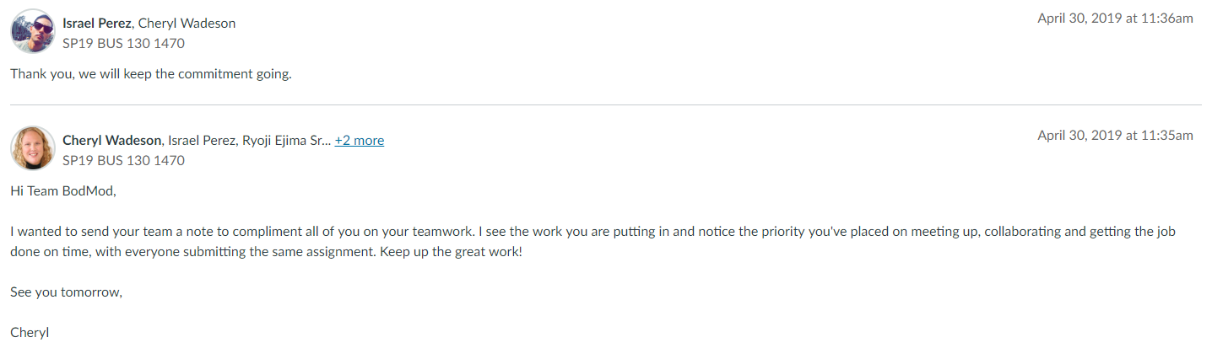

Slide 12
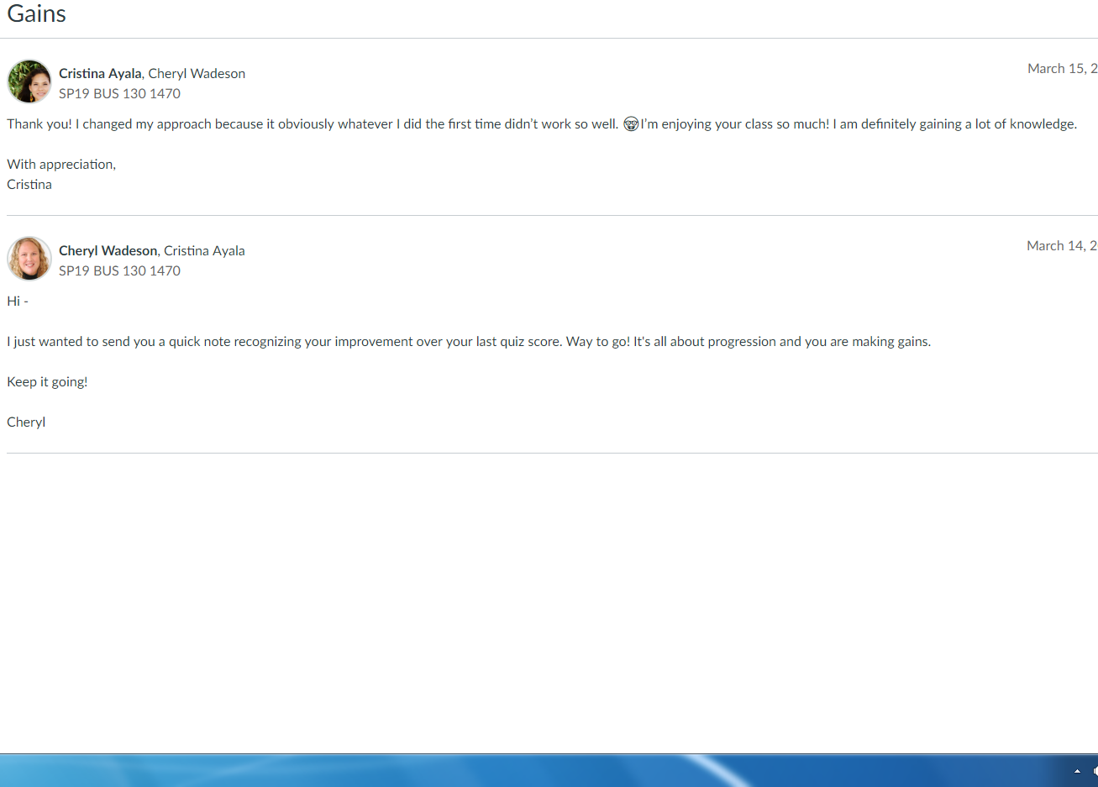

Slide 13
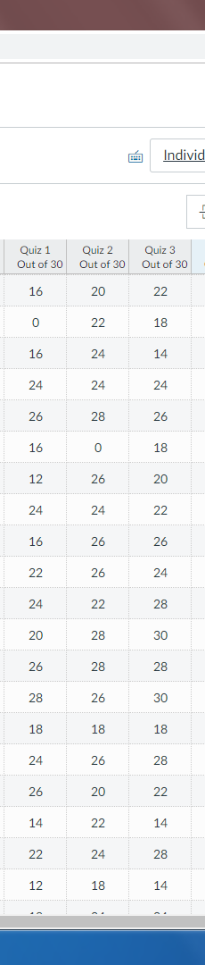
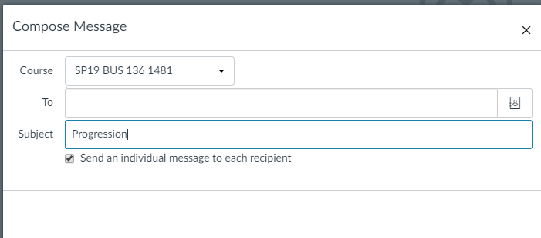
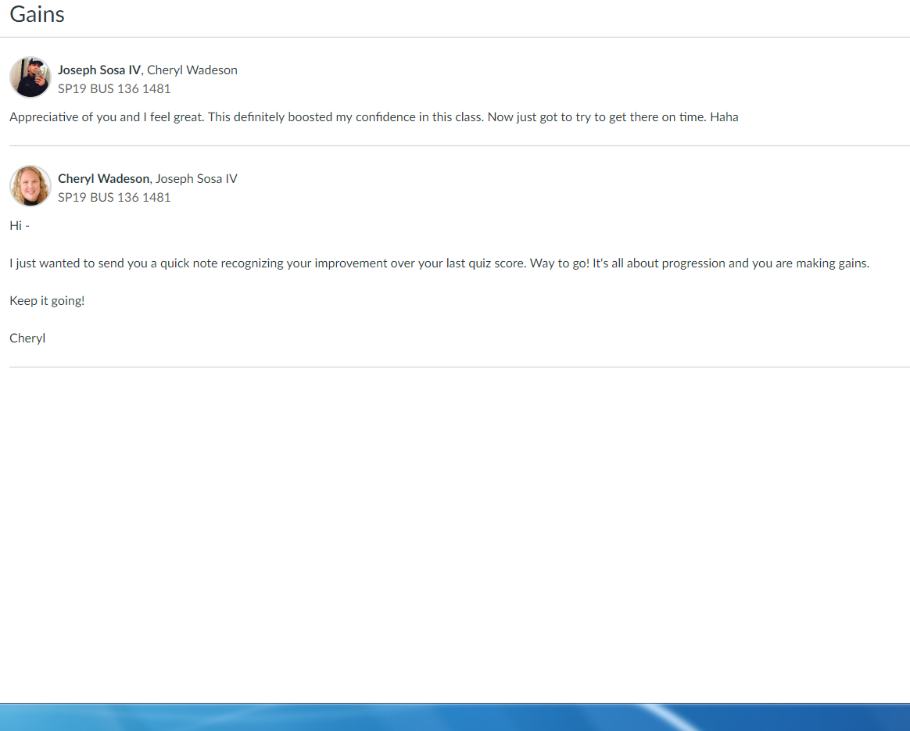
1
2
3

Slide 14






Improving Active Listening
Stop talking
Out of sight,
Out of mind
Empathize
Stay humble:
Opportunity to
learn
Repeat back, clarify
Body language:
What isn’t being spoken
Notes:
Ways to improve your listening skills:
Stop talking! Allow others to contribute and don’t interrupt.
Remove distractions. Research shows that merely having your phone visible nearby compromises your focus (even if it’s muted and you don’t pick it up, your brain is still wondering about it.)
Empathize with the speaker (put yourself in their shoes.) You don’t have to agree to empathize.
Be patient and humble. Stay focused on understanding what’s being said rather than focusing how you will respond. Approach each conversation as though you have something to learn.
Read between the lines. Sometimes the most important messages aren’t being directly stated.
Observe body language. Is there a disconnect between what you’re hearing and seeing?
Ask questions, paraphrase, and clarify.

Slide 15
Reflective Writing – 1) identify which area(s) you could improve upon. 2) Describe a student interaction that didn’t go well because of one of these areas.
Stop talking
Out of sight,
Out of mind
Empathize
Stay humble:
Opportunity to
learn
Repeat back, clarify
Body language:
What isn’t being spoken
Notes:
Reflective writing – crystallizes learning when it connects to us. Helpful for students who need time to process first before discussions.

Slide 16
Less Me,
More We
Notes:
Teach the students, not the book. The book is the guide and they read before class. I draw on my experience to humanize what’s what they’ve learned with stories or exercises from my career. Nearly every class students have some activity or small group discussion and some practical tips I’ve learned that make them more effective: 1) they like when I assign groups because I mix it up each time – no one wants to be the kid picked last in gym.; 2) this is the single largest builder of community which creates for a cohesive class experience. Maslow – we have a need to belonging. This leads to strong attendance; 3) I can’t overstate the increased levels of social anxiety and mental health issues I see. So the notion of talking face to face may be terrifying at first. But small doses over time make a tremendous difference – but you have to mix it up (both the approach, and the people). Variety makes all the difference in the world. You see confidence surge over time. We need to give time and space for connection. To communicate with the incredible diversity we are fortunate to have in our community colleges. Students from 16-80 from all different walks of life.
But more often than I’d have imagined, students literally need to learn to speak face to face. How to be confident enough to express an opinion, but humble enough to be open to other perspectives. Those aren’t just career skills – those are life skills. So if I can humbly suggest – less me, more we. Build in time and space for discussion, but mix it up. By the end of the semester, everyone will know each other – usually by first name – and that makes the notion of class presentations far less terrifying.

Slide 17

co-creators
Notes:
Marketing 101 - engage your customers – the best brands not only engage their customers in online communities, they invite them into design the process.

Slide 18
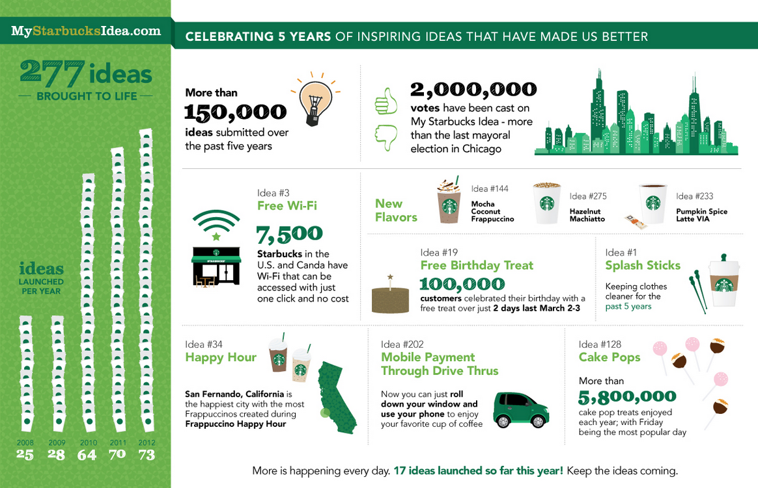
co-creators
Notes:
How? They ask for it. Create a two-way dialogue with your customer. Get to know their wants and needs and be transparent with your feedback.

Slide 19
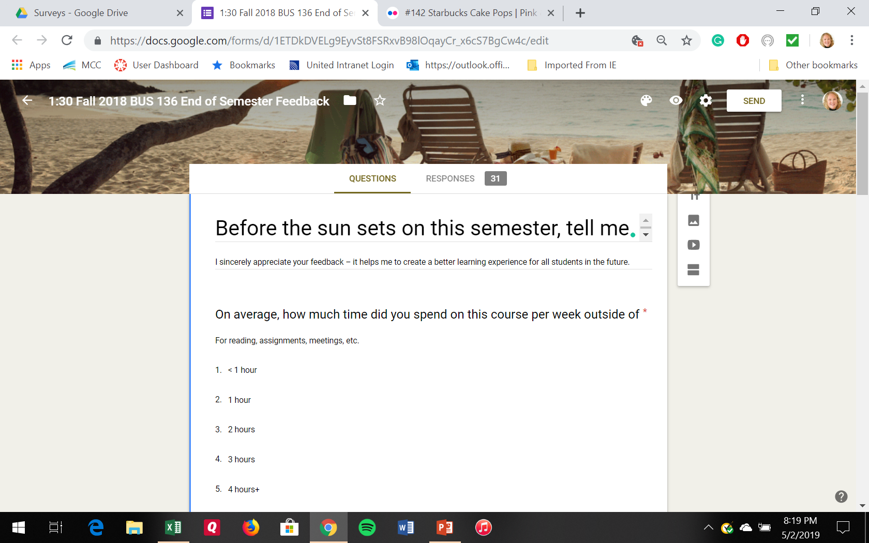
Notes:
Course design is for students by students

Slide 20
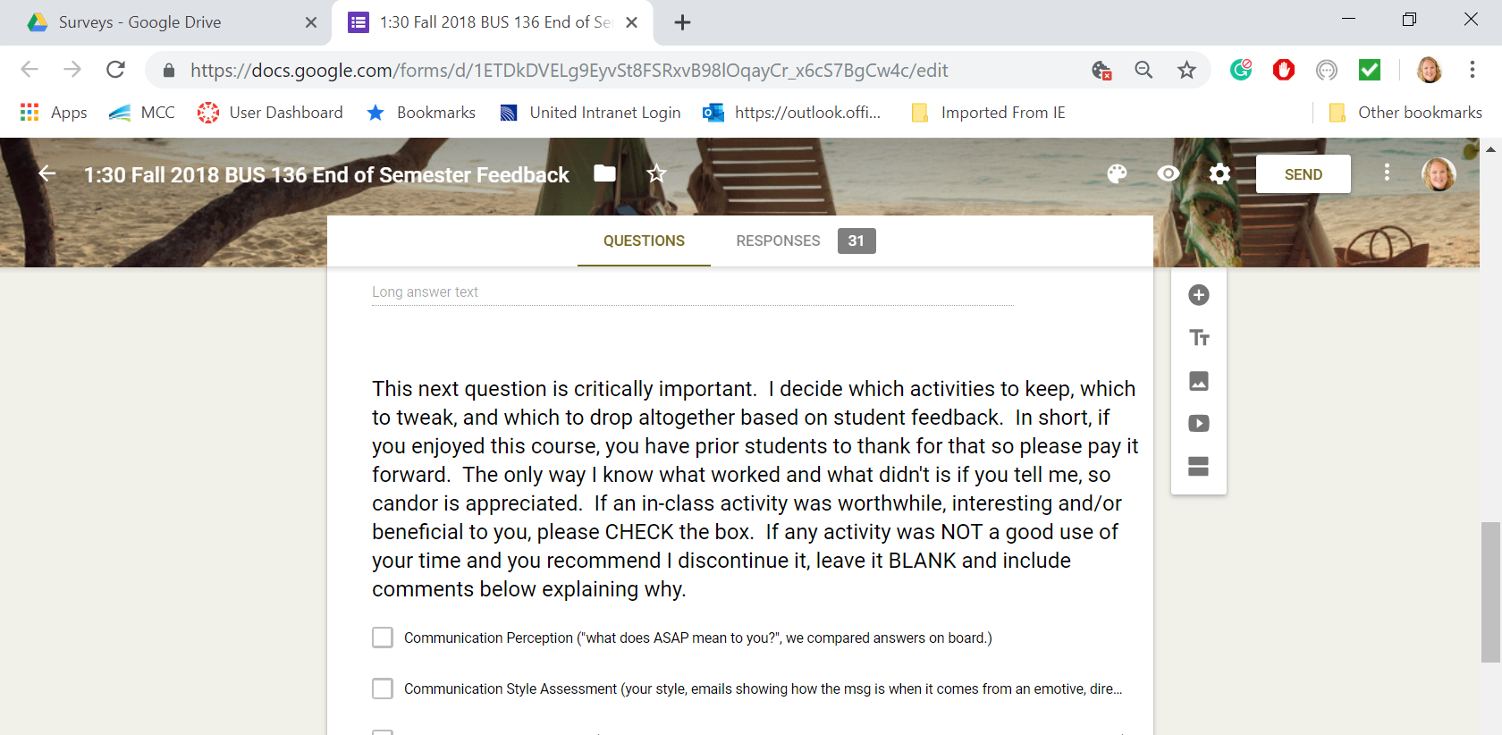
Notes:
75% + is my target.

Slide 21

Crystal Clear?
Notes:
Handout, compare with table groups

Slide 22

Student as customer
Acknowledge progress
Reflective Writing
Less Me, More We (~35% me talking)
Co-Creators > keep, tweak or abandon
Communication Perception activity
Notes:
Handout, compare with table groups

