Slide 1
Enhancing Personal Responsibility Skills with Class Projects
Howard L. Eskew, Jr.
Professor, Business & Accounting
San Diego Mesa College
May 3, 2019

Slide 2
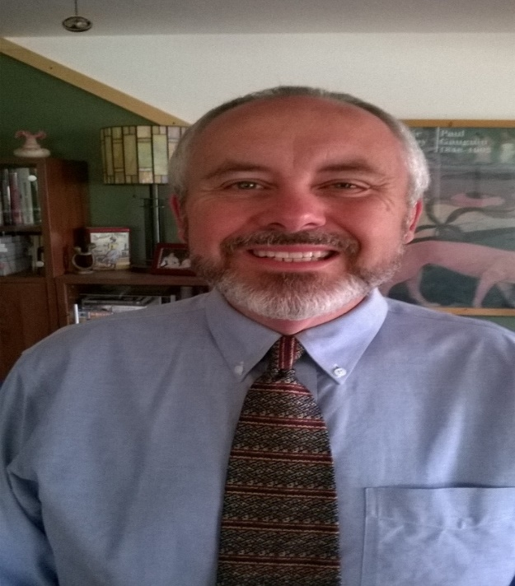
Who Am I?
The Professor
  Have taught full time and as an adjunct for nearly 12 years.
The Executive
  SVP & CCO for Community Bank.
  Over 20 years in the Financial Services Industry.
  Experience in Manufacturing & IT.
The Entrepreneur
  Co-founded a Community Bank.
  Owned eCommerce company.
  Real estate investor
  Part-time retailer.

Slide 3
What We’ll Cover Today
Individual Projects.
Group Projects.
Rubrics & Surveys.
Projects.
  Business Communications Projects.
  Personal Finance Projects.
  Entrepreneur Projects.
Questions and answers.

Slide 4
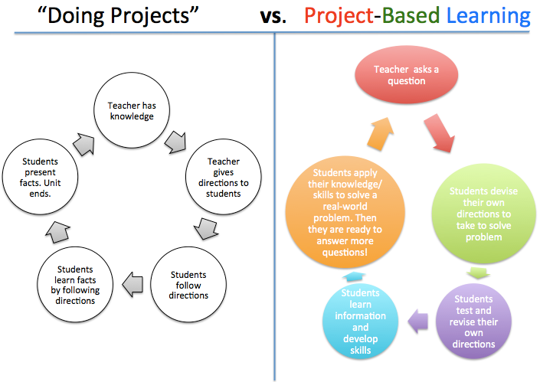
What is the “End Goal” for your Project???
Source: Doing project vs. project based learning. (2013). Retrieved from https://msellieb.wordpress.com/2013/05/04/doing-projects-vs-project-based-learning/

Slide 5
Individual Projects
Make projects applicable to students’ world with industry in mind.
Take them out of their comfort zone.
Create project maps – set mini goals.
Keep them accountable.
No surprises – make expectations clear; but not necessarily directions.
Strategically use discussion boards, reflection papers and /or surveys.
Allow students to evaluate the project from their perspective.

Slide 6
Group Projects
Explain that groups (Teamwork & Collaboration) are a reality.
Do small activities in the class, mix students.
Teams (groups) are created through an interview process.
Develop teams contracts. Teammates can be “fired”.
Create a project map – set mini goals.
Students evaluate each other’s performance periodically.
Presentations are “Powerful”!!!

Slide 7
Rubrics, Discussion Boards, and Surveys
In industry, employees and teams are evaluated on performance.
Students want to know expectations; but allow them to control the process.
Students want to achieve their goals.
Make rubric available at the same time the project is presented.
Consider negotiating the rubric.
Give opportunities to analyze, self-reflect, and teach each other.
Make the surveys safe.
Allow students to evaluate the project.

Slide 8
Business Communications Projects
Employment Preparation Project
Intercultural Communication Project

Slide 9
Employment Preparation Project
This project has five (5) components:
  1.) Identify a job position that you would like to apply for.
  2.) Develop your professional social network.
  3.) Compose a Letter of Application for this position.
  4.) Construct your resume.
  5.) Develop a video resume.

Slide 10
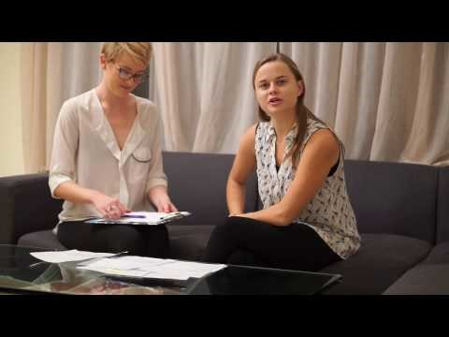
Employment Preparation Project https://youtu.be/HyoY69xqGeI

Slide 11
Intercultural Communication Project
This project has students create a 10-12 slide PowerPoint:
  1.) Examine how the U.S. is viewed by another culture and why.
  2.) Compare and contrast the value and communication norms.
  3.) Recommend & support strategies first time visitors can employ to
  learn and deal with norms and perceptions.
  4.) Use at least three sources to research your information.
  5.) Include speaker note and add voice narrative to your slides.

Slide 12
Personal Finance Projects
Personal Budget Project
Personal Finance Team Project

Slide 13
Personal Budget Project
Start with setting SMART Goals
Develop their monthly budget (must integrate goals)
Meet mentor and discuss financial plan
Reflection Paper
Execute budget, collect actual data and create variances
Meet mentor, evaluate results, identify bottlenecks & discuss plan
Repeat Steps 5 & 6
Reflection Paper
Survey

Slide 14
Personal Finance Service Learning Team Project
This team project has four components:
  1.) Identify a problem or issue that effects our community.
  2.) Research the issue, collect data, and propose a solution.
  3.) Create a visual communication piece such as a video, infographic,
  PSA, fact sheet, poster series or any combination to be used in
  in a formal presentation.
  4.) Group presentation open to the campus, industry, and local
  politicians.

Slide 15
Entrepreneurship Projects
Rejection Therapy
Throw Out the First Pitch
Bootstrapping Your Business
Business Planning Project

Slide 16
Rejection Therapy
Entrepreneurs need to learn to handle one thing well - - - REJECTION.
Each day for the next 14 days solicit rejection for a thought, idea, or suggestion and document your daily attempts at soliciting rejection.
This project will make you uncomfortable!!!!
Have fun with this. Students may be surprised that sometimes people may say yes when you least expect it and no when you do not.

Slide 17
Throw Out the First Pitch
Select a simple product to pitch, such as a water bottle. Or have students pitch themselves! The purpose is to have them in front of the class demonstrating the points you make about pitching in 90 seconds.
On a set of 3×5 cards, write down a recognized product—pencil, ruler, picture frame, stapler, etc. Give them one minute to think of an innovative way to use the product. By innovative, we want to know how the product can be used in a way not obvious to others.

Slide 18
Bootstrapping Your Business
Give students real money. Lead a short discussion about bootstrapping. Give students one week to make as much as possible.
They will likely have questions about what to do to make that money. Be vague when you give directions. Allow them to hit roadblocks and figure it out as they go.
One week later, lead a discussion about what students did to earn money.
The point here is the money is actually a barrier to making money.
  If they tried to purchase something, sell it, etc., had to do that over and over again to make any real money.
  Students who just offer their time or expertise to make a few dollars probably made more money with less effort.

Slide 19
Business Planning Project
Takes students through the entire Entrepreneurship process.
Work in teams.
Have them use an online ideation platform.
This project asks them to:
  Identify the problem.
  Create a solution.
  Go through the Business Plan Process.
  Create a prototype and a pitch video.
  Pitch idea in a front of a group of advisors, investors, financiers, and clients.

Slide 20
Questions????

Slide 21
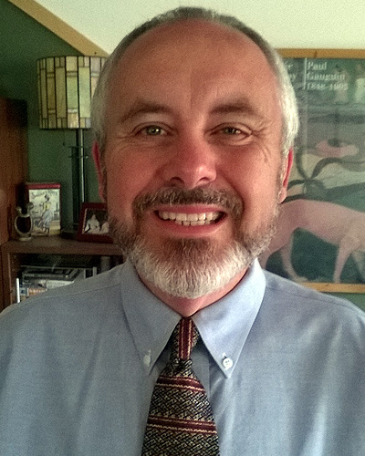
Please feel free to reach out!!!
Howard L. Eskew, Jr.
San Diego Mesa College
7250 Mesa College Drive
San Diego, CA 92111
(619) 388-5957 Office
Email: heskew@sdccd.edu
Twitter: @profeskew
Website: www.sdmesa.edu

Slide 22
Thank you!
San Diego Mesa College: The Leading College in Equity and Excellence

