Slide 1



Digital Fluency – Your Online presence
By Cindy Morrin
Associate Professor of Counseling
Cuyamaca College

Slide 2




What is Digital Fluency?
Sharing documents, pictures, and programs online
Access to personal or private information on the web
Social Media such as Facebook, LinkedIn & Twitter
Online tools like Google and YouTube to find data
Determining the “usefulness” and “truthfulness” of such sources
Notes:
Explain to students the first two points in bold are two of the four primary traits of Digital Fluency that will be the focus of this lesson.

Slide 3

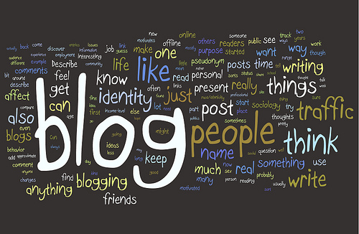

Using Social Media
In what ways have you seen friends, family or colleagues use social media to create or maintain a positive and professional online presence?
How is social media used in the job search?
Why is it important to create a positive and professional online presence?
Today - Develop a professional LinkedIn profile & research ePortfolios

Slide 4
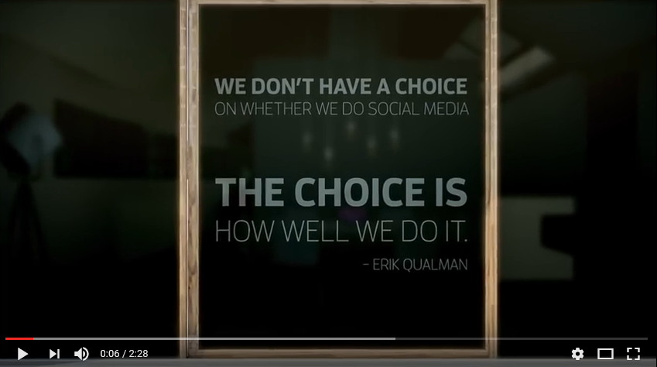
Social Media Today
https://youtu.be/PWa8-43kE-Q
Notes:
Video is hyperlinked on image but can also be accessed here https://youtu.be/PWa8-43kE-Q
Video is 7th version of the Social Media Revolution Series by Erik Qualman.
Advances in technology and global connections give way to new forms of social media and their use to connect us in our personal and professional lives. The use of social media is no longer optional, but required to stay connected in our global community. Now we must determine how we will use technology and social media appropriately. Advances in technology and the growing use of platforms and social media allow us to create online reputations that will help us be successful in the new world of work.

Slide 5


Technology, Social Media & the Search for Work
Today’s students and workers need to be more proactive and more tech savvy than in the past
In the midst of the growing gig economy, social media is a powerful tool in the search for work and helps to build a professional online reputation
Social media provides opportunities to brand, network, and job search including research into a company’s culture to see if it would be a good fit for you
Professional online presence offers a more detailed picture of a candidate than just a resume and helps recruiters determine a culture fit
Employers and HR professionals use social media and technology to screen candidates during the recruitment and hiring process
Notes:
Technology and social media are becoming increasingly important in our hyper-connected world, and as more digital natives enter the workforce, this is especially true in the job search. You can use social media to build an online presence by sharing your background, demonstrating your experience, and showing your personality. Your online presence conveys who you are to the world, both personally and professionally. Remember, what you share online is available for all to see, even prospective employers. Employers do search candidates online, and your online presence could be the difference between getting the job and being eliminated for consideration.
Your online presence includes social media, even personal platforms such as Instagram, Facebook and Twitter are open game for employers. Be mindful of what you post, and think through how it might reflect on you before you post.
Social media can also be used as a job search tool because many companies are using social media to brand their company culture. Social media is a great tool to use when researching a company. This gives job seekers the opportunity to research company culture, identify trends and hot topics in the industry, identify management changes, and connect with professionals in the organization.

Slide 6

OVER 94% OF RECRUITERS USE SOCIAL MEDIA

Slide 7

Clean Up Your
Digital Dirt
LinkedIn
Network
LinkedIn is your resume that never sleeps.
More than 90% of recruiters use LinkedIn as their primary search tool.
Your LinkedIn profile is your professional brand in the world
It’s the result you want immediately when someone Googles you.
Connect, connect, connect!
Don’t be afraid to put yourself out there and make sure people know who you are.
Keep in contact with your professors or advisors, and inquire about possible referrals or leads.
Ask a faculty member or internship supervisor for a recommendation, particularly if you worked closely with them.
Be your own best advocate.
Hiring managers WILL Google you!
Google yourself. Ask yourself, “If I were an employer, would I hire me?”
If you answered an honest “no,” remove all pictures and content that may give employers an inaccurate perception of you.
If you question it, then it’s time to delete, remove, un-tag, etc.

Slide 8
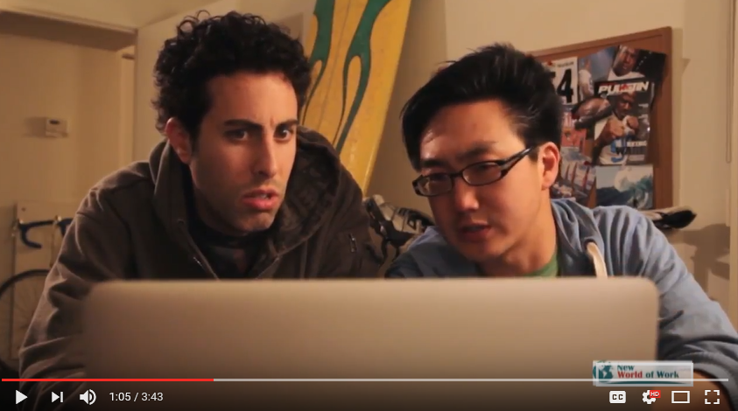
What Not to Do
https://www.youtube.com/watch?v=nujXijLKDoY
Notes:
NWoW Digital Fluency “What Not to Do” Video. Video is hyperlinked on the image and can also be accessed here https://www.youtube.com/watch?v=nujXijLKDoY
Point out to students these are exaggerated, but often times people make basic mistakes on social media that negatively influence how others see their abilities and skills. On the next slide, focus on positive examples of how individuals have successfully used social media in professional promotion.

Slide 9

Your Online Reputation
Google search of your name
  Try it now! Type your first and last name in the Google search bar and watch the results filter in
  Need to be more specific? Include the city and state that you live in after your name
What did you find?
Remember that in addition to using online tools to find general information, you can find specific information about your own “digital footprint”
Notes:
It’s important we are aware of our online presence and we create and maintain a professional online presence that will impress. Ask students to use their mobile device, or share if they do not have one, to Google their name and see what they find. Have a class discussion on what they find. Let them know that if they found content that could be considered inappropriate by a recruiter, you will discuss tips on “cleaning up the digital dirt.” Also tell the class you will discuss strategies on using social media positively and ways they can strengthen their online reputation.

Slide 10

Build a Professional Online Presence
Feature lots of positive things in profile
  Leadership, memberships and affiliations, community activities, interests, hobbies, travel, etc.
Have a complete profile
  Build profiles and keep them up to date, incomplete profiles can show you don’t follow through
Showcase professional knowledge and skills by contributing to discussions
  Include links, articles and videos related to an industry or profession
Include key words
Be active
  Join groups and associations, connect with people, request recommendations
Notes:
Tell students to include an abundance of positive attributes and characteristics in their profiles such as leadership, membership and affiliations, community activities, interests and hobbies. Also, be positive when communicating in a post or message. Finally, supporting and recommending other people’s work, sharing helpful information and contributing to discussions are other ways a job seeker can show they are authentic, polite and positive. Incomplete profiles can communicate to recruiters that you would not follow through or complete projects in your work.

Slide 11
Recruiters Use Social Media
92% of recruiters are using social media in their outreach
  LinkedIn is #1 tool recruiters find most effective when vetting candidates during hiring process
  Facebook and Twitter are also used as well as blogs, Instagram, YouTube and Snapchat
Recruiters consider pictures, posts, comments when evaluating candidates
  Spelling and grammar errors as well as inappropriate content such as photos from a party with alcohol may negatively effect your image
  Content that accurately reflects your personality, experience and qualifications in an industry and shows solid communication skills can be positive
Notes:
According to Jobvite Recruiter Nation Report 2016, the Annual Social Recruiting Survey, the overwhelming majority of recruiters (87%) find LinkedIn most effective when vetting candidates during the hiring process.
Everything posted on the internet is written in pen, not pencil. It can not be “erased” even if it’s deleted. It’s important to be conscientious about what we post as well as what our networks post about us. Proactively managing social media presence and our online reputation is a must. A good rule of thumb is to post content you would be comfortable addressing in an interview. Refrain from posts that are emotionally charged especially as they relate to politics, details about your personal life, work complaints. Keep content positive, light and fun.

Slide 12
LinkedIn
100% Professional, fastest growing professional networking platform. Professionals are joining Linked at a rate of more than two new members per second
Worldwide membership, over 467 million members in over 200 countries and territories
LinkedIn’s fastest-growing demographics are students and recent college graduates There are more than 40 million on LinkedIn! There are 50,000+ internships and jobs for students on LinkedIn
It’s similar to an online resume but better! Allows users to create and maintain professional online presence by displaying relevant education and work related experience, showcasing skills and projects, and demonstrating achievements
Networking platform that gives users opportunity to connect with colleagues, join groups and associations, share and learn about industry related information, follow and research companies, search for jobs and learn about job opportunities from recruiters who actively reach out
Notes:
Introduce LinkedIn and reiterate some of the key aspects that make LinkedIn different from other social networking sites like Facebook or Instagram. LinkedIn is a networking site for your professional life. It allows users to connect with others, learn about trends and news in their field, search and apply for jobs and internships. Students and recent graduates are the fastest growing users of LinkedIn. Reassure students that if they are hearing about LinkedIn for the first time, it’s understandable as many students are still learning about the tool. Let them know it’s an exciting tool to help students develop as professionals and bridge what they’re doing in school to the world of work. Explain that the next section of the presentation will include resources on how students can use LinkedIn.

Slide 13

LinkedIn is for our Students
https://youtu.be/YWp6AN00D_c
Notes:
Show the video to ensure students understand what LinkedIn is and its value to them as students. The video is imbedded in the slide but can also be accessed here: https://youtu.be/YWp6AN00D_c

Slide 14
Build your professional brand
9 out of 10 company recruiters use LinkedIn- so should you! 75% of hiring managers look at profiles to learn about candidates.
How do you get recruiters’ attention? Here are the LinkedIn profile must haves:
  Education- your profile is 10x more likely to be viewed if you list your school, major, and degree
  Photo- this should be a headshot. Include it and your profile could get 21x more views
  Experience- list internships and jobs to make your profile 36x more likely to be found by recruiters
  Volunteer Experience- list it if you have it. 41% of hiring managers value it as much as work experience
  Skills- add skills you’ve learned inside and outside of the classroom, including 21st Century Employability Skills. If you list 5+ skills on your profile, you’ll get up to 17x more profile views
Notes:
Refer to the resource The Student’s Guide to LinkedIn produced by LinkedIn.

Slide 15
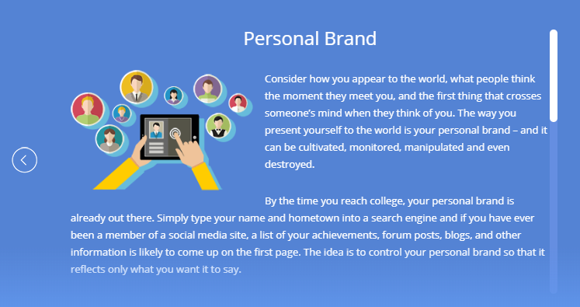
You Control Your Brand
Be clear about who you are and what you want. Make sure all your social media platforms reflect who you are. For instance, a very professional LinkedIn profile can be quickly undermined by a not-so-clean Twitter feed.
Keep in mind that who you associate with can affect your brand. You want to align yourself with movers and shakers, reputable companies, honored colleagues, and excellent educational opportunities. Each can elevate your brand beyond what you could achieve on your own.
BEWARE: A brand can be destroyed with the click of a mouse. Always be careful of what you post online. In person, stay friendly and professional at all times. Never do something that you might regret, as it could eventually find its way around, whether through word of mouth or online.

Slide 16
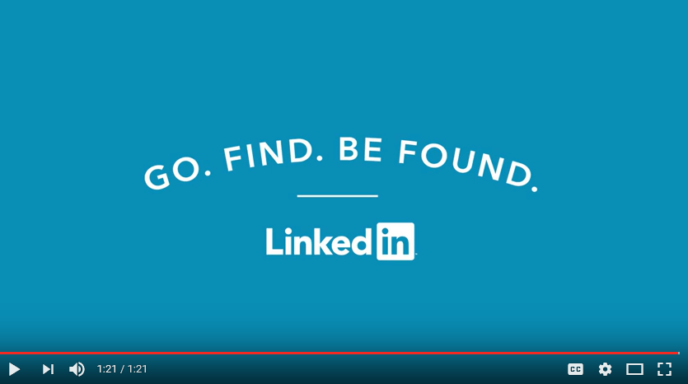
Top Five Profile To-Do's
https://www.youtube.com/watch?v=B8WZxYFaSmI
Notes:
Video is embedded in slide but can also be accessed here https://www.youtube.com/watch?v=B8WZxYFaSmI

Slide 17
LinkedIn Resources
Cindy’s LinkedIn Example: https://www.linkedin.com/in/cindy-morrin-58393015/
Students Guide to LinkedIn and Building a Great Student Profile handouts
Student Jobs 101 https://students.linkedin.com/ - Includes The Student Job Hunting Handbook Series and exploring jobs on LinkedIn
LinkedIn Students App- Recommended reading, companies, careers, and jobs based on education
LinkedIn in Higher Education https://university.linkedin.com/linkedin-for-students- Resources for students to learn the benefits of a LinkedIn profile and presence, and help them get started. Includes videos and quick tip sheets to use LinkedIn for job hunting, building a professional brand, building a profile, finding a job or internship, how to communicate effectively and connect with alumni
Notes:
Give students the accompanying handouts “Students Guide to LinkedIn” and “Building a Great Student Profile”. Pull up the Students Jobs 101 page to show learners the resources available to help them use LinkedIn. Reference the LinkedIn Students app they can download for free to get personalized recommendations on reading material, companies to follow, careers to research and jobs to consider all based on their education. Lastly, pull up the LinkedIn in Higher Education website to show students the additional resources to help them use LinkedIn and build a profile. There are tons of great videos they can watch.
Note- LinkedIn also provides resources for higher education professionals https://university.linkedin.com/higher-ed-professionals. Tools include tip sheets and videos on topics such as conducting profile reviews with students, using university pages, and marketing materials for campus use.

Slide 18
Electronic Portfolios
Electronic portfolios or ePortfolios are the new resume
Common for professionals to use to communicate their experience and showcase their accomplishments in the job search
Employers and recruiters want candidates to show them what they’ve done, not just tell them
Electronic materials that document accomplishments and may include papers, videos, pictures and hyperlinks, assembled in an online web platform
ePortolios allow students to showcase projects and achievements in a visual way to communicate knowledge and skills gained through their academic experiences

Slide 19
ePortfolios and the Job Search
Students who have ePortfolios can include the URL on their resume, cover letter, LinkedIn profile and in their email signature line
Some ePortfolio tools, like Portfolium, integrate job search technology so students can apply for jobs and submit their ePortfolio as part of their application
Portfolium – free ePortfolio for students
  https://portfolium.com/
  Student Example: https://portfolium.com/ShabrikaKing
  Cindy’s Portfolium: https://portfolium.com/cindymorrin

Slide 20
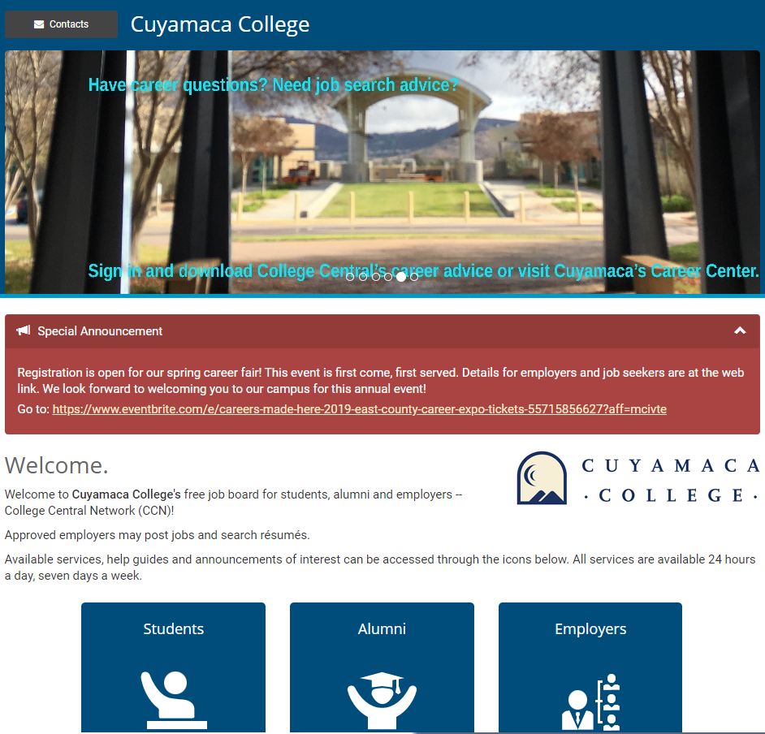
Register on College Central www.collegecentral.com/cuyamaca
Access job opportunities 24 hours a day, 7 days a week. To look at the job list you may use a Career Center computer or use your own.
Post a resume to the Online Job Board. This will prompt our resume tutors at the Career Center to review and take a look at your resume. You may be called in to bring your resume with you for an additional appointment and assistance to work on it.

Slide 21

Next Steps: Practice!
Courses:
Digital Media Foundations Learning iPhone and iPad Security Learning Android Phone and Tablet Security Computer Components and Peripherals for IT Technicians
Top 5 Tips for YouTube Channel
Videos:
Digital communication
Overview of digital security
Information security
Digital signatures
Determining the source: Hardware or software
How search engines work
Understanding search engines
Google Search
LinkedIn and New World of Work have partnered to provide suggested next steps after each of the 21st Century Skills lessons.
Go to: www.linkedin.com/learning
These videos will help you continue to explore Digital Fluency. You can earn certificates of completion to post on your LinkedIn profiles along with any of your digital badges and skills verifications.
Notes:
All these videos are hyperlinked on the NWoW-LinkedIn Crosswalk document, which can be found under the College section at www.newworldofwork.org. The Crosswalk also provides suggestions for funding to access the videos.

