Slide 1
CREATIVE THINKING
STIMULATING CREATIVITY IN STUDENTS
……..Begins With…….
CREATIVE ASSIGNMENTS

Slide 2
STEP 1
BRAINSTORMING
MAKE A LIST OF
OUT OF THE BOX - NEW VISION IDEAS
FOR AN ASSIGNMENT IN YOUR DISCIPLINE TO TEACH A PARTICULAR SUBJECT

Slide 3
EXAMPLE
DICIPLINE: DIGITAL MEDIA FOR THE VISUAL ARTIST
SUBJECT: AUDIO ART
RELEVANT EXAMPLES: AUDIO ARTISTS’ PROJECTS
CREATIVE ASSIGNMENT BRAINSTORMING IDEAS:
EXPERIENCING SPACE, TIME, & EXPERIENCE THROUGH SOUND
COMBINING STORY TELLING AND WALKING
TALKING WHILE WALKING
LISTENING WHILE WALKING

Slide 4
STEP 2
PRESENTATION
BUILD A RELEVANT PRESENTATION OF
HIGH QUALITY WORK
IN YOUR DISCIPLINE TO GIVE STUDENTS A
CONTEXT
PRIOR TO THE ASSIGNMENT WHICH CAN BE REFERENCED AS AN EXAMPLE TOWARD THEIR OWN INTERPRETIVE AND CREATIVE RESULTS

Slide 5
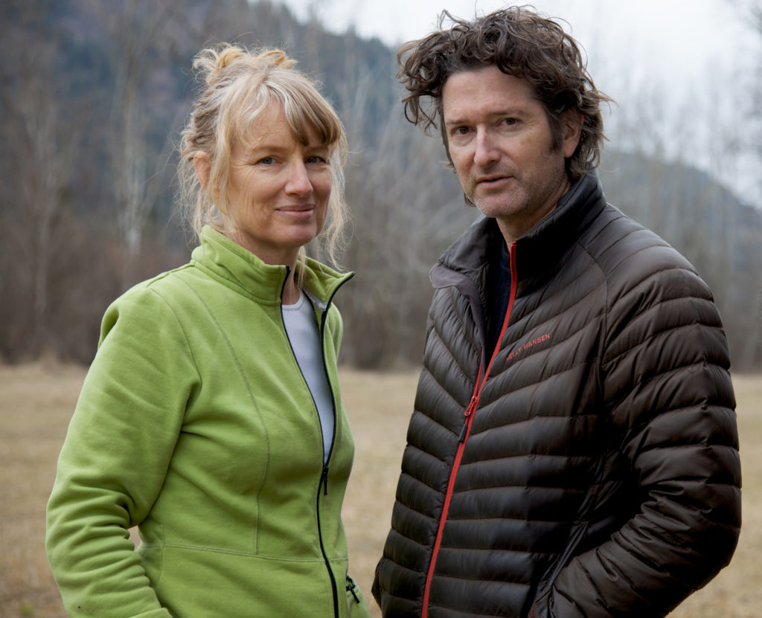
Janet Cardiff
Sound, Performance, Language, Visual Imagery
Janet Cardiff is a Canadian artist who works chiefly with sound and sound installations; especially a form she calls audio walks. She works in collaboration with her husband and partner George Bures Miller. Cardiff and Miller currently live and work in British Columbia, Canada

Slide 6
Janet Cardiff: Her Long Black Hair Audio Walk
(10:18)

Slide 7
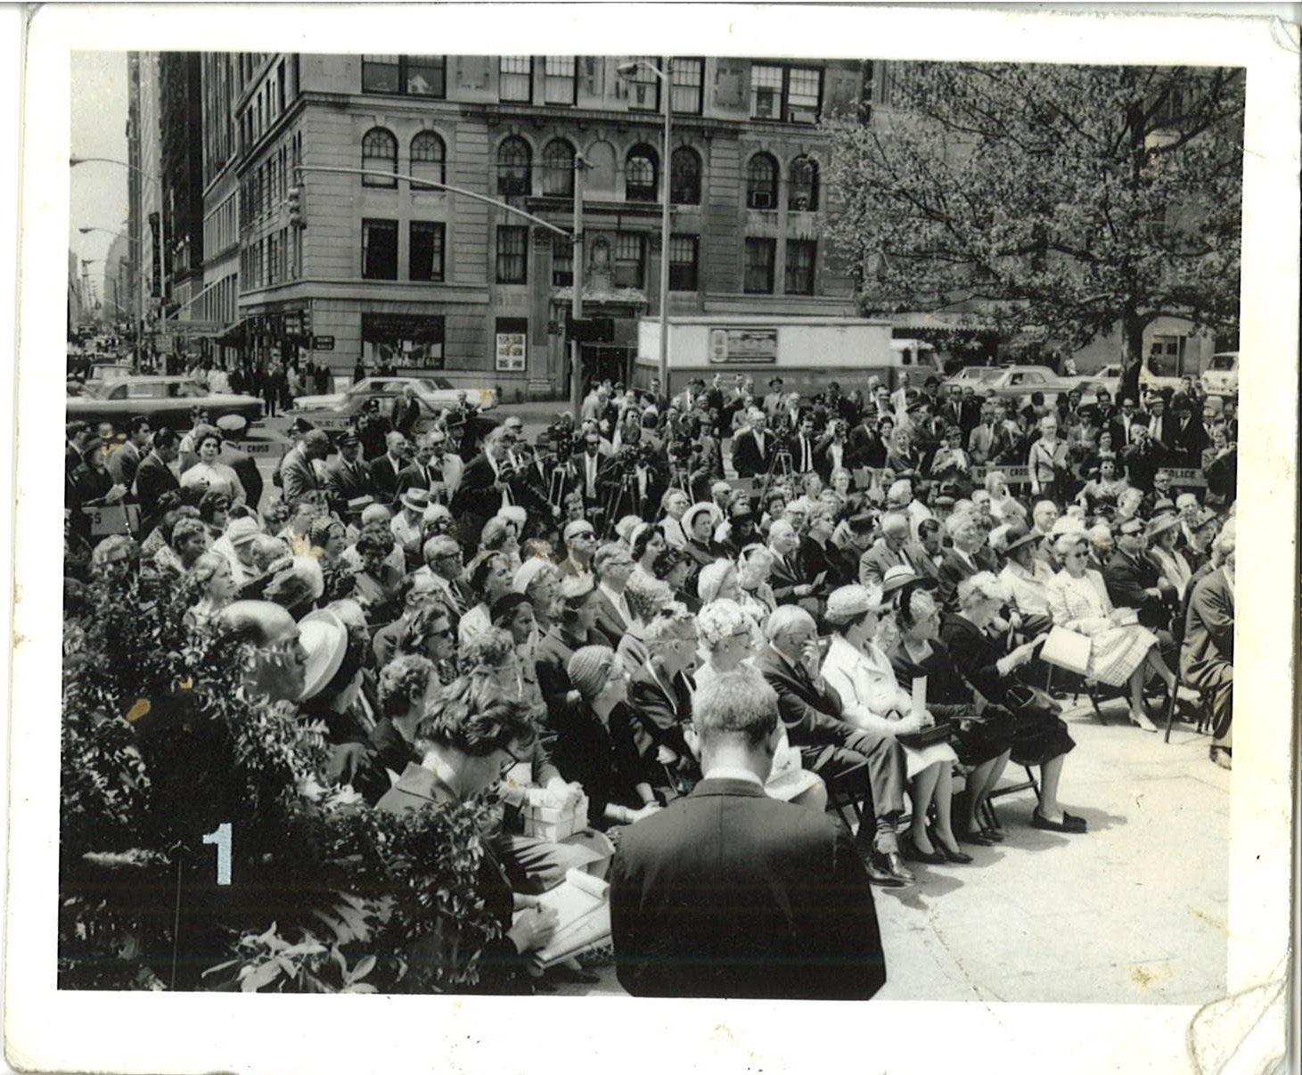

Slide 8
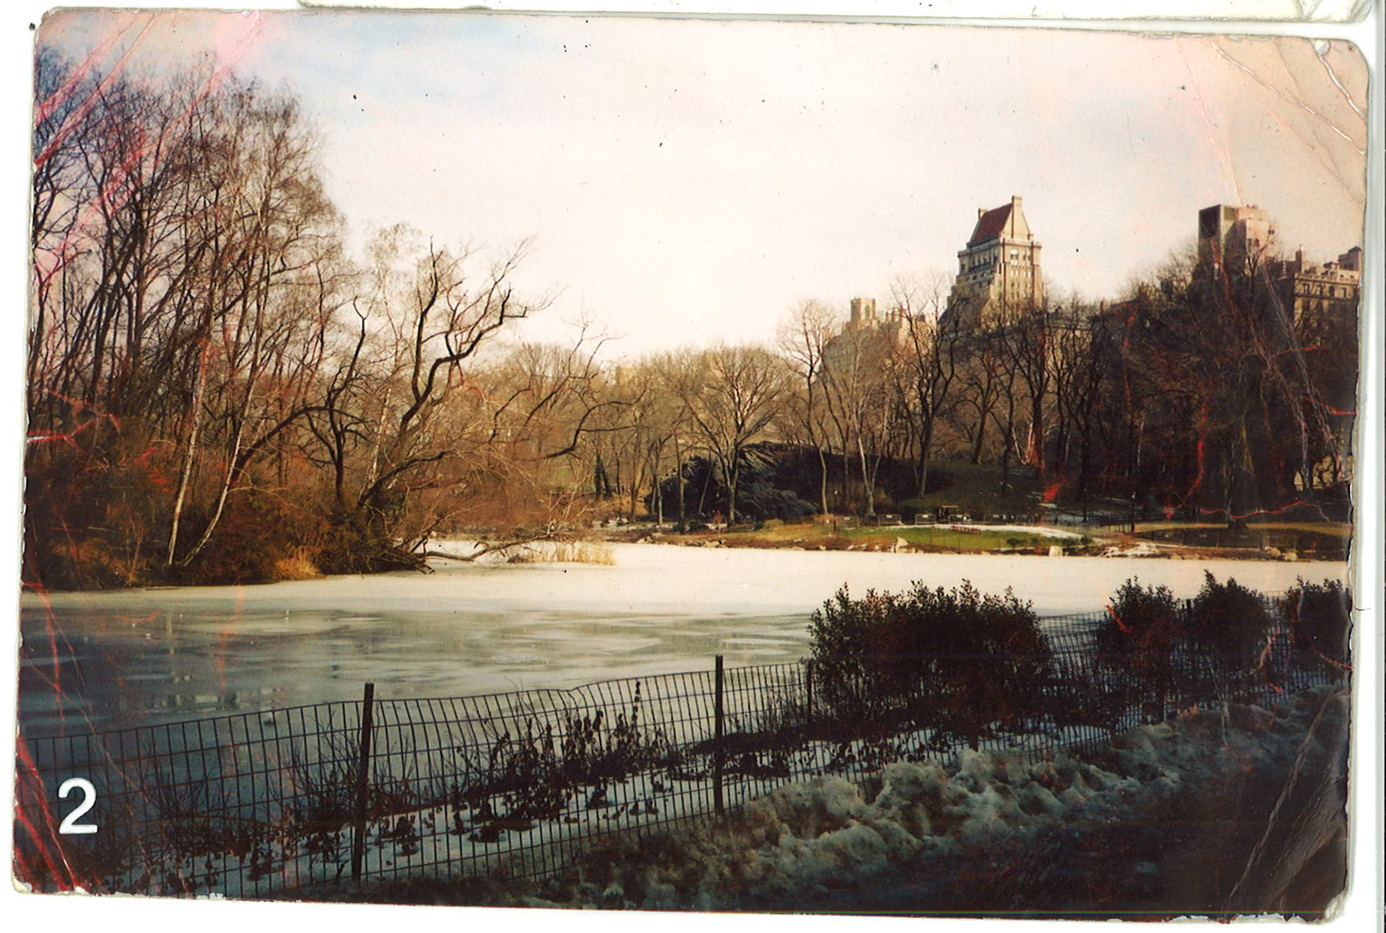

Slide 9
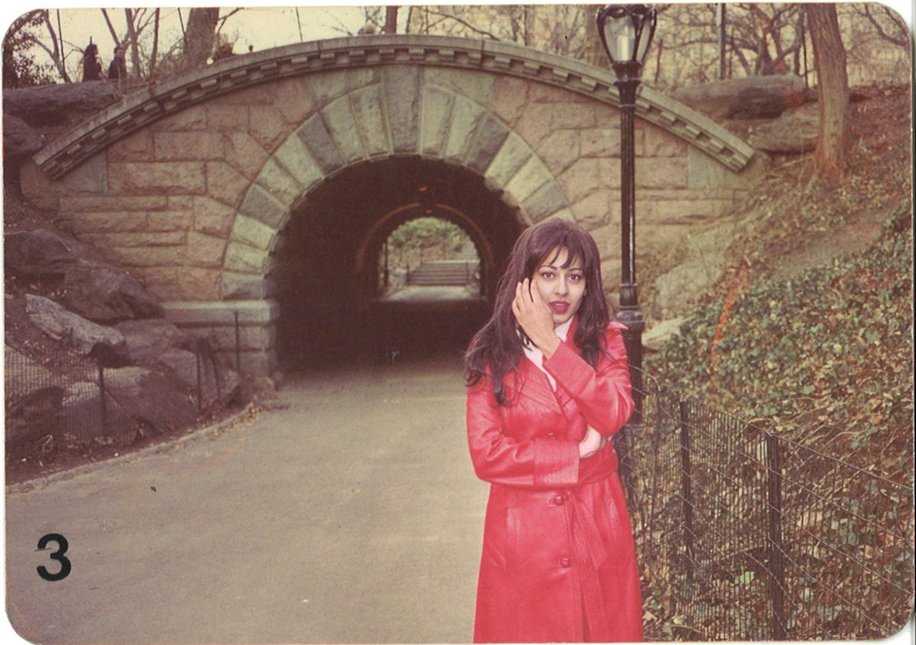

Slide 10
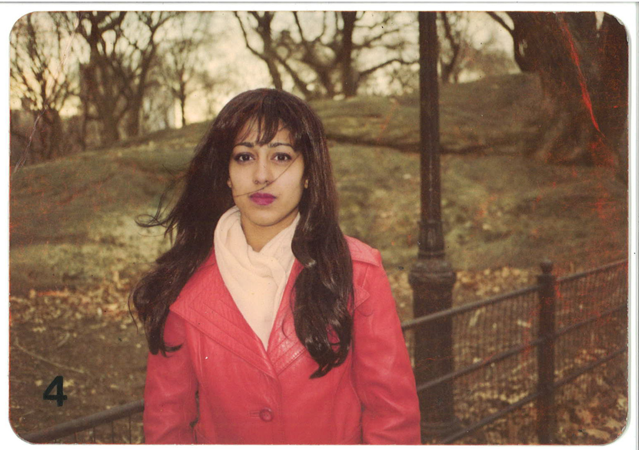

Slide 11
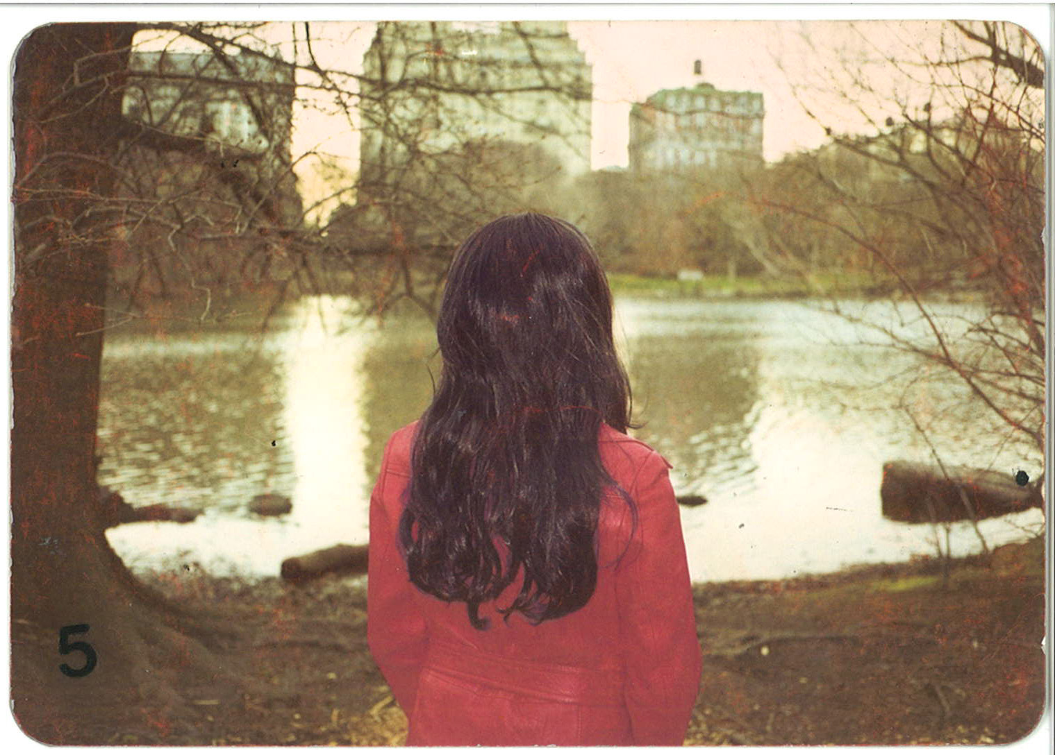

Slide 12
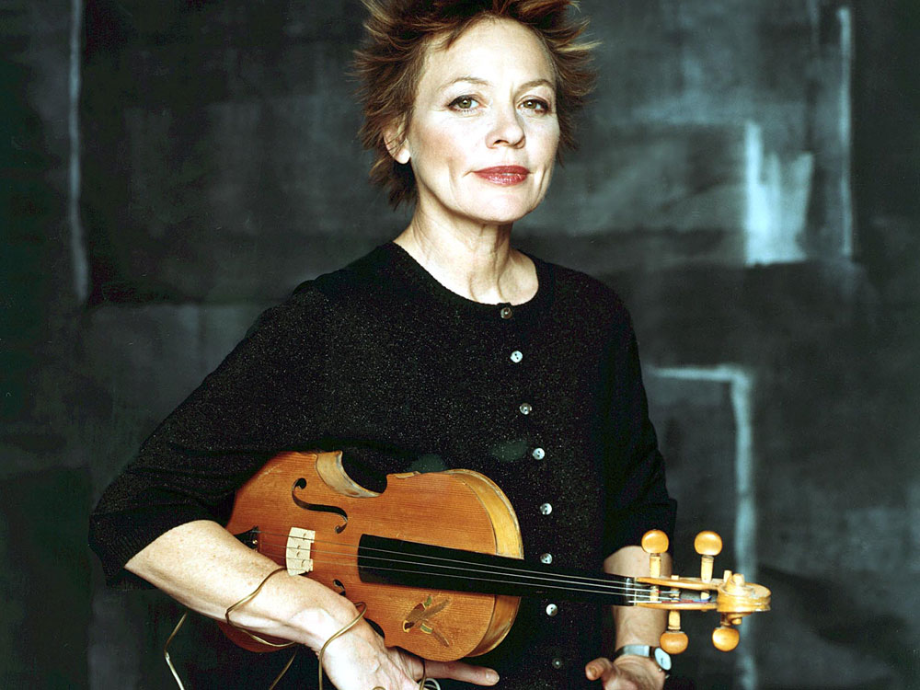
Laurie Anderson
Sound, Performance, Language, Visual Imagery
(b. 1947) American “avant-garde” artist, composer, musician, film director. Her medium is performance art, music, and multi-media. She is a pioneer of electronic music, inventing devices and creating her own sounds.

Slide 13
Laurie Anderson: Stories from the Nerve Bible (audio pieces)
(25:09)

Slide 14
STEP 3
IN-CLASS GROUP INTERACTIVE ACTIVITY
Discussion Questions
Create a list of discussion questions that the students will discuss in groups
Group Activity:
Break out into groups of ”_____”
The instructor facilitates 5 minute discussions on each question

Slide 15
STEP 4
THE CREATIVE ASSIGNMENT
BUILD THE CREATIVE ASSIGNMENT BASED ON
THE INITIAL BRAINSTORMING IDEAS
COMBINED WITH
THE SELECTIVE HIGH-QUALITY WORK PRESENTATION

Slide 16
EXAMPLE
ASSIGNMENT: A NARRATIVE WALK
PROJECT DESCRIPTION:
CHOOSE A LOCATION WHERE YOU WILL BE WALKING AND RECORDING YOURSELF WHILE SPEAKING ABOUT A TOPIC OF RELEVANCE TO YOU.
RELEVANCE CAN BE FROM A PERSONAL, SOCIAL, OR HISTORIC PERSPECTIVE.
INCLUDE PRINTED PHOTOGRAPHS INSTRUCTING YOUR LISTENERS TO REFERENCE AT VARIOUS MOMENTS IN THE AUDIO STORY.
RETRACE YOUR STEPS AND CREATE A MAP FOR YOUR LISTENERS
THE PROJECT WILL BE NARRATED BY THE STUDENT, THEN EACH STUDENT WILL BECOME A LISTENER OF ANOTHER STUDENT’S PROJECTS.
THE NARRATOR BECOME THE LISTENER
CONCEPTUAL EXPERIENCE: WALKING IN EACH OTHER’S SHOES

Slide 17

STEP 5
THE RESULTS:
STUDENTS THINKING CREATIVELY
STUDENT PRESENTATIONS
Gabriel Siguenza, Lucid Dream, 2018 Audio Work 08:45

Slide 18


Slide 19


Slide 20
STEP 1
BRAINSTORMING
STEP 2
PRESENTATION
STEP 3
GROUP ACTIVITY
STEP 4
CREATIVE ASSIGNMENT
STEP 5
STUDENT CREATIVE THINKING

