Slide 1
Region 10 Skills Symposium
May 2019
Collaboration
Wendy Wiehl, Pharm.D.
San Diego City College
Alcohol and Other Drug Studies

Slide 2

Collaboration
Small group work on a complex activity is challenging, engaging, stimulating
Requires “positive interdependence” (Johnson, Johnson, Holubec, 2008)

Slide 3

Positive Interdependence
“A situation in which attaining a goal, completing the task, being successful, and earning a good grade require teamwork and sharing knowledge” (edutopia.org)

Slide 4
Collaboration
Small groups allow for minimization of nonparticipation
Allows for assessment of individual as well as group
Shifts role from instructor to coach
Students can discuss concepts and find solutions together

Slide 5
Collaboration
Allows for development of higher level of thinking
Oral communication
Self-management
Leadership skills
(Center for Teaching Innovation)

Slide 6
Collaboration
Promotes student-faculty interaction
Increases student retention, self-esteem, responsibility
Exposure to diverse perspectives
Preparation for real-life social and employment situations
(Center for Teaching Innovation)

Slide 7

Collaboration
Most complex communal, social, workplace problems are solved by groups, not individuals
Variety of skills

Slide 8

Collaboration
Primary benefits of collaborative work are social
  Interpersonal communication
  Trust
  Skill in working with others

Slide 9
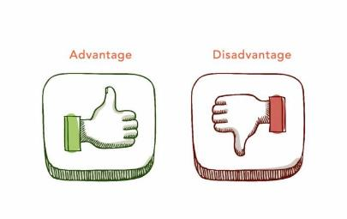
Selection of group members
Teacher assigned vs student selection
Advantages/disadvantages to each

Slide 10

Teacher assigned groups
Based on same skill level or randomly
Randomly
  Draw names
  Count off
  Colored index cards
  Random list generator (random.org)

Slide 11
Teacher assigned groups
Advantages
  Easy to administer
  Breaks-up friendship groups
  Allows students to work with others they wouldn’t ordinarily
  Seen by students as fair

Slide 12

Teacher assigned groups
Disadvantages
  Some students may worry about getting stuck with incompatible members

Slide 13

Student selection of group members
Advantages
  Easy to administer
  Students like freedom to choose

Slide 14

Student selection of group members
Disadvantages
  Can be difficult for students who don’t know anyone in class
  Some may see it as unfair

Slide 15
Alcohol and Other Drug Studies
AODS program prepares students for substance use disorder counseling positions
Occupation is part of a multidisciplinary team
Student demographics
Science often seen as intimidating

Slide 16

Candy Neuron assignment
Candy is fun!
Also teaches creative thinking
Assignment follows midterm
  Break/reward
  Builds on what has been learned
  Prepares for final

Slide 17
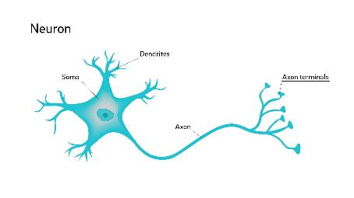
Candy Neuron assignment
Students must create two neurons, pre-synaptic and post-synaptic
Must label parts as well as processes
Must illustrate the mechanism of action of several drugs of abuse

Slide 18
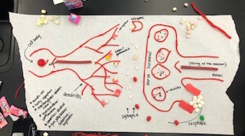

Slide 19
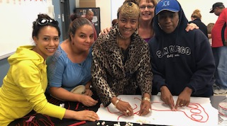

Slide 20
