Slide 1
CTE Data Unlocked:
Tools for Growing Enrollment and Strengthening
CTE Pathways
Kathy Booth, WestEd
March 3, 2017
Access this presentation at: bit.ly/ctedataunlocked2017

Slide 2
Why do you work at a community college?

Slide 3
How do your goals align with system priorities?
SSSP: students have the information they need for a strong start
Basic Skills: students have the skills they need for college-level coursework (efficiently)
Equity: all students can access and succeed in college
College Promise Program: students can afford college
Associate Degrees for Transfer: students can get a four-year degree (efficiently)
Strong Workforce Program: students are prepared for high demand, high skill jobs
SB1070/CCPT/Linked Learning: students get an early start on building college and career skills
Adult Ed/Noncredit: adult students have a pathway to credit coursework

Slide 4

How does that align with our incentive structure?
Funding is driven by apportionment (any student, any seat)
Apportionment focus leads to a churn model (get students in the door, but little attention to progress)

Slide 5
Our business model is out of sync with our students and our goals

Slide 6
Downside of the Churn Model #1: We’re Not Keeping Up with the Times

Slide 7

"The overall number of high school graduates will plateau for most of the next decade…. The average size of graduating classes between 2027 and 2032 is expected to be smaller than those in 2013."
“Knocking at the College Door,” Western Interstate Commission for Higher Education (WICHE), 2016

Slide 8

Significant numbers enrolled in adult education in 2015-16:
1 million in Adult Basic Education/Adult Secondary Education
700,000 in ESL
400,000 in CTE
Analysis for the 2015-16 AEBG Report

Slide 9

Among 31 institutions around the state not currently providing any form of noncredit, close to half plan to begin offering noncredit within the next two years. Forty-five percent plan to offer ESL for the first time within two years and 39% plan to offer CTE for the first time within two years.
The Past, Present and Future of Noncredit Education in California, 2016

Slide 10
The biggest opportunities for growth in community college enrollments are with adult learners—who tend to enroll in short-term programs
Our college structures and initiatives are not set up to support adult learners
We need to provide options that work for both short-term advancement as well as opportunities for more comprehensive education

Slide 11
Downside of the Churn Model #2: Progress is Not Rewarded

Slide 12
Pop Quiz:
Are our students making progress?
How many units attempted in the California Community College system were not degree/certificate-applicable or transferable?
15%
RP Group Analysis of students enrolled in 2015-16

Slide 13
Pop Quiz:
Are our students making progress?
How long, on average, does it take students to transfer?
4 years
RP Group Analysis of students enrolled in 2015-16

Slide 14
Pop Quiz:
Are our students making progress?
How long, on average, does it take students to earn a degree?
5 years
RP Group Analysis of students enrolled in 2015-16

Slide 15
Pop Quiz:
Are our students making progress?
How long, on average, does it take students to earn a certificate?
5 years
RP Group Analysis of students enrolled in 2015-16

Slide 16

Associate degrees for transfer
Time to degree (from 7 years to 5 years) and median units are going down, which cuts into FTES.
Basic skills reforms
Time to college-level coursework and equity gaps are going down, but unless the college enrolls students in more non-developmental courses, FTES goes down with it.

Slide 17

SSSP
Older learners may not be willing to do assessment, orientation, and ed planning if their goal is just to take a few targeted courses.
Strong Workforce Program
Colleges are developing more targeted, short-term sequences to be responsive to employer needs, but high-cost, low-efficiency courses are likely to be cut during economic downturns.

Slide 18
Our system goals are at odds with our reward structure, such that incremental reforms can actually disadvantage colleges and students.

Slide 19
Downside of the Churn Model #3: Ignores Students’ Financial Realities

Slide 20

Skills without degrees
Certificates accounted for 22% of post-secondary awards in 2010, up from 8% in 1980
Certificates are now the second most common postsecondary award, ahead of associate’s degrees and master’s degrees
54% of these certificates are short-term (1 year or less)
  2012 study by Georgetown University’s Center on Education and the Workforce
But short-term credentials have far less earning potential over time.

Slide 21

Students of color are less likely to pursue longer-term awards
28% of white students and 26% of students from Asian backgrounds earned either a longer-term certificate or an associate degree, compared to only 17% of black students and 16% of Latinos.
The gap is concerning in part because white and black students were roughly as likely to earn very short- and short-term certificates, but black students were less likely to move on to longer-term credentials.
  2016 Inside Higher Ed article on stackable credential study

Slide 22

CTE students are less likely to become transfer-ready
Relatively few CTE students (15%) become ready for transfer
Under-represented students are over-represented in CTE pathways that do not lead to transfer
  Engineering and Industrial Technology
  Family and Consumer Science
  Education
Under-represented students are under-represented in CTE pathways that lead to transfer
  Business Management
  Information Technology
  Health
  Renah Wolzinger, 2017

Slide 23
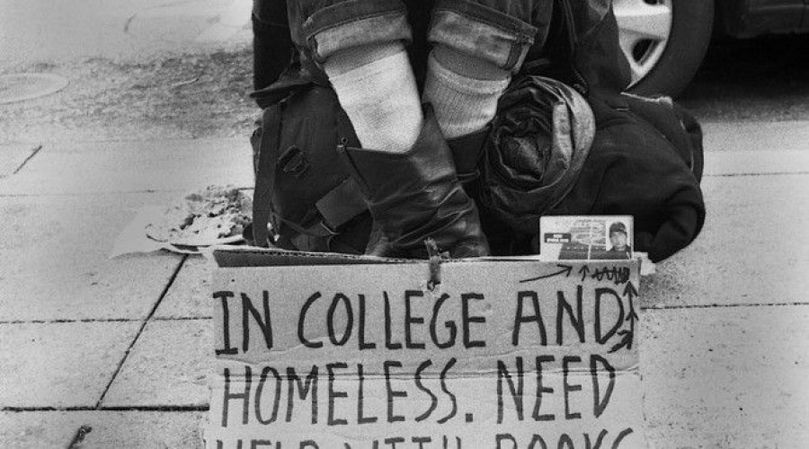
Researchers at the University of Wisconsin surveyed more than 4,000 undergrads at community colleges across the country. The results? Twenty percent of students reported being hungry, 13 percent homeless.
Student may be gravitating to short-term credentials because they don’t have the financial stability necessary for full-time enrollment, unless colleges can help them access comprehensive financial aid and support from social services.
  2017 NPR Article on study of community college student poverty

Slide 24

Time is of the essence
You can receive the Pell Grant for no more than 12 semesters, or what would roughly be six years of full-time study. In other words, the lifetime maximum is based on the years enrolled and not in dollars. Once that maximum has been reached, there’s no appeal possible and the student can’t receive a Pell Grant at any school.
If students opt for short-term awards, and take years to earn them, they may not be able to transfer and earn a four-year degree—which would net them higher earnings over time.
  Post on a college resource board

Slide 25
Degrees without skills
While associate degrees and long-term certificates generally result in large wage increases and stronger employment rates, this is not the case for Associate Degrees in Liberal Arts, according to studies in California, Washington, Kentucky, North Carolina, and Michigan.
While this degree may be perceived as a way to prepare for a bachelor’s degree, the majority of students who earn this award do not transfer.
  2015 analysis by the Community College Research Center

Slide 26

    Even without the financial aid consideration, we have to recognize that time spent in college is expensive for our students in term of lost wages, childcare, transportation, and a sense of purpose.

Slide 27
Short term certificates can offer students a critical boost in earnings in the near term, but it is only through ultimately pursuing long-term certificates, associate degrees, and bachelor’s degrees aligned with the job market that they will have opportunity to advance up the career ladder and earn better wages. They shouldn’t have to start over to reach these goals.

Slide 28
If we want to grow FTES, we’ll have to change our business model

Slide 29
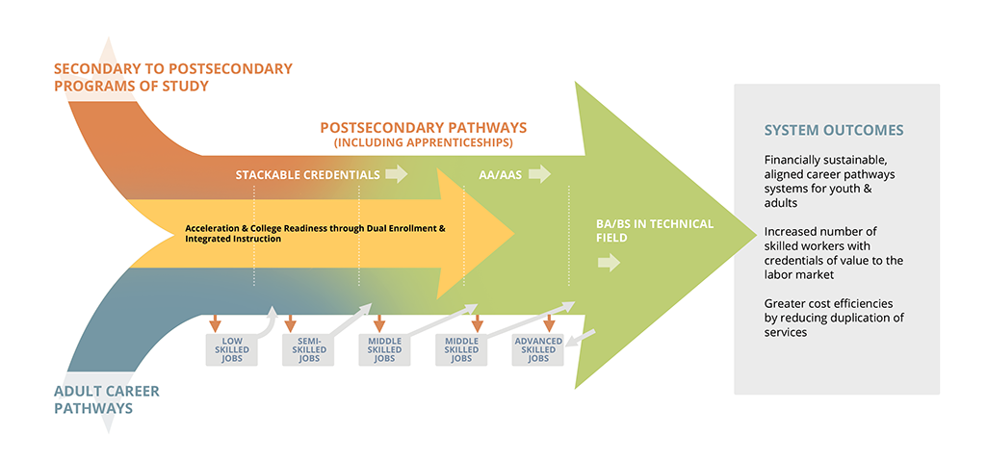
We need to help students stay
We can’t assume that new folks will keep showing up (or rely on the economy tanking)
We need to turn our attention to keeping the students we already have (survey results show students are happy with our programs)
We need to segment those markets to determine how to best attract and serve each one (this is a principle of strategic enrollment management)
But we shouldn’t reinforce silos between CTE and transfer students
Perkins Collaborative Resource Network

Slide 30

This is where guided pathways come in
Creates an alternative structure that addresses what’s not working about our current model
Rather than starting from scratch, provides a framework for integrating initiatives such as SSSP, Equity, Basic Skills Transformation, the Strong Workforce Program, and California College Promise

Slide 31
A different business model
  Recognize that students are in college to train for employment and that they may attend college at multiple points to move up in their careers
  Identify how liberal studies courses help to build crucial 21st Century skills and complement technical courses
  Redesign the curriculum around coherent sets of related competencies and ensure that students build skills that can be applied to multiple degrees, certificates, and jobs

Slide 32
A different business model
  Provide program maps and support student plans that explicitly align with jobs and transfer opportunities
  Enable students to make informed choices by offering real-time information on jobs and entry-level salaries in regional labor markets, at various levels of educational attainment—including bachelor’s degrees
  Re-think advising approaches to ensure that students see the full pathways of opportunities both within and beyond community college
  Ensure that students don't have to start over when they come back to college or move on to the next level of their education

Slide 33

Starts with student priorities
What are my career options?
What are the education paths to those careers?
What will I need to take?
How long will it take and how much will it cost?
How much financial aid can I get?
Will my credits transfer?
Community College Research Center

Slide 34
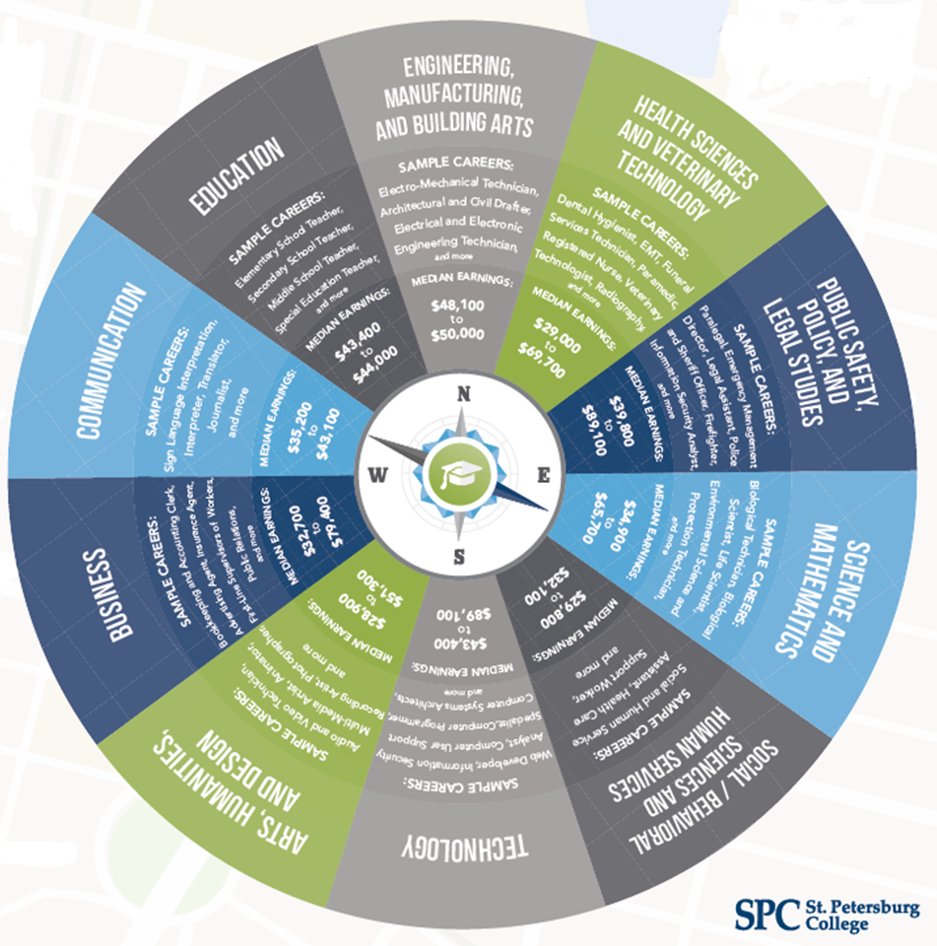
Provides options to advance in higher education and careers
  Clear links to career opportunities in the region (both in the near-term and through longer educational pathways)
  Coursework aligns with four-year college transfer requirements
  Appropriate courses for the ongoing training needs of skills-builders

Slide 35





Four pillars of guided pathways

Slide 36
Clarify the Path
Faculty and student services professionals work together to create clear program maps
Specific course sequences
Progress milestones
Program learning outcomes
Regional employment opportunities
Related majors at four-year institutions

Slide 37
Enter the Path
Ensure students quickly acquire the academic and college-going skills they need
Link educational planning to career goals
Restructure basic skills as an accelerated and contextualized onramp to students’ chosen programs of study

Slide 38
Stay on the Path
Track student progress within pathways and connect with students when they go off path to help them make progress toward their desired goal
Restructure the college to further student progress, such as scheduling that ensures students can complete majors in a timely fashion and sample course schedules

Slide 39
Ensure Learning
  Focus on program-level learning outcomes that align with the workplace and transfer requirements, and build essential knowledge and skills across individual courses
  Emphasize the quality of learning, including a focus on critical thinking, collaboration, and problem-solving in all programs, and the integration of work-based learning and competency-based assessments

Slide 40
There are specific changes you can make right now

Slide 41

Help students figure out their options
I think sometimes a lack of direction is a problem. Someone just tells you to take whatever you want, and you don’t really have a goal in mind. I think it’s really hard for people when there’s no end in sight and there’s no goal in mind to even continue to go, because you’re just probably going to get really frustrated and want to drop out.
- Community college student, interviewed for Completion by Design

Slide 42
Help students figure out their options
K-12: Use early college credit options to help students better understand career and educational pathways to rewarding jobs. Make sure students understand and apply for financial aid before they get to college.
Adult Ed/Noncredit: Leverage partnerships with AEBG consortia and workforce development boards to help students better understand the local job market and social service supports that can help them engage in longer-term training options.
Skills-Builders: Determine which skills-builders pathways lead to job opportunities and provide students with information on how to continue along that career pathway.

Slide 43
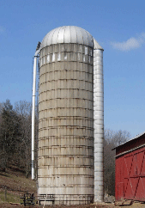
Help students cross our silos
Relatively few students are successfully navigating stackable credentials or transferring—they need help identifying how to keep going in their pathway.
Of the nearly 85,000 students who completed a first health CTE credential between 2000-2009, only about 13% earned a second award within six years.
2016 PPIC Study

Slide 44
Help students cross our silos
K-12: Use the Code Alignment Project to look at the inter-relationships between courses, certificates, degrees, and jobs in similar majors, then use this information to support advising so students keep ascending educational ladders.
Adult Ed/Noncredit: Create articulation agreements between noncredit/adult ed pathways that allow students to move directly into related majors, and provide advising on these options.
Skills-Builders: Determine if there are discrete clusters of coursework that align with changes in employer needs that could be marketed to former students.

Slide 45


Make sure basic skills isn’t a barrier
SSSP requirements may put unnecessary hurdles in the way of skills-builder students.
Outside of contextualized courses, there are gaps between basic skills sequences and CTE pathways, which can prevent students from continuing.

Slide 46
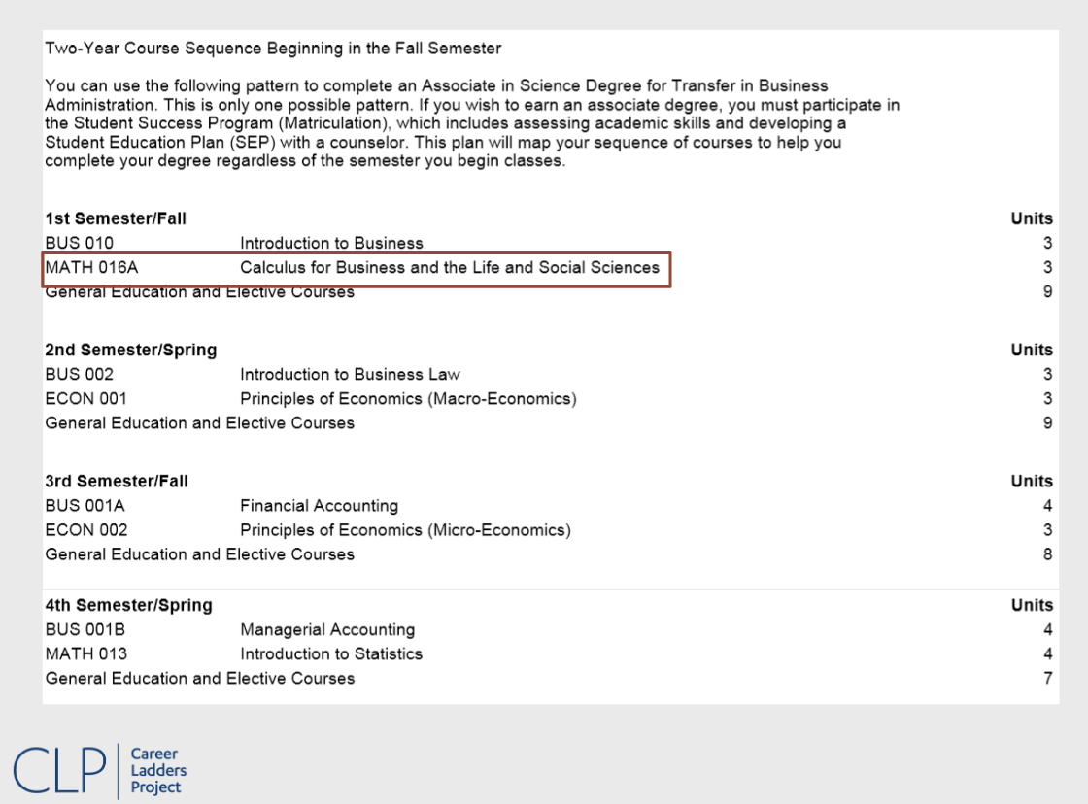

Slide 47
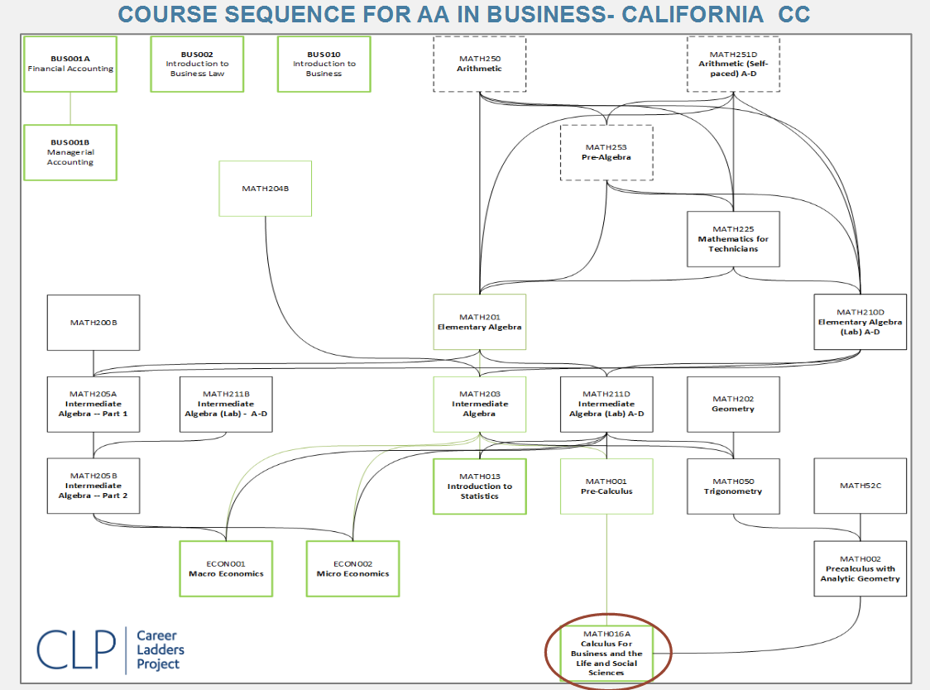

Slide 48
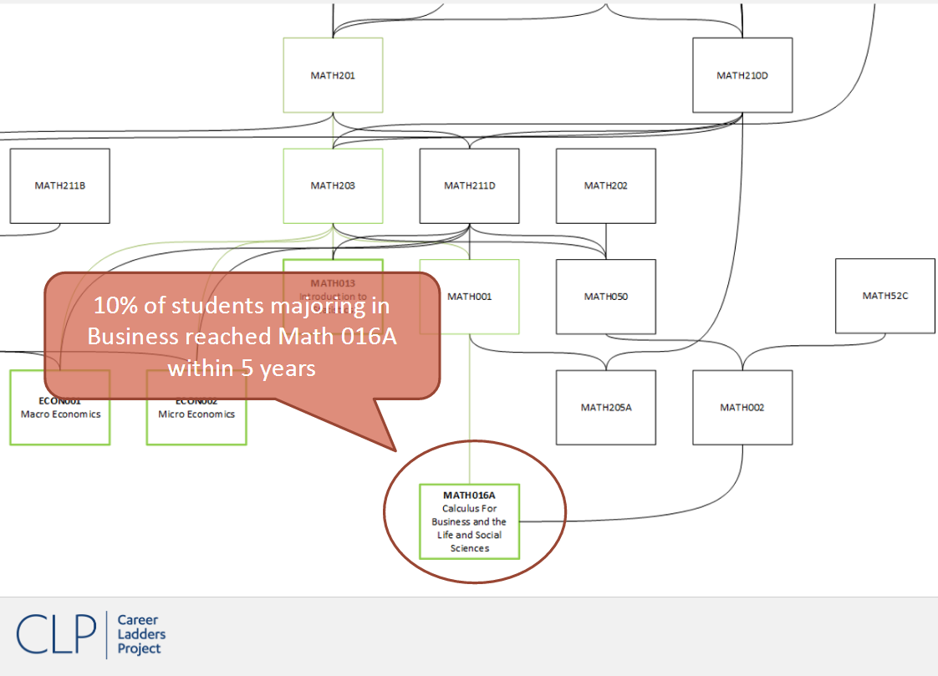

Slide 49
Make sure basic skills isn’t a barrier
K-12: When mapping CTE pathways, ensure that students can get to from basic skills courses to required courses, so they don’t give up and drop out. Ensure that tests are not underplacing students.
Adult Ed/Noncredit: Ensure that pathways teach the competencies required to start the pathway without remediation and that students don’t have to repeat content they have already mastered.
Skills-builders: Identify whether assessment requirements for older students make sense, and create specific exemptions for these students.

Slide 50
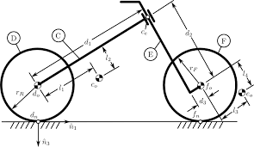
Help students see the value of transfer courses
Washington state elected to include passing transfer-level math as a momentum point for CTE programs in its performance funding formula, to encourage pathways that will help students get to higher wage jobs.
Idea: Provide information to students on how they can expand their education and career options by taking the courses that will help them advance in transfer pathways.

Slide 51
We need to bridge CTE and transfer

Slide 52
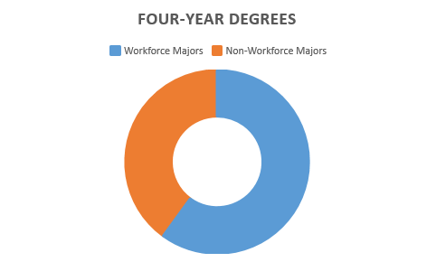
Investigate underlying assumptions
Pay attention to assumptions that students’ interest in getting jobs are only focused on narrow technical skills.
Check assumptions that people who transfer will not be pursuing majors that connect to the workforce.

Slide 53

Recognize the role of the liberal arts
Employers say they need more 21st Century skills—which are heart of the liberal arts.
Ensure that students who are pursuing short-training to get a job are also building these skills through targeted general studies coursework.
Document how general studies help student attain critical 21st Century skills.

Slide 54
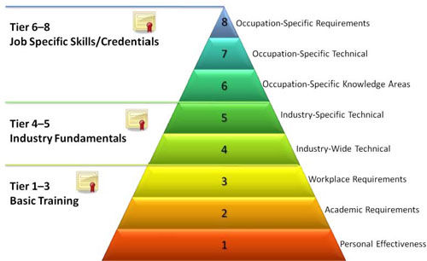
Design for true stackability
To help students pursue multiple awards over time, or and to ensure they have the option to switch majors, create clear connections between specific award pathways and ensure that students don’t have to start over.

Slide 55

Plan for long-term career pathways
In constructing meta-majors or creating sector strategies, intentionally blend CTE and non-CTE offerings so that students can build the complex skillsets they will need to change careers and advance up career ladders over time.
What if completing a CNC machining certificate was viewed as part of a pathway to an advanced degree in engineering?

Slide 56
Attending to student progress will grow FTES, while meeting college goals

Slide 57
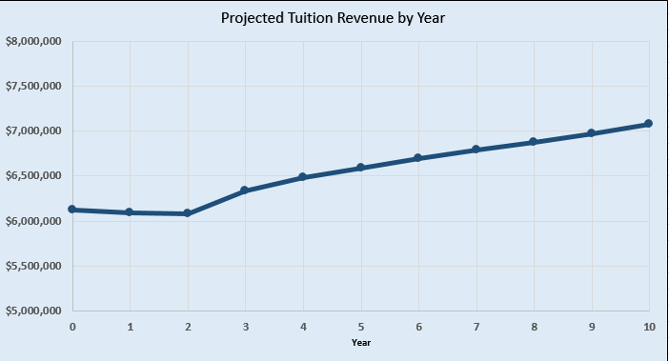
Guided pathways grow FTES
CCRC has developed an Excel tool that allows you to calculate the economic returns of improving retention rates.
Colleges would see a 15%
increase in revenue with just a
1% increase in retention rates
each year.
www.caguidedpathways.org/resources

Slide 58
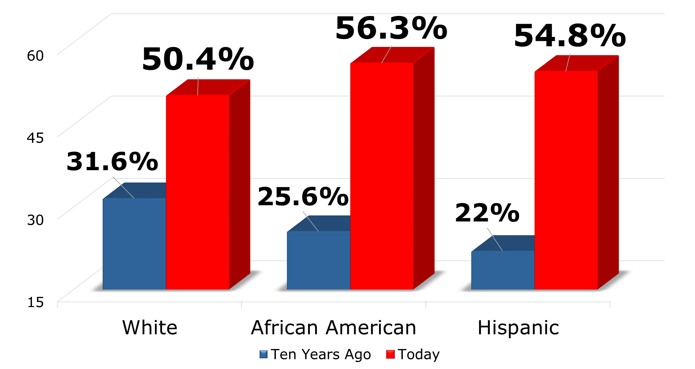
GSU Graduation Rates by Race & Ethnicity
Guided pathways close equity gaps
Georgia State University Completion Rates

Slide 59
Are you ready to dig in?

Slide 60

Small Group Work:
Find a Way to Train for
High-Demand Jobs

Slide 61
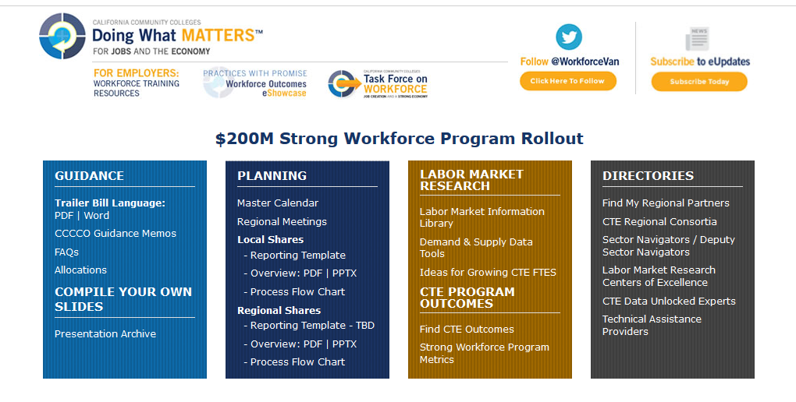
Labor Market Information Library
http://doingwhatmatters.cccco.edu/StrongWorkforce.aspx

Slide 62
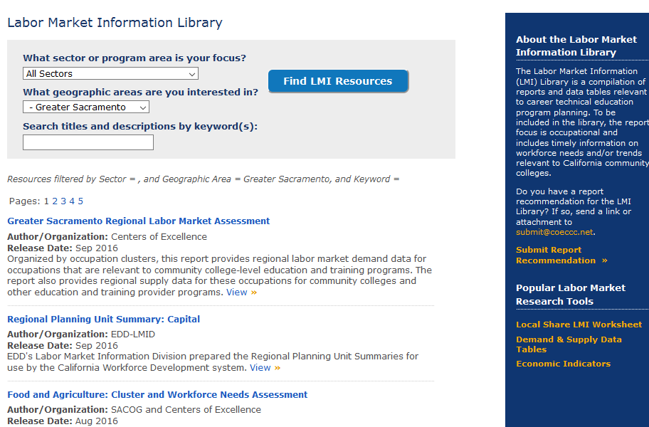
Explore Data by Region and Sector
http://doingwhatmatters.cccco.edu/StrongWorkforce/LMILibrary.aspx

Slide 63
Top Five Sacramento Region Middle Skills Jobs
Occupation Type | Annual Job Openings | 5 Year Change | Median Wages | Wages Will Support
Office & Admin Support (customer service reps) | 2,921 | +2% | $20.52 | 1 adult, 1 kid
Healthcare Practitioners (registered nurses) | 1,972 | +15% | $39.69 | 1 adult, 3 kids
Healthcare Support (home health aides) | 1,674 | +17% | $16.19 | 1 adult
Installation, Maint. & Repair (general & auto) | 1,409 | +8% | $22.89 | 1 adult, 2 kids
Sales & Related (retail sales supervisors) | 1,301 | +1% | $21.82 | 1 adult, 1 kid
Centers of Excellence, 2016 Regional Labor Market Assessment: Greater Sacramento

Slide 64
Using your phone, go to your college’s website.
Identify the specific courses you would take each term to earn a CTE certificate or degree that would prepare you for one of these high-demand occupations, assuming that you had been placed into:
  Basic skills math at two-levels below
  Basic skills English at one-level below
Could all counselors and advisors please raise your hands?
You have 15 minutes!

Slide 65

What was it like?
What made it hard?
What made it easy?
What does it make you want to do when you get back to your campus?

Slide 66
CTE Rebranding Campaign

Slide 67
First you are supposed to go to a four year college; if you can’t get in there, then you go to a community college so you can transfer to a four year college; and then, and only then, if you can’t or don’t want to do that, you can try a technical career.”
Interview, Ogilvy Public Relations, 2016

Slide 68

Findings from statewide study
Overall awareness of CTE programs in general is high, but familiarity and specific understanding is low
Students agree that a CTE class or program could help them financially and lead to a job that interests them, and would consider taking classes, but need more information before enrolling
Students are most likely to seek out information online
Ogilvy Public Relations, 2016

Slide 69

Working with Ogilvy, the Chancellor’s Office is developing a statewide brand for CTE that can be adapted to serve local and sector-specific needs
This brand will be translated into templates that can be adapted for regional and local use
The campaign will launch in early summer

Slide 70
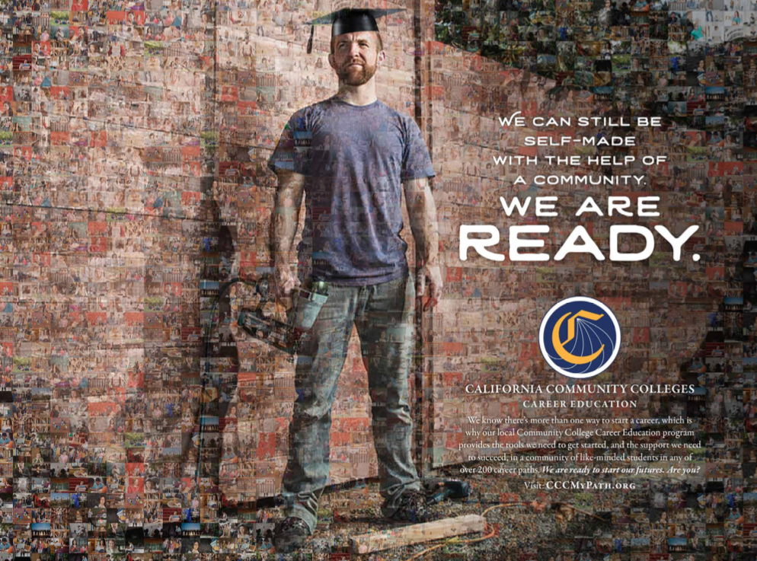
The Chancellor’s Office will continue to work with Regional Chairs and PIOs on synchronization of activities
Statewide, $3 million to be spent on campaign activities, including the development of templates for local use
Doing What Matters regions will be able to leverage this investment with an additional $3 million for outreach to employers and prospective students
Guidance on how regions can contract directly with Ogilvy for local efforts coming next week from Chancellor’s Office

Slide 71
Tools to Help Students Find their Path

Slide 72
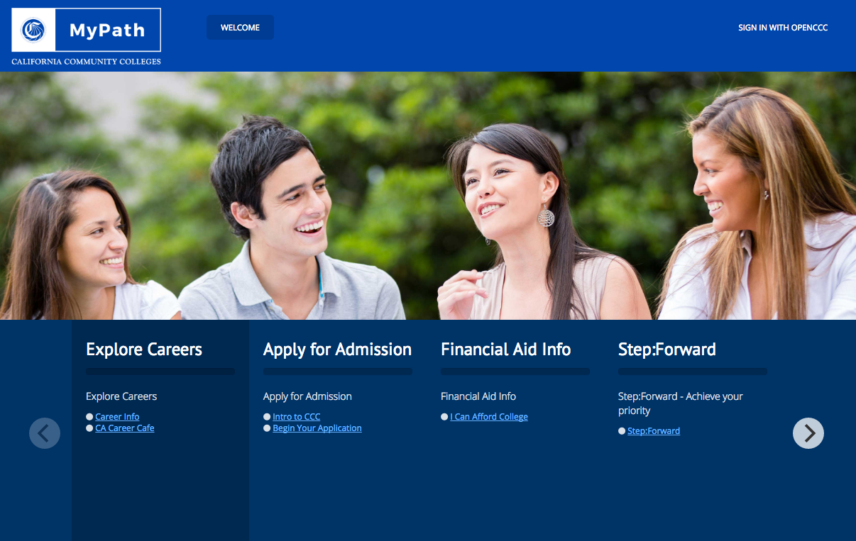
CCC My Path
Portal to information that can support student decisions, before they enroll
Institution-specific accounts can be used to aid students throughout their educations, in either a supplemental or replacement model
Draft

Slide 73
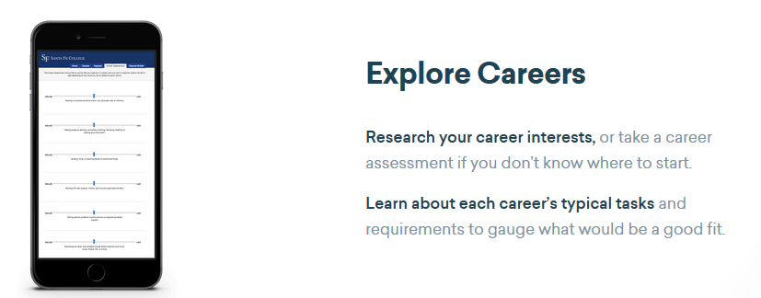
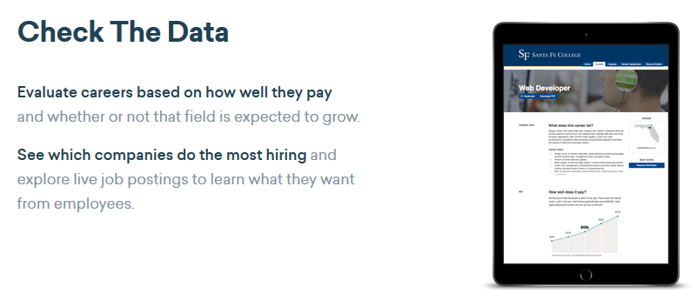
Career Coach (using EMSI data)

Slide 74
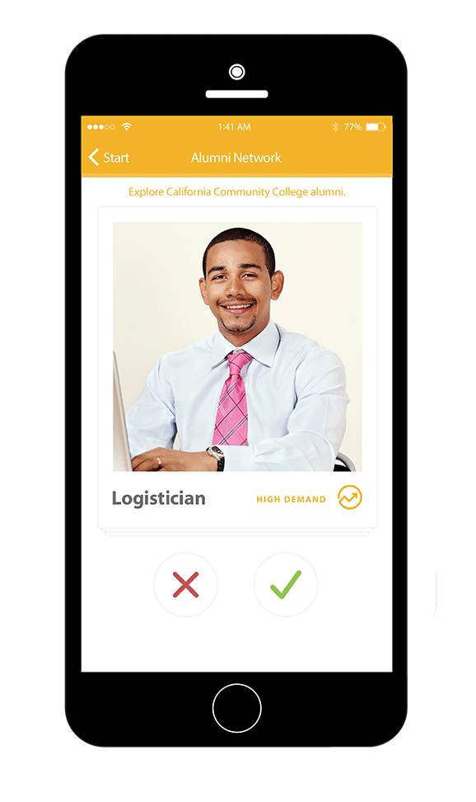
Here to Career
The 60 question interest explorer quiz based on the O*NET Interest Profiler
View student salaries before and after a student earn CCC degrees or certificates (using Salary Surfer data)
Successfully piloted in Inland Empire, now being developed for the full state
Spanish language version coming this spring
https://foundationccc.org/what-we-do/workforce-development/here-to-career-mobile-app

Slide 75
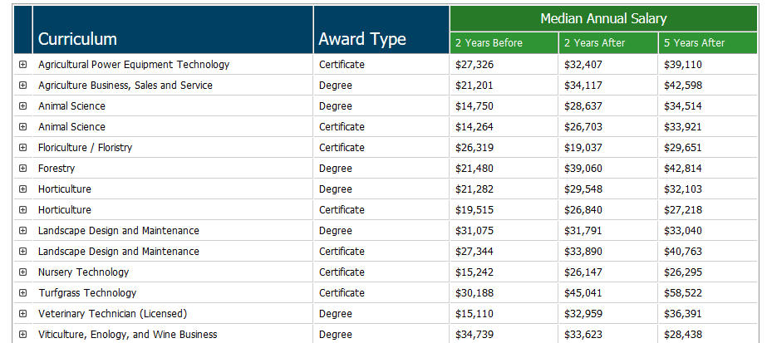
Salary Surfer
http://salarysurfer.cccco.edu/SalarySurfer.aspx

Slide 76
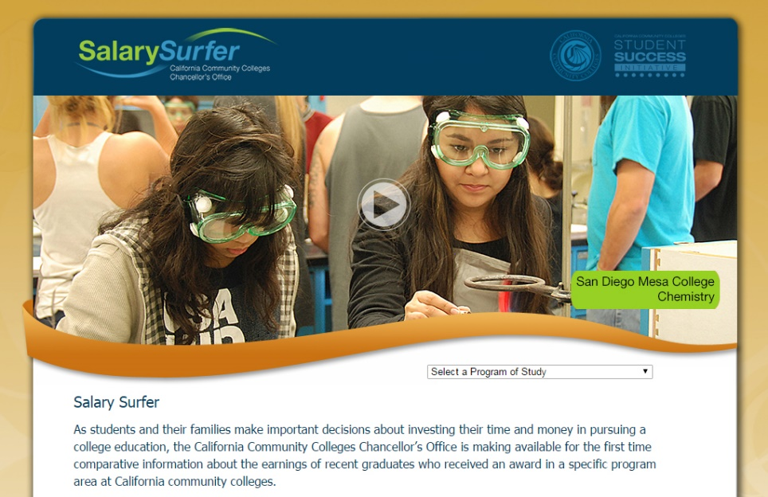
Salary Surfer
100 short videos describing the certificate and degree programs in Salary Surfer (20 already done)
Videos will be available to colleges to co-brand for local marketing efforts, social media, and also embedded into Here to Career mobile app.
Example video

Slide 77
Finding data on students, progress, and economic outcomes

Slide 78
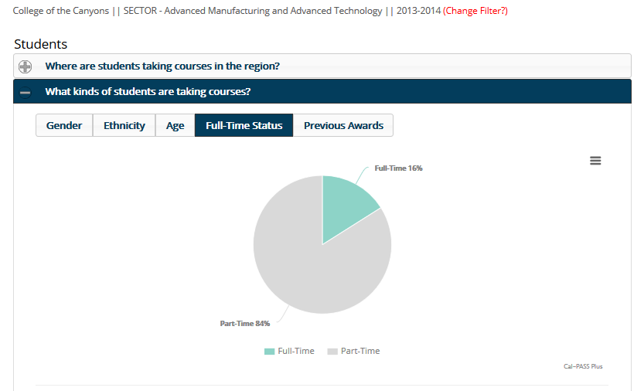
Identify your current market

Slide 79
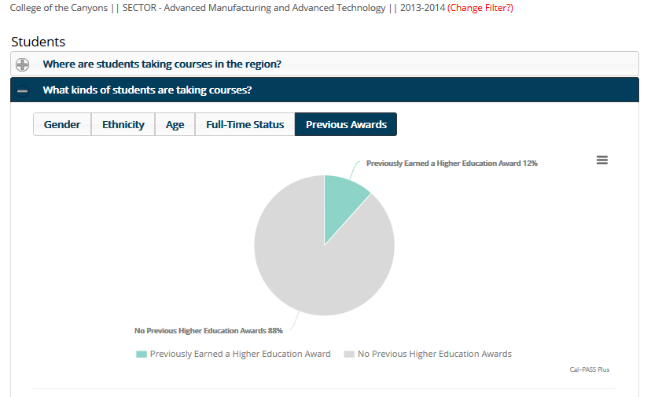
Identify your current market

Slide 80
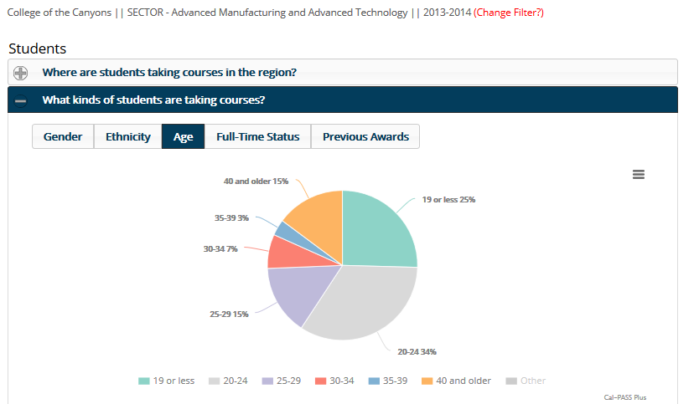
Identify your current market

Slide 81
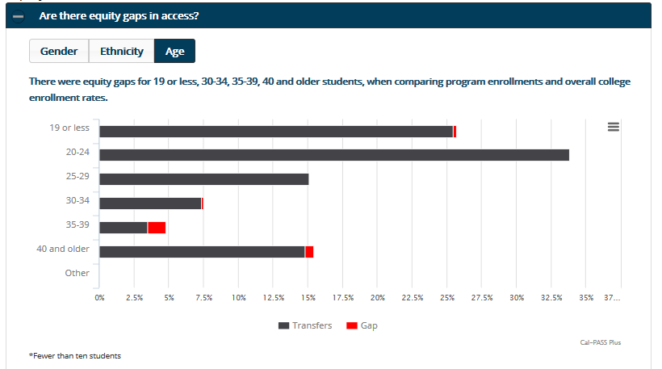
Identify your current market

Slide 82
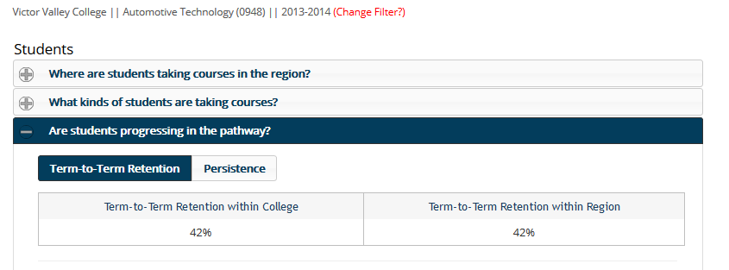
Determine students pathway progress

Slide 83
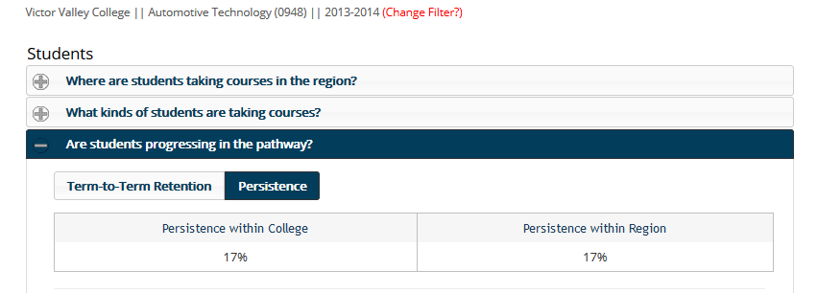
Determine students pathway progress

Slide 84
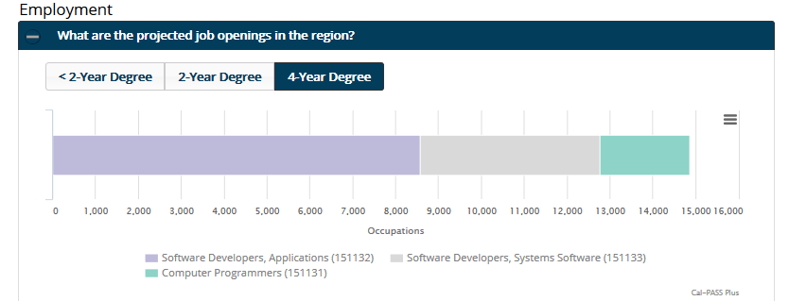
Identify long-term educational options

Slide 85
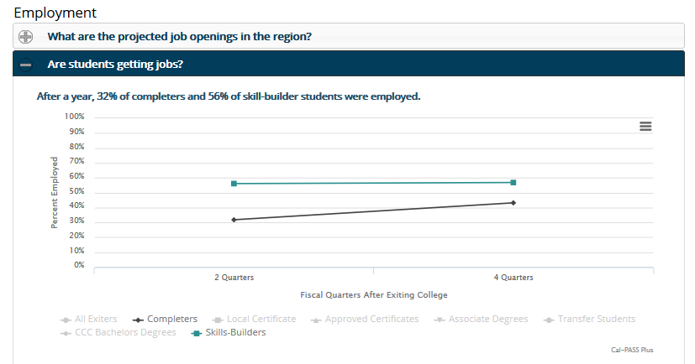
Understand economic outcomes

Slide 86
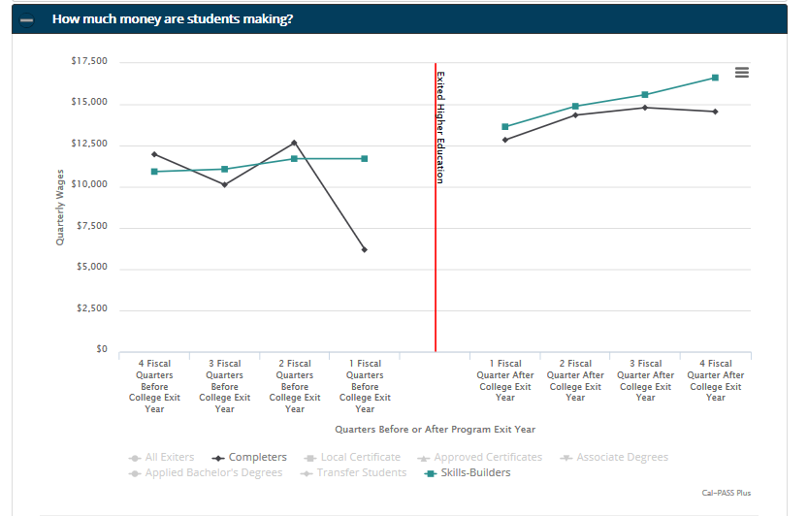
Understand economic outcomes

Slide 87
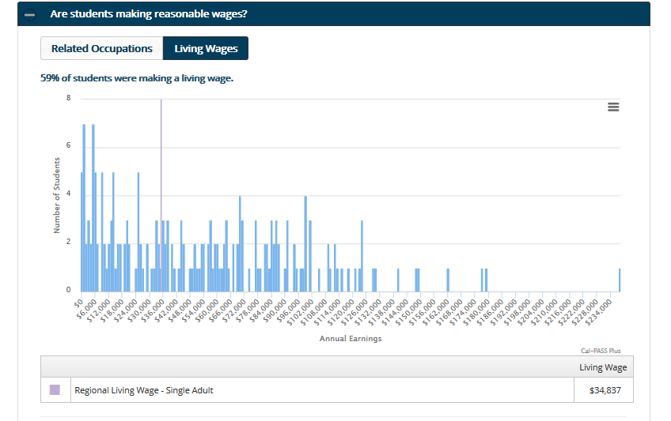
Understand economic outcomes

Slide 88


Slide 89
Small Group Work:
Student Progress and Outcomes

Slide 90
Gather with your college or other participants and use the worksheet to look up information on student progress and outcomes at your college.
You have 20 minutes.

Slide 91
How could you use information about the types of students you are serving, their progress within a program, and their economic outcomes to make the case for changing college policies and practices?
How could you frame the argument for these changes, using the likely impact on enrollments?

Slide 92
What will you do based on what you learned today?

Slide 93
Build Your Skills
Online resources

Slide 94
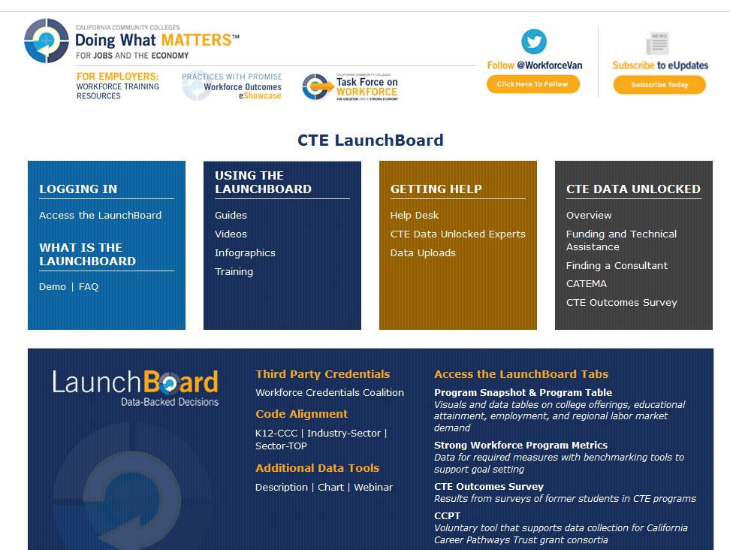
http://doingwhatmatters.cccco.edu/LaunchBoard.aspx

Slide 95
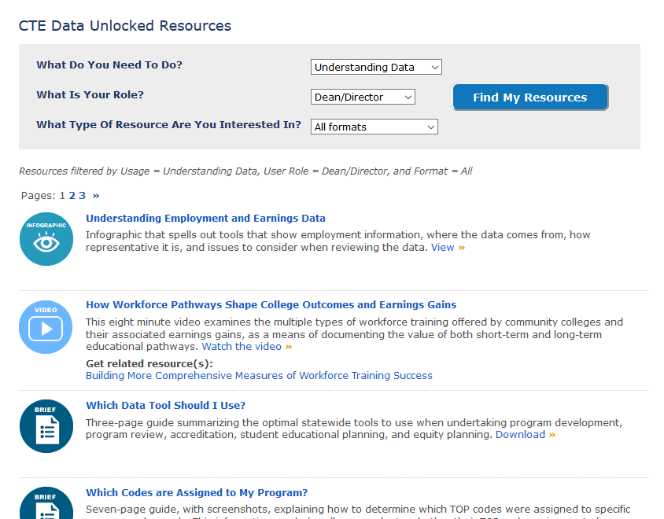
http://doingwhatmatters.cccco.edu/LaunchBoard/Resources.aspx

Slide 96
Access this presentation: bit.ly/ctedataunlocked2017
Find Out More:
LaunchBoard:
doingwhatmatters.cccco.edu/LaunchBoard.aspx
Guided Pathways Information: caguidedpathways.org
Code Alignment Pilot: bit.ly/CodeAlignmentPilot

