Slide 1
Introducing Community College Psychology Majors to Skill Sets Desired by Employers
Jaye Van Kirk, M.A., M.A.
San Diego Mesa College
APA San Francisco, Calif. Moscone Center 2018
August 10, 2018

Slide 2


Questions:
Who are the stakeholders?
When do we educate students about skill sets & careers? How?
What skill sets would be valuable for the workforce?
Notes:
Who are stakeholders? (Jaye undergraduate Psychology majors)
When do we educate students about skill sets & careers? (Jaye: early) How? (Tanya)
What skill sets would be valuable for the workforce? (Paul)

Slide 3
Stakeholders:
Community college students
(San Diego Mesa College Psych 201)
  Diverse students (n=143); (matched pre/post n=53):
  Sex:
    females (76.98%)
    males (23.02%)
  Ethnicity:
    Latino/a (35.25%)
    European Americans (28.78%)
    Asian/Pacific Islander (15.83%)
    African American (7.9%)
    Native American (2.88%)
  Education:
    freshman (5.07%)
    sophomore (50.72%)
    junior (36.96%)
    senior (3.62%)
  Major:
    Psychology (94.89%)
  Age: (18-53 years) M=23

Slide 4

Introduce career exploration early
Academic & career opportunities course
Community college lower division course
strategic planning & proactive approach
1 unit class
16 weeks
4 module workbook
Pass/no pass

Slide 5
Skills sets acquired in coursework & extra curricular activities
Big Three Skill Sets
APA Learning Goals
1. Analytical/critical thinking
2. Written/verbal communication
3. Intrapersonal & quality of character skills
1. Knowledge base of Psychology
2. Scientific inquiry & critical thinking
3. Communication
4. Ethical & social responsibility
in a diverse world
5. Professional development

Slide 6
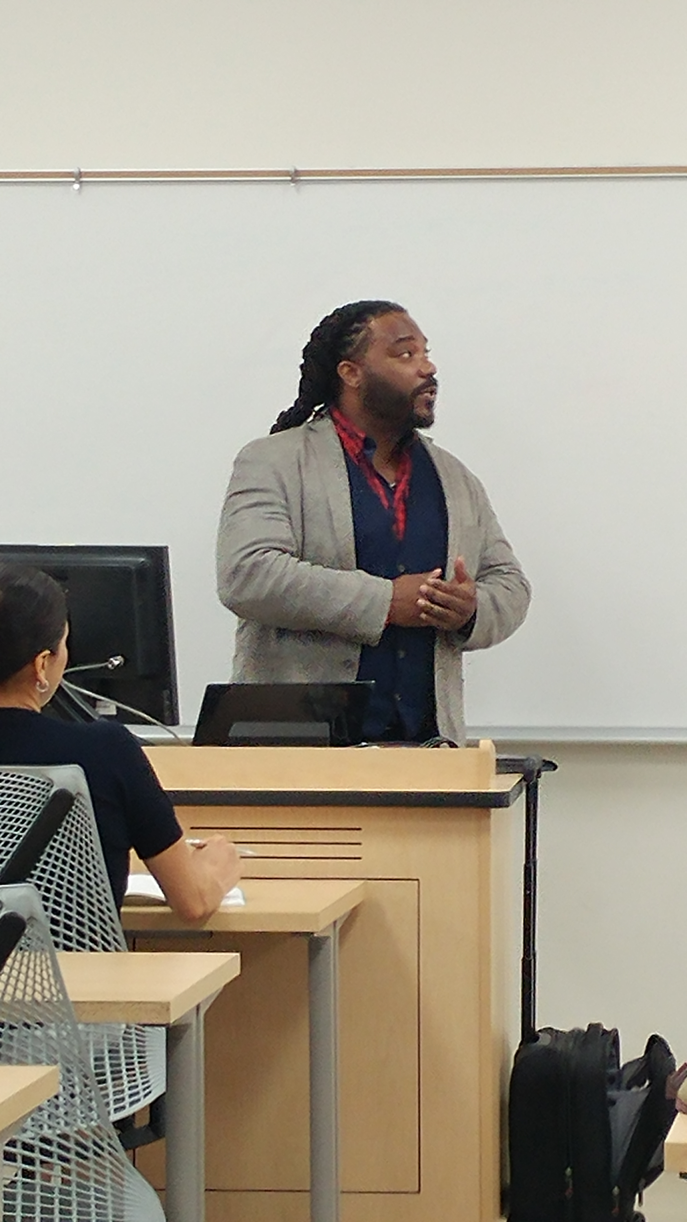
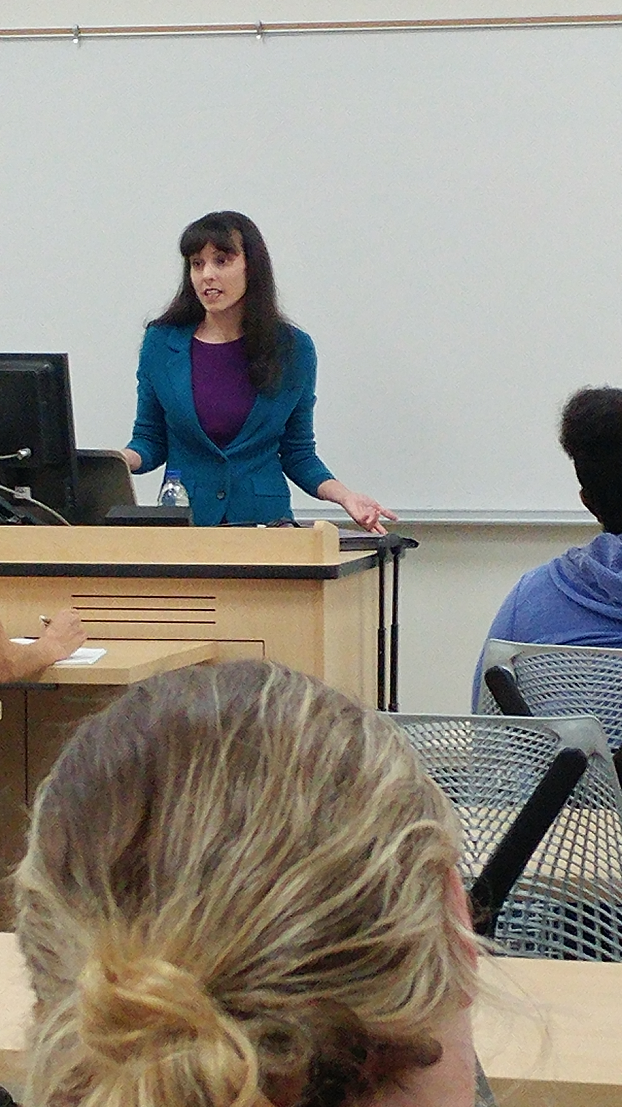
How to increase awareness of skills & job options?
Informal
  Announcements
Formal
  Lectures
  Assignments
  Guest speakers
Ricky Pope (ABD)
Counseling Psychology
Summer Brooks, MA
Animal behaviorist
San Diego Mesa College alumni

Slide 7



Informal:
Announcements of job opportunities with B.A. in Psychology
Breadth of career options!
FBI agent
psychometrist
User experience researcher (Google)
Behavior technicians
Human factors engineer
Social media manager
AI innovation researcher (Facebook)
Foresight strategist (Facebook)
Notes:
Emphasize diverse career options

Slide 8

Knowledge Based Assignments :
Module readings & reflections
Module 1
Plan of Action
Module 2
What employers want
Module 3
Where to get what employers want
Module 4
Career Center services
Notes:
Modules suitable for short (5 week) and longer courses (16 week). Used at San Diego Mesa College, Indiana University Southeast and Drexel University.

Slide 9
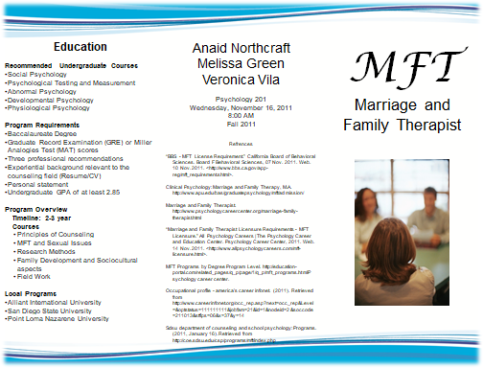
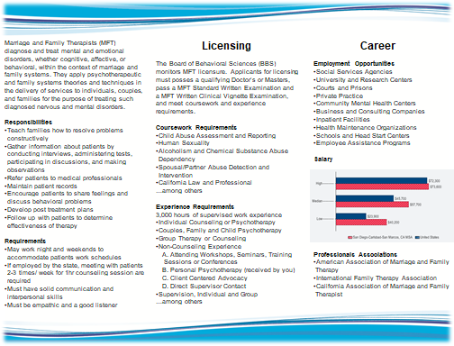
Skills based assignments
Informational interview
Resume/curriculum vitae
Customized educational plan
Career brochure
E-portfolio
Notes:
Emphasizes career exploration via networking opportunity, preparation, proactive, professional development

Slide 10
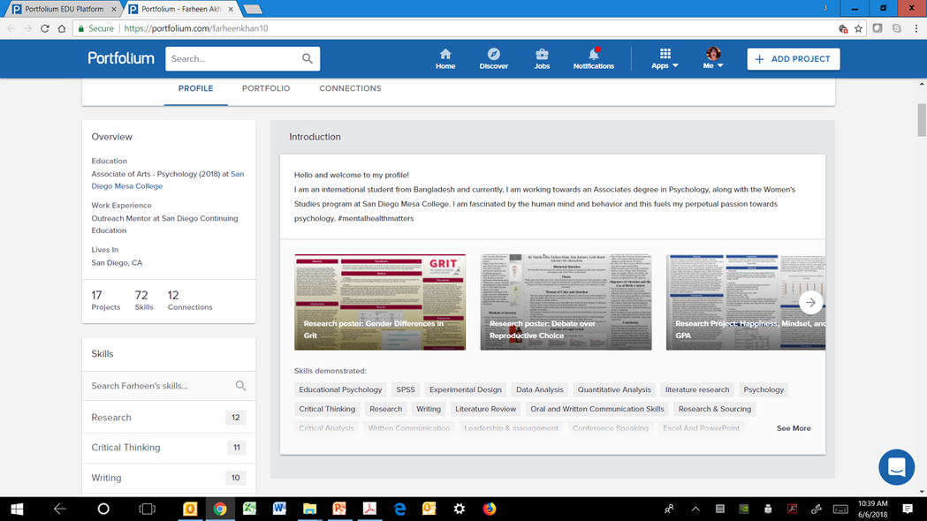
Current trends assignment: e-portfolio
Evidence of skills
skills
Notes:
Students must be prepared for the ways that jobs are made available in the digital world. Must be able to articulate skills they have acquired and demonstrate them (e.g. via digital portfolio) to potential employers.

Slide 11
Did these make a difference?

Slide 12
Diverse Career goals
Clinical/counsel 22.30% n=31
MFT 10.07% n=14
Social work 7.9% n=11
I/O 13.67% n=19
Psychobiology 4.32% n=6
Animal behavior 3.6% n=5
Research 6.47% n=9
Criminal justice 7.9% n=11
Not sure 14.39% n=20
Notes:
Career options diverse representing sub-discipline areas.

Slide 13
Pre/post data:
degree aspirations (n.s.)
Wilcoxon Signed Ranked Tests indicated that post-test ranks were statistically significantly higher than pre-test ranks in preparedness for:
  undergraduate studies Z=-2.72, p<.006
  graduate school (missing data)
  workforce Z=-2.07, p<.03.

Slide 14
Pre/post data
Wilcoxon Signed Ranked Tests indicated that post-test ranks were statistically significantly higher than pre-test ranks in competences in:
  finding jobs (Z=-3.1, p<.0001)
  internships (Z=-3.53, p <.0004)
  creating resumes (Z=-2.39, p<.01)
  interviewing (Z=-2.25, p<.02)
  Likert: 1=not at all 3=somewhat 5=very

Slide 15
Perceived rank of assignments to enhance knowledge of careers:
Most Valuable
Guest speakers
Other (portfolio)
Informational interview
Lectures
Valuable
Resume/cv
Educational plan
Informational interview
Moderately Valuable
Career brochure
Modules
Likert: 1=least valuable 3= moderately valuable 5= most valuable

Slide 16




Conclusion
Lower division career courses help students:
Plan for their futures
Expand awareness of career options
Increase awareness of skills employers desire
Encourage students to seek opportunities to actively achieve career goals.

Slide 17


Jaye Van Kirk, M.A., M.A.
jvankirk@sdccd.edu

